Slide 1
The Internet Technical Community
5 April 2019
Where to engage with standards makers and operators
Kevin Meynell
Manager, Technical & Operational Engagement
meynell@isoc.org

Slide 2
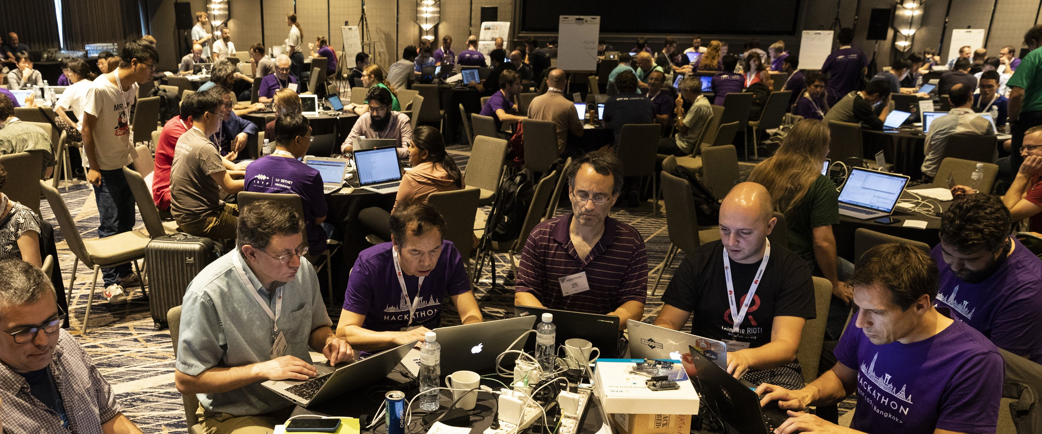
The Internet is in the making…
Where do I go to influence the future of the Internet?

Slide 3
Open Meetings are Happening Near You!
IG
National, Regional, and global Internet Governance Forums (IGF)
ICANN Meetings
School of Internet Governance
Network Operators Meetings
Peering Forums
IETF
(Internet Engineering Task Force)

Slide 4
IETF: Internet Engineering Task Force
The IETF produces the technical standards that are used to run the Internet
Large open international community of network engineers, operators, vendors and researchers concerned with development and smooth operation of the Internet
Volunteers participate on an individual basis to develop and refine protocols that are useful to operators, manufacturers and vendors utilising the Internet who support the work of the IETF
Anyone can participate in the meetings and discussions
Produces open standards known as Request for Comments (RFCs)
Meets three times each year around the world – usually in March, July & November

Slide 5
Network Operator Groups: Big Three
RIPE – targeted at European, Middle East & Eurasian region (https://www.ripe.net/)
2 per year (usually May & October)
Also deals with RIR issues for RIPE region
APRICOT – targeted at Asia-Pacific region (https://www.apricot.net/)
1 per year (usually February)
Also deals with RIR issues for APNIC region
Another smaller APNIC meeting (usually September)
NANOG – targeted at North American region (https://www.nanog.org/)
3 per year (usually February, June & October)
More commercially oriented

Slide 6
Network Operator Groups: Major Regionals
MENOG – targeted at Middle East (https://www.menog.net/)
1 per year (usually April)
Doubles-up as RIPE regional meeting
ENOG – targeted at CIS (former Soviet Union) region (https://www.enog.net/)
1 per year (usually April)
Doubles-up as RIPE regional meeting
SANOG – targeted at South Asia region (https://www.sanog.org/)
2 per year (usually January & July)
AIS/AfNOG/AfriNIC (https://www.afnog.org)
2 per year (April/May/June & November/December)
Also deals with RIR issues for AfriNIC region

Slide 7
Other Regional & National Events
SdNOG – Sudan NOG https://sdnog.sd
IRNOG – Iran NOG www.irnog.com
e-AGE – targeted at Arab States Research & Education Networks (http://asrenorg.net/)
TF-CSIRT – targeted at European & Middle East CSIRTs (https://www.tf-csirt.org/)
OIC-CERT – targeted at Middle East CSIRTs (https://www.oic-cert.org/)

