Slide 1



Autonomous Network Alerting Systems and Programmable Networks
Dr. Ahmed AlEroud
Department of Information Systems
Yarmouk University, Jordan
ahmed.aleroud@yu.edu.jo

Slide 2
Software Defined Networks
Possible definitions:
  SDN is a new network architecture:
    That’s makes it easier to program networks.
    With the core idea that software remotely controls network hardware.
    SDN is a framework to allow network administrators to automatically and dynamically manage and control a large number of network devices, services, topology, traffic paths, and packet handling (quality of service) policies using high-level languages and APIs.
Notes:
SDN/OpenFlow have recently gained a lot of attention in the industry and the academia.

Slide 3
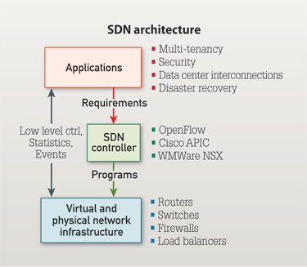
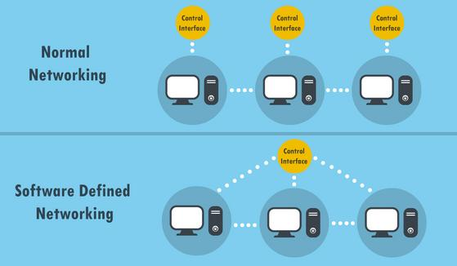
Software Defined Networks

Slide 4
Security Challenges Vs. opportunities in SDNs
With the promise of programmable networks will come a with security challenges, including the need to protect the new network controller
At the same time SDNs offer several mechanisms to protect against Cyber Attacks

Slide 5
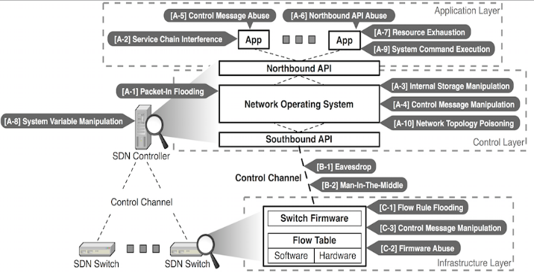
SDN Misuse/Attack Cases
SDN misuse/attack cases

Slide 6
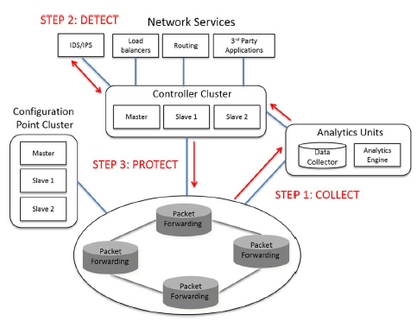
SDN architecture and Security Benefits
Can be used for Data collection and Attack Detection
Xia, W., et al., A survey on software-defined networking. IEEE Communications Surveys & Tutorials. 17(1): p. 27-51.

Slide 7
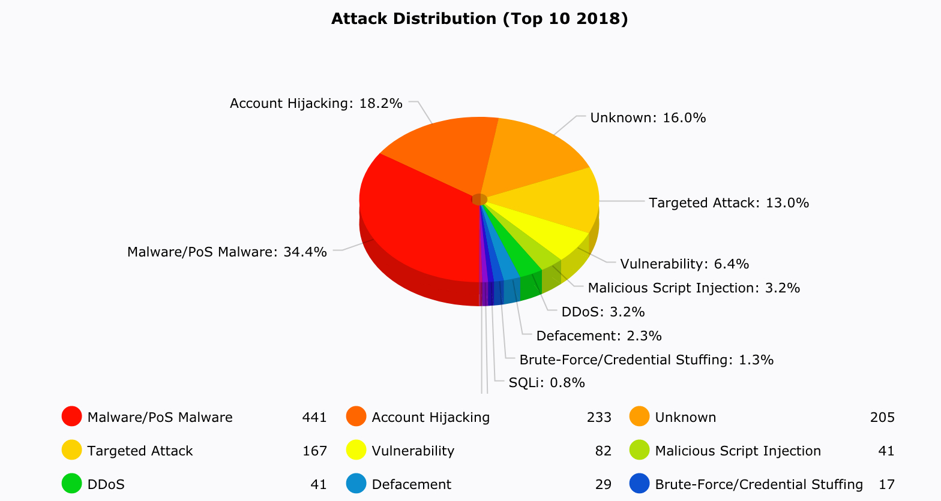
Unknown Attacks are on rise!
https://www.hackmageddon.com/2019/01/15/2018-a-year-of-cyber-attacks/

Slide 8
Research Question
Can we reduce the Risk of Unknown attacks Using Software Defined Networks?

Slide 9
Research Approach

Slide 10
Data Collection
Communicate with the OpenFlow switches to make customized traffic queries and receive customized traffic that is requested from the network or the switches.
Can be analyzed by existing Intrusion Detection Systems
Attack signatures of Known attacks can be created

Slide 11
Detection of known Attacks
Rule-based (Signature matching approach)
Incoming connections are tested using attack profiles
If No match is discovered, the connection is classified as Normal
If Full match is discovered, the connection is labled as a Known attack
If a partial match is discovered, then there is a probability of an unknown attack

Slide 12
Attack graphs to Discover unknown attack
In each graph there is a single special node called target node (TAN) that represents the final objective of all steps
Since each node is related to one or more vulnerabilities each of which has a Common Vulnerability (CVSS) score, nodes will be connected to the TAN node using such a score.

Slide 13

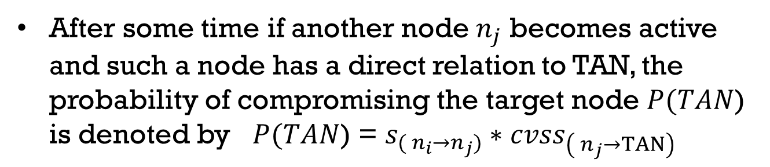
Discovering Unknown attacks
If an event is found to be similar to one of the profiles ${ AP}_{n_{i}}=\{f_{1},….,f_{m}\}$ in the database , an alert is raised and the node $n_{i}$ becomes active.
After some time if another node $n_{j}$ becomes active and such a node has a direct relation to TAN, the probability of compromising the target node $P(TAN$) is denoted by $P(TAN$) = $s_{({ n}_{i}→n_{j})}∗{cvss}_{\left({ n}_{j}→TAN\right)}$

Slide 14
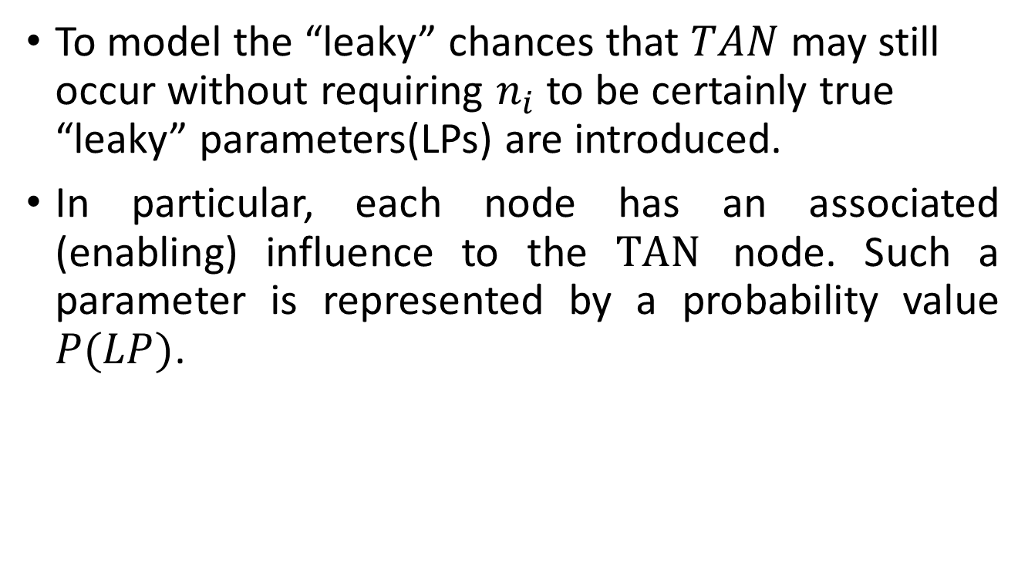
Discovering Unknown attacks
To model the “leaky” chances that $TAN$ may still occur without requiring $n_{i}$ to be certainly true “leaky” parameters(LPs) are introduced.
In particular, each node has an associated (enabling) influence to the $TAN$ node. Such a parameter is represented by a probability value $P(LP)$.

Slide 15
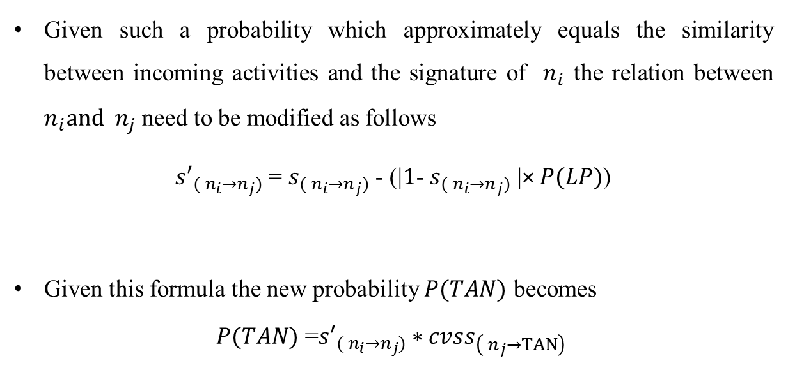
Discovering Unknown attacks
Given such a probability which approximately equals the similarity between incoming activities and the signature of $n_{i}$ the relation between $n_{i}and n_{j}$ need to be modified as follows
${s′}_{({ n}_{i}→n_{j})}$ = $s_{({ n}_{i}→n_{j})}$ - (|$1$- $s_{({ n}_{i}→n_{j})}$ |× $P(LP)$)
Given this formula the new probability $P(TAN)$ becomes
$P(TAN)$ =${s′}_{({ n}_{i}→n_{j})}∗{cvss}_{\left({ n}_{j}→TAN\right)}$

Slide 16
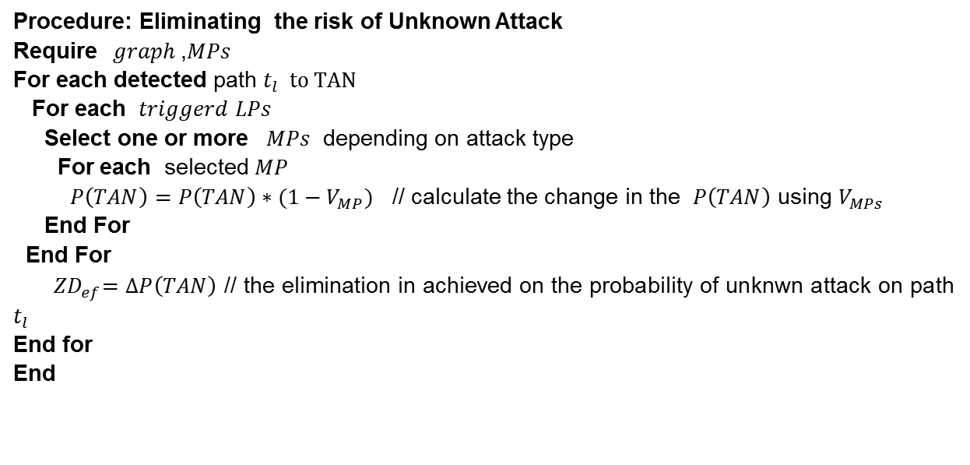
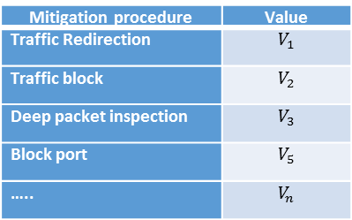
Eliminating the Risk of unknown Attack Using Open Flow Actions
Table 1: Reducing the risk of zero-day attacks using some mitigation procedures in Open flow Architecture
Mitigation procedure | Value
Traffic Redirection | $$V_{1}$$
Traffic block | $$V_{2}$$
Deep packet inspection | $$V_{3}$$
Block port | $$V_{5}$$
….. | $$V_{n}$$
Procedure: Eliminating the risk of Unknown Attack
Require$graph$,$MPs$
For each detected path $t_{l} to TAN$
For each $triggerd LPs$
Select one or more $MPs$ depending on attack type
For each selected $MP$
$P\left(TAN\right)=P\left(TAN\right)∗(1−V_{MP})$ // calculate the change in the $P\left(TAN\right)$ using $V_{MPs}$
End For
End For
${ ZD}_{ef}=∆P\left(TAN\right)$ // the elimination in achieved on the probability of unknwn attack on path $t_{l}$
End for
End

Slide 17
Experiments and Analysis
Network topology used to generate suspicious and benign flows

Slide 18
Denial of Service Attack Scenarios

Slide 19
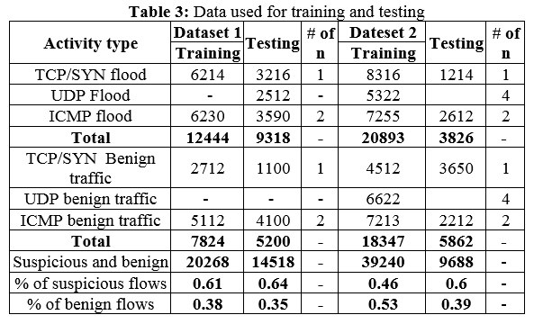
Datasets used for Experiments

Slide 20
Results

Slide 21
Conclusions
We proposed a novel technique to mitigate unknown attacks on SDNs.
Our approach is driven by Graph theory to identify such attacks on SDNs.
We propose to design and implement algorithms for:
Creation of attack graphs to identify unknown attacks using SDNs
Initial Results Show that Our approach is very effective

