Slide 1
AS15169

Slide 2
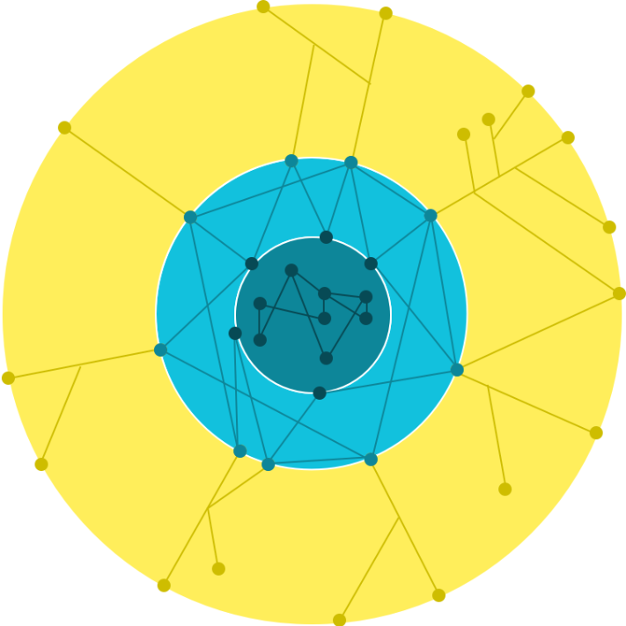
Infrastructure
Data centers
Edge pops
GGCs

Slide 3
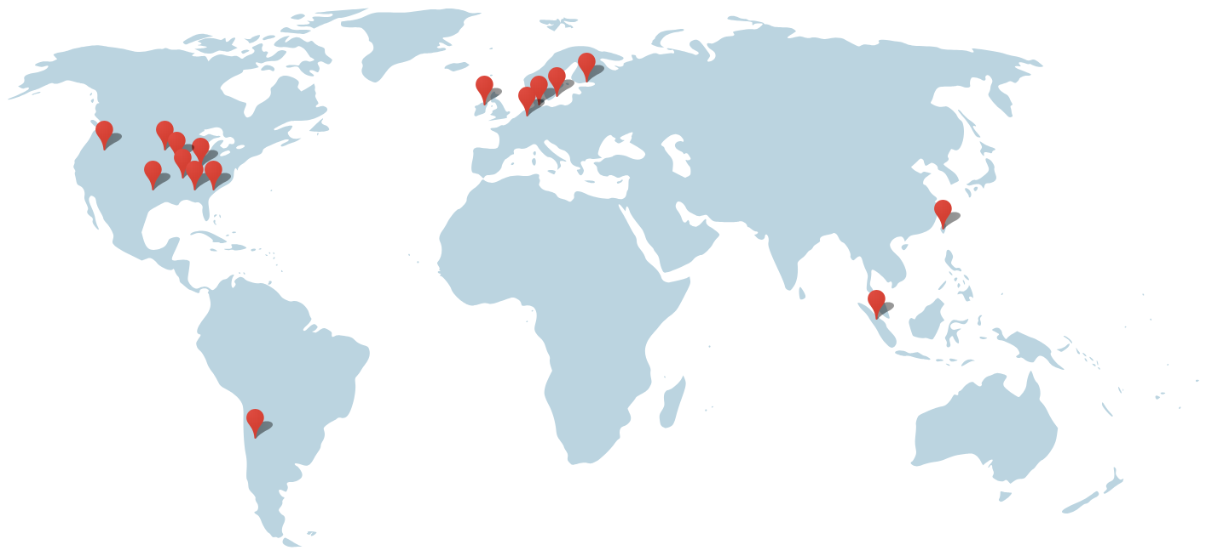
Our core
Belgium
Finland
Denmark
Dublin
Netherlands

Slide 4
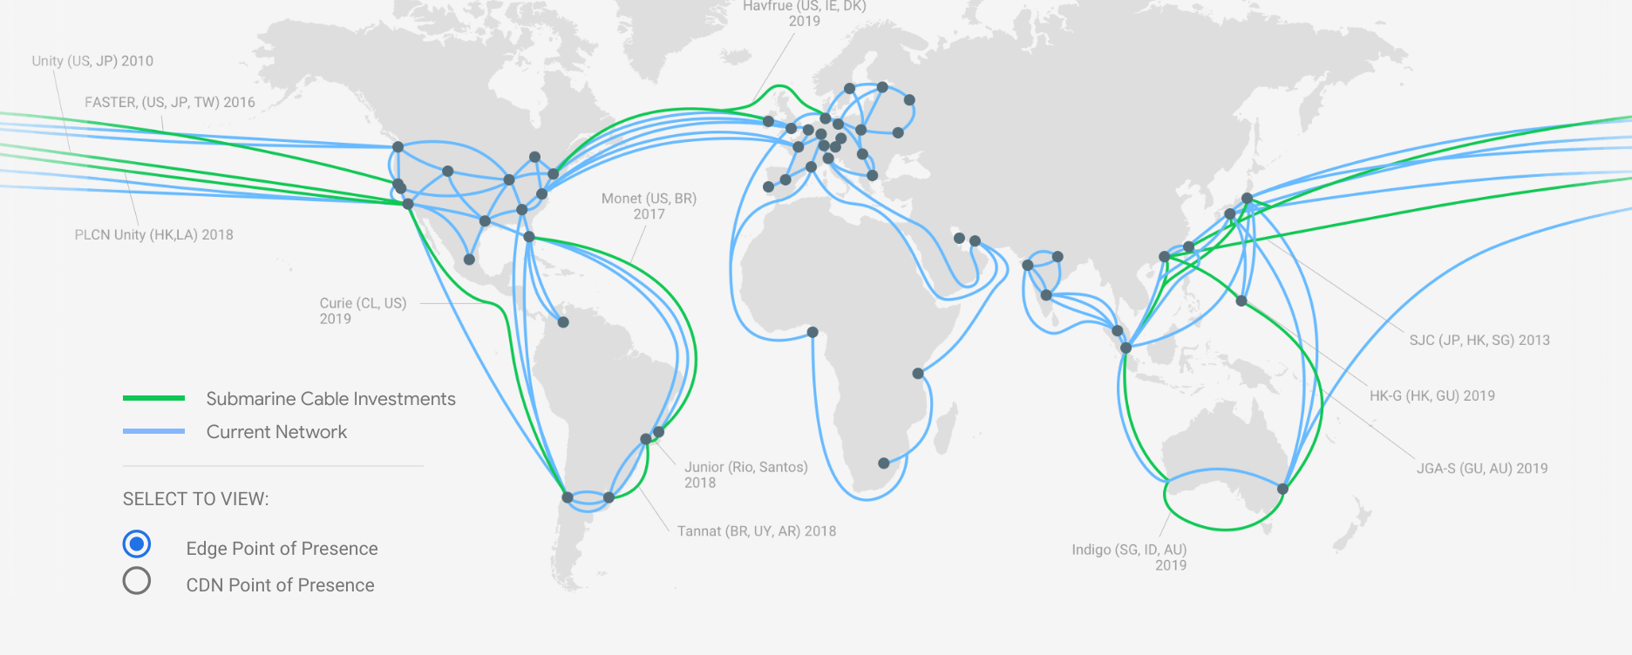
Edge pops
+100 Edge locations
FJR
UAE - Fujairah Smarthub
MCT
Oman - Blue City
MRS
Interxion
MIL
Avalon campus
SOF
Telepoint

Slide 5
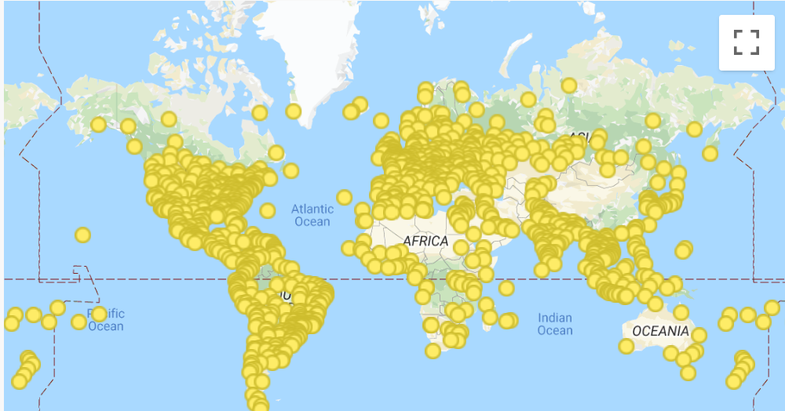
GGCs
Deep within partners networks.
Can serve between 60% and 80% of the total AS15169 traffic volume.
Great tool to increase cost savings for our partners while enhancing end -user performance.

Slide 6
Traffic flows facts
Serves traffic from edge nodes (GGC), then direct peering , then via indirect paths
We optimizes traffic delivery for end-user performance so we carry traffic on our own network as close to users as possible
We respect AS path length and prefix specifics when deciding how to exchange traffic, still traffic may not follow these guidelines as a result of observed performance between Google serving locations and the end-user.
Internal mapping system has visibility over prefixes originating from an ASN based on BGP Announcements and then using our mapping formula we rank serving options based on latency, path congestion, link utilization and advertisement location

Slide 7
Best practices
Please advertise all your routes in all locations where you peer with Google, don’t hard TE by using prefixes announcements, instead use sticky notes “communities”
Make sure your Peeringdb records are up to date, our automation tools depends on it
From 2019-Q2 we will be applying route filters to all our BGP sessions make sure to update your ASN data on the IRR system.
To avoid any routing issues please keep your Maintainer, ASN, AS-SET, and Route objects up to date. We use RADB, RIPE, APNIC, AFRINIC, ARIN, NTT and Level3.
Google Public DNS 8.8.8.8, are not designed as ICMP network testing services we rate limit ICMP. The termination point of the TCP/UDP session with Google may not represent the full network path between a user and the service

Slide 8
Contacts
For peering & GGC Register your interest at peering.google.com
General Peering operations issues and questions noc@google.com
GGC Specific Questions - ggc@google.com
Google ISP Portal - Self Service - isp.google.com
Manage your tickets
Monitor your Google traffic levels
Check your video quality, prefix quality and Google traffic flows
Long term planning and high level escalations hossama@google.com

