Slide 1
Connecting the unconnected
Abdalmonem Galila: Universal Acceptance Ambassador
Duration: 30 Min

Slide 2
Every thing is about the end user
Notes:
UTF-8 is a standard way of storing Unicode code points (characters and modifiers) in 8-bit bytes.

Slide 3
Name
Abdalmonem Galila
Occupation
Deputy Manager .Masr “.مصر” IDN ccTLD “NTRA”
Backgrounds
Technical “ex. *unix, programing, administrations”

Slide 4
User Rights
Do I have the right to access the internet with my own local language for a domain name
Do I have the right to have an email address in my own local language

Slide 5
http://سجل.مصر
مشرف@اختبار-سجل.مصر
http://وزارة-الاتصالات.مصر

Slide 6
Contents1
Warm Up Exercise
Some Statistics
Internationalized Domain Names
Why IDNs
User Perception
Some Statistics
Email Address Internationalization
Why EAIs
User Perception
Issues With The Current Systems

Slide 7
Contents2
Universal Acceptance “UA” Steering Group “UASG”
UA in a Nutshell
Verbs Of UA Readiness
Conclusion
Q & A

Slide 8
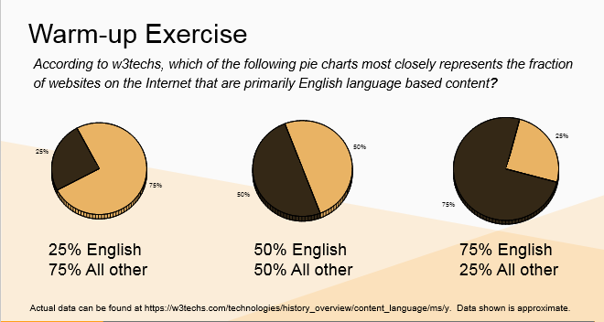

Slide 9
Why there is a need for a multilingual website

Slide 11
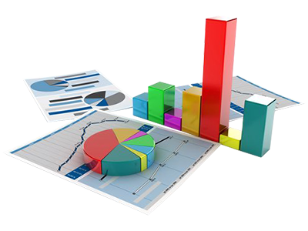
Some statistics
Top Ten Languages Used Online
Internet Users By Language
Internet Users Growth
Twitters Usage

Slide 12
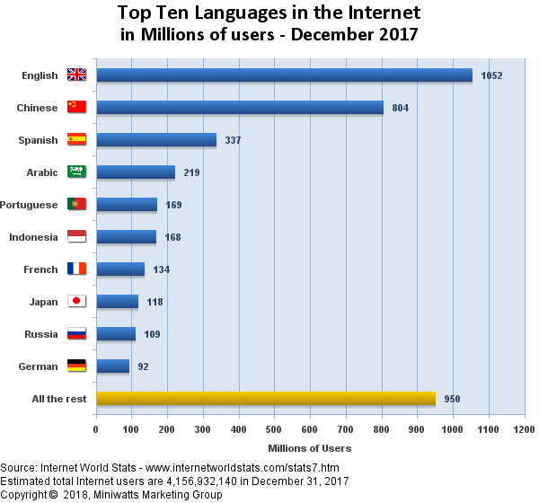
Top ten languages used online
Source : http://www.internetworldstats.com

Slide 13
Some statistics
Source : http://www.internetworldstats.com

Slide 14
Some statistics
Source : http://www.internetworldstats.com

Slide 15
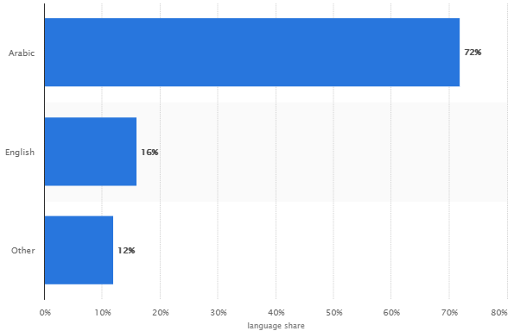
Some statistics
Distribution of twitter usage in the Middle East and North Africa in 2016, by language
Source : https://www.statista.com

Slide 16
What are the messages driven from the above exercise ?

Slide 17
Internationalized domain names

Slide 18
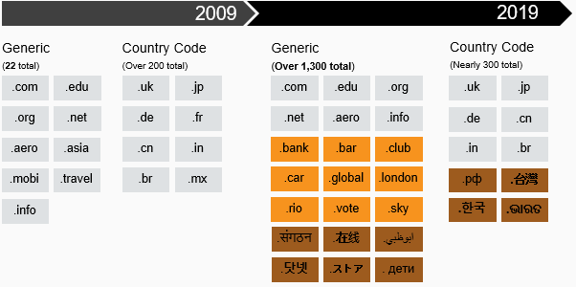
What’s Changed?!
TLD not just in English
TLD not just 2 or 3 characters (2001)
Domain Names list no longer static (2013)
7

Slide 19
Why idns

Slide 20
User perception
IDN domain names displayed correctly in familiar way
IDN domain names accepted when I want to have a hosting space
ASCII domain names and IDN names should be treated equally
Search engines, social media applications, software tools, browsers, … etc handle IDNs correctly

Slide 22
Some statistics
How Much Email Do We Use Daily?
201.4+ Billion Emails Sent/Received Per Day Worldwide
8.3+ Billion Emails Sent/Received Per Hour Worldwide
4.9 Billions Worldwide Email Accounts Expected By 2017
Source :-https://www.radicati.com/

Slide 23
Some statistics
Only 26% of internet users are English users.
Source : http://www.internetworldstats.com

Slide 24
What are the messages driven from the above statistics ?

Slide 25
E-Mail is the most popular used application Worldwide.
Number of E-Mail accounts still increasing.
Non-English users more than English users

Slide 26
Email Address Internationalization

Slide 27
Why eai
Keep my online identity through using my own local language.
Preserve my local cultural and traditional heritage.
Easier to remember and to communicate will with other online users.
IDN, local content websites and EAI.
It is natural to use local language to access your email for the people around the world.

Slide 28
User Expectation
MUA “Email Client” should able to process EAI emails
MTA “Email Servers” should be able to process EAI emails
Ability to send | receive emails from another parties
EAI address usage across the internet same as the legacy address “Social media, mail hosting, … etc.”
Anti-Spam engines will be able to do its work

Slide 29
Issues With The Current Systems
You can't get a HTTPs certificate for your IDN name
There some issues related to mixing between LTR and RTL scripts in the same label
You can’t sign up for social media’s like Facebook, Twitter ….etc. using you EAI address
Some of the email servers does not support EAI
Some of the email clients does not process EAI addresses correctly
Most of the internet enabled applications could not handle domain names or email address using the new gTLDs

Slide 30
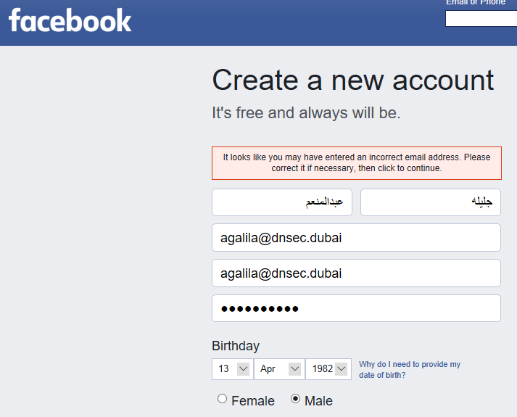
Current systems

Slide 31
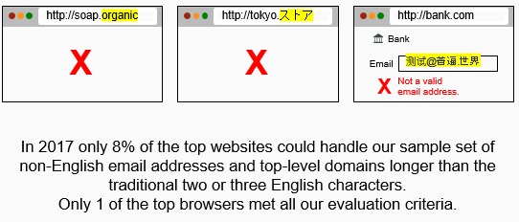

Slide 32
User Rights
Do I have the right to use internet enabled applications, systems, devices which can handle my local language domain name correctly
Do I have the right to use internet enabled applications, systems, devices which can handle my an email address in my own local language

Slide 33
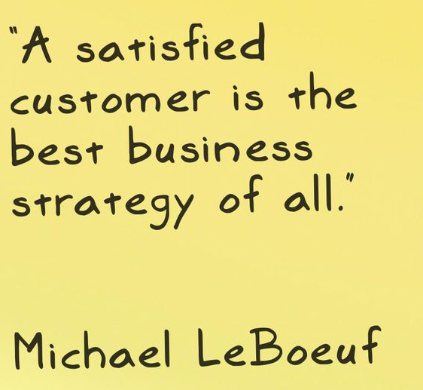
All Things Are Related To End Users

Slide 34
Universal Acceptance steering group
Founded in February 2015
Tasked with undertaking activities that will effectively promote the Universal Acceptance of all valid domain names and email addresses
Comprised of more than 120 companies (including Afilias, Apple, CNNIC, Go Daddy, Google, Microsoft, THNIC and others), governments and community groups

Slide 35
Benefits Of UA Adoption
There is a combined USD 9.8 billion annual opportunity coming from software systems working in harmony with the common Internet infrastructure. This is a conservative estimate.
Support for IDNs, which allow domain names in all of the world’s languages, could bring 17 million additional new users online. These include users whose lack of local language services was previously a barrier to a complete online experience.

Slide 36
UA IN A NUTSHELL
Universal Acceptance (UA) ensures that all domain names and email addresses can be used by all Internet-enabled applications, devices and systems.

Slide 37
Is your system Ready For Opening Business to the Next Billion Internet Users

Slide 38
Targeted Systems
Ask yourself these questions:
Does it have a field for a domain name
Does it have a field for an email address
Does your software read | write a domain name from | to file
Does your software read | write an email address from | to file

Slide 39
Verbs of ua readiness
Accept
Validate
Store
Process
Display

Slide 40
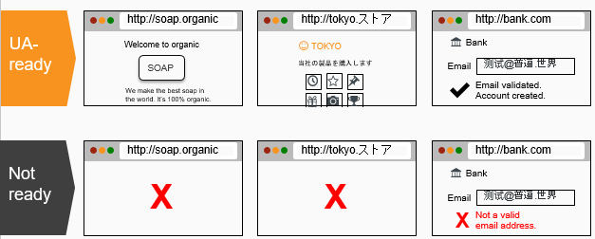
Verbs of ua readiness

Slide 41
Summary
Accept
Validate
Store
Process
Display
Since the Unicode standard is continually expanding, check code points not defined when application / service was created – shouldn’t “break” user experience.
Use supported Unicode-enabled APIs
Use latest Internationalized Domain Names in Applications (IDNA) Protocol & Tables documents for Internationalized Domain Names (IDNs).

Slide 43
https://uasg.tech/

