Slide 1
The Sudanese IXP re-invented itself
ASN : 37256
: 328421
Peering DB :
Location : Khartoum
Website: www.sixp.sd
contact : admin@sixp.sd
Moumena Abdalla

Slide 2
Content :-
Introduction .
Goals .
Achievements
The status .
Why Change .
How changed .
www.sixp.sd admin@sixp.sd

Slide 3
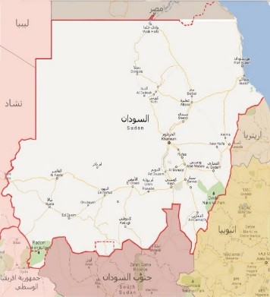
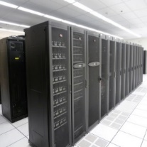
National Information Center
The national information center -NIC- founded in 1999 supported with an act issued the same year. Later; in 2010 this act has been updated to accomdate and cover newer issues in the field of ICT as well as as playing a consultantation role for government.
NIC working in several tracks; in terms of infrustracture,applications, standards as well as informatization promation. NIC working side by side with its stakeholders from the differnent governmental inistitutions, private sectors and the civil organizations.
Sudan Internet
Exchange Point
National Software
center
Laws and regulations
National Network
National DataCenter
www.sixp.sd admin@sixp.sd

Slide 4
National Information Center Initiative
Connecting local ISP among themselves.
Avoiding the unnecessary use of the international bandwidth of the country by keeping the local Internet traffic at local level.
Promoting the implementation of new services and the development of local contents. National Information Center considered establishing Sudan internet Exchange Point (SIX) including a Data Center with a professional 24/7 NOC.
www.sixp.sd admin@sixp.sd

Slide 5
Sudan IXP :-
Local IXP , Operated by NIC , no membership fees , founded in 2011 .
Layer 2
9 Members connected : (Canar , Zain , MTN , Sudatel , Sudren , Maxnet, SIS(.SD), NDC,PCH).
BGP peering for IPV4 , IPV6 .
Hosting PCH having DNS node , Quad 9 .
www.sixp.sd admin@sixp.sd

Slide 6
Goals :-
Local traffic stays local
Better network performance, better service quality,…
In the case of internet blackout ; the services remains available on the level of Sudan .
Less on the internet costs because of restricting the movement internally.
www.sixp.sd admin@sixp.sd

Slide 7
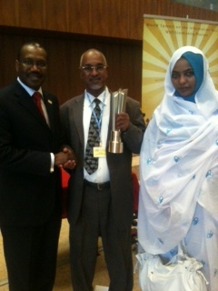
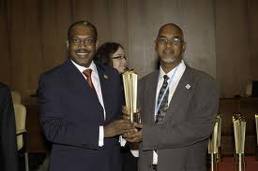
Achievements:
SIXP Prize :
SIXP had participated in the contest of International Telecommunication Union (ITU) and won the prize as the best project for the year 2012.
www.sixp.sd admin@sixp.sd

Slide 8
Comparison by Tb (2015-2017-2018)
 | SUDATEL | ZAIN | MTN | CANAR | MAXNET
2015 | 13.12 | 5.61 | 3.69 | 11.63 | 0.78
2017 | 14.81 | 12.83 | 13.06 | 18.12 | 0.82
2018 | 37.05 | 50.23 | 29.01 | 19.21 | 5.56
www.sixp.sd admin@sixp.sd

Slide 9
Aggregate traffic:-
www.sixp.sd admin@sixp.sd

Slide 10
How Sudanese IXP RE - INVENTED itself :-
We've been working on this plan since 2017 , but change was difficult not from technically side but the question was, why! it's working ? .
A number of meetings have been held on the issue with members, it was agreed that the Implementation will be through use the route server . after that began the migration plan. The test began for four days and the test was successful.
www.sixp.sd admin@sixp.sd

Slide 11
Why changed from l3 to l2 ?
Layer2 is “real” Exchange point
expected results
No limitation of the expansion . Easy troubleshooting .
Strategic vision
content provider peering
Regional peering
www.sixp.sd admin@sixp.sd

Slide 12
The status …
past
present
Regional IXP
International Peer
(CDN)
Future
Layer 3
Dns node
7 Members
IPV4
Quad 9
Layer2
Ipv4 & Ipv6
Add 2 member (9 member )
New ASN &IPV4 &IPV6 . For management .
Add new hardware .
(Technical Agreement)with member .
www.sixp.sd admin@sixp.sd

Slide 13
How change from L3 to L2 :-
In cooperation with Sudan internet Community, and with good planning from SIXP’s Management, and through Customized open Source software's , to make SIXP of the best regional IXP
We’re using :
Bird as Route Server
Birdeye as Route reflector
IXP Manager as GUI for the Route server
www.sixp.sd admin@sixp.sd

Slide 14
we started with a new BGP session through a new physical connection for All existing + New members (SIS, NDC) along side to existing L3 connections to minimize the downtime period.
After that we performed some test procedures to ensure the efficiency and Quality by advertising some test prefixes from All members.
With very good results, the Migration operation has been done with all members at the same time with 15 Minutes downtime during the lean time at 02:00 am.
www.sixp.sd admin@sixp.sd

Slide 15
The setup is not bilateral peering relationships but done through route server .
All members connected to route server .
www.sixp.sd admin@sixp.sd

Slide 16
SIXP Team :-
www.sixp.sd admin@sixp.sd

Slide 17
Sudan IXP
Thank You
☺
www.sixp.sd admin@sixp.sd

