Slide 1
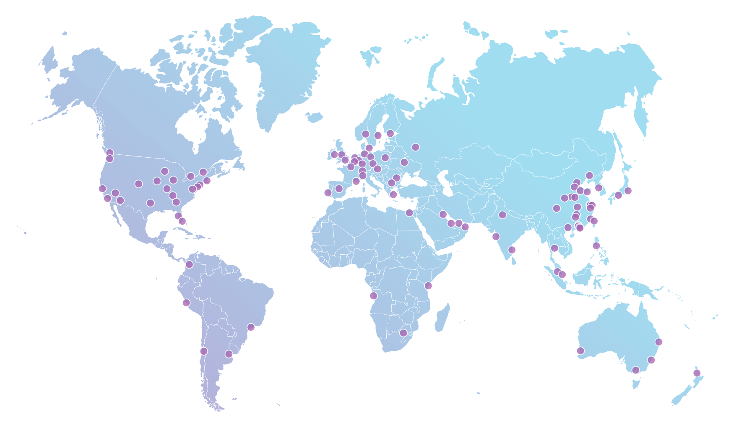
AS13335 / Cloudflare Peering Personal
•ASN: 13335
•Traffic Profile: Content
•Peering Policy: Open
•Peering Locations: GLOBAL
We are in 202 exchange points worldwide. More details on PeeringDB
•PeeringDB Entry: http://as13335.peeringdb.com
•Contact: peering@cloudflare.com ; isppartners@cloudflare.com

