Slide 1
Geopolitics of routing,
What RIPE tells us of geography and power: a methodological approach
Loqman Salamatian and Louis Pétiniaud

Slide 2
Outline
Representation
BGP
AS-Level Graph
BGP Updates
BGP AS Level Graph snapshots
Modeling Internet as a graph
Graph Embedding (I-III)
Topological Versus Geographical
Investigating the geopolitics behind the network
Connectivity in the Middle East
Investigating throught cables
Submarine Cables over Spatial Proximity in Lebanon
The Reshaping of Space “from” Saudi Arabia
Borderizing in cyberspace?
Borderizing the Iranian national territory
Borderizing a non-national territory in Kurdistan

Slide 3
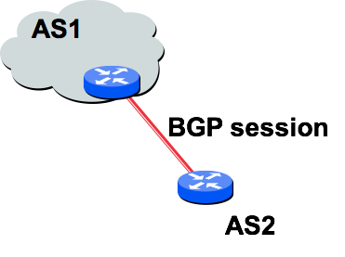
Representation : BGP
BGP = Border Gateway Protocol:
■is a Policy-Based routing protocol
■is the de facto EGP of today’s global Internet
■is a relatively simple protocol, but configuration is complex and the entire world can see, and be impacted by, your decisions, your misconfigurations and so on...

Slide 4
Representation : AS-level Graph I
■ Divided into Autonomous Systems
–Distinct regions of administrative control
–Routers/links managed by a single “institution”
–Service provider, company, university, …
■ Hierarchy of Autonomous Systems
–Large, tier-1 provider with a nationwide backbone
–Medium-sized regional provider with smaller backbone
–Small network run by a single company or university
■ Interaction between Autonomous Systems
–Internal topology is not shared between ASes
–… but, neighboring ASes interact to coordinate routing

Slide 5
Representation : BGP Updates
■ We use bgpstream to get BGP updates from several open BGP feeds
All RIPE rrcxx feeds
JSON updates
–collector': 'rrc19', 'message': 'announce', 'peer': {'address': '197.157.79.173', 'asn': 37271}, 'time': 1515110408, 'fields': {'asPath': ['37271', '6939', '52320', '23106', '23106', '23106', '262700'], 'prefix': '187.102.120.0/21', 'nextHop': '197.157.79.173’},
■ Augmented
–'flags': {'version': 'v4', 'shortPath': ['37271', '6939', '52320', '23106', '262700'], 'geoPath': ['ZA', 'US', 'CO', 'BR', 'BR'], 'names': ['WorkonlineCommunications(Pty) Ltd', 'Hurricane Electric, Inc.', 'GlobeNetCabosSubmarinosColombia, S.A.S.', 'CemigTelecomunicaçõesSA', 'EfibraTelecom LTDA - EPP'], 'risk': 9.262460855949895e-05, 'previousPath': None, 'activePath': None, 'category': None}}

Slide 6
Representation : BGP AS level graph snapshots
AS paths reveal existence of link in between ASes
Link can be inferred to be broken when all prefixes passing by it are withdrawn.
We infer the AS topology and updates it following BGP updates
Caveat
The inferred topology is not complete as BGP announcement might be filtered
This is why we try to mix several feeds
It take around one hour to get an almost full AS graph view with more than 60k AS

Slide 7
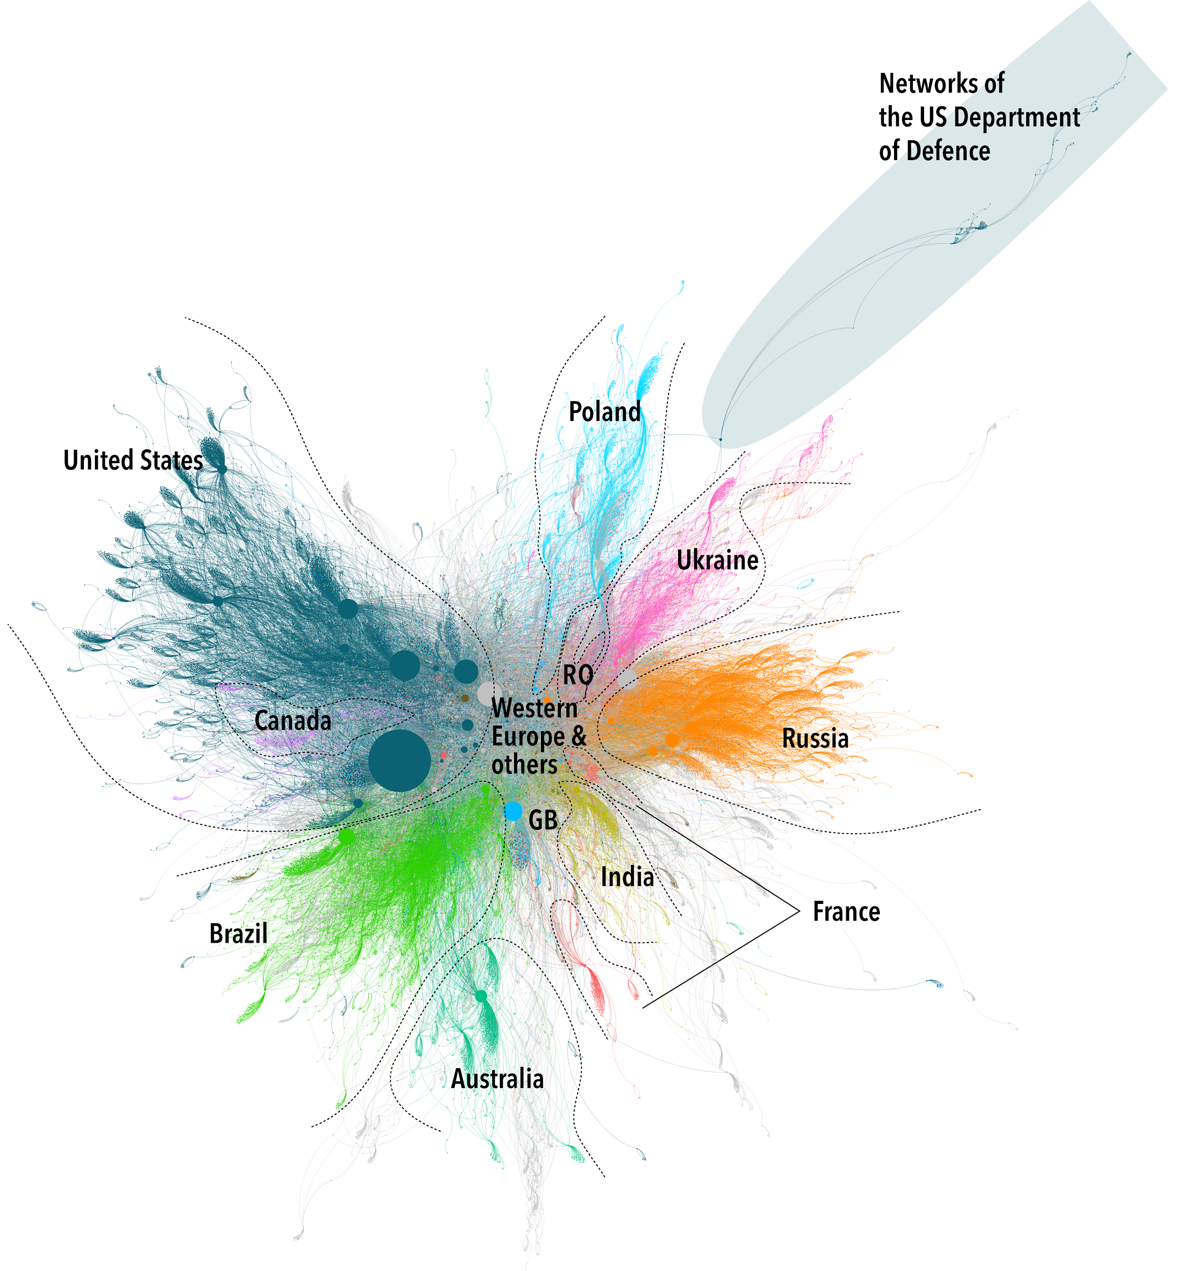
Representation : Modeling Internet as a graph II

Slide 8
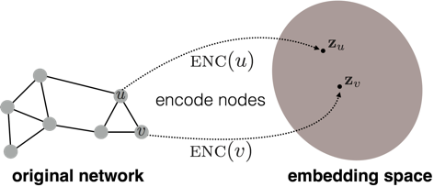
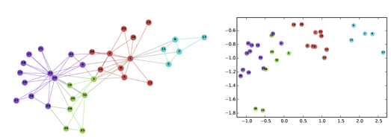
Representation : Graph Embedding I
Goal is to encode nodes so that similarity in the embedding space approximates similarity in the original network

Slide 9
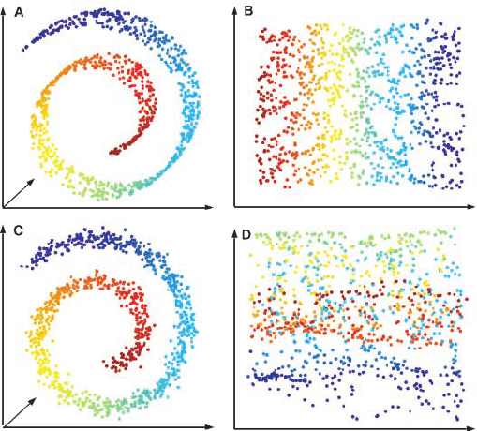
Representation : Graph Embedding II
Projection space
Generally the space basis are fixed
We just exchange the coordinates
Representation learning is the major problem
Can be dealt by seeing the representation as a point in a meta-space
Dimensionality reduction
Finding the good enough space for representing the information

Slide 10
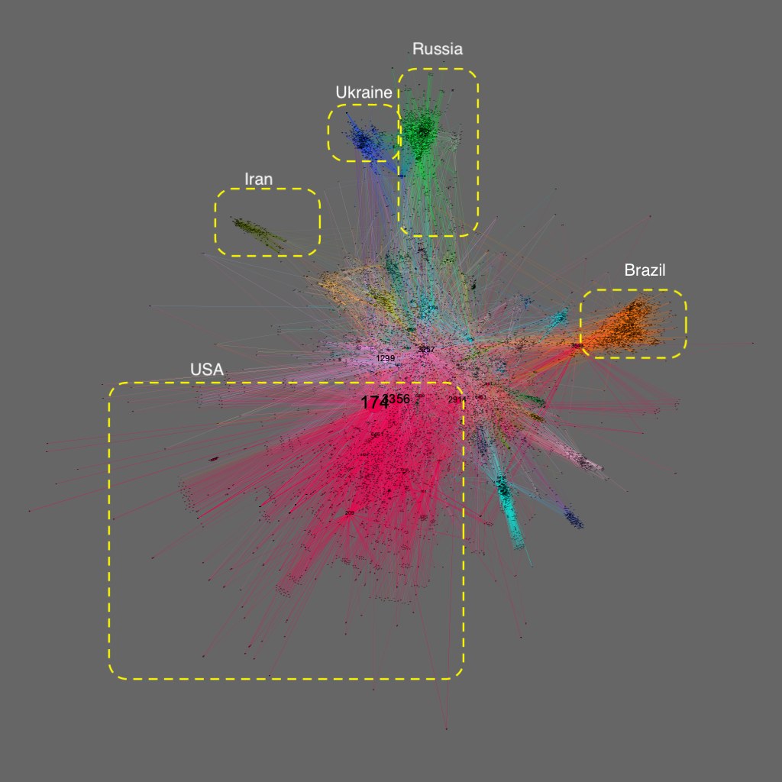
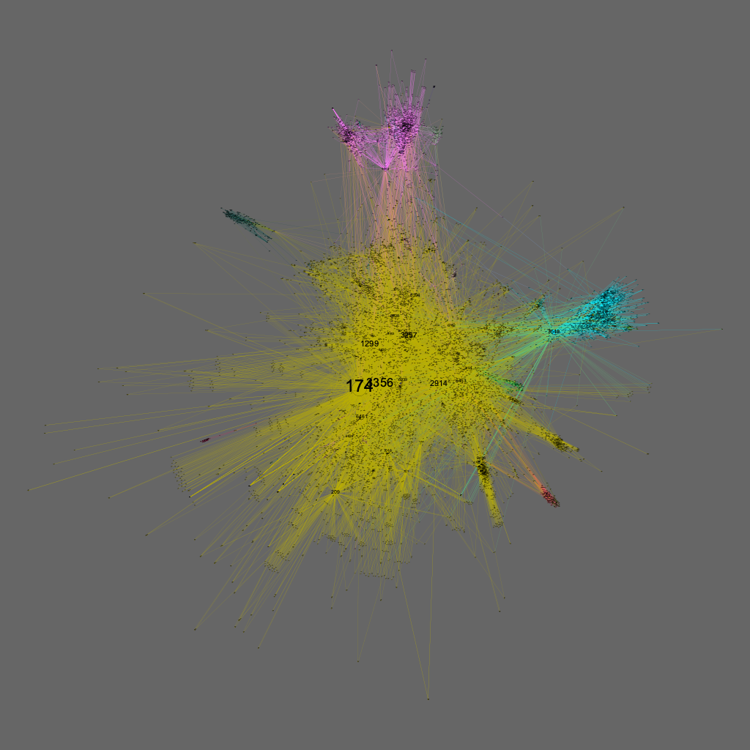
Representation : Graph Embedding III
Spectral embedding and connectivity can be used to show zones of influence in the network

Slide 11
Topological versus Geographical : Investigating the geopolitics behind the network
Internet is a dual space by essence:
Geographical as a network of cable
Topological as an abstract entity of router intertwined by BGP
Our initial questions:
How does the geopolitical context influences the network paths?
Reciprocally, can we get a better grasp on the geopolitical context by looking at the AS-level graph?
What is the exact relationship between geography and topology?

Slide 12
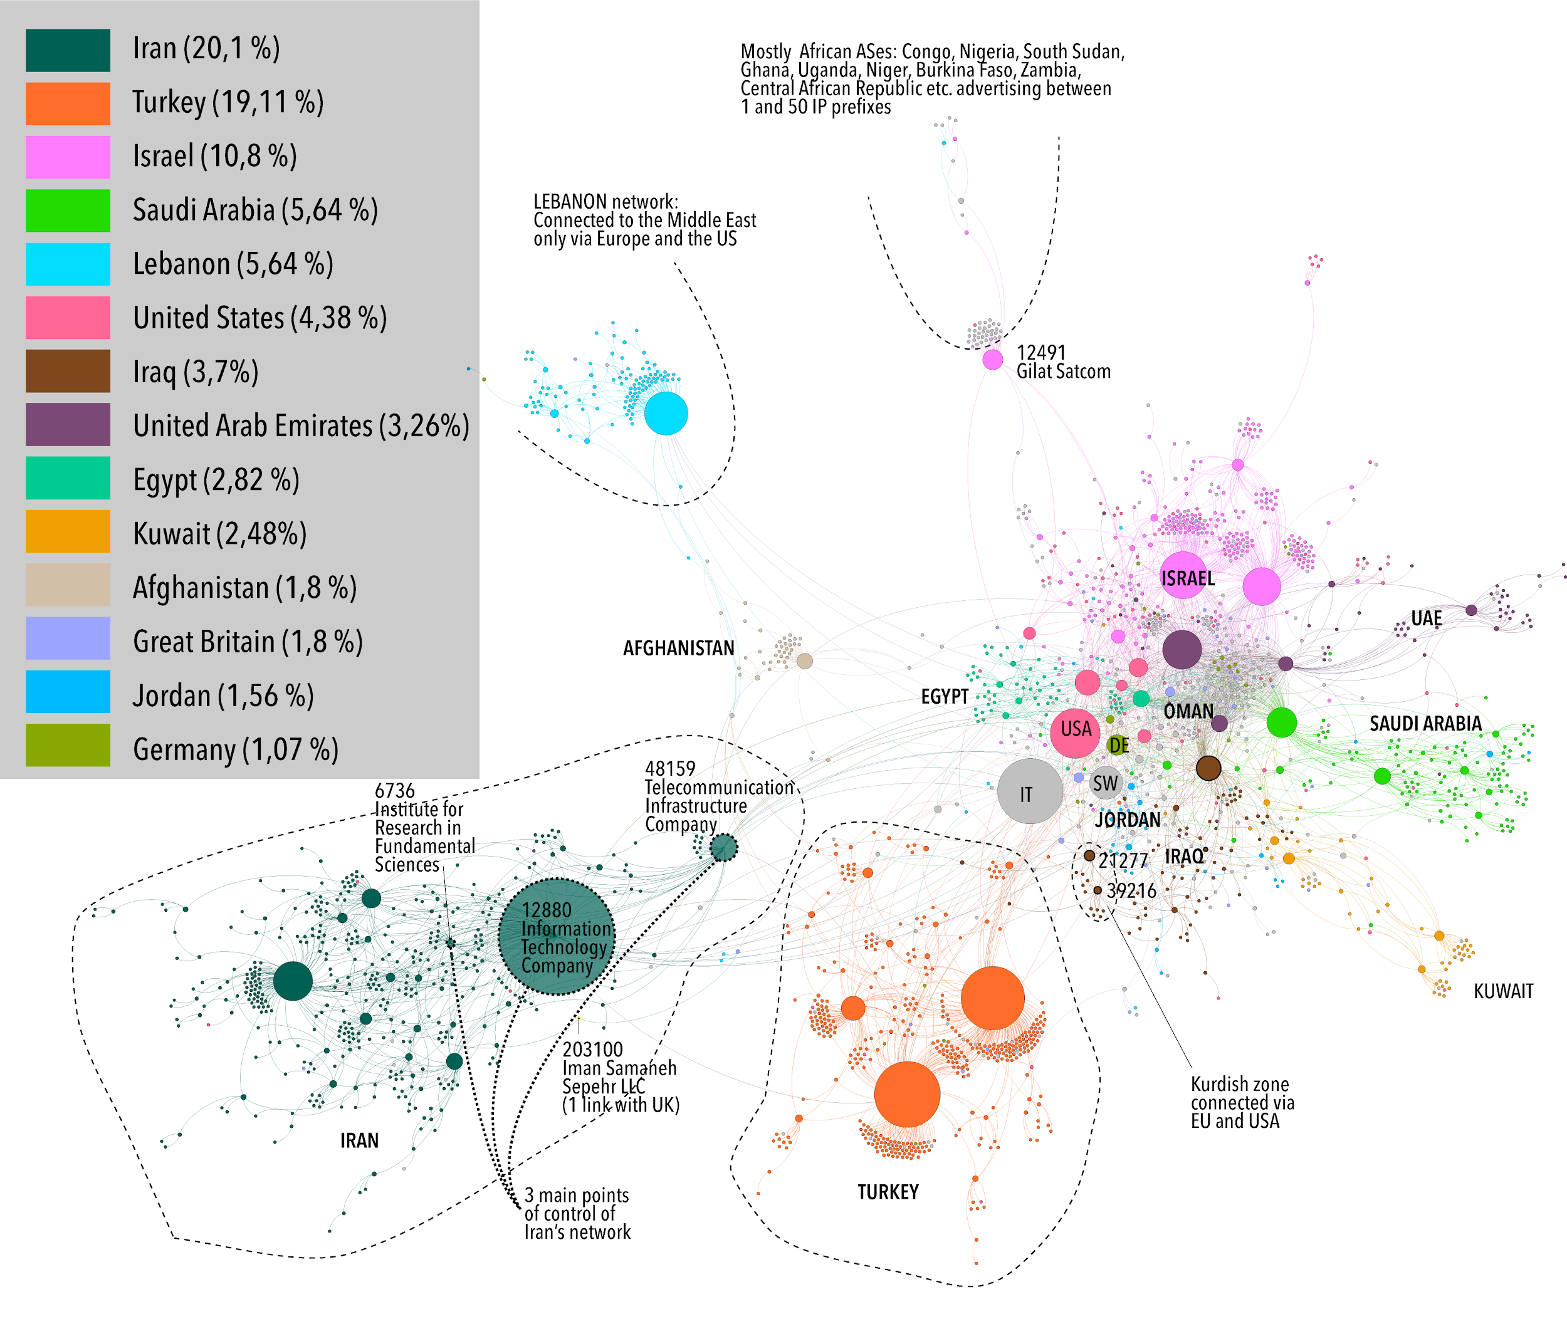
Topological versus Geographical : Connectivity in the Middle-East

Slide 13
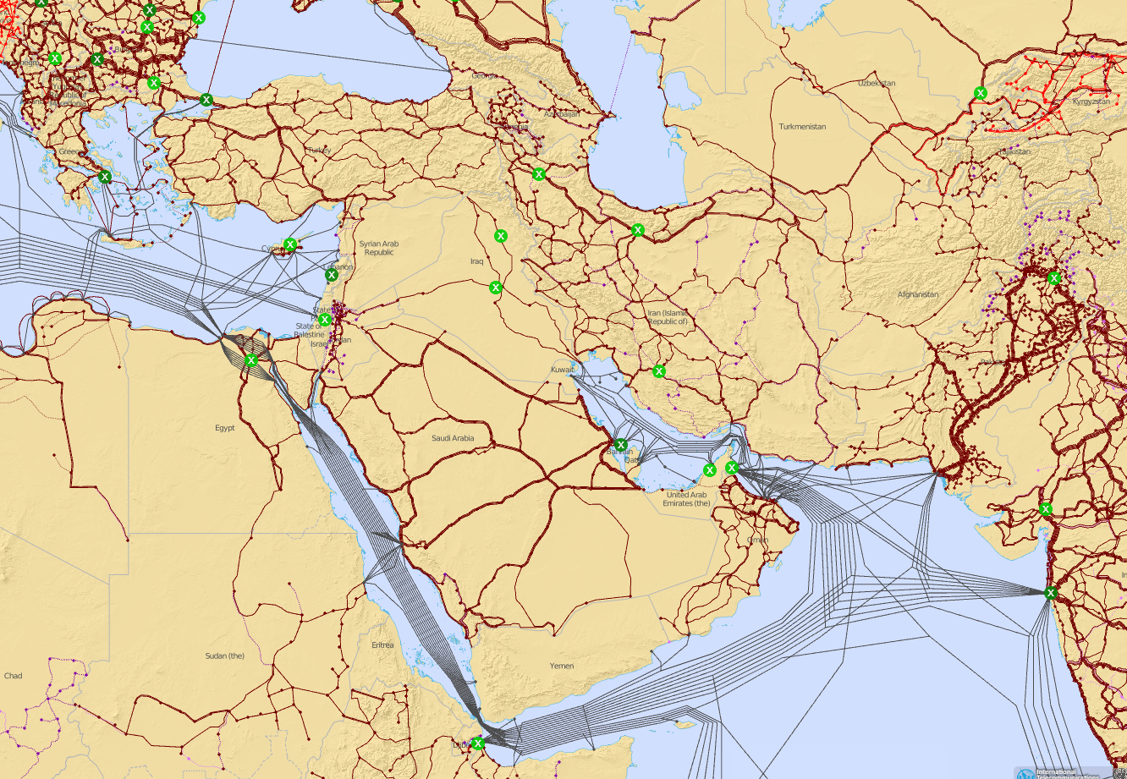
Topological versus Geographical : Investigating through cables
What is the exact relationship between geography and topology?

Slide 14
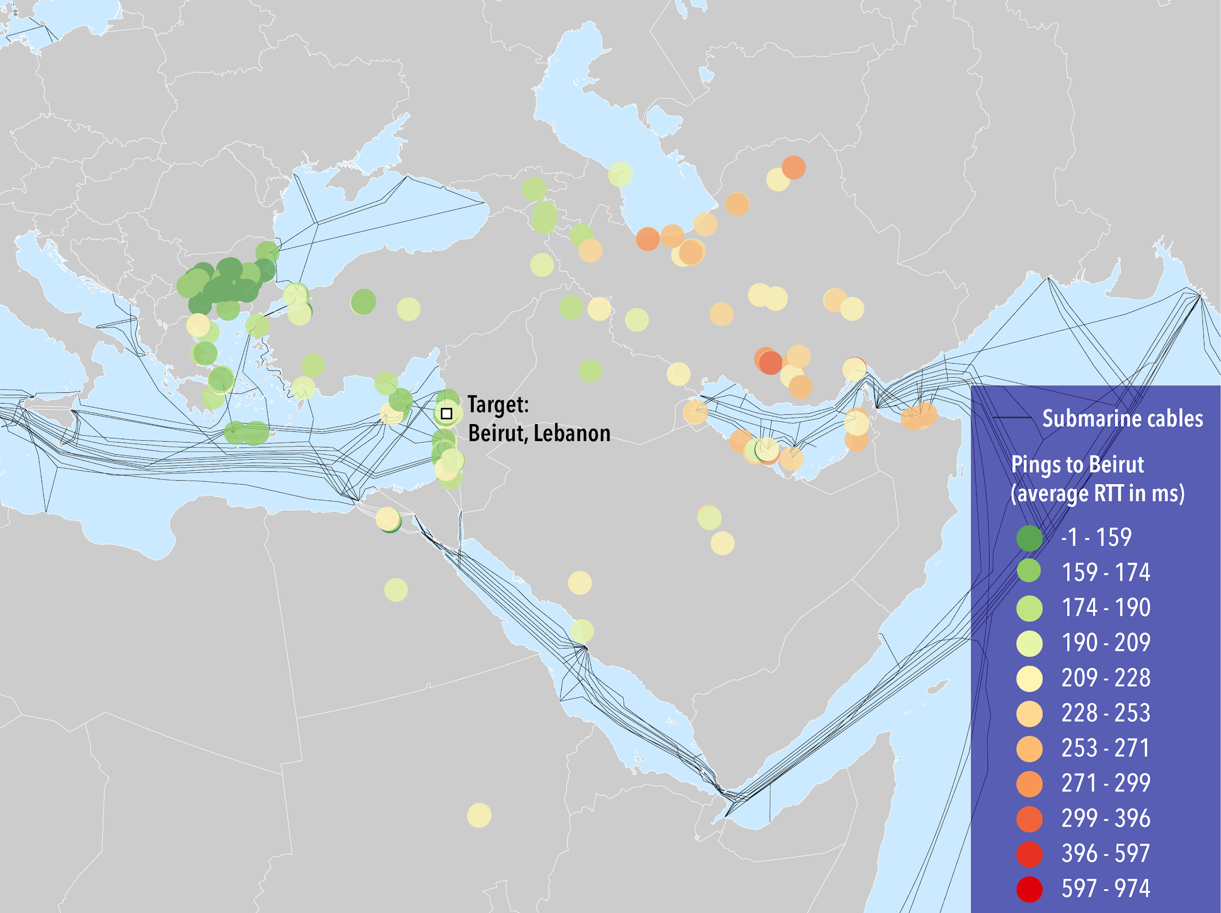
Topological versus Geographical : Submarine Cables over Spatial Proximity in Lebanon

Slide 15
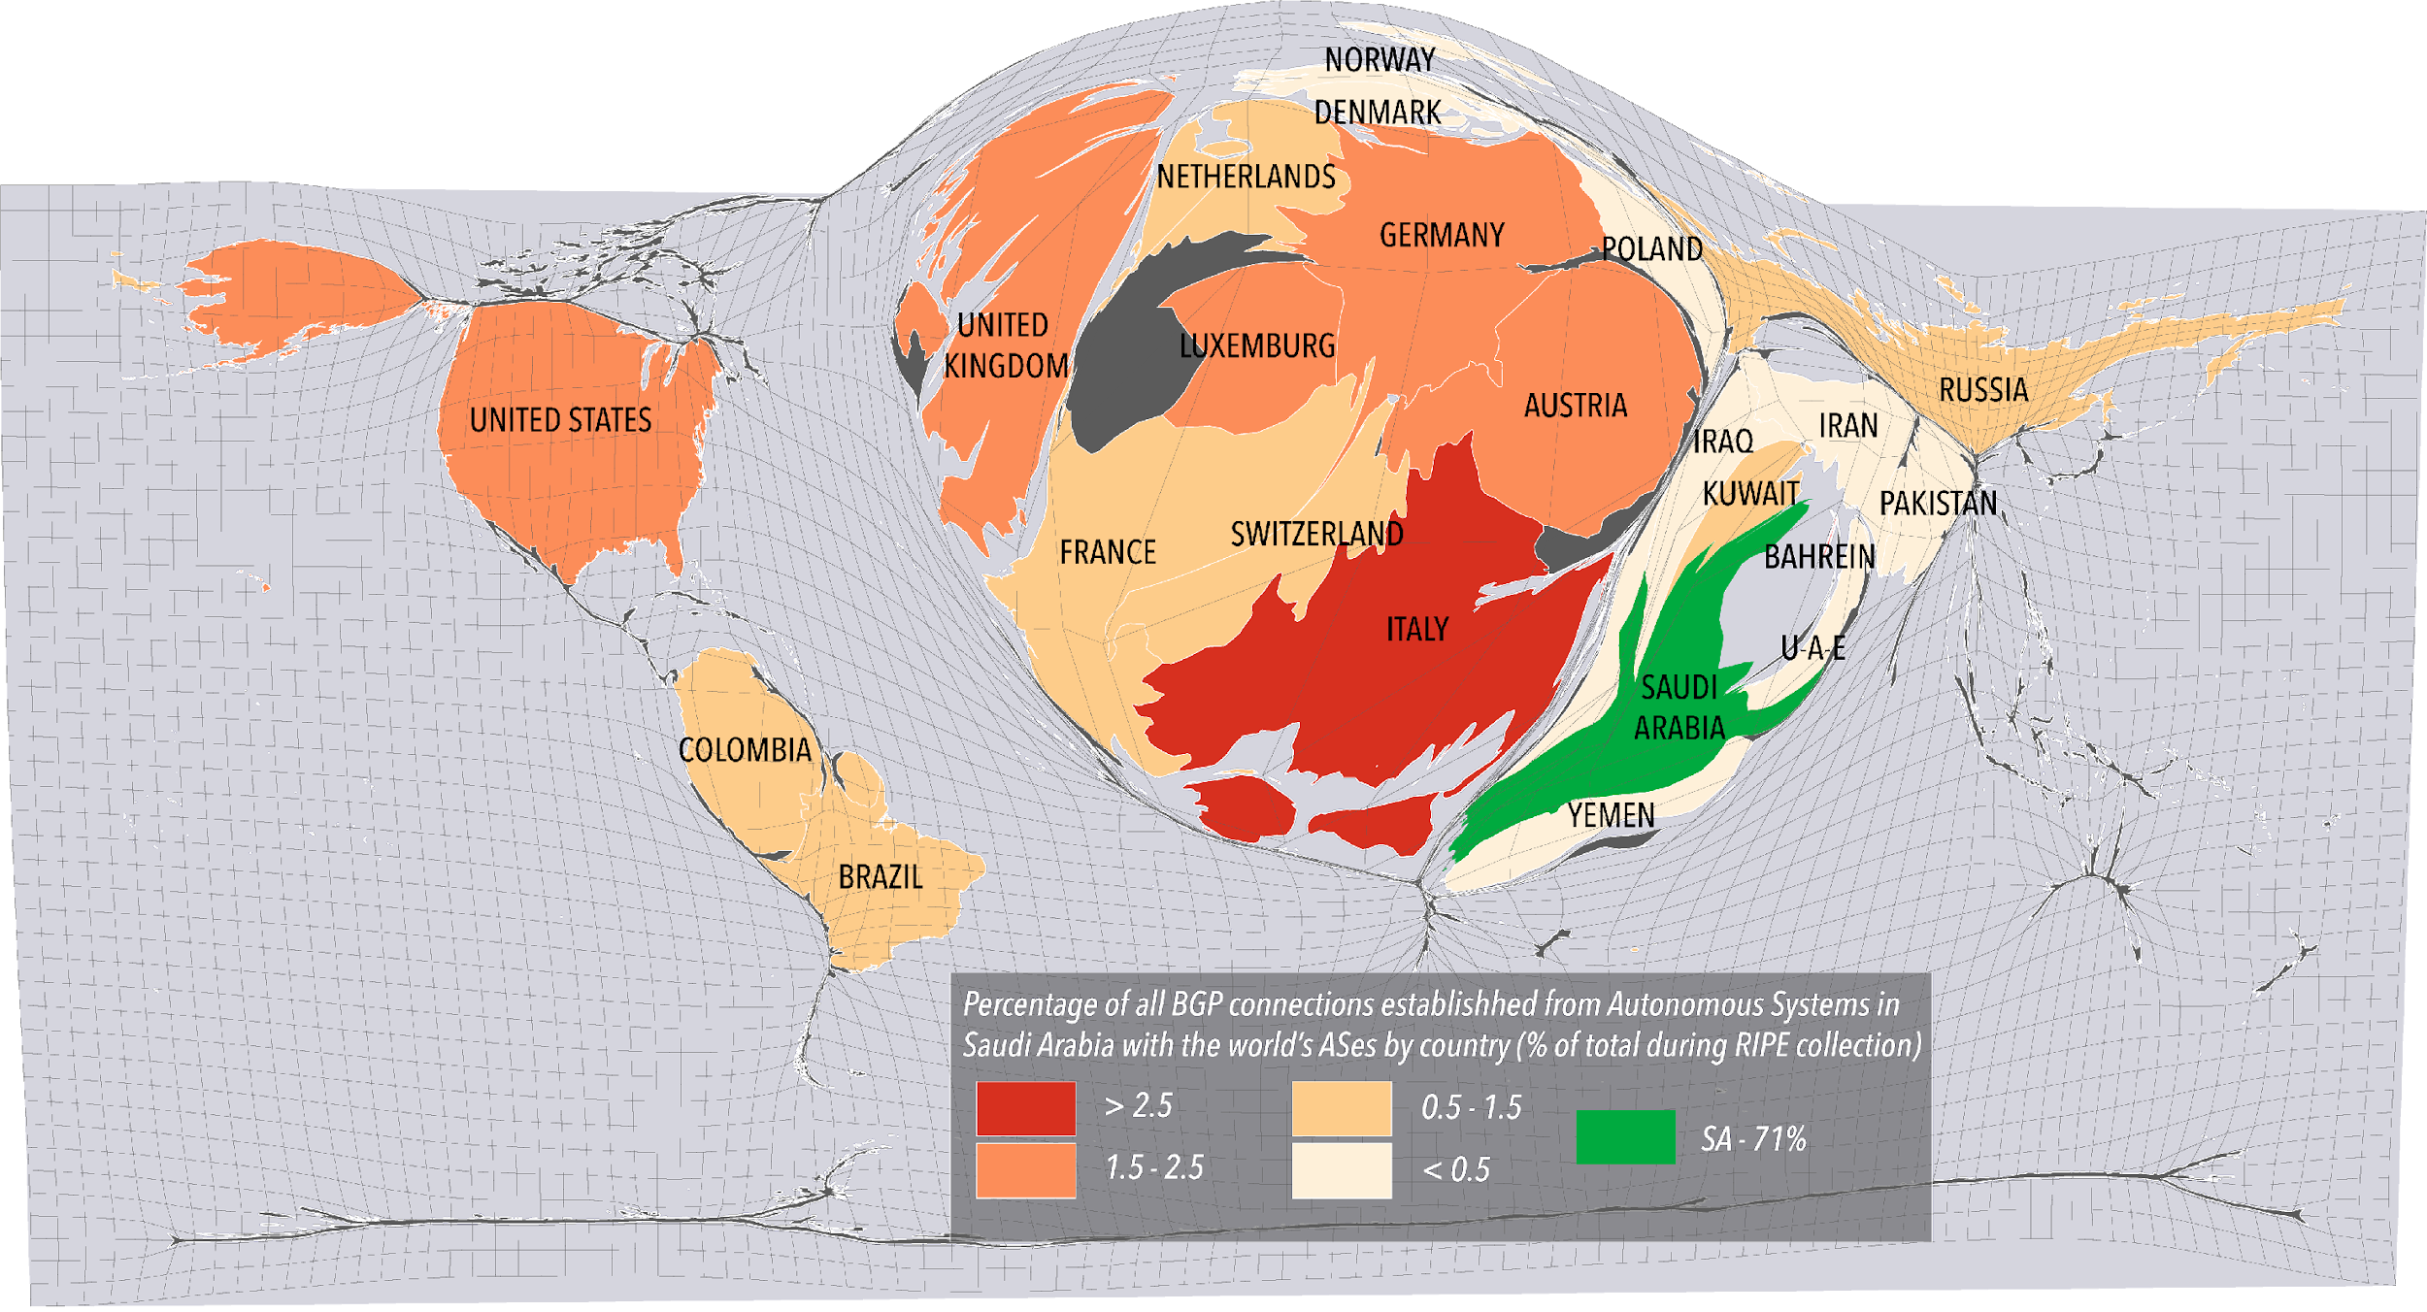
Topological versus Geographical: the Reshaping of Space “from” Saudi Arabia
How can we reshape geography according to the distance induced by the topology?

Slide 16
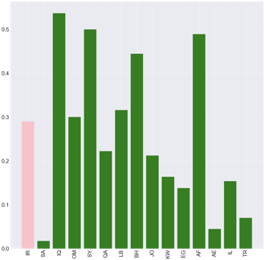
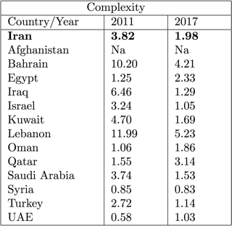
Borderizing in cyberspace (I) a national territory: the Case of Iran
Point of control : the smallest set of autonomous systems that have the potential to control virtually all (90%) of the traffic within a given country
Complexity : The network complexity metric determines the complexity of controlling who connects to the Internet within a given country

Slide 17
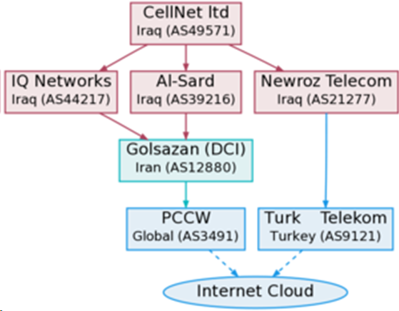
Borderizing in cyberspace (II) a non-national territory: the Iraqi Kurdish network in 2013

Slide 18
Conclusions :
Routing and politics are deeply tied : need for creating satisfying representations taking into account this entanglement
Many unasked questions : need for the right settings to further explore them.
Multidisciplinary research is necessary in routing analysis and cybersecurity.
Need for other and/or better data sets
(Geolocated) terrestrial cables data
Atlas probes located in remote regions
Standardized addresses of Autonomous systems

