Slide 1
Iran LIRs Group
By: Arash Naderpour

Slide 2
What is it?
Formed in April 2015
No mailing list (we don’t like noise and boring emails)
No website (maybe this year)
Use Instant Messaging : first on Viber, now on Telegram (backup: WhatsApp)
Currently 355 members (LIR contacts and Network Operators)
Supporting (New) LIRs and our common interests
RIPE, RIPE NCC and LIR related activities

Slide 3
Why, How and Goals:
To spread the Knowledge:
RIPE vs RIPE NCC?
RIPE NCC SSA!
RIPE NCC Payment terms and Iran Sanctions
Iran LIR’s Community Benefits:
Fairness (payment methods)
Training courses
Networking
Free entry to RIPE meetings
RIPE Working Groups, Proposal Development Process
RIPE NCC GM, Voting

Slide 4
Iran and the GM
320 eligible voting members for Iran.
Average for whole RIPE NCC service region in previous GMs is approx 8%
Approx 15% of eligible Iranian members registered already.
2014 (Iran 17th most votes registered) 11 out of 468 votes
2015 (Iran 3rd most votes registered) 53 out of 590 votes
2016 (Iran 3rd most votes registered) 86 out of 1191 votes
2017 (Iran 9th most votes registered) 51 out of 1381 votes
2018 Let’s see

Slide 5
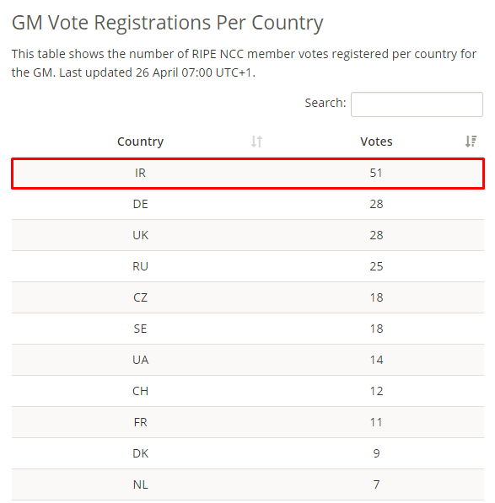
Accomplished: RIPE NCC GM2018 Registration 16-18 May
Total: 290

Slide 6
Iran LIR Group vs IRNOG
LIR Group is different than IRNOG in:
Number and type of members
Discussions
Structure
Goals
How to join
Persian-LIR mailing list at RIPE NCC

Slide 7
Current concerns and Plans:
New members
Payment methods for Iranian members
RIPE PDP (silent yes)
General Knowledge about RIPE, and NCC Services in Iran
RIPE NCC Charging Scheme 2020
Atlas coverage in Iran (25% of networks are covered)

Slide 8
Need your support:
Spread the word
Join the group if you are an LIR or Network Operator
Training Materials and Courses in Persian
Discussions
Comments
Volunteers

Slide 9
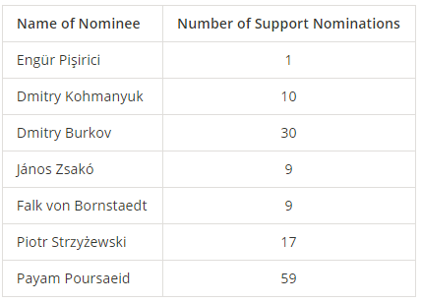
Latest news and lesson learned:
Iran LIRs community has supported Payam Poursaied nomination for EB boad – GM 2018

Slide 10
Questions?

