Slide 1

MENOG 18
Segment Routing
Rasoul Mesghali CCIE#34938
Vahid Tavajjohi
From HAMIM Corporation

Slide 2
Agenda
Introduction
Technology Overview
Use Cases
Closer look at the Control and Data Plane
Traffic Protection
Traffic engineering
SRv6

Slide 3

Introduction
MENOG 18

Slide 4
MPLS Historical Perspective
MPLS “classic” (LDP and RSVP-TE) control-plane was too complex and lacked scalability.
LDP is redundant to the IGP and that it is better to distribute labels bound to IGP signaled prefixes in the IGP itself rather than using an independent protocol (LDP) to do it.
LDP-IGP synchronization issue, RFC 5443, RFC 6138
Overall, we would estimate that 10% of the SP market and likely 0% of the Enterprise market have used RSVP-TE and that among these deployments, the vast majority did it for FRR reasons.
The point is to look at traditional technology (LDP/RSVP_TE) applicability in IP networks in 2018. Does it fit the needs of modern IP networks?

Slide 5
MPLS Historical Perspective
In RSVP-TE and the classic MPLS TE The objective was to create circuits whose state would be signaled hop-by-hop along the circuit path. Bandwidth would be booked hop-by-hop. Each hop’s state would be updated. The available bandwidth of each link would be flooded throughout the domain using IGP to enable distributed TE computation.
First, RSVP-TE is not ECMP-friendly.
Second, to accurately book the used bandwidth, RSVP-TE requires all the IP traffic to run within so-called “RSVP-TE tunnels”. This leads to much complexity and lack of scale in practice.

Slide 6
1.network has enough capacity to accommodate without congestion
traffic engineering to avoid congestion is not needed. It seems obvious to write it but as we will see further, this is not the case for an RSVP-TE network.
2.In the rare cases where the traffic is larger than expected or a non-expected failure occurs, congestion occurs and a traffic engineering solution may be needed. We write “may” because it depends on the capacity planning process.
3.Some other operators may not tolerate even these rare congestions and then require a tactical traffic-engineering process.
A tactical traffic-engineering solution is a solution that is used only when needed.

Slide 7




An analogy would be that one needs to wear his raincoat and boots every day while it rains only a few days a year.
N2*K tunnels While no traffic engineering is required in the most likely situation of an IP network, the classical MPLS TE solution always requires all the IP traffic to not be switched as IP, but as MPLS TE circuits.
the classic RSVP TE solution is an “always-on” solution
This is the reason for the infamous full-mesh of RSVP-TE tunnels.
complexity and limited scale,
most of the time, without any gain

Slide 8
Goals and Requirements
Make things easier for operators
  Improve scale, simplify operations
  Minimize introduction complexity/disruption
Enhance service offering potential through programmability
Leverage the efficient MPLS dataplane that we have today
  Push, swap, pop
  Maintain existing label structure
Leverage all the services supported over MPLS
  Explicit routing, FRR, VPNv4/6, VPLS, L2VPN, etc
IPv6 dataplane a must, and should share parity with MPLS

Slide 9
Operators Ask For Drastic LDP/RSVP Improvement
Simplicity
  less protocols to operate
  less protocol interactions to troubleshoot
  avoid directed LDP sessions between core routers
  deliver automated FRR for any topology
Scale
  avoid millions of labels in LDP database
  avoid millions of TE LSP’s in the network
  avoid millions of tunnels to configure

Slide 10
Operators Ask For A Network Model Optimized For Application Interaction
Applications must be able to interact with the network
  cloud based delivery
  internet of everything
Programmatic interfaces and Orchestration
  Necessary but not sufficient
The network must respond to application interaction
  Rapidly-changing application requirements
  Virtualization
  Guaranteed SLA and Network Efficiency

Slide 11
Segment Routing
Simple to deploy and operate
  Leverage MPLS services & hardware
  straightforward ISIS/OSPF extension to distribute labels
  LDP/RSVP not required
Provide for optimum scalability, resiliency and virtualization
SDN enabled
  simple network, highly programmable
  highly responsive

Slide 12
Technology Overview
MENOG 18

Slide 13

What is the meaning of Segment Routing?
Segment 1
20
10
CE1
PE1
P2
P3
P4
Segment
2
10
10
P5
P6
P7
PE2
CE2
Segment 3
PE2
Default Cost is 100

Slide 14
24001
Adj-SID Label
SR in one Slide
16007
Prefix-SID Label
Service: L3VPN,L2VPN,6PE,6 VPE
16099
24001
24001
Prefix-SID
Loopback0
Label 16099
Segment 1
16007
16007
CE1
PE1
P1
P2
P3
P4
Segment
2
Prefix-SID
Loopback0
Label 16007
Adj Label 24001
16007
Prefix-SIDs are global Labels
Adj-SIDs are local labels
P5
P6
P7
PE2
CE2
Segment 3
16007
PE2
Deviate from shortest path-Source Routing:
Traffic Engineering based on SR
Default: PHP at each segment

Slide 15
Let’s take a closer look

Slide 16
Source Routing
  the source chooses a path and encodes it in the packet header as an ordered list of segments
  • the rest of the network executes the encoded instructions (In Stack of labels/IPv6 EH)
Segment: an identifier for any type of instruction
• forwarding or service
Forwarding state (segment) is established by IGP
  LDP and RSVP-TE are not required
  Agnostic to forwarding data plane: IPv6 or MPLS
MPLS Data plane is leveraged without any modification
  push, swap and pop: all that we need
  segment = label

Slide 17
Segment Routing – Overview
• MPLS: an ordered list of segments
is represented as a stack of labels
• IPv6: an ordered list of segments is
encoded in a routing extension header
• This presentation: MPLS data plane
Segment → Label
Basic building blocks distributed
by the IGP or BGP
Control Plane
Routing protocols with extensions
(IS-IS,OSPF, BGP)
SDN controller
Data Plane
MPLS
(segment ID = label)
IPv6
(segment ID = V6 address)
Paths options
Dynamic
(SPT computation)
Explicit
(expressed in the packet)
Strict or loose path

Slide 18
Global and Local Segments
Global Segment
Any node in SR domain understands associated instruction
Each node in SR domain installs the associated instruction in its
forwarding table
MPLS: global label value in Segment Routing Global Block
(SRGB)
Local Segment
Only originating node understands associated instruction
MPLS: locally allocated label

Slide 19
Global Segments – Global Label Indexes
Global Segments always distributed as a label range
(SRGB) + Index
Index must be unique in Segment Routing Domain
Best practice: same SRGB on all nodes
  “Global model”, requested by all operators
  Global Segments are global label values, simplifying network
  operations
  Default SRGB: 16,000 – 23,999
  Other vendors also use this label range

Slide 20
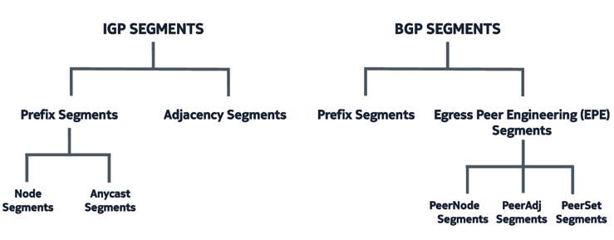
Types of Segment

Slide 21
IGP Segment
Two Basic building blocks distributed by IGP:
-Prefix Segment
-Adjacency Segment
Prefix-SID (Node-SID)
Segment
Segment
Segment
Segment
1
Segment
1
Segment
3
Segment
1
Segment
Segment
2
Segment
4
Adjacency-SID
Segment
Segment

Slide 22
1
5
IGP Prefix Segment
Node-SID
16006
16006
16006
7
Shortest-path to the IGP prefix
  Equal Cost Multipath (ECMP)-
  aware
Global Segment
Label = 16000 + Index
Advertised as index
Distributed by ISIS/OSPF
Default SRGB 16000-23,999
16006
2
6
16006
1.1.1.6/32
16005
1
5
1.1.1.5/32
16005
16005
7
16005
16005
2
6

Slide 23
Node Segment
FEC Z
push 16065
swap 16065
to 16065
swap 16065
to 16065
pop 16065
A
B
C
D
A packet injected anywhere with top label 16065 will reach E via shortest-path
E
16065
E advertises its node segment
  Simple ISIS/OSPF sub-TLV extension
All remote nodes install the node segment to E in the MPLS Data Plane

Slide 24
Node Segment
FEC Z
push 16065
swap 16065
to 16065
swap 16065
to 16065
pop 16065
A
B
C
D
A packet injected anywhere with top label 16065 will reach E via shortest-path
E
16065
16065
16065
16065
Packet to E
Packet to E
Packet to E
Packet to E
Packet to E
E advertises its node segment
  simple ISIS sub-TLV extension and OSPF
All remote nodes install the node segment to E in the MPLS dataplane

Slide 25
Adjacency Segment
Adj to 7
1
5
24057
A packet injected at node 5 with label 24056 is forced through datalink 5-6
Adj to 6
7
24056
2
6
C allocates a local label and forward on the IGP adjacency
C advertises the adjacency label
Distributed by OSPF/ISIS
simple sub-TLV extension
  (https://datatracker.ietf.org/doc/draft-ietf-isis-segment-routing-extensions/)
  https://www.iana.org/assignments/isis-tlv-codepoints/isis-tlv-codepoints.xhtml
C is the only node to install the adjacency segment in MPLS dataplane

Slide 26
Datalink and Bundle
Pop 9003
9001 switches on blue member
9002 switches on green member
9003 load-balances on any member of the adj
Pop 9001
A
B
Pop 9002
Pop 9003
Adjacency segment represents a specific datalink to an adjacent node
Adjacency segment represents a set of datalinks to the adjacent node

Slide 27
A path with Adjacency Segments
9105
9107
9107
9101
9103
9103
9105
9105
9105
9107
1
3
5
9103
9101
9105
9105
7
9107
7
2
4
9103
6
9105
9103
9105
9105
Source routing along any explicit path
  stack of adjacency labels
SR provides for entire path control
7

Slide 28
Combining Segments
Prefix-SID
16007
16007
24078
24078
24078
16011
16011
16011
Adj-SID
Packet to Z
Packet to Z
Packet to Z
Steer traffic on any path
through the network
Path is specified by list of
segments in packet header, a
stack of labels
No path is signaled
No per-flow state is created
For IGP – single protocol, for
BGP – AF LS
16007
16007
1
5
7
9
16011
24078
11
3
6
8
10
16011
Packet to Z
16011
16011
Packet to Z
Packet to Z

Slide 29
Labeling Which prefixes?
GE 0/0/0/0
P1
P2
P3
P4
10.20.34.0/24
Prefix attached to P4 | Outgoing label in CEF? Entry in LFIB?
Prefix-SID P4 (10.100.1.4/32) | Y
Prefix-SID P4 without Node flag (10.100.3.4/32) | Y
loopback prefix without prefix-sid (10.100.4.4/32) | N
link prefix connected to P4 (10.1.45.0/24) | N
• So, this is the equivalent of LDP label prefix filtering: only
assigning/advertising labels to /32 prefixes (loopback prefixes, used by
service, (e.g. L3VPN), so BGP next hop IP addresses)
• Traffic to link prefixes is not labeled!

Slide 30

Data
7
46
4
Explicit loose path for low latency app
Data
7
Dynamic path
R1
SID: 1
R3
SID: 3
R5
SID: 5
Explicit path
R7
SID: 7
High cost
Low latency
Adj SID: 46
R2
SID: 2
R4
SID: 4
R6
SID: 6
SID: Segment ID
No LDP, no RSVP-TE

Slide 31
Any-Cast SID for Node Redundancy
A group of Nodes share the same SID
Work as a “Single” router, single Label
Same Prefix advertised by multiple nodes
traffic forwarded to one of Anycast-Prefix-SID based on best IGP Path
if primary node fails,traffic is auto re-routed to other node
• Application
– ABR Protection
– Seamless MPLS
– ASBR inter-AS protection
200
70
70
Packet
Packet
Anycast SID: 200
200
Packet
200
70
70
30
40
Packet
70
Packet
10
20
90
50
60
80

Slide 32
Binding-SID
All Nodes SRGB [16000-23999]
Prefix-SID NodeX: 1600X
Binding-SID X->Y: 300XY
BSID:
30410
SID:
30710
1
2
3
4
5
6
7
8
9
10
1→4
16003
16006
16004
16004
16007
16007
16009
4→10
30410
30410
30410
30710
30710
30710
16010
16010
Node 10
Node 10
Node 10
Node 10
Node 10
Node 10
Node 10
Node 10
Node 10
Binding-SIDs can be used in the following cases:
Multi-Domain (inter-domain, inter-autonomous system)
Large-Scale within a single domain
Label stack compression
BGP SR-TE Dynamic
Stitching SR-TE Polices Using Binding SID

Slide 33
BGP Prefix Segment
Shortest-Path to the BGP Prefix
Global
16000 + Index
Signaled by BGP
Node SID: 16001
12
10
1
13
3
11
14
BGP-Connections

Slide 34
BGP Peering Segment
Egress Peering Engineering
16001
30012
BGP-Peering-SID
18005
30012
18005
Packet
18005
Packet
Packet
BGP-Peering-SID
SID: 30012
12
10
Node SID: 16001
Packet
1
2
13
5
3
7
5.5.5.5/32
11
Node SID:
18005
14
AS1
AS2
Pop and Forward to the BGP Peer
Local
Signaled by BGP-LS (Topology Information) to the controller
Local Segment- Like an adjacency SID external to the IGP
Dynamically allocated but persistent

Slide 35
WAN Controller
SR PCE Collects via BGP-LS
IGP Segments
BGP Segments
Topology
SR
PCE
BGP-LS
Collects information from network
12
BGP-LS
10
1
2
13
5
3
7
5.5.5.5/32
11
Node SID:
18005
14
IGP-1
IGP-2

Slide 36
An end-to-end path as a list of segment
SR
PCE
PCEP,Netconf, BGP
Controller learn the network topology and usage dynamically
Controller calculate the optimized path for different applications: low latency, or high bandwidth
Controller just program a list of the labels on the source routers. The rest of the network is not aware: no signaling, no state information → simple and Scalable
12
Node SID:
16002
Adj SID: 124
10
Node SID: 16001
{16001,
16002,
124,
147}
2
4
Peering SID: 147
1
50
Low latency
Low bandwidth
{124,
147}
{147}
13
{16002,
124,
147}
7
3
11
5
14
High latency
High bandwidth
IGP-1
IGP-2
BGP-Peer
Default ISIS cost metric: 10

Slide 37
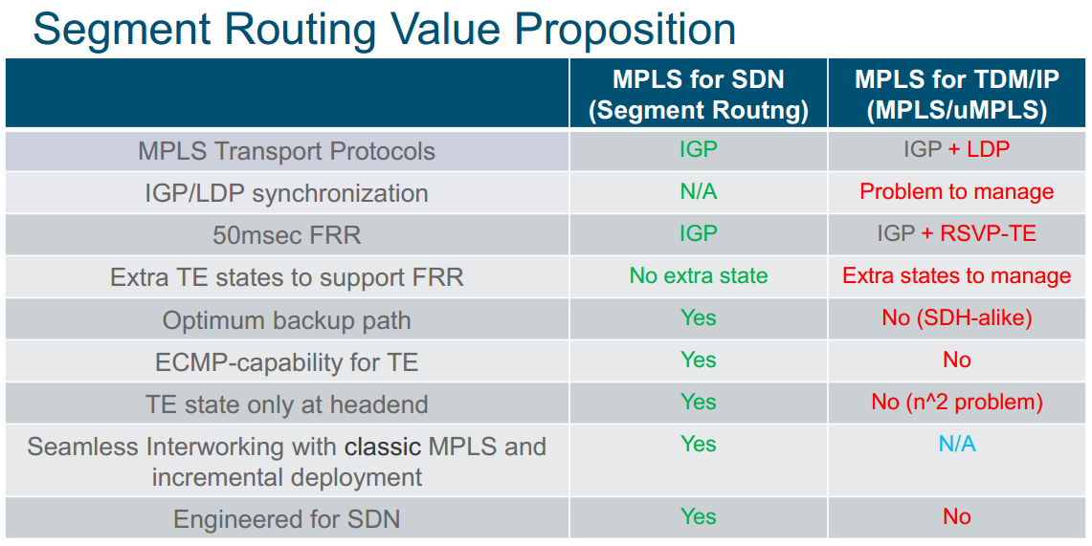

Slide 38
MENOG 18
Segment Routing
Segment Routing Global Block

Slide 39
Segment Routing Global Block (SRGB)
Segment Routing Global Block
  Range of labels reserved for Segment Routing Global Segments
  Default SRGB is 16,000 – 23,999
A prefix-SID is advertised as a domain-wide unique index
The Prefix-SID index points to a unique label within the SRGB
  Index is zero based, i.e. first index = 0
  Label = Prefix-SID index + SRGB base
  E.g. Prefix 1.1.1.65/32 with prefix-SID index 65 gets label 16065
  index 65 --> SID is 16000 + 65 =16065
Multiple IGP instances can use the same SRGB or use different non-overlapping SRGBs

Slide 40
1
2
3
4
Recommended SRGB allocation:
Same SRGB for all
16000
16004 | Idx 4
23999
24000
1048575
16000
16004 | Idx 4
23999
24000
1048575
Same SRGB for all:
Simple
Predictable
easier to troubleshoot
simplifies SDN Programming
16000
23999
24000
24004 | Idx 4
31999
1048575
SRGB
16000-2399
SRGB
16000-2399
SRGB
24000-31999

Slide 41
MENOG 18
Segment Routing
IGP Control and Date Plane

Slide 42

MPLS Control and Forwarding Operation with Segment
Routing
Services
No changes to
control or
forwarding plane
PE-1
MP-BGP
IPv4
IPv6
IPv4
VPN
IPv6
VPN
VPWS
VPLS
PE-2
Packet
Transport
IGP label
distribution for
IPv4 and IPv6.
Forwarding plane
remains the same
LDP
RSVP
BGP
Static
IS-IS
OSPF
IGP
PE-1
PE-2
MPLS Forwarding

Slide 43
SR IS-IS Control Plane overview
• IPv4 and IPv6 control plane
• Level 1, level 2 and multi-level routing
• Prefix Segment ID (Prefix-SID) for host prefixes on loopback interfaces
• Adjacency SIDs for adjacencies
• Prefix-to-SID mapping advertisements (mapping server)
• MPLS penultimate hop popping (PHP) and explicit-null label signaling

Slide 44
ISIS TLV Extensions
SR for IS-IS introduces support for the following (sub-)TLVs:
– SR Capability sub-TLV (2) IS-IS Router Capability TLV (242)
– Prefix-SID sub-TLV (3) Extended IP reachability TLV (135)
– Prefix-SID sub-TLV (3) IPv6 IP reachability TLV (236)
– Prefix-SID sub-TLV (3) Multitopology IPv6 IP reachability TLV (237)
– Prefix-SID sub-TLV (3) SID/Label Binding TLV (149)
– Adjacency-SID sub-TLV (31) Extended IS Reachability TLV (22)
– LAN-Adjacency-SID sub-TLV (32) Extended IS Reachability TLV (22)
– Adjacency-SID sub-TLV (31) Multitopology IS Reachability TLV (222)
– LAN-Adjacency-SID sub-TLV (32) Multitopology IS Reachability TLV (222)
– SID/Label Binding TLV (149)
• Implementation based on draft-ietf-isis-segment-routing-extensions

Slide 45
SR OSPF Control Plane overview
SR OSPF Control Plane Overview
• OSPFv2 control plane
• Multi-area
• IPv4 Prefix Segment ID (Prefix-SID) for host prefixes on loopback interfaces
• Adjacency SIDs for adjacencies
• MPLS penultimate hop popping (PHP) and explicit-null label signaling

Slide 46
OSPF Extensions
OSPF adds to the Router Information Opaque LSA (type 4):
  – SR-Algorithm TLV (8)
  – SID/Label Range TLV (9)
• OSPF defines new Opaque LSAs to advertise the SIDs
  – OSPFv2 Extended Prefix Opaque LSA (type 7)
  >OSPFv2 Extended Prefix TLV (1)
  • Prefix SID Sub-TLV (2)
  – OSPFv2 Extended Link Opaque LSA (type 8)
  >OSPFv2 Extended Link TLV (1)
  • Adj-SID Sub-TLV (2)
  • LAN Adj-SID Sub-TLV (3)
• Implementation is based on
– draft-ietf-ospf-prefix-link-attr and draft-ietf-ospf-segment-routing-extensions

Slide 47
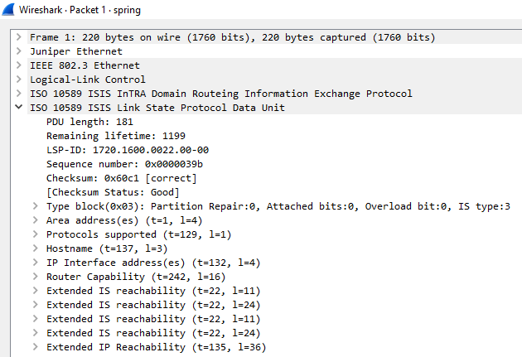
TLV 22
TLV 135

Slide 48
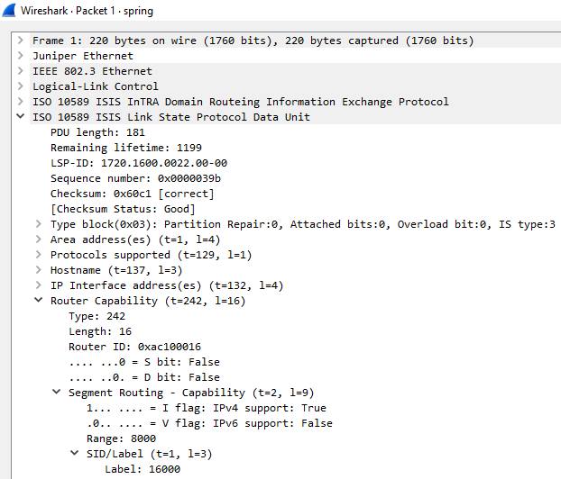
TLV 242

Slide 49
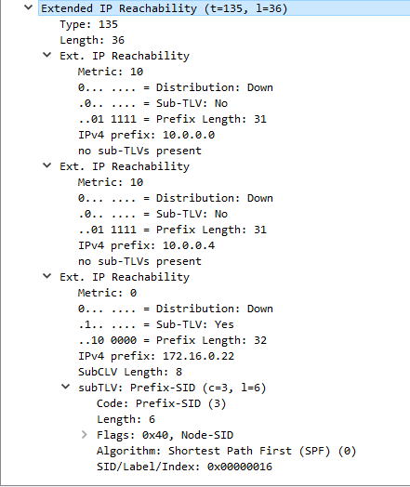
TLV 135
Sub-TLV 3
Prefix-SID
SID-Index
16

Slide 50
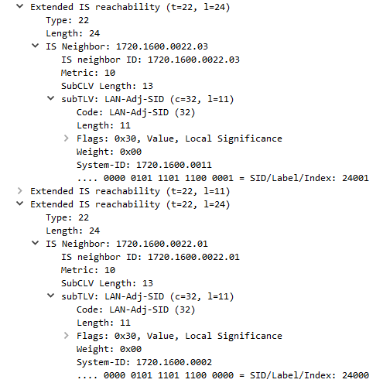
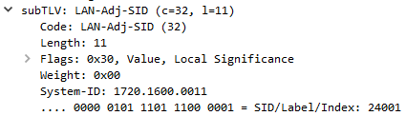
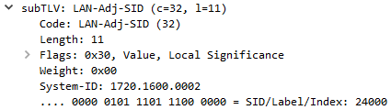
TLV 22
Sub-TLV 32
LAN-Adj-SID
LAN-Adj-SID
24001

Slide 51
Use Cases
MENOG 18

Slide 52
Unified MPLS
EPN 5.0
Metro Fabric
Provisioning
Netconf
Yang
Netconf
Yang
Programmability
PCE
L2/L3VPN Services
LDP
BGP
LDP
BGP
BGP
Intra-Domain CP
BGP-LU
BGP-LU
IGP With SR
FRR or TE
RSVP
IGP With SR
LDP
Intra-Domain CP
IGP
Do More With Less

Slide 53
IPv4/v6 VPN/Service transport
5
5
5
7
7
7
VPN
VPN
VPN
Packet to Z
Packet to Z
Packet to Z
Site-1
VPN
PE-1
2
3
VPN
5
Packet to Z
Packet to Z
PHP
PE-7
Site-2
VPN
5
4
5
6
7
7
5
7
7
7
  IGP only
    No LDP, No RSVP-TE
  ECMP multi-hop shortest-path
VPN
VPN
VPN
Packet to Z
Packet to Z
Packet to Z

Slide 54
Internetworking With LDP
MENOG 18

Slide 55
Simplest Migration: LDP to SR
Initial state: All nodes run LDP, not SR
Step1: All nodes are upgraded to SR
in no particular order
Default label imposition preference = LDP
Leave default LDP label imposition preference
Step2: All PEs are configured to prefer SR Label imposition
in no particular order
Step3: LDP is removed from the nodes in the network
in no particular order
Final State: All nodes run SR,Not LDP
LDP
SR
LDP
SR
LDP+SR
LDP+SR
segment-routing mpls sr-prefer
3
4
LDP
SR
LDP+SR
LDP+SR
SR
LDP
SR
1
LDP
2
5
6
LDP
SR
LDP
SR
LDP+SR
LDP+SR
LDP Domain

Slide 56
1
2
3
4
5
segment-routing mpls sr-prefer
16000
16005 | 16005
23999
24000
24002 | 24001
1048575
16000
16005 | 24005
23999
24000
24001 | 32011
1048575
16000
23999
24000
24005 | 16005
31999
32011 | 24003
1048575
16000
16005 | pop
23999
24000
24003 | pop
1048575
Local/in lbl
Out lbl
Local/in lbl
Out lbl
Local/in lbl
Out lbl
Local/in lbl
Out lbl
SRGB
segment-routing mpls (defualt)

Slide 57
LDP/SR Interworking - LDP to SR
When a node is LDP capable but its next-hop along the SPT to the destination
is not LDP capable
  no LDP outgoing label
In this case, the LDP LSP is connected to the prefix segment
C installs the following LDP-to-SR FIB entry:
incoming label: label bound by LDP for FEC Z
outgoing label: prefix segment bound to Z
outgoing interface: D
This entry is derived and installed
automatically , no config required
LDP
SR
A
Z
B
C
D
Prefix | Out Label (LDP), Interface
Z | 16, 0
Input label(LDP) | Out Label (SID), Interface
32 | 16006, 1

Slide 58
1.1.1.5/32
lbl 90100
1.1.1.5/32
90007
1.1.1.5/32
1
2
3
4
5
LDP
SR
SID 16005
90008 | 90100
24000
90100 | 90007
24000
16005 | 16005
31999
90007
16000
16005 | pop
23999
24000
Local/in lbl
Out lbl
Local/in lbl
Out lbl
Local/in lbl
Out lbl
Local/in lbl
Out lbl
SGB
Copy
LDP LSP
16005
????

Slide 59
LDP/SR Interworking - SR to LDP
When a node is SR capable but its next-hop along the SPT to the destination
is not SR capable
no SR outgoing label available
In this case, the prefix segment is connected to the LDP LSP
Any node on the SR/LDP border installs SR-to-LDP FIB entry(ies)
SR
LDP
A
Z
B
C
D
16006
Prefix | Out Label (SID), Interface
Z | ?, 0
Input Label(SID) | Out Label (LDP), Interface
? | 16, 1

Slide 60
LDP/SR Interworking - Mapping Server
A wants to send traffic to Z, but
  Z is not SR-capable, Z does not advertise any prefixSID
  → which label does A have to use?
The Mapping Server advertises the SID mappings for the non-SR routers
  for example, it advertises that Z is 16066
A and B install a normal SR prefix segment for 16066
C realizes that its next hop along the SPT to Z is not SR capable hence C installs
an SR-to-LDP FIB entry
  incoming label: prefix-SID bound
  to Z (16066)
  outgoing label: LDP binding
  from D for FEC Z
A sends a frame to Z with a
single label: 16006
SR
LDP
Z(16006)
A
Z
B
C
D
Prefix | Out Label (SID), Interface
Z | 16006, 0
Input Label(SID) | Out Label (LDP), Interface
16006 | 16, 1

Slide 61
Mapping-Server
1.1.1.5/32
lbl 90090
1.1.1.5/32
Imp-null
1
2
3
4
5
SR
LDP
1.1.1.5
16000
16005 | 16005
23999
16000
16005 | pop
23999
16000
16005
23999
90002 | 90090
Local/in lbl
Out lbl
Local/in lbl
Out lbl
Local/in lbl
Out lbl
90090 | pop
90090 | pop
Local/in lbl
Out lbl
NA ?
90090
Copy

Slide 62
Traffic Protection
MENOG 18

Slide 63
Classic Per-Prefix LFA – disadvantages
• Classic LFA has disadvantages:
– Incomplete coverage, topology dependent
– Not always providing most optimal backup path
→Topology Independent LFA (TI-LFA) solves these issues

Slide 64
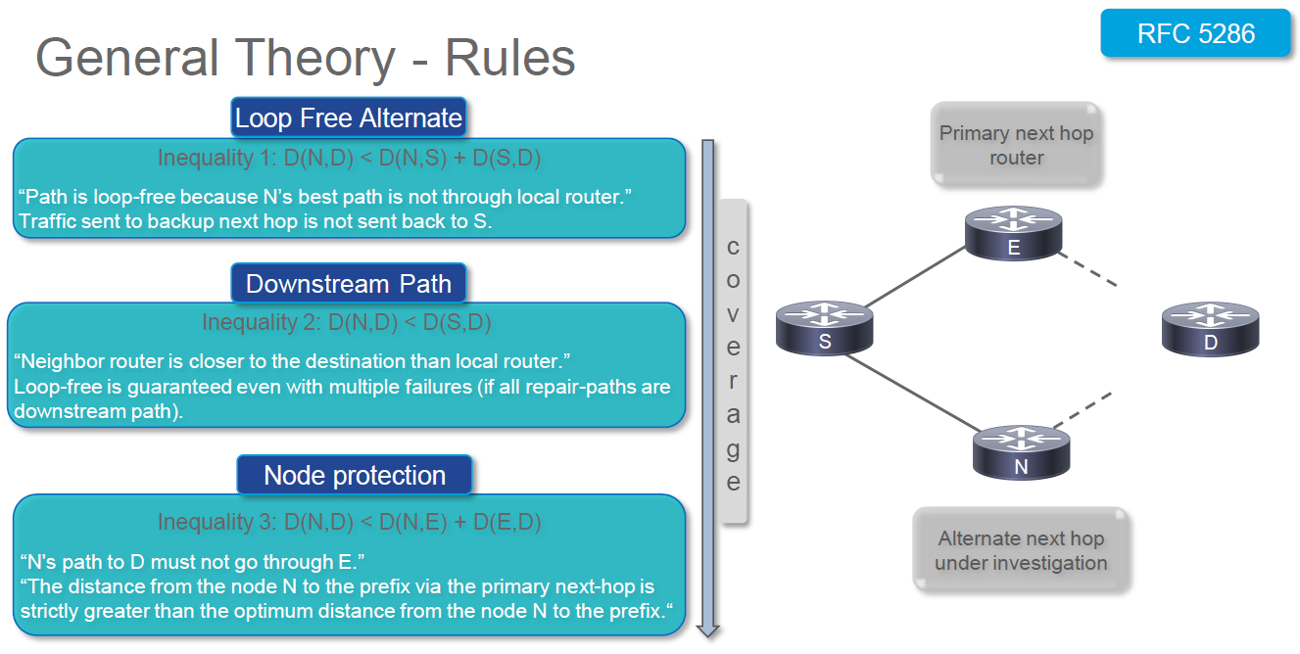
Classic LFA Rules

Slide 65
Classic LFA has partial coverage
Classic LFA is topology dependent: not all
topologies provide LFA for all destinations
– Depends on network topology and metrics
– E.g. Node6 is not an LFA for Dest1 (Node5) on
Node2, packets would loop since Node6 uses Node2
to reach Dest1 (Node5)
→Node2 does not have an LFA for this destination
(no → backup path in topology)
Topology Independent LFA (TI-LFA)
provides 100% coverage
Dest-1
5
X
1
2
3
20
6
7
5
Dest-2
Default Metric : 10
Initial
Classic LFA FRR
TI-LFA FRR
Post-Convergence

Slide 66
Classic LFA and suboptimal path
Classic LFA may provide a suboptimal FRR backup
path:
– This backup path may not be planned for capacity, e.g. P
node 2 would use PE4 to protect a core link, while a
common planning rule is to avoid using Edge nodes for
transit traffic
– Additional case specific LFA configuration would be needed
to avoid selecting undesired backup paths
– Operator would prefer to use the post-convergence path as
FRR backup path, aligned with the regular IGP
convergence
→ TI-LFA uses the post-convergence
path as FRR backup path
PE-4
Dest-1
100
100
5
X
1
2
3
6
7
5
Dest-2
Default Metric : 10
Initial
Classic LFA FRR
TI-LFA FRR
Post-Convergence

Slide 67
TI-LFA – Zero-Segment Example
• TI-LFA for link R1R2 on R1
• Calculate LFA(s)
- Compute post-convergence SPT
- Encode post-convergence path in a SID-list
- In this example R1 forwards the packets towards R5
Prefix-SID Z
Packet to Z
A
Z
1
2
1000
Packet to Z
P-Space
5
Prefix-SID Z
Packet to Z
4
3
Q-Space
Default metric: 10

Slide 68
TI-LFA – Single-Segment Example
TI-LFA for link R1R2 on R1
- Compute post-convergence SPT
- Encode post-convergence path in a SID-list
- In this example R1 imposes the SID-list <Prefix-SID(R4)> and sends packets towards R5
Prefix-SID Z
Packet to Z
A
Z
Packet to Z
1
2
Prefix-SID (R4)
P-Space
Prefix-SID Z
5
Prefix-SID Z
Packet to Z
Packet to Z
4
3
Q-Space
Default metric: 10

Slide 69
TI-LFA – Double-Segment Example
Prefix-SID Z
Packet to Z
A
Z
Packet to Z
TI-LFA for link R1R2 on R1
- Compute post-convergence SPT
Encode post-convergence path in a SID-list
- In this example R1 imposes the SID-list <Prefix-SID(R4), Adj-SID(R4-R3)> and sends packets towards R5
1
2
Prefix-SID (R4)
Adj-SID (R4-R3)
P-Space
Prefix-SID Z
5
Prefix-SID Z
Packet to Z
Packet to Z
4
3
1000
Q-Space
Adj-SID (R4-R3)
Prefix-SID Z
Default metric: 10
Packet to Z

Slide 70
TI-LFA for LDP Traffic
LDP (1,Z)
Packet to Z
A
Z
Packet to Z
1
2
LDP (5,4)
Adj-SID (R4-R3)
P-Space
Prefix-SID Z
5
Prefix-SID Z
Packet to Z
Packet to Z
4
3
1000
Q-Space
Adj-SID (R4-R3)
Default metric: 10
Prefix-SID Z
Packet to Z

Slide 71
Traffic Engineering
MENOG 18

Slide 72
RSVP-TE
• Little deployment and many issues
• Not scalable
  – Core states in k×n2
  – No inter-domain
• Complex configuration
– Tunnel interfaces
• Complex steering
– PBR, autoroute
Does not support ECMP

Slide 73
SRTE
• Simple, Automated and Scalable
  – No core state: state in the packet header
  – No tunnel interface: “SR Policy”
  – No head-end a-priori configuration: on-demand policy instantiation
– No head-end a-priori steering: automated steering
• Multi-Domain
  – SDN Controller for compute
  – Binding-SID (BSID) for scale
• Lots of Functionality
– Designed with lead operators along their use-cases
Provides explicit routing
Supports constraint-based routing
Supports centralized admission control
No RSVP-TE to establish LSPs
Uses existing ISIS / OSPF extensions to advertise link attributes
Supports ECMP
Disjoint Path

Slide 74
RR
SR
PCE
SR
PCE
1.1.1.10
10
11
1.1.1.11
BGP
1.1.1.5
16005
1.1.1.22
16022
1.1.1.3
16003
PCEP
BGP-LS
PCEP
BGP
PCC
PCC
3
5
T:30
22
1.1.1.2
PCEP
BGP
1.1.1.21
BGP
PCEP
2
Domain-1
ISI-S/SR
Domain-2
ISI-S/SR
21
13
14
1.1.1.7
16007
1.1.1.9
16009
1.1.1.23
16023
PCC
PCC
7
9
23
VRF Blue
T:30
VRF Blue
Router-id of NodeX: 1.1.1.X
Prefix-SID index of NodeX: X
Link address XY: 99.X.Y.X/24 with X < Y
Adj-SID XY: 240XY
Default IGP Metric: I:10
Default TE Metric: T:10
TE Metric used to express latency
Domain-1
ISI-S/SR
Domain-2
ISI-S/SR

Slide 75
MAP: Community (100:777) means
“minimize TE Metric” and
“compute at PCE”
MAP: 1.1.1.21/32 in vrf BLUE must receive
low latency service → tag with
community (100:777)
VPN Label : 99999
COMPUTE: minimize TE Metric to Node22
SR
PCE
RESULT: SID list: OIF: to3
RR
PCreq/reply
10
11
BGP:
1.1.1.21/32
via 21
BSID:
30022
3
5
T:30
22
2
13
14
21
7
9
23
VRF Blue
T:30
VRF Blue
Automated Steering uses color extended communities and nexthop to match with the color and end-point of an SR Policy
E.g. BGP route 2/8 with nexthop 1.1.1.1 and color 100
will be steered into an SR Policy with color 100 and end-point 1.1.1.1
If no such SR Policy exists, it can be instantiated automatically (ODN)

Slide 76
SRv6
MENOG 18

Slide 77
SRv6 for underlay
Horrendous states scaling in k*N^2
SRv6 for Underlay
Simplification, FRR, TE, SDN
RSVP for FRR/TE
IPv6 for reach

Slide 78
Opportunity for further simplification
NSH for NFV
Additional Protocol and State
UDP+VxLAN Overlay
Additional Protocol just for tenant ID
SRv6 for Underlay
Simplification, FRR, TE, SDN
IPv6 for reach
Multiplicity of protocols and states hinder network economics

Slide 79
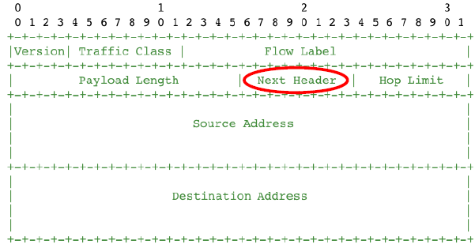
IPV6 Header
Next Header (NH)
Indicate what comes next

Slide 80
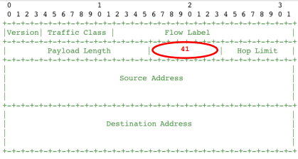
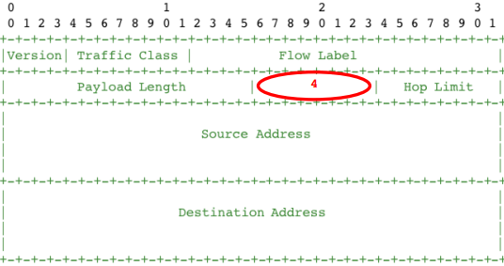
NH=IPv6
NH=IPv4

Slide 81
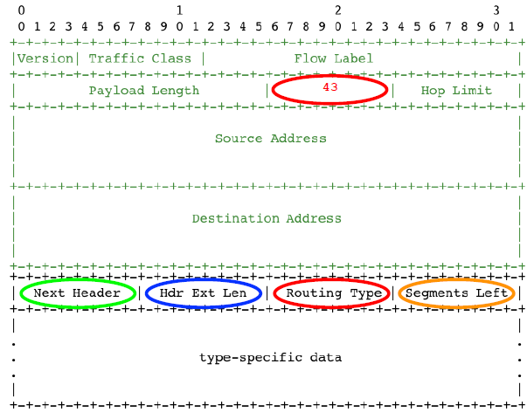
NH=Routing Extension
• Generic routing extension header
  – Defined in RFC 2460
  – Next Header: UDP, TCP, IPv6…
  – Hdr Ext Len: Any IPv6 device can skip this header
  – Segments Left: Ignore extension header if equal to 0
• Routing Type field:
  > 0 Source Route (deprecated since 2007)
  > 1 Nimrod (deprecated since 2009)
  > 2 Mobility (RFC 6275)
  > 3 RPL Source Route (RFC 6554)
  > 4 Segment Routing

Slide 82
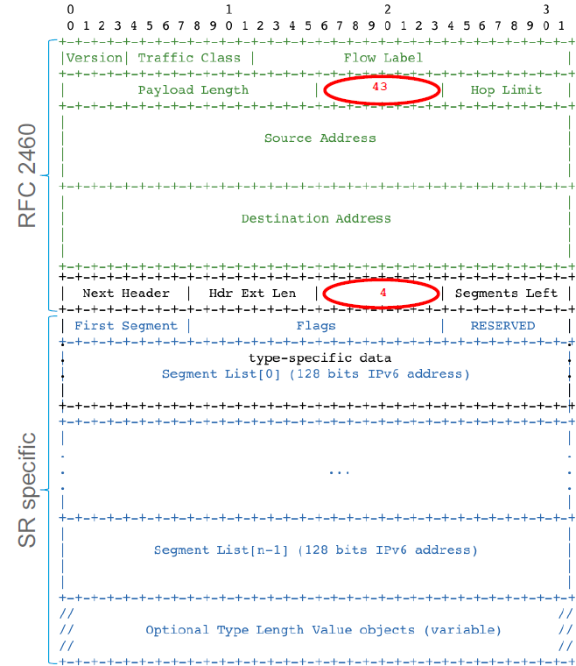
NH=SRv6
  NH=43,Type=4

Slide 83
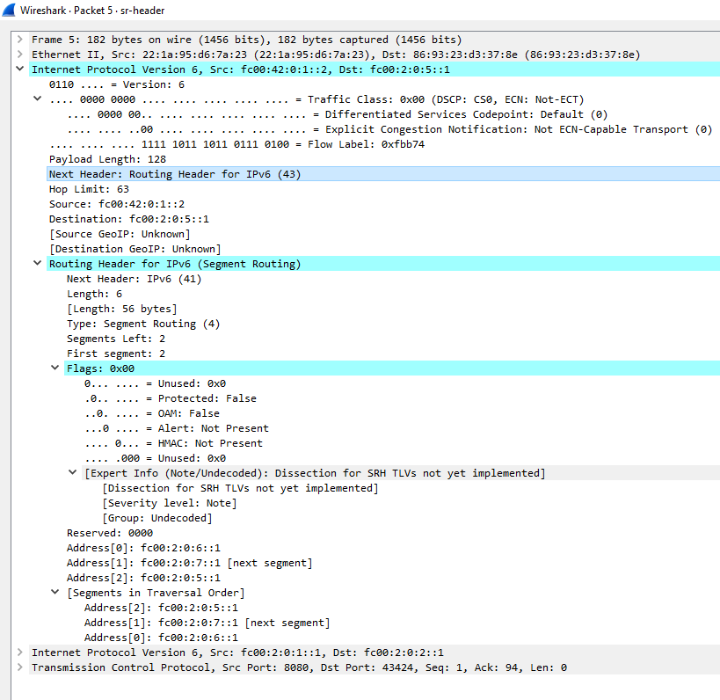
NH=43
Routing Extension
RT = 4
Segment-List

Slide 84
MENOG 18
SRH Processing

Slide 85
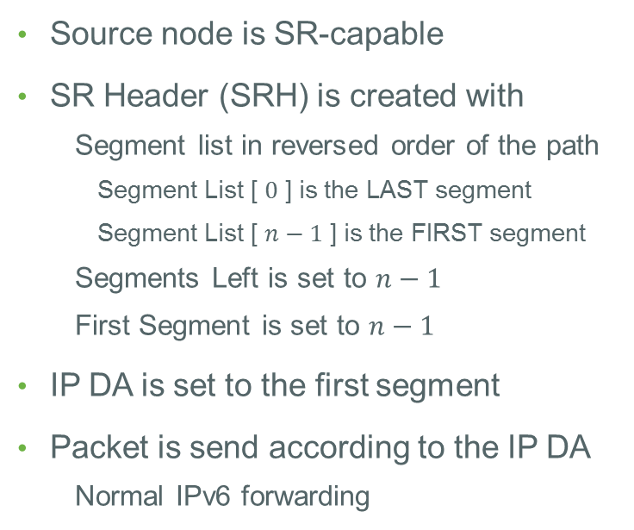
Source Node
1
A1::
2
A2::
3
A3::
4
A4::
Source node is SR-capable
SR Header (SRH) is created with
  Segment list in reversed order of the path
    Segment List [ $0$ ] is the LAST segment
    Segment List [ $n−1$ ] is the FIRST segment
  Segments Left is set to $n−1$
  First Segment is set to $n−1$
IP DA is set to the first segment
Packet is send according to the IP DA
  Normal IPv6 forwarding
IPv6 Hdr
SA = A1::, DA = A2::
SR Hdr
( A4::, A3::, A2:: ) SL=2
Payload
Version
Traffic Class
Flow Label
Flow Label
IPv6 Hdr
Payload Length
Next = 43
Hop Limit
Source Address = A1::
Destination Address = A2::
Next Header
Len= 6
Type = 4
SL = 2
First = 2
Flags
TAG
SR Hdr
Segment List [ 0 ] = A4::
Segment List [ 1 ] = A3::
Segment List [ 2 ] = A2::
Payload
Notes:
Here we assume that the source node is SR-capable.
But of course we are also able to handle cases where the source is either not SR capable or not aware that SR is used at some point in the network. In these cases the SR information can be added later on the path.
We'll see that in the use-case section
Summarized representation of the headers

Slide 86
Non-SR Transit Node
Plain IPv6 forwarding
Solely based on IPv6 DA
No SRH inspection or update
1
A1::
2
A2::
3
A3::
4
A4::
IPv6 Hdr
SA = A1::, DA = A2::
SR Hdr
( A4::, A3::, A2:: ) SL=2
Payload
Notes:
Before reaching 2, the packet may traverse a non-SR transit node.
And this is not a problem at all.
Since the IP DA is A2::, the SR H will not even be looked at before reaching 2.

Slide 87
SR Segment Endpoints
A
A1::
2
A2::
3
A3::
4
A4::
SR Endpoints: SR-capable nodes whose address is in the IP DA
SR Endpoints inspect the SRH and do:
  IF Segments Left > 0, THEN
    Decrement Segments Left ( -1 )
    Update DA with Segment List [ Segments Left ]
    Forward according to the new IP DA
IPv6 Hdr
SA = A1::, DA = A3::
SR Hdr
( A4::, A3::, A2:: ) SL=1
Payload
Version
Traffic Class
Flow Label
Flow Label
IPv6 Hdr
Payload Length
Next = 43
Hop Limit
Source Address = A1::
Destination Address = A3::
Next Header
Len= 6
Type = 4
SL = 1
First = 2
Flags
TAG
SR Hdr
Segment List [ 0 ] = A4::
Segment List [ 1 ] = A3::
Segment List [ 2 ] = A2::
Payload
Notes:
At 2 we have reached the IP Destination Address
At this point the forwarding engine will look at whatever is next in the packet

Slide 88
SR Segment Endpoints
1
A1::
2
A2::
3
A3::
4
A4::
SR Endpoints: SR-capable nodes whose address is in the IP DA
SR Endpoints inspect the SRH and do:
  IF Segments Left > 0, THEN
    Decrement Segments Left ( -1 )
    Update DA with Segment List [ Segments Left ]
    Forward according to the new IP DA
  ELSE (Segments Left = 0)
    Remove the IP and SR header
    Process the payload:
      Inner IP: Lookup DA and forward
      TCP / UDP: Send to socket
      …
IPv6 Hdr
SA = A1::, DA = A4::
SR Hdr
( A4::, A3::, A2:: ) SL=0
Payload
Version
Traffic Class
Flow Label
Flow Label
IPv6 Hdr
Payload Length
Next = 43
Hop Limit
Source Address = A1::
Destination Address = A4::
Standard IPv6 processing
The final destination does not have to be SR-capable.
Next Header
Len= 6
Type = 4
SL = 0
First = 2
Flags
TAG
SR Hdr
Segment List [ 0 ] = A4::
Segment List [ 1 ] = A3::
Segment List [ 2 ] = A2::
Payload

Slide 89
Deployments around the world
Bell in Canada
Orange
Microsoft
SoftBank
Alibaba
Vodafone
Comcast
China Unicom

Slide 90
Deployments in IRAN
IRAN TIC new Network is going to be implemented based on SR

