Slide 1
Internet Service Provider Attack Scenario
MENOG
2018

Slide 2
About me
Mohammad Reza Mostame
Expert in information security
Email: info@rnpg.ir

Slide 3
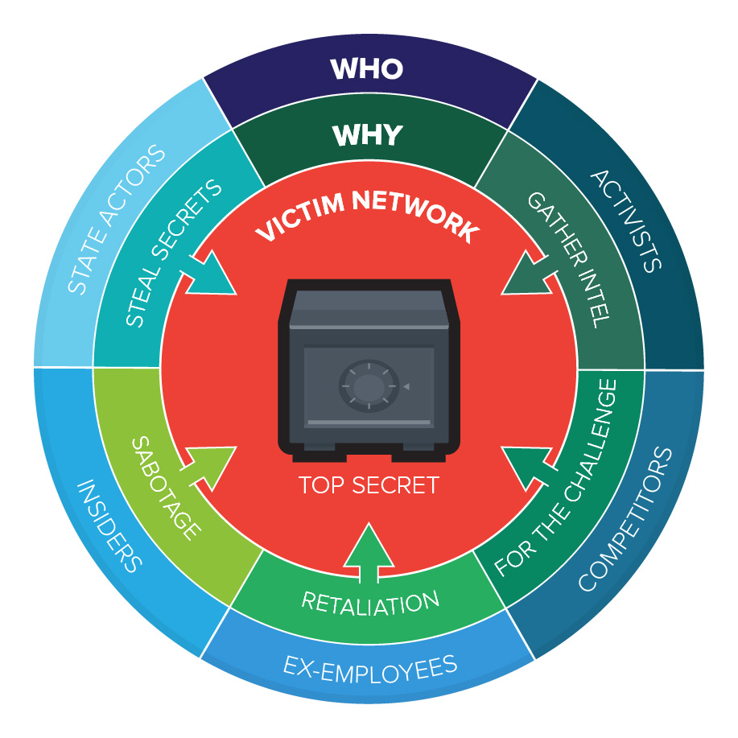
Internet Service Provider threats
Service unavailability
Data leakage
Abuse of network resources
Mohammad Reza Mostame – CTO of RNPG

Slide 4
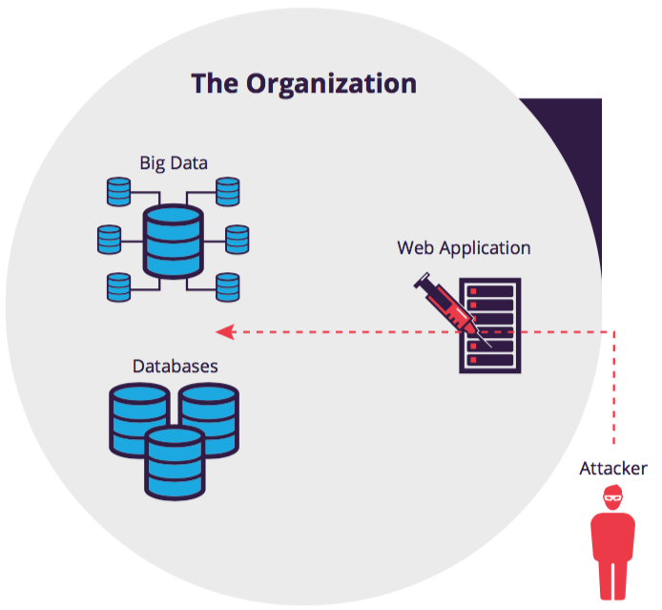
Network access through web applications
Web application vulnerability
SQL Injection
OS access
Privilege escalation
Layer 2 network attack
Mohammad Reza Mostame – CTO of RNPG

Slide 5
Routers access method
monitoring software vulnerabilities
Routers vulnerabilities
Routers misconfigurations
Mohammad Reza Mostame – CTO of RNPG

Slide 6
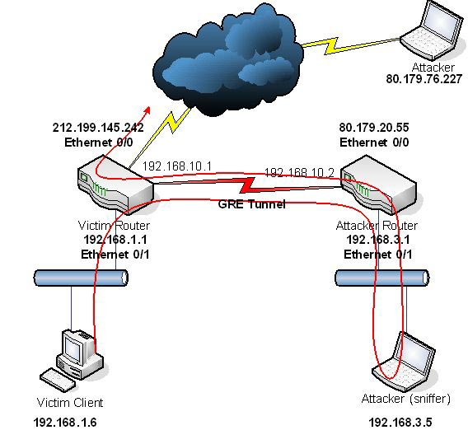
Attack scenario against Internet Service Provider
Getting access to the routers and hijack the network traffic
Mohammad Reza Mostame – CTO of RNPG

Slide 7
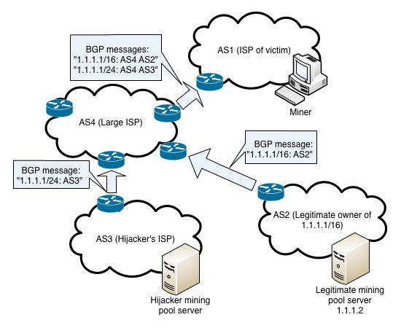
Attack scenario against Internet Service Provider
BGP hijack
Mohammad Reza Mostame – CTO of RNPG

Slide 8
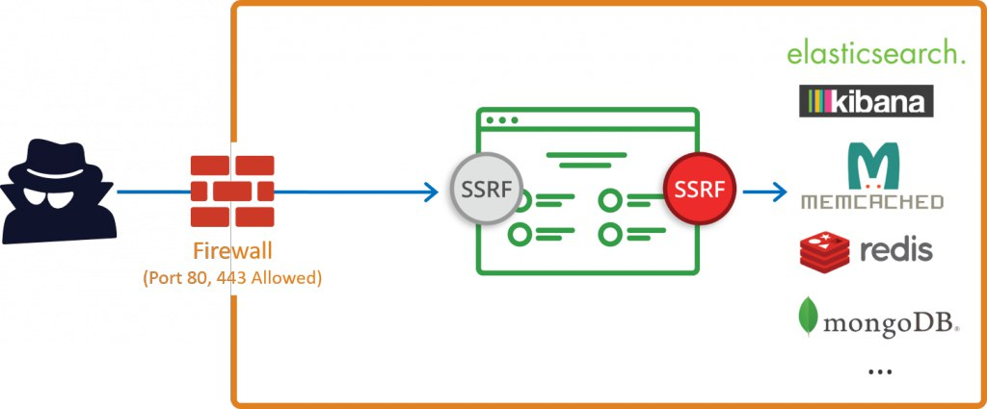
Attack scenario against Internet Service Provider
Remote File Inclusion’s vulnerability leads to Firewall bypass
Mohammad Reza Mostame – CTO of RNPG

Slide 9
Attack scenario against Internet Service Provider
LDAP Injection attack
Pass The Hash vulnerability
Escalate privileges to the administrator in Active Directory
Mohammad Reza Mostame – CTO of RNPG

Slide 10
How to secure the Internet Service Provider’s infrastructure!
Mohammad Reza Mostame – CTO of RNPG

Slide 11
First: Identify threats
Penetration testing can help us to find the threats.
ISP’s threats divided into 4 sections
Web application vulnerability and exploitation
Misuse of Network resources
Misuse of OS vulnerability
Mobile applications threats
Mohammad Reza Mostame – CTO of RNPG

Slide 12
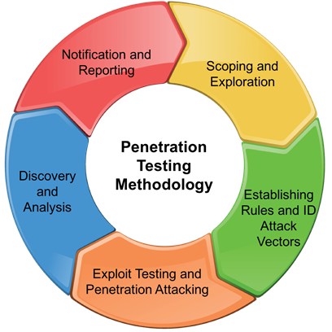
Penetration testing benefits
Preventing Information Loss
Preventing Financial Loss
Protect Your Brand in Market
Essential part of compliance standards or certifications for your business
Mohammad Reza Mostame – CTO of RNPG

Slide 13
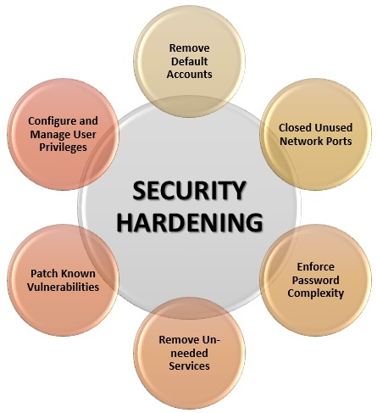
Second: Secure your business
Web application hardening
Network hardening
OS hardening
DLP
Mohammad Reza Mostame – CTO of RNPG

Slide 14
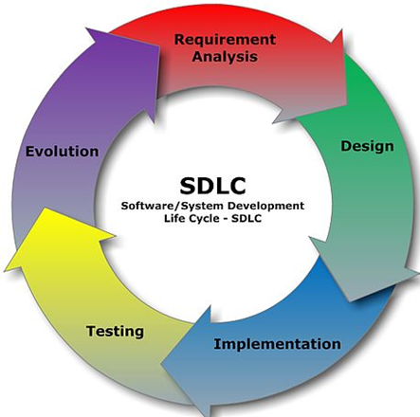
Web application hardening
Runtime Application Self-Protection (RASP)
Web Application Firewall (WAF)
Secure Software Development Life Cycle (SDLC)
Database Firewall (DBFW)
Mohammad Reza Mostame – CTO of RNPG

Slide 15
Network hardening
Service hardening
Device hardening
Intrusion Prevention System & Firewall
Mohammad Reza Mostame – CTO of RNPG

Slide 16
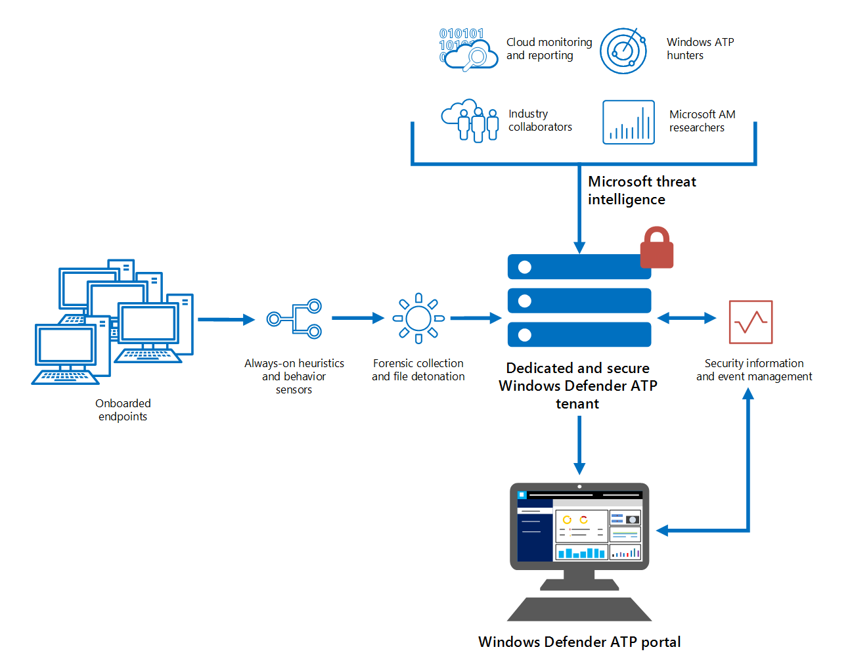
OS hardening
Application hardening
Sandbox
Vulnerability management
Mandatory Access Control (SE Linux)
Mohammad Reza Mostame – CTO of RNPG

Slide 17
Data Loss Prevention
AD RMS (Active Directory Rights Management Services)
Host Based DLP
Network Based DLP
Mohammad Reza Mostame – CTO of RNPG

Slide 18
Defense In Depth
Mohammad Reza Mostame – CTO of RNPG

Slide 19
Questions and Answer
Thanks
http://rnpg.ir

