Slide 1
Proactive Network Protection Through DNS
S. Alireza Vaziri
Notes:
Hello
In next 20 minutes I’m going to talk how to use DNS to protect your network and users from common attacks.

Slide 2
Agenda
Today Security Challenges
Methods of Network Protection
DNS and DNSSEC
DNS RPZ
Threat Intelligence
Machine Learning Classifier
Notes:
We are facing dozens of security challenges these days in our network, unpatched machines getting involved in botnet activities, some of our clients sends spams and uneducated users get caught in phishing attacks.

Slide 3
Me
Alireza Vaziri
Network Engineer
Security Practitioner
Notes:
We are facing dozens of security challenges these days in our network, unpatched machines getting involved in botnet activities, some of our clients sends spams and uneducated users get caught in phishing attacks.

Slide 4
Today’s Headache
Botnets
Spams
Phishing
🤕
Notes:
We are facing dozens of security challenges these days in our network, unpatched machines getting involved in botnet activities, some of our clients sends spams and uneducated users get caught in phishing attacks.

Slide 5
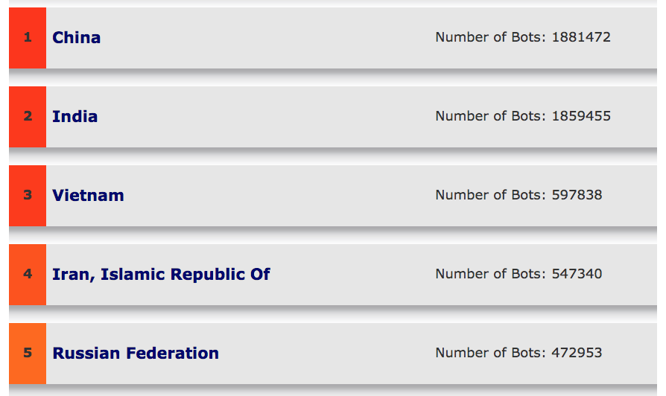
Worst Botnet Countries 🤦🏻‍♂️

Slide 6
Are we secure? NO!
Firewall
IDPS
Antivirus
Patch Management
Technical Malware Controls
Notes:
Are we secure?
No!

Slide 7
RIP DPI
Resource Hungry
Everything is Encrypted
Polymorphic Malwares
🧐
Notes:
Let’s accept that DPI is dead, since everything is encrypted deep down and with today’s bandwidths you have to spend tens of thousand of dollars on a single DPI appliance. What about malwares? Modern malwares change themselves as they distribute, so it is hard to detect new types of traffic with signature based models.

Slide 8
NetFlow Based Botnet Detection
Flow Based Analysis on malware traffic
Machine Learning based prediction
Notes:
I have tired to control botnet activities using ML and NetFlow, analyzing malicious flow and training the machine to find similar flows.
Mainly it detects botnet activity at IP layer. But something was missing in detection method, most of modern malwares use DNS for their activities.
You can find the talk in RIPE75 archive.

Slide 9
Malware Distribution URLs
afobal.cl
alvoportas.com.br
bestdove.in.ua
blogerjijer.pw
bright.su
dau43vt5wtrd.tk
domnicpeter.in.net
dzitech.net
fadzulani.com
hruner.com
☠️
Notes:
As I have mentioned, most of the modern malwares use domain names` to distribute and connecting back to their command and control server. This is a little portion of Zeus botnet.

Slide 10
😣

Slide 11
DNS-Based Malware Control
Fast
Cheap
Easy to deploy
Notes:
As long as most of the networks have their own DNS server, protecting network and users with existing infrastructure wouldn’t be a noticeable cost for the network operators.

Slide 12
DNS is vulnerable by design
Stateless Query
Easy to hijack
No integrity check
RFC 3833
Notes:
Before protecting your users from malwares, we have to make sure that our DNS infrastructure is safe. DNS, one of the key role in internet is vulnerable by design. Unfortunately DNS queries are prone to hijacking and a MITM could redirect a user to malicious IP, despite the user have typed the correct address. RFC 3833 has some of the threats that DNS have.
So what is the solution?

Slide 13
DNSSEC
Answers are signed
Resolver check integrity
Notes:
DNSSEC is a security extension to the legacy DNS. It make sure that DNS answers to queries haven’t been manipulated during transit in network by signing the answers with keys. As long as DNS servers are using DNSSEC we are sure that users are being directed to legitimate IP address of the website. But what about malicious domains that we don’t want our users have access to?

Slide 14
DNS RPZ (Response Policy Zone)
Zone being updated periodically
Check Query and Response for malicious records
Return bad domains with NXDOMAIN
Redirect user to custom page
Block C&C, Phishing, Malware
✋🏻
Notes:
DNS RPZ or Response Policy Zone, DNS Server check a custom zone to see if users query or response is listed in the zone. It returns NXDOMAIN to the user or redirect user to a custom page for educational purpose. It protects users from visiting malicious websites or connecting to a CnC server.

Slide 15
BIND RPZ
response-policy { zone "rpz"; };
$TTL 300
@ IN SOA localhost. need.to.know.only. (
201802121 ; Serial number
60 ; Refresh every minute
60 ; Retry every minute
432000 ; Expire in 5 days
60 ) ; negative caching 1 minute
IN NS LOCALHOST.
example.com IN CNAME .
*.example.com IN CNAME .
Notes:
This is a simple BIND RPZ configuration which block example.com

Slide 16
DNS Success Stories
Quad9
OpenDNS
CloudFlare
Notes:
These are the services that have protected users for FREE! But you can keep your data in house using your local DNS server.

Slide 17
😄

Slide 18
Zone Update
Automatic Multiple Source (Blacklists)
Manually added hosts
AXFR/IXFR
Notes:
So how do we update the zone? RPZ could be updated automatically and manually from different sources.

Slide 19
Local Threat Intelligence
Detecting New Malicious Domain
Holding Reputation Score (ASN, IP, Domain)
Notes:
`

Slide 20
Background Check
Alexa Rank
Google Page Rank
Number of subdomain
Number of – and .
Domain age in WHOIS
PTR record
ASN
👮🏻
Notes:
I have started to do a background check on domains that have been queried to my DNS server. These data helped me to create reputation score based on fetched data.

Slide 21
Protect Top Hosts from Phishing
Shaparak.ir
Bankmellat.ir
Bmi.ir
Tamin.ir
🎣
Notes:
These are some of the most popular websites that have been under heavy phishing attack, and unfortunately hundreds of identity and credit card data have been stolen from unaware users.

Slide 22
Fuzzy Logic
Used in Google search
Notes:
Some of the phishing domains are similar to their legitimate one. Fuzzy logic is the one that google uses for it’s search recommendation. When you type something wrong, it suggest you the correct term. These typos might get user getting into phishing attacks.

Slide 23
Machine Learning
Dataset from Phishtank and RBLs
Domain Background Check
Train and Test data
🧠
Notes:
There are thousands of malicious domains in public blacklists, So I have fetched them and gather data for reputation score. Based on the data I have trained a ML model to detect new malicious domains based on the trained model.

Slide 24
Query Logs
# rndc querylog
Notes:
In BIND you have to enable logging for queries (It has severe effect on performance)

Slide 25
Procedure
Blacklist fetching
Fetch Extra Data
Train ML model
Check DNS logs
Add new domains to list

Slide 26
KNN Classifier
Domain Type | Trusted | Malicious
Dataset | 1000 | 700
KNN | 10 | 6
Train/Test | 50/50 | 50/50
Accuracy | 85.7% | 82.2%

Slide 27
What is missing?
DNS RPZ is not a total solution (Domain Fronting)
RPZ cannot control direct IP connectivity
RPZ cannot control URLs
Notes:
There is no single security solution to secure your network, RPZ could add another layer of defense to your network. As long as request goes through DNS server, RPZ could help, but for any reason if traffic being redirected from DNS server, you don’t have any control over it with your DNS server. Detecting and analyzing URLs is playing major role in phishing detection, which you cannot do it with DNS server.

Slide 28
What do we need?
Public Threat Intelligence feed
STIX, TAXII, CybOX
Public Resolver
Shadowserver
Notes:
We Desperately need a Public Threat Intelligence Feed to handle cyber attacks, I ask our network providers, Please do something!

Slide 29
Publish
https://github.com/aliereza/MLDNS
Notes:
We Desperately need a Public Threat Intelligence Feed to handle cyber attacks, I ask our network providers, Please do something!

Slide 30
Questions?

