Slide 1




Impact of Carrier-Grade NAT
on Web Browsing
Ali Safari Khatouni
Enrico Bocchi
Stefano Traverso
Alessandro Finamore
Valeria Di Gennaro
Marco Mellia
Maurizio Munafò
Dario Rossi
Notes:
Do we need the pictures?

Slide 2


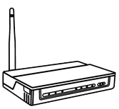


NAT at a glance - Traditional NAT44
Internet
10.0.0.1
Home NAT
10.0.0.2
128.130.90.61
10.0.0.*
10.0.0.3
Public IP address
worldwide unique
registered addresses
Private IP addresses
unregistered addresses

Slide 3
NAT at a glance - Traditional NAT44
Internet
10.0.0.1
Home NAT
10.0.0.2
128.130.90.61
10.0.0.*
10.0.0.3
Public IP address
worldwide unique
registered addresses
Private IP addresses
unregistered addresses

Slide 4
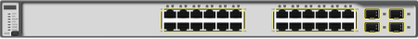
…and Carrier Grade NAT – NAT444
Internet
Carrier Grade NAT
Home NAT
ISP subnet becomes a large private network
Home routers are assigned private IPs
The amount of required public addresses is reduced as well as cost
ISP Subnet

Slide 5
Carrier Grade NAT (CGN)
The deployment of CGN has some implications:
Breaks the end-to-end IP connectivity
Introduces reachability problems for NAT-ted devices
  Need of successful NAT traversal techniques
  Updates of non-NAT friendly applications
Mandates the network keeps the state of the connections
Impacts negatively lawful intercept
May have performance implications
Our investigation goals
  Does CGN impact users’ browsing experience?
  Are there any benefits in not having a public IP?
  Answer with measurements

Slide 6
Methodology
Notes:
Do we need the pictures?

Slide 7
Methodology roadmap
Large scale passive measurement
  A real ISP deployment
  Customers are offered public or private address
  Traffic monitored to extract performance metrics
Leverage statistical tools
  Collect and compare empirical probability distributions
  Check and assess eventual differences
Focus on
  Web traffic and performance

Slide 8









Monitoring Scenario
ISP Point of Presence
Private Addresses
Internet
Carrier-Grade
NAT
Public Addresses
Passive Probe
Dataset
  1 month of real traffic recorded, October 2014
  17,000 household monitored, 40% with public IP address
  1.7Billion TCP flows, 0.7Billion HTTP requests
http://tstat.polito.it

Slide 9
Measurements
Household
Server
Passive Probe
T_{SYN}
SYN
RTT
SYN-ACK
TWHT
T_{Establish}
ACK
T_{Request}
HTTP GET
ACK
TTFB
T_{Response}
HTTP RESPONSE
THROUGHPUT
Time
T_{Last}

Slide 10
Assessing the Impact of CGN
Consider 9 performance metrics
Measure distinct probability distributions for each metric
  Tied to private and public households
Jensen-Shannon Divergence
Quantify the difference between a pair of probability distributions
Based on the Kullback-Leibler divergence
  Symmetric
  Bounded to finite value

Slide 11
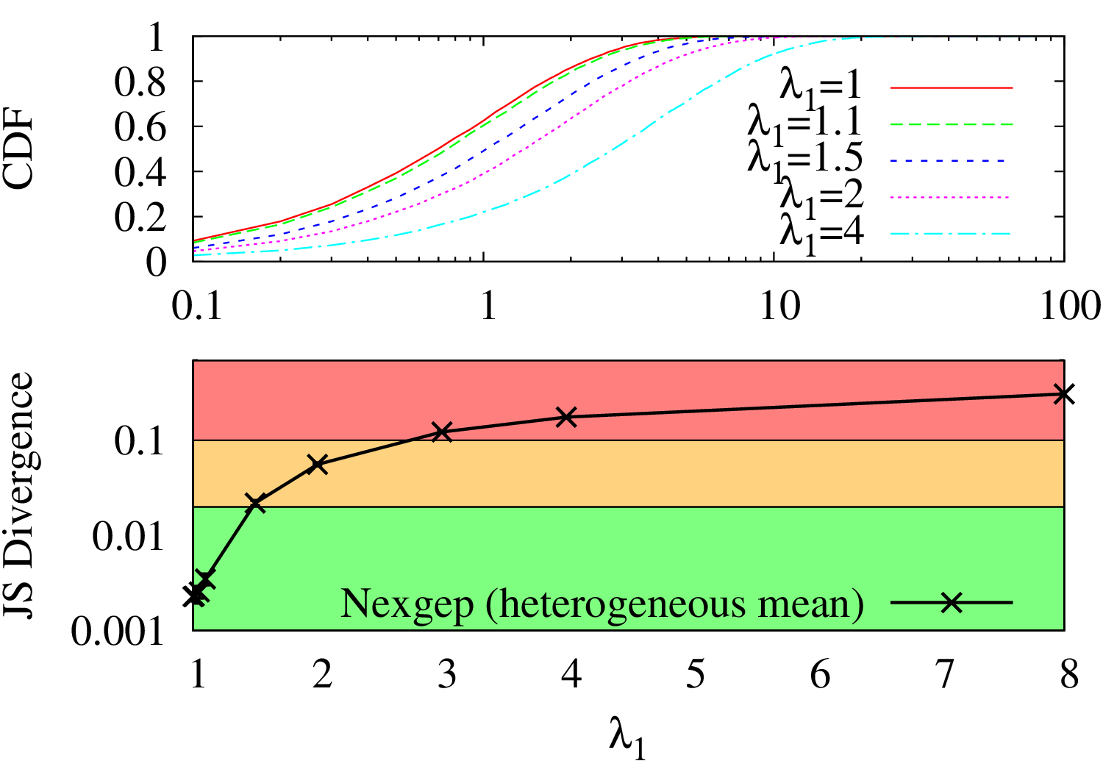
Jensen-Shannon Calibration
Need of a threshold to discriminate between
significant and negligible differences
Calibration with:
Negexp CDF
λ₀ = 1, fixed
λ₁ varies [1 ÷ 8]

Slide 12
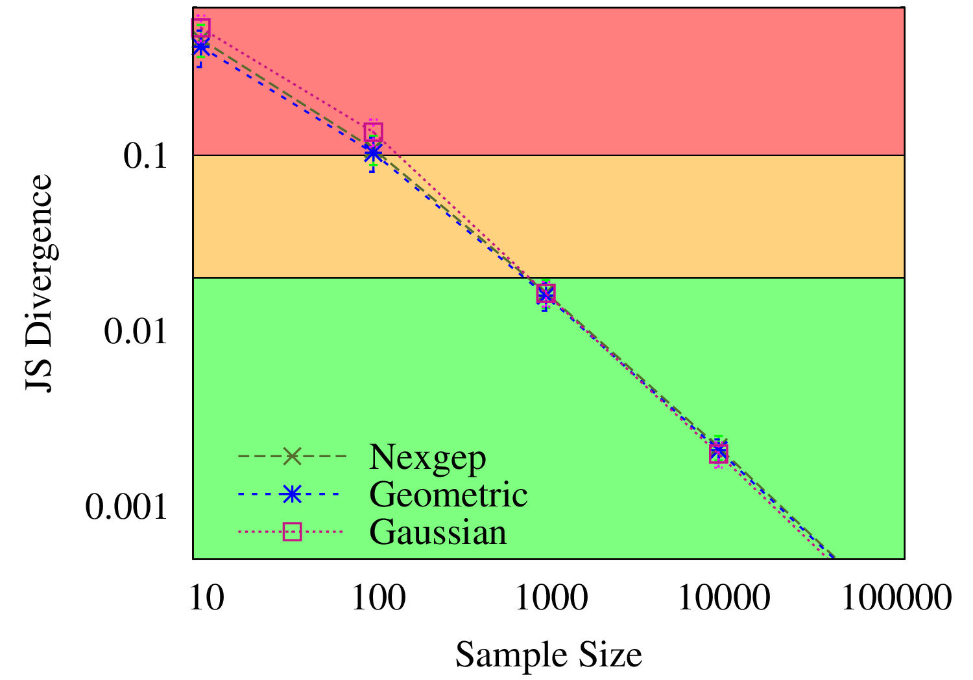
Jensen-Shannon Calibration
Recommendations to avoid bias:
Tool calibration to avoid measurement artifacts
Adequate binning strategy
Relevant population size
Distribution samples
are TCP flows
Dataset
  1.7B TCP flows
  0.7B HTTP requests

Slide 13
Performance Metrics Analysis
Notes:
Do we need the pictures?

Slide 14
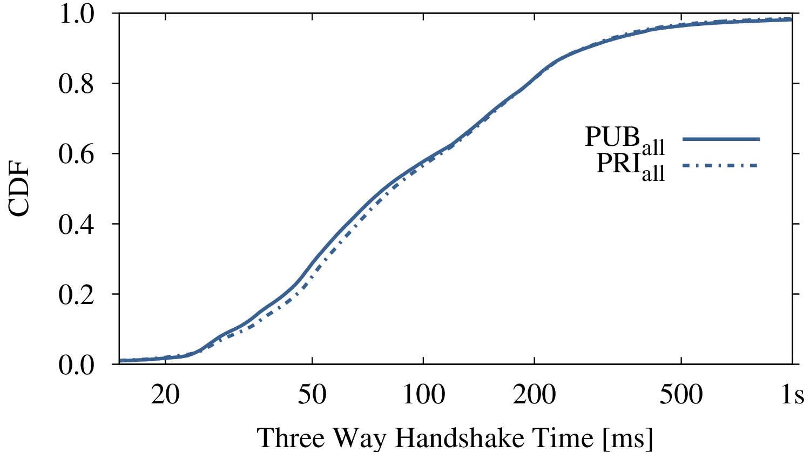
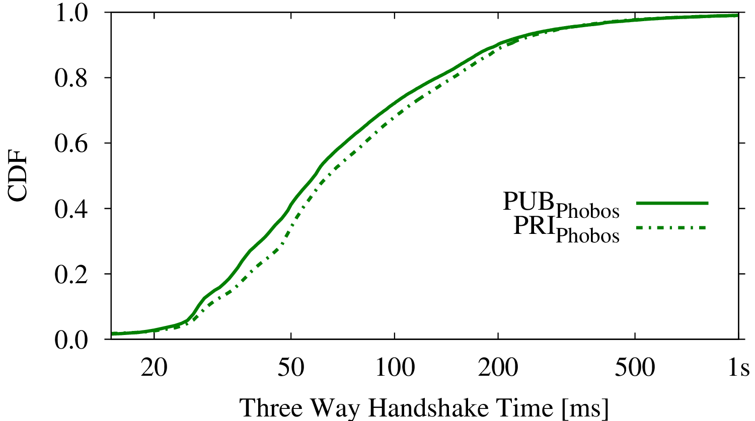
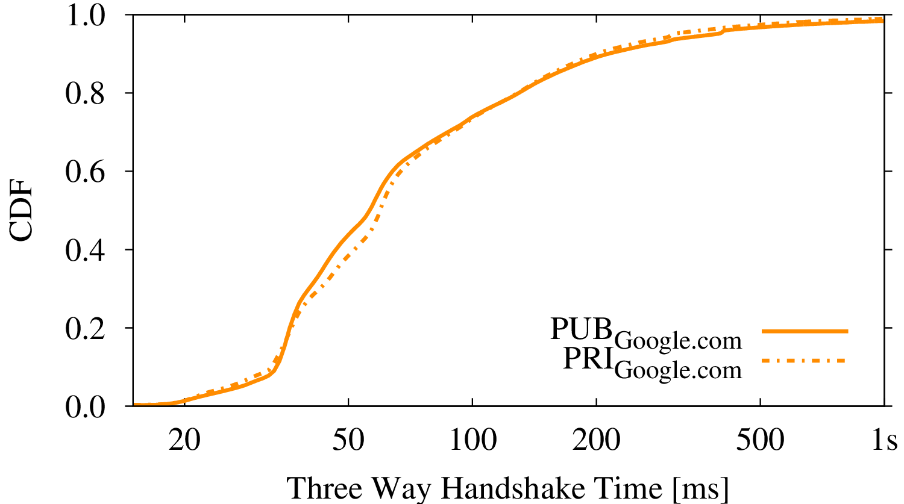
Performance Metrics – TWHT
Service | JS Div
All | 0.002
Phobos | 0.016
Google.com | 0.010
Three Way Handshake Time (TWHT)
  Any remote server (all)
  iTunes contents (phobos.apple.com - Akamai)
  Google Search (Google.com)

Slide 15
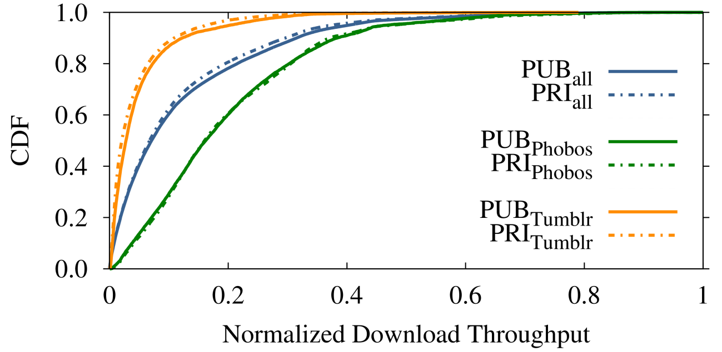
Performance Metrics – Throughput
Three Way Handshake Time (TWHT)
Download Throughput
  Any remote server (all)
  iTunes contents (phobos.apple.com - Akamai)
  Tumblr Blogging Platform (Tumblr.com)
Service | JS Div
All | 0.001
Phobos | 0.022
Tumblr | 0.021

Slide 16
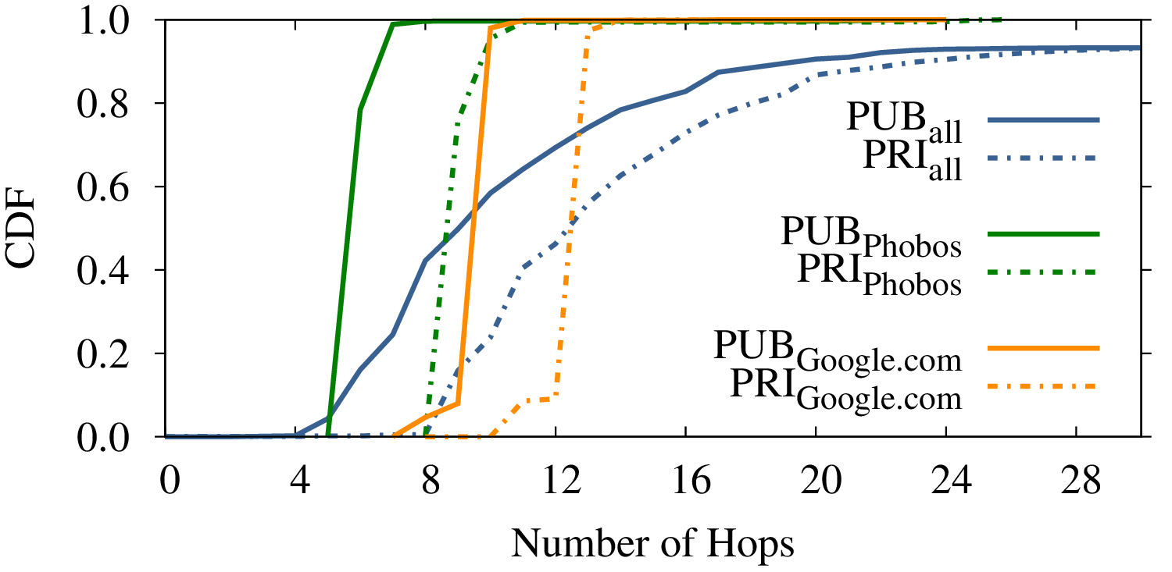
Performance Metrics – Number of Hops
Three Way Handshake Time (TWHT)
Download Throughput
Number of Hops
  Any remote server (all)
  iTunes contents (phobos.apple.com - Akamai)
  Google Search (Google.com)
Service | JS Div
All | 0.223
Phobos | 0.689
Google.com | 0.666
Only metric showing
noteworthy differences
4 hops more for private customers
Affecting any service being contacted

Slide 17
Jensen-Shannon Results
Three intervals identified
  Significant differences JS_{div} ≥ 0.1
  Noticeable differences 0.02 ≤ JS_{div} < 0.1
  Negligible differences JS_{div} < 0.02
Metric | Any Server | Google.com | Phobos.com
Number of Hops | 0.223 | 0.666 | 0.689
Latency (RTT) | 0.001 | 0.006 | 0.007
Establish (TWHT) | 0.002 | 0.010 | 0.016
HTTP 1st (TTFB) | 0.002 | 0.006 | 0.006
Throughput | 0.001 | - | 0.022
Number of SYN | <0.001 | <0.001 | <0.001
Out of Sequence | <0.001 | - | -
Duplicates | 0.001 | 0.001 | <0.001
Our investigation goals
  Does CGN impact users’ browsing experience?
We observe no significant impact
  Are there any benefits in not having a public IP?

Slide 18
Benefits of having a
Public / Private IP address
Notes:
Do we need the pictures?

Slide 19
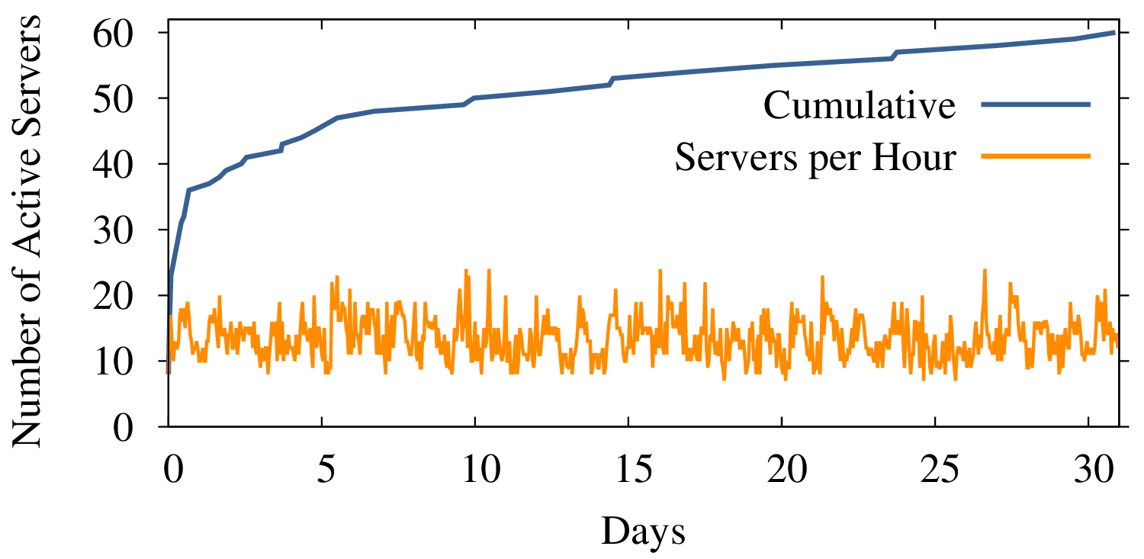
Active Servers
Does the customer need IPv4 reachability?
  Is there any ISP customer running a server at home?
Detection technique
Look for customers answering at least one incoming connection
  Protocols: HTTP(S), IMAP(S), POP(S), SMTP(S)
  No P2P
Only 0.6% of customers
runs servers at home

Slide 20
Saving in IP addresses using NAT
How many active IP are present?
  Assume an idle timer of 5min at the CGN
  Active: generated one connection in the last 5min
Customer base: ~17000
Max concurrently active: ~7000
Saving due to CGN: ~60%

Slide 21
What about PAT?
How many concurrent connection?
  Concurrent: active in the past 5 min
95% have less than 600
99% have less than 2400
Worst case have more than 20000
Possible saving (with 65k ports)
95% ok => 100x
99% ok => 27x
Worst case => 1x

Slide 22
Conclusions
Goal: assess the impact of CGN on users’ web browsing
  Large scale passive measurements
  Multiple performance metrics considered
  Jensen Shannon to pinpoint relevant statistical differences
CGN does not harm users’ web browsing
Current investigations
  How to correctly dimension CGN and
  what is the saving in IPv4 address?
  Is there any implications on P2P traffic?

Slide 23



Questions?
ali.safari@polito.it
http://www.ict-mplane.eu
Notes:
Do we need the pictures?

Slide 24

Unsolicited Traffic
What about unsolicited traffic?
How many home routers are victims of port-/net- scans?
?
Private Addresses
Carrier-Grade
NAT
Public Addresses
Compile a list of potential attackers
  Remote hosts sending TCP-SYN messages to more than 50 IPs in the PoP
Focus on destination ports with well-known services or vulnerabilities

Slide 25
Unsolicited Traffic
Destination Port | Description | Percentage of victims in PoP
 |  | PRI | PUB
80 | HTTP | 1.8 | 78.5
443 | HTTP Secure (HTTPS) | 0.1 | 78.9
143 | Internet Message Access Protocol (IMAP) | <0.1 | 79.3
995 | Post Office Protocol (POP3 over SSL) | <0.1 | 79.2
25 | Simple Mail Transfer Protocol (SMTP) | 0.1 | 79.0
22 | Secure Shell (SSH) | <0.1 | 79.2
135 | MS Remote Procedure Call | <0.1 | 79.3
3389 | MS Windows Remote Desktop | 0.1 | 79.3
1433 | MS SQL Server | 0.1 | 79.3
3306 | MySQL Server | 0.1 | 79.3
445 | MS Active Directory | <0.1 | 79.2
Our investigation goals
  Does CGN impact users’ browsing experience?
  Are there any benefits in not having a public IP?
0.6% of customers needs IPv4 reachability
Public IPs are 80x more likely to be victim of attacks

