Slide 1
Anycast CDN
Ahmad Reza Mollapour
ArvanCloud
MENOG 18 - Tehran
April 25, 2018

Slide 2
What are we talking about?
#MENOG18

Slide 3
Traditional CDN vs. Modern CDN
#MENOG18

Slide 4
GeoDNS
#MENOG18

Slide 5
GeoDNS with ECS
#MENOG18

Slide 6
IP Anycast
#MENOG18

Slide 7
Complexity
#MENOG18

Slide 8
5000+
2,500,000,000
Websites
Requests
#MENOG18

Slide 9
Web Request Share of Iranian Websites Worldwide
Continent | Percent
Europe | 64.2%
America | 23.9%
Asia | 7.1%
Oceanic | 4%
Africa | 0.7%
Antarctica | 0.1%
#MENOG18

Slide 10
Web Request Share of Iranian Websites in Asia
Area | Percent
Middle East | 74%
Other Asian Countries | 24%
#MENOG18

Slide 11
Middle East Web Request Share for Iranian Websites
Country |  | Percent
 | United Arab Emirates | 51.6%
 | Turkey | 26.1%
 | Iraq | 8.5%
 | Saudi Arabia | 5.1%
 | Kuwait | 4.4%
 | Qatar | 1.1%
 | Oman | 0.6%
 | Egypt | 0.5%
 | Syria | 0.4%
 | Lybia | 0.3%
 | Bahrain | 0.2%
 | Cyprus | 0.2%
 | Jordan | 0.1%
 | Palestine | 0.06%
 | Yemen | 0.02%
Place | Service Provider
1 | Turk Telecom
2 | Emirates Telecommunications Corporation
3 | EarthLink Iraq
4 | Turkcell
5 | SaudiNet
#MENOG18

Slide 12
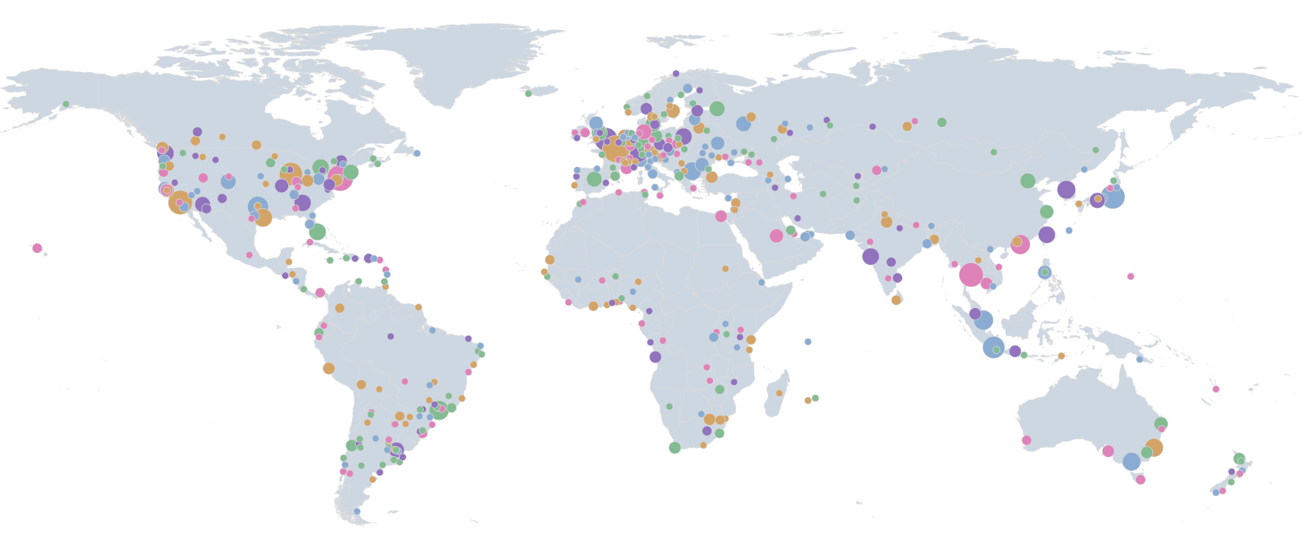
Worldwide IXP Distribution
#MENOG18

Slide 13
Common Internet Exchange Points
Exchange Point | Exchange Point
DE-CIX Frankfurt | IX Australia NSWNSW-IX
DE-CIX Madrid | IX Australia VICVIC-IX
AMS-IX | JPIX OSAKA
IX.br Rio de Janeiro | JPIX TOKYO
IX.br São Paulo | NAP Africa IX Johannesburg
Equinix Ashburn | BBIX Tokyo
Equinix Chicago | Boston Internet Exchange
Equinix Dallas | MegaIX Melbourne
Equinix Hong Kong | MegaIX Sydney
Equinix New York | NYIIX
Equinix Singapore
Equinix Sydney
Equinix Tokyo
SIX Seattle
CoreSite - Any2 California
#MENOG18

Slide 14
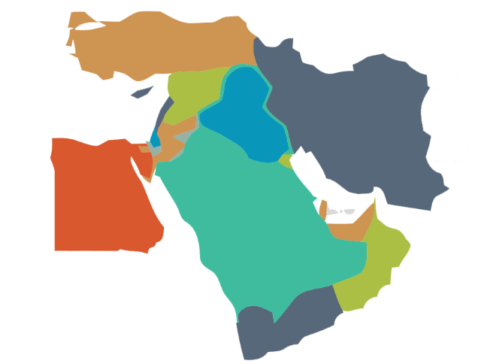
No Common IXP in Middle East !
#MENOG18

Slide 15
Middle East IXPs
Country | City | IXP | Peer | Amazon | ArvanCloud | CloudFlare | EdgeCast | CacheFly | Fastly | Incapsula
United Arab Emirates | Dubai | UAE-IX by DE-CIX | 54 | × | × | × | × | × | × | ×
Iran | Tehran | Tehran-IX | 44 | × | ✔ | × | × | × | × | ×
United Arab Emirates | Fujairah | SmartHub-IX | 18 | × | × | ✔ | × | × | × | ×
Turkey | Istanbul | DE-CIX Istanbul | 17 | × | × | ✔ | × | × | × | ×
Egypt | Cairo | MiddleEast-IX | 10 | × | × | × | × | × | × | ×
Iran | Shiraz | Shiraz-IX | 10 | × | ✔ | × | × | × | × | ×
Turkey | Istanbul | IST-IX | 8 | N/A | N/A | N/A | N/A | N/A | N/A | N/A
Iran | Mashhad | Mashhad-IX | 7 | × | ✔ | × | × | × | × | ×
Iran | Tabriz | Tabriz-IX | 6 | × | ✔ | × | × | × | × | ×
Egypt | Cairo | Cairo-IX | 4 | × | × | × | × | × | × | ×
Bahrain | Manama | GatewayGulf-IX | 3 | × | × | × | × | × | × | ×
Cyprus | Lefkosia | Cyprus-IX | 3 | × | × | × | × | × | × | ×
Saudi Arabia | Riyadh | SaudiArabia-IX | N/A | N/A | N/A | N/A | N/A | N/A | N/A | N/A
#MENOG18

Slide 16
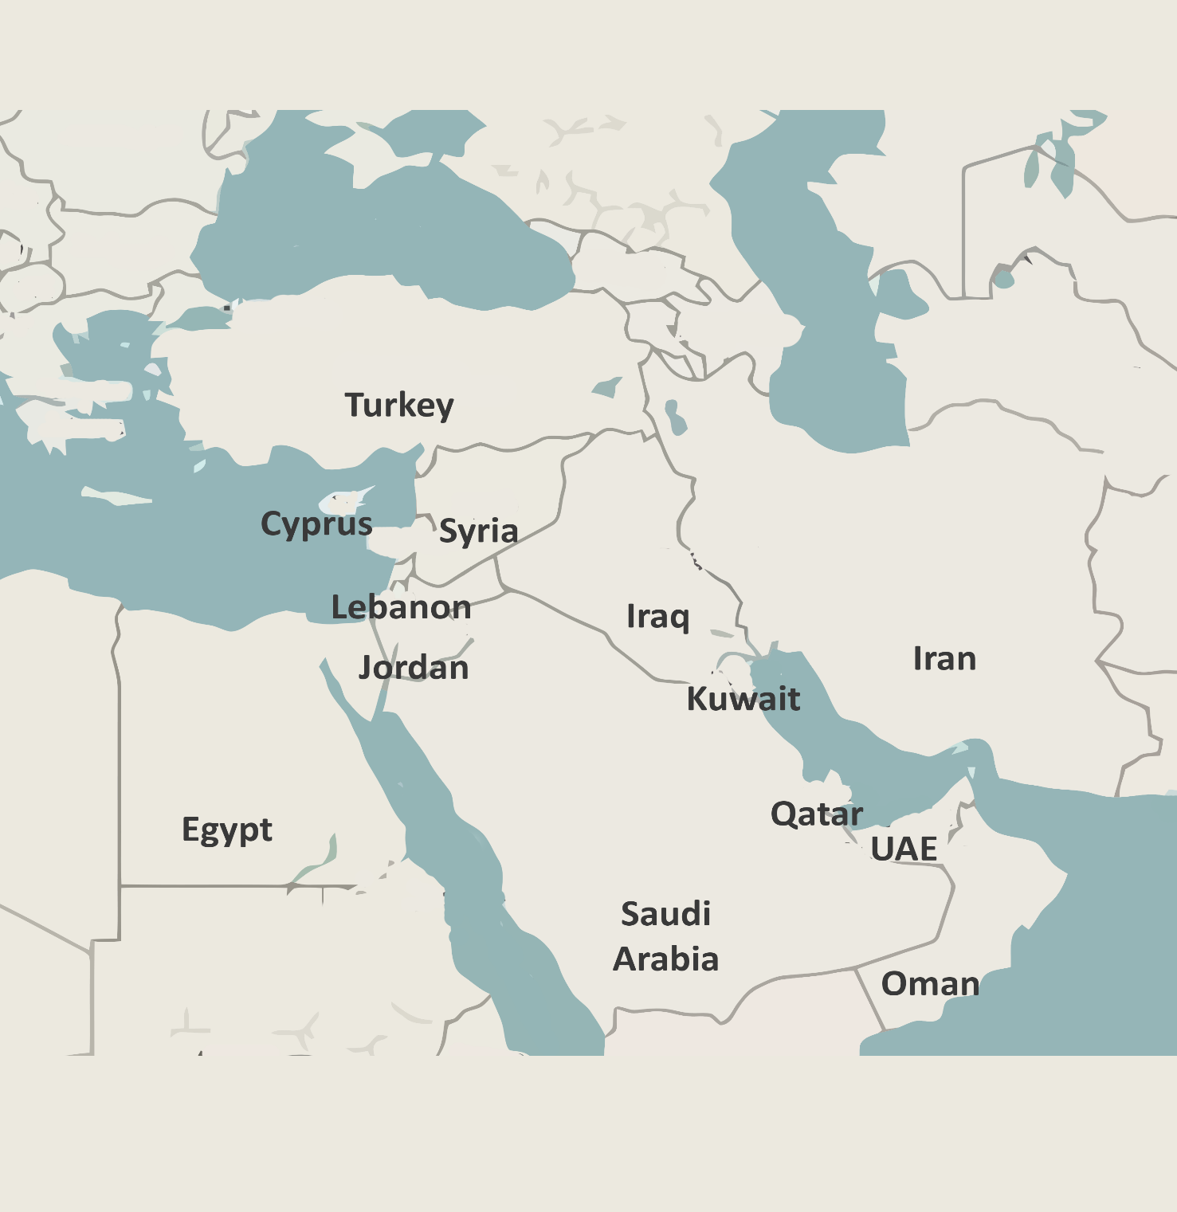
Iran
155
ms
184
198
122
ms
150
ms
190
ms
1 ms
Latency to Other Countries
#MENOG18

Slide 17
Turkey
101
155
ms
88
91
ms
150
ms
143
ms
1 ms
Latency to Other Countries
#MENOG18

Slide 18
United Arab Emirates
143
ms
180
190
ms
158
330
ms
1 ms
150
ms
Latency to Other Countries
#MENOG18

Slide 19
EU
NA
113.1
ms
230.1
ms
SA
AS
284
ms
305.8
ms
OC
354.1
ms
#MENOG18

Slide 20
Reduce Latency by Peering in Local IXPs
#MENOG18

