Slide 1
IPv6 Implementation Challenges in Iran

Slide 2
HELLO!
I am Shahin Gharghi
I am IPv6 enthusiast.
Shahin@Gharghi.ir
Notes:
Work for R&D department of Asiatech

Slide 3
Agenda
Transition Steps
Challenges for implementation
Statistics after implementation
Problems
Notes:
Pass quickly on transition mechanisms

Slide 4
TRANSITION STEPS
Phases for implementing IPv6 in a fixed service provider
Notes:
I chose dual-stack for every service. Because I didn’t to impact other services and we have time

Slide 5
Two Factors for Finding Priorities
Significance
A service with more users will have more IPv6 traffic.
Complexity
If implementation complexity is too much, it is better to postpone it for the end.
Notes:
How to eat an elephant? Cut it in smaller pieces and eat it
We have several services and we needed to categories them and get them priority

Slide 6
Notes:
We moved services with less complexity and more importancy at first

Slide 7
Challenges
Difficulties in IPv6 implementation

Slide 8
Every provider needs to get permission from security authorities before advertising IPv6
Notes:
Security permission

Slide 9
Provider Cooperation
TIC doesn’t advertise IPv6 by default
Notes:
We had many problems in peering on v6 with TIC

Slide 10
Devices Don’t Support IPv6
Cisco as BRAS
Some of RADIUS attributes are not supported
PCEF
Charging asked for new module and extra charge for supporting IPv6
CPEs
Most of ADSL modems don’t support IPv6
Notes:
Cisco cannot understand some IPv6 radius attributes although it is supported by RFC
Our PCEF support asked for money and an update to support IPv6
Many CPEs do not support IPv6 or they don’t support every function

Slide 11
AAA IPv6 Awareness
AAA needs to save 2 extra attributes
Framed-IPv6-Address
Delegated-IPv6-Prefix
AAA should has IPv6 Address Management for assigning static IPv6 to customers
Notes:
The most challenge was AAA
And there is no AAA to fully support IPv6 and also see it as a product

Slide 12
Training Staff
Training staff is time/money consuming
People are not motivated in learning IPv6
Notes:
The most time consuming is training staff. Also when they don’t like to learn new technologies and don’t know why should they learn

Slide 13
IPv6DR Logs
There is no NAT
We need a copy of traffic for saving logs
Multiple IPs
There are multiple IPv6s per user
Notes:
We have to have IPv6DR log like IPDR but it needs to pass whole traffic into a device or send a copy of it and

Slide 14
Statistics
Statistics after implementing IPv6
Notes:
We were keen to see the statistics

Slide 15
ONLY 0.5%
Of broadband users asked for IPv6 connectivity

Slide 16
IPv6 Usage by Broadband Users
Notes:
The IPv6 usage of broadband users in

Slide 17
82,000 USERS
20,000 USERS
6,000 USERS
Switched to dual-stack
Were ready to use IPv6
Asked for Delegated IPv6 Address
Notes:
The hard part was ADSL users because of AAA and PCEF but we made it

Slide 18
IPv6 Usage by ADSL Users
Notes:
This is internet usage of ADSL users after one month

Slide 19
Potentially IPv6 Traffic
Instagram
About 30% of Iran’s internet traffic goes to Instagram servers
Telegram
Telegram is the most popular messenger in Iran, having around 25% of Iran’s total traffic.
Google
Many websites use Google libraries, besides, there are many customers for google services like Gmail in Iran.
Notes:
25% goes to Telegram
30% goes to Instagram
Many websites use google services

Slide 20
WHY
don’t we have much traffic?!
Yellow
Is the color of gold, butter and ripe lemons. In the spectrum of visible light, yellow is found between green and orange.

Slide 21
Happy Eyeballs
Yellow
Is the color of gold, butter and ripe lemons. In the spectrum of visible light, yellow is found between green and orange.
50ms time for DNS
250ms time for first response
Notes:
We figured out that we have much delay

Slide 22
ADSL Latency
Last Mile
Transmission
International
Notes:
An ADSL Latency divides into 3 parts

Slide 23
Last Mile
ADSL link latency is between 6ms to 100ms
Average RTT is about 40ms
Notes:
From customer CPE to Telco

Slide 24
Transmission
Datacenter to Province
It is usually VPLS served by TIC
Province to Telco
It is different in every province.
Mostly MPLS served by TCI
Notes:
We have 31 provinces that they have multiple cities and telco centers

Slide 25
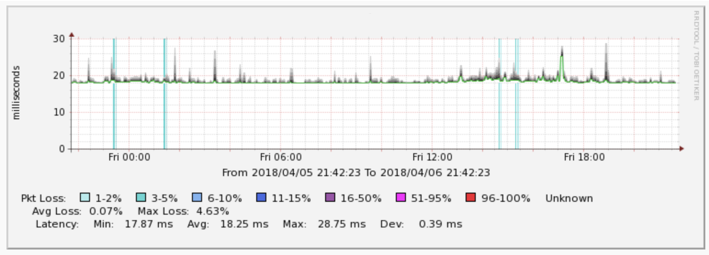
TIC VPLS
Transmission
International
Average RTT of VPLS is 20ms

Slide 26
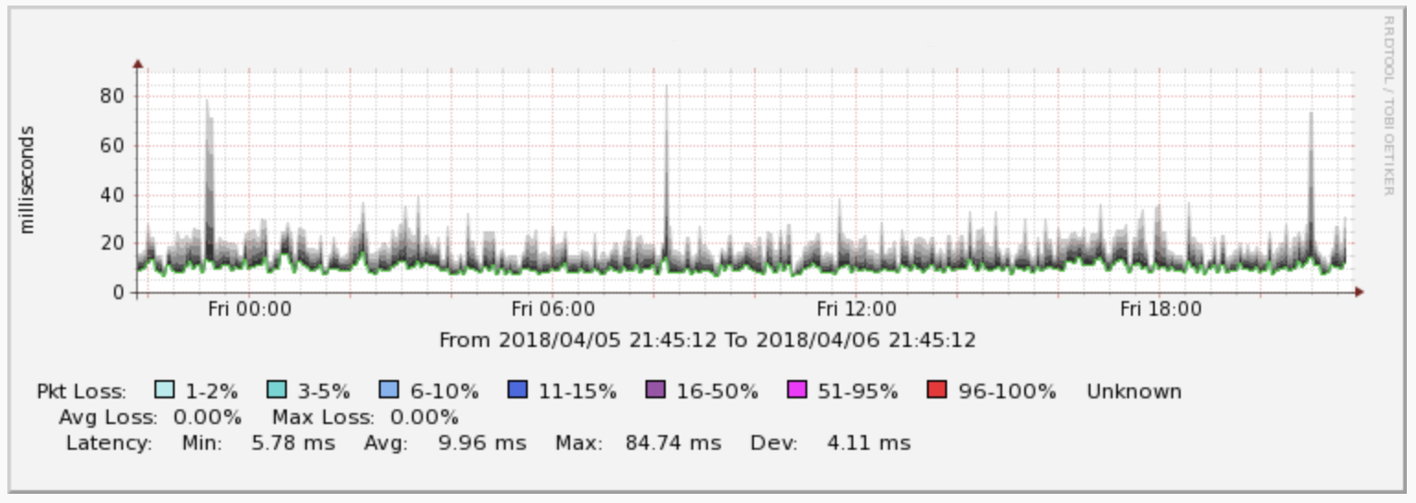
Provinces MPLS
Transmission
International
Average RTT of MPLS is 10ms

Slide 27
International Links
Only one provider
There is only one provider in Iran.
Two networks: AS12880, AS48159
Several international providers
It is possible to access various international providers via TIC.
No international CDN
International CDNs cannot have a local cache because of sanctions.
No peering with neighbors
TIC has no peering in neighbor countries.
Notes:
We have only one provider with very low quality
Several International providers that customer can’t choose
International CDNs can’t go to Iran because of sanctions
TIC seems doesn’t like peer in neighbor IXPs

Slide 28
RTT to Instagram
Notes:
Measurment from Iranian probes to Instagram

Slide 29
RTT to Telegram
Notes:
Measurment from Iranian Probes to Telegram
Also most of probes are hosted in datacenters not over ADSL links

Slide 30
RTT to Iran From Various Countries
Notes:
Simple latency monitor from various countries to Iran

Slide 31
NO IPv6 in Datacenter
TIC does not accept IPv6 traffic for datacenters at all
Notes:
Content is very important but no v6 on datacenter
There are two types of internet with TIC doesn’t peer on v6 with Datacenter Internet

Slide 32
Good News is we can peer on IPv6 in IXP
Notes:
We can peer on IPv6 and increase traffic

Slide 33
THANKS!
Any questions?
You can find me at:
@shahin.gharghi
Shahin@Gharghi,ir

