Slide 1
Capacity Building
List of available online course and tutorials

Slide 2
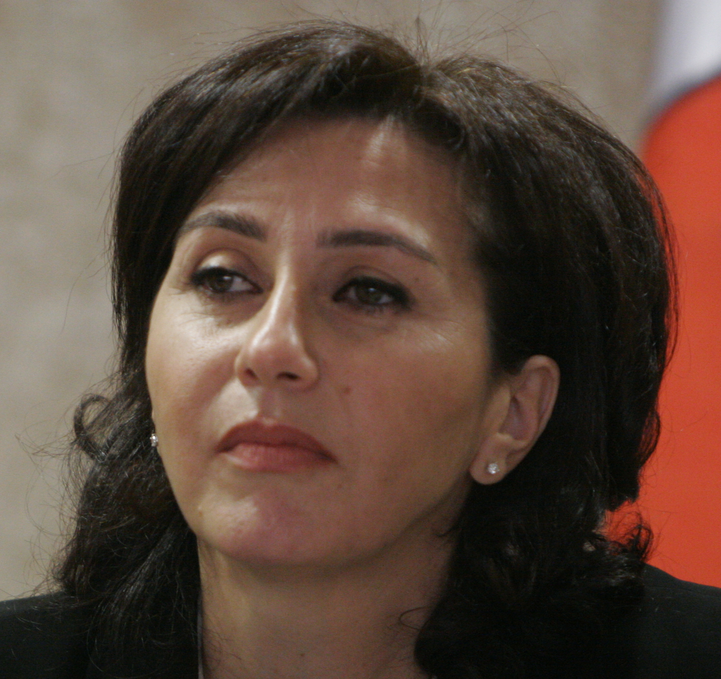

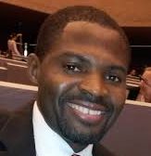
Middle East Regional Bureau
Established in November 2016
  Arab Workshop @ IGF 2016
  IXP Best Practices workshop in Beirut 24-25 March 2017
  Middle East Chapters Workshop 19-21 April 2017
  2 regional calls; several one on one calls and meeting
- Strategic Objectives
  Empowering chapters and members
  Strengthening Government Relationships
  Address Gender Gap
  Improve Participation in the Digital Economy
  Build the Middle East Technical Community
  Engagement through partnerships with governments, civil society, and private sector

Slide 3
How can we spread technical know how
Internet Society has several online courses of interest to the technical community
These courses are administered through a blended/hybrid model to combine online learning with face-to-face (over Zoom) class time in a structured manner.
A local moderator to groups of 8 people or more. The groups come together to discuss the material in the online courses.
The Internet Society is looking for moderators for the following courses

Slide 4
Building Computer Security Incident Response Teams (CSIRTs)
The goal of this online course is to provide high-level guidance on the scope, motivation and importance of establishing Computer Security Incident Response Teams (CSIRTs), and covers the process of setting up CSIRTs from all relevant perspectives such as business management, process management and the technical perspective. The topics covered in this course are as follows:
Background on CSIRTs
Planning for a CSIRT
Developing the Business Plan
Promoting the Business Plan
Operational and Technical Procedures
Training the Staff
Practical Example of a CSIRT Task
Languages Available: English

Slide 5
Building Wireless Community Networks
This course provides a solid foundation on how to build wireless community networks to foster collective endeavor through a shared, intangible network. It covers important topics such as wireless network standards, radio physics, practical network planning, IP network administration, radio device configuration, securing wireless networks, and others. The modules in this course are as follows:
Wireless Networking Standards – IEEE
Radio Physics
Radio Link
Introduction to Networking
The Network Layer
Routing
The Upper Layers
Network Topologies and Infrastructure
Radio Device Configuration
How to Make Wireless Networks Secure
Example of Access Point Configuration
Troubleshooting a Wireless Network
Languages Available: English (Spanish and Russian currently in development)

Slide 6
Combating Spam and Mobile Threats
This course focuses on the growing use of mobility to access the Internet, the risks of becoming infected by malware, spreading botnets, redirecting Internet traffic to malicious websites, hijacking cloud and hosting services and inserting spyware onto computers and handheld devices. It shows how the risk increases and impacts countries and users who are unaware or under prepared to address the problem of spam and malicious threat. The course will provide you with a better understanding of the online and mobile threats facing governments, businesses and consumers today. This course includes the following modules:
Introduction to Spam
Malware and Botnets
Phishing
Domain Name System and Internet Protocol Exploits
Mobile Threats
Languages Available: English and Spanish

Slide 7
Digital Footprints
These online tutorials were developed to help you not only learn about your digital footprint, but help you make the right choices to take back control of your online identity. There are nine (9) tutorials in this series:
What is a Digital Footprint?
Why Did We Start Leaving Such Big Footprints?
What is the Economic Bargain for Internet Users?
Are Digital Footprints a Problem?
Do Different Devices Make Different Digital Footprints?
How Can I Manage My Digital Footprints?
Who Is Tracking Me and How Do They Do It?
What Dynamics are at Work in the World of Digital Footprints?
How Does Legislation Affect Digital Footprints?
Languages Available: English, French, Spanish, Bahasa and Urdu

Slide 8
Introduction to Network Operations
This introductory online course is targeted at novice/entry level UNIX/Linux users pursuing careers in Network or System Administration. The course is practically oriented and guides the trainee step by step on how to install and setup a working UNIX server, connect it to the Internet and then run a caching Domain Name System (DNS) server in a virtualized environment. The techniques covered in the course are applicable in real world environments to setup Internet-ready caching DNS servers. It is a foundation course that provides trainees with necessary skills to allow them to progress to more advanced topics in the future. The topics covered in this course are as follows:
Introduction to UNIX
FreeBSD Installation
Networking
Working with FreeBSD Ports
Working with the UNIX Shell
Editing with VIM
Introduction to Shell Scripting
DNS Fundamentals
Domain Name System
Languages Available: English, French and Spanish

Slide 9
Shaping the Internet – History & Futures
This course provides an overview of Internet governance touching on key areas such as its history, policy principles, actors and stakeholders, infrastructure, regulatory frameworks, multilingualism, cybersecurity, and others. The course also discusses and analyses the multi-stakeholder model, examines the developmental aspects of Internet governance, and looks at the collaborative nature of achieving Internet security and resilience. The modules that comprise this course are as follows:
History of the Internet
Internet Invariants
Introduction to Internet Governance
Internet Actors and Stakeholder Groups
Internet Policy Principles
Infrastructure
Regulatory Frameworks
Internet Governance for Development
Multilingualism and Internationalization
Legal Aspects of Internet Governance
Cybersecurity and Resilience
Languages Available: English, French, Spanish and Portuguese

Slide 10
25 Under 25
The search is on. Who is #thenext25?
25 Under 25 will identify and spotlight the next generation of Internet leaders to advance our mission.
Nominations open now through 31 May.
Awardees will join us in Los Angeles for the Internet Hall of Fame Induction Ceremony and InterCommunity.
Their participation will include the Collaborative Leadership Exchange and unparalleled networking.
internetsociety.org/25th/25-under-25
Notes:
Collaborate with our Chapters, global community, and universities to identify 25 exceptional next generation Internet leaders under the age of 25.
Use as a catalyst to drive youth engagement in Chapters and in the Internet Society
Create a media campaign to highlight their work using the #ShineTheLight style photography and short descriptors
Bring the 25 young leaders to the Internet Hall of Fame ceremony to network with the IHOF Inductees

Slide 11
For more information on how to become a moderator please contact
Salam Yamout yamout@isoc.orgamout@iscg
Niel Harper harper@isoc.org

