Slide 1

Introduction to du
Emirates Integrated Telecommunications Company (du) opened for business in 2006. du offers mobile and fixed telephony, broadband connectivity and Internet Protocol Television (IPTV) services to individuals, homes and businesses.
Vision
Enhance customers’ lives - any time, anywhere.
Mission
Delight customers, be the employer of choice for the best talent, create optimal value for their shareholders through business excellence and innovation, and proudly contribute to the transformation of the community.
Talent
Skills
Energies
Connect, Inspire and reward all it touches, every day

Slide 2
WHY IPv6 ?
1.A : IPv4 public IP’s depletion
As our network and services expand we will need more public IPv4 IP’s & the IPv4 Pool available with IANA is nearly depleted resulting in the IPv4 public IP’s being costly and unavailable.
Du Public IP Range | Jan-17
5.X.X.X/17 | 89%
5.X.X.X/15 | 57%
80.X.X.X/16 | 63%
87.X.X.X/15 | 38%
91.X.X.X/14 | 73%
94.X.X.X/13 | 68%
213.X.X.X/19 | 91%
Total Utilization | 68%

Slide 3
1.B IPv4 private IPs depletion
Private IPv4 IP’s segment available is also limited and we will be facing difficulties in expanding our internal networks if we keep relying on IPv4 IPs on the long run.
Du Private IP Range | Jan-17
172.X.X.X/12 | 12%
10.X.X.X/8 | 70%
3x 192.X.X.X/16 | 0%
Total Utilization | 64%

Slide 4


2) Business new trends and the new concepts:
Like IOT (Internet of Things), IOE (Internet of Everything) , M2M (Machine to Machine) and Smart Cities that are expected to connect huge number of devices to the internet and will need huge number of IPs that cannot be accommodated by current capacity of IPv4 IPs.

Slide 5
3) Ability to provide wider ranges of useable IPs to our enterprise customers which means potential for new business opportunities.
4) To enhance security the NATTING proportion b/w the Private to Public IP’s in the network needs t be reduced. This requires huge numbers of Public IP’s to be purchased which were not available with RIPE & acquiring the same from Open market would incur huge costs.
This will be resolved with the induction of the IPv6 in the Network as this will eliminate the issue of IP scarcity.

Slide 6
IPv6 Transition Approach
Save on IPv4
Address Consumption
Offer IPv4 /IPv6 Dual Stack
Post
Dual Stack strategy
Private & Public IPv4 optimization
Enabling IPv6 in Core, Edge and IGW
DS-Lite
Implement centralized BNG model for all fixed residential
Reclaim poorly-used
IPv4 address blocks
Continue Using Private IPv4 for mobile data with NAT
Migrate the Mobile IPv4 addresses allocation to MPLS/VPN
Use 6vPE / 6PE in the IP Core layer.
Enable IPv6 DS on the BNG for fixed residential
Enable IPv6 DS on the Mobile GWs for mobile users
Enable IPv6 DS for enterprise customer on the Service edge
NAT-64
DNS-64
Xlat-464

Slide 7
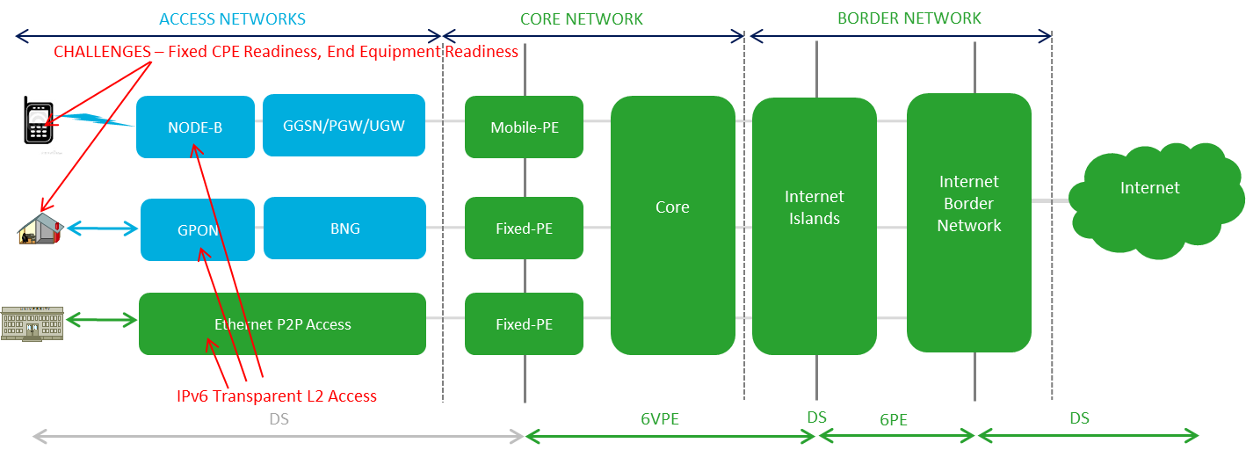
Where we are today
Network Layers Supporting IPv6 Service
Network Layers currently under testing for IPv6 Service
Notes:
6PE and 6VPE both are MPLS based
6PE provides global IPv6 reachability over IPv4 MPLS. It allows one shared routing table for all other devices. 6VPE prefixes is still the IPv4 address that is used for IPv4 L3 VPN routes (6VPE is VRF based)

Slide 8
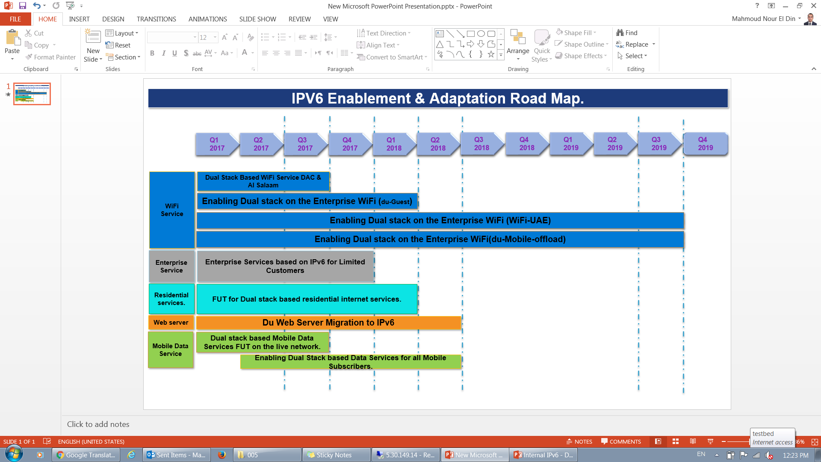
IPv6 Adaptation Road Map

Slide 9
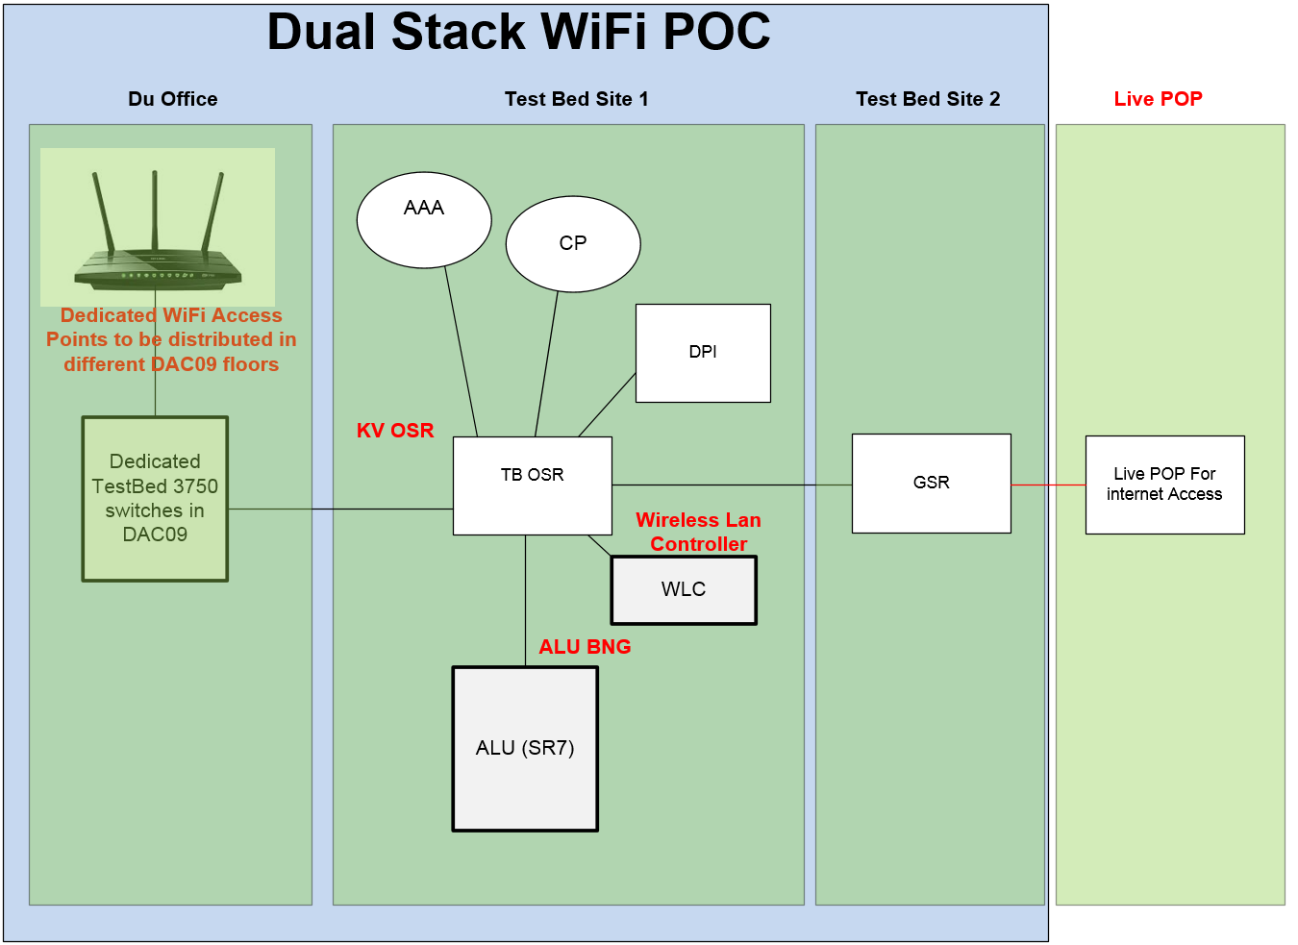
Success Stories
1.Dual Stack WiFi POC
All the Offices in Du were equipped with additional WiFi AP’s providing dual stack (IPV6/IPV4) access to the internet. The objective of this exercise was to test end user experience with dual stack browsing while using different terminals.
It will also serve as a Launching pad for the full scale WiFi Deployment planned this year.

Slide 10
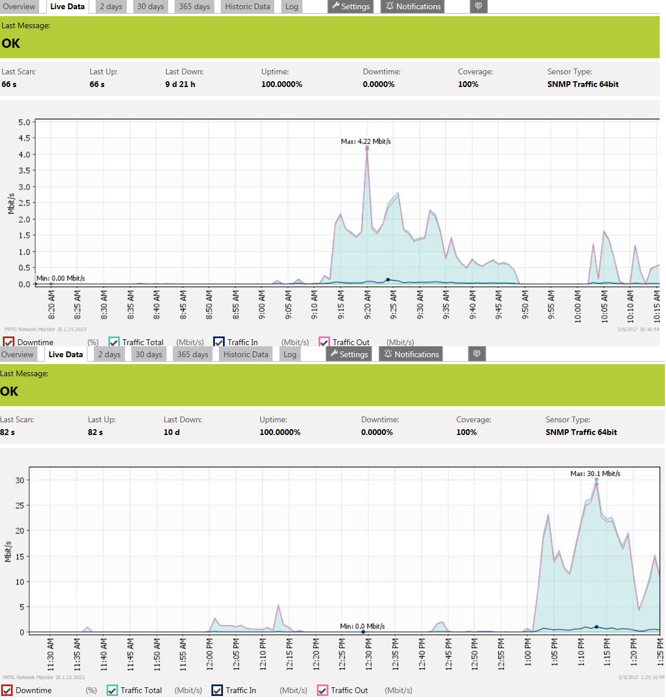
Traffic Statistics

Slide 11
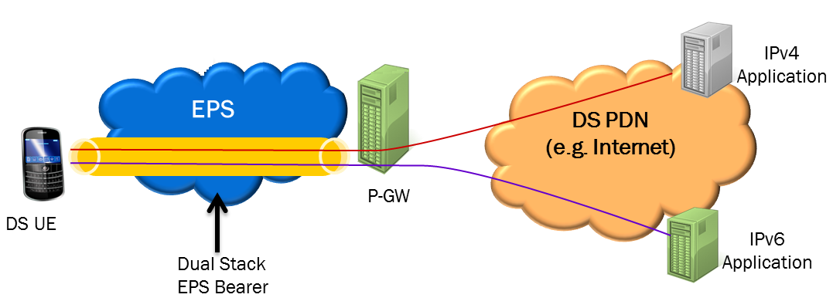
2.Dual Stack based Mobile Data Browsing FUT
One of the Major Service impacted by IPv4 exhaustion is the mobile Data Browsing as for the PDP APN IP Pools are required. Du’s strategy was that Services impacted by IPv4 exhaustion are to adopt IPv6 Transit Plan first. In line with the strategy we are enabling the PDP APN Pool & the Gi Path to handle Dual Stack.

Slide 12
Testing updates from Mobile Terminal Vendors
S No# | Vendor | Test Result Mobile | Test Result WiFi | Comments/Updates
1 | Apple | Passed | Passed | Testing is successful for both DHCPv6 and SLAAC.
2 | Samsung | Passed | Passed | As other Android handsets, it supports SLAAC only, can be pushed to customers once we give vendor Go ahead.
3 | HTC | Passed | Passed | As other Android handsets, it supports SLAAC only.
4 | LG | Passed | Passed | As other Android handsets, it supports SLAAC only
6 | Blackberry | Not Applicable | Passed | BB10 support IPV6 only with WiFi interface but not with Mobile interface.
7 | Huawei | Not Tested | Not Tested | Supports dual stack from Ascend Mate onwards. Should act as other Android handsets
8 | Microsoft | Not Tested | Passed | Works fine with DHCPV6 and SLAAC.
9 | Sony | Not tested | Not Tested | Should act as other Android handsets

Slide 13
Testing updates from Fixed CPE Vendors
S No# | Vendor | Test Result IP TV | Test Result WiFi | Comments/Updates
1 | Nokia | Passed | Passed
2 | Huawei | Passed | Passed

Slide 14
Lessons Learned
IPV6 was not working initially on the DNS/DHCP server. After investigation we figured out that IPv6 should be manually enabled on DNS/DHCP Server. As per the support documentation that should be enabled by default.
Android Phones were not working with DHCPv6, we configured both SLAAC and DHCPv6, In case end device doesn’t support SLAAC address it will request for DHCPv6 address.
VSS devices should be running on the latest IOS versions to support the IPv6 Filtering.
The Prepaid / Postpaid bundles triggering & DPI required extensive development & testing on the UGW side.
IT Mediation Team & the Down stream teams [Data Warehouse] required development & testing to ingest the modified format of the CDR’s.
The Provisioning systems [BSCS / HPSA ] required package upgrades to support the provisioning.
14

