Slide 1


MSR: A Multipath Secure Reliable Routing Protocol for WSNs
Presented by:
Mariam Ahmed Moustafa
elansary.mam@gmail.com
Faculty of Engineering, Alexandria University, Egypt
24 March 2016 | RIPE NCC / MENOG 16

Slide 2
Mariam Ahmed Moustafa
Is a talented Researcher, Teaching Assistant, Co-Founder of Dimensions Egypt. She received a Master of Science degree in Computer Science and Systems Engineering, Faculty of Engineering, Alexandria University, Egypt. She started her career as a Java software developer at ISFP (Integrated Solutions for Ports) for six years and IT Analyst at Unilever, then she joined the university as a teaching assistant for 6 semesters, after then she became the BlackBerry Developer Community Manager by developing dozens of top rated/paid mobile applications and games. In 2014, she establishes her own-business as a software company called "Dimensions", which is specialized in developing 2D/3D and video games, mobile applications and Interactive architecture modeling. Mariam now is looking for applying to the next logical step in her life goals to be a PhD student.
Mariam dream to make a big change in her society by typically model the Arab-African tech-women. She loves drawing. She can be contacted at: elansary.mam@gmail.com

Slide 3

MSR Publications
[2] Mariam Moustafa, Moustafa Youssef and Nazih Elderini, "MSR: A Multipath Secure Reliable Routing Protocol for WSNs", The 9th ACS/IEEE International Conference on Computer Systems and Applications, AICCSA 2011, Sharm El-Skeikh, Egypt, December 2011.
[3] Mariam Moustafa, Moustafa Youssef. Nazih Elderini and Magdy Abd-Elazim Ahmed "Analysis of MSR Routing Protocol for WSNs", The 12th IEEE International Conference on Wireless Information Technology and Systems ICWITS 2012, Hawaii, USA, November 2012.

Slide 4
Objectives
Establish the need for secure routing in WSNs.
Present the main contributions of MSR scheme.
Analyze the proposed scheme and discuss the experimental results.
Suggesting future extensions.

Slide 5
Agenda
Introduction.
Motivation.
MSR: A Multipath Secure Reliable Routing Protocol for WSNs.
Scheme analysis.
Experimental Results.
Conclusion.
References.

Slide 6
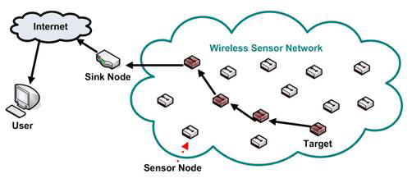
Introduction: WSNs Definition
Recent advances in wireless communications have motivated the widespread of wireless sensor networks (WSNs), with the development of extremely small, low-cost, and low-power of multi functional sensor nodes.

Slide 7
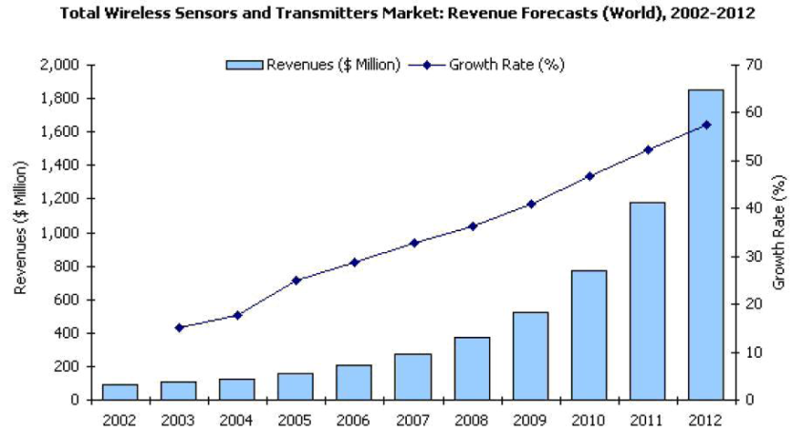
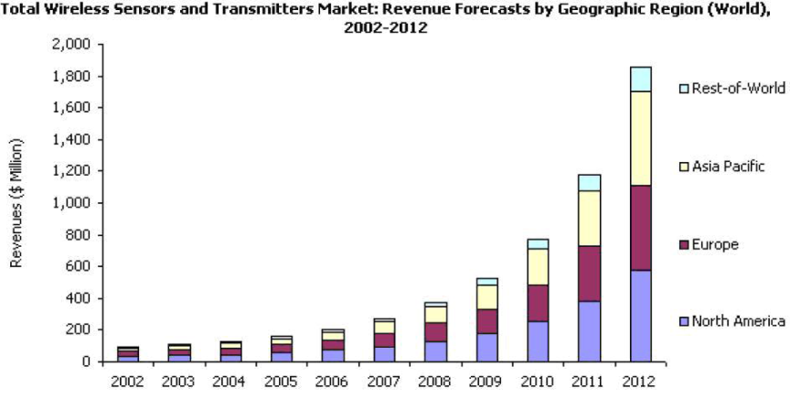
Introduction: WSNs Market Trend
WSNs market is growing worldwide. There is a drastic change in last few years and these number increases in future.

Slide 8
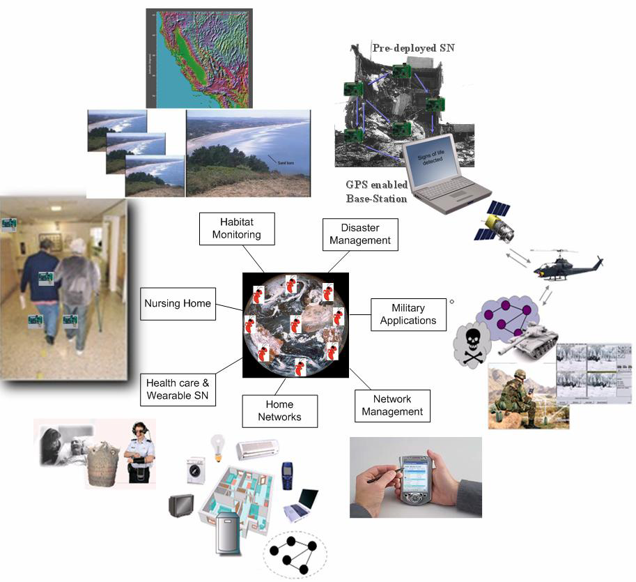
Introduction: WSNs Applications
WSNs have attracted huge interest from the wireless research community due to their potential applications for both the military and civilian domains.

Slide 9
Introduction: WSNs Limitations
Power restrictions.
Storage restrictions.
Limited computational power
Lack of global IDs.
Random deployment.
Cooperative concept.
The hostile and remote environment.

Slide 10
Motivation – Why Secure Routing?
Communication security and reliability are two important issues in WSNs.
WSNs possess a number of additional security attacks.
Infeasible of using traditional security solutions like, cryptography which requires complex processing to provide encryption to the transmitted data.
Lack of secure routing protocols, many sensor network routing protocols have been proposed for WSNs, only few of them addressed secure routing.
Lightweight secure routing protocols should be addressed.

Slide 11
Contribution
Proposing a novel MSR secure routing protocol.
Utilizing erasure coding as a splitting method.
Utilizing passive acknowledgment as a security validation method.
Providing security study against major attacks.
Evaluating MSR scheme‘s performance.

Slide 12
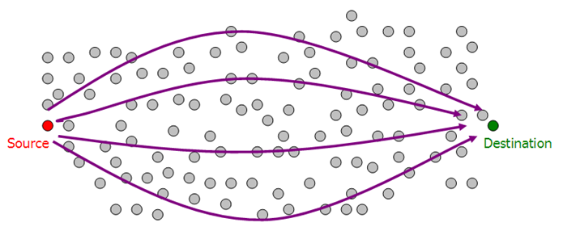
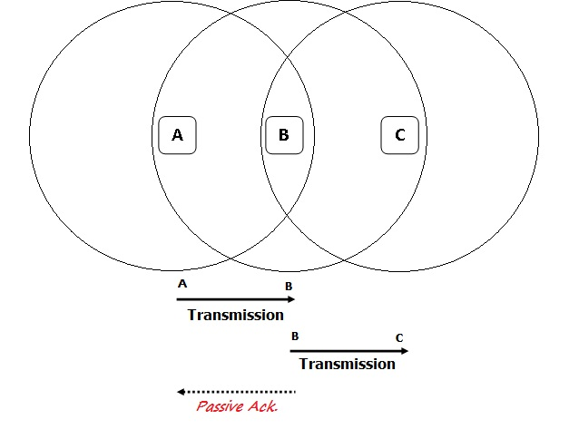
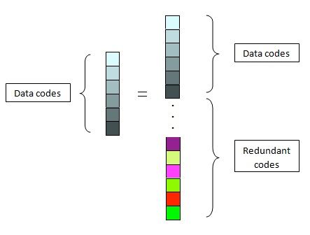
MSR: A Multipath Secure Reliable Routing Protocol for WSNs
Passive Acknowledgment
Erasure Coding
On-Demand Multipath Routing

Slide 13

Background – Erasure Coding
Erasure coding is a forward error correction (FEC) code for the binary erasure channel, which transforms a message of m blocks into a longer message with n blocks (codeword) such that the original message can be reconstructed from a subset of the n symbols. The fraction r=m/n is called the code rate.

Slide 14

Background – Passive Acknowlegdement
Passive Acknowledgment (PACK) refers to the sender passively listens after finishing the message transmission to confirm that the message has been received by the destination (indirect overhearing) .

Slide 15
MSR: A Multipath Secure Reliable Routing Protocol for WSNs
Passive Acknowledgment
Erasure Coding
On-Demand Multipath Routing

Slide 16
Security Analysis
Security Attacks in WSNs:
  Blackhole attack.
  Selective forwarding attack.
  Hello flood attack.
  Acknowledgment spoofing attack.
  Replay attack.
  Alter attack.
  Spoofing attack.
  Sinkhole attack.
  Wormhole attack.
  Sybil attack.

Slide 17
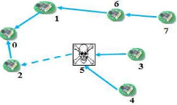
Security Analysis (cont.)
Security Attacks Definitions in WSNs:
  Blackhole attack: when a malicious node drops all the packets through it.

Slide 18
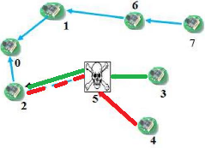
Security Analysis (cont.)
Security Attacks Definitions in WSNs:
Selective forward attack: when a malicious node can however drop or forward certain messages (it selectively forward the packets).

Slide 19
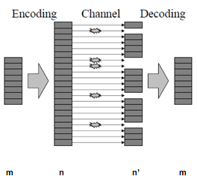
Splitting Method using Erasure Coding
Erasure coding provides an efficient option for achieving reliability against the noisy channel and efficient data replication without end-to-end retransmission.

Slide 20
Security Checks via Enhanced Passive Acknowledgment
A consistent dropping of a packet from a neighbor can be used as a sign of a blackhole attack.
A partial dropping of a packet from a neighbor can be used as a sign of a selective forward attack.
Packet headers can be checked to detect any malicious changes in the headers. This can be used to detect spoofing.
The packet content itself can be analyzed to detect any unauthorized changes to the packet. This can be used to detect alter.

Slide 21
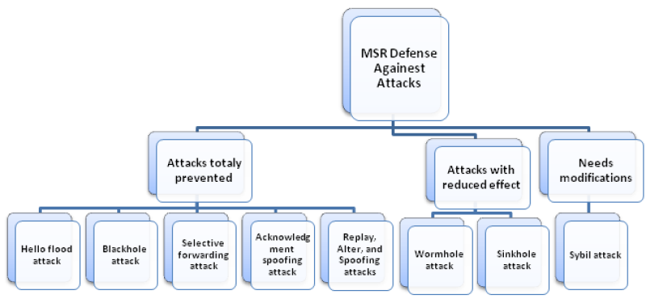
Security Analysis (cont.)

Slide 22
Experimental Results
MSR protocol is implemented using NS-2 simulator. The main objective of the simulation is to evaluate the effectiveness of MSR relative to AOMDV (Ad hoc On-demand Multipath Distance Vector) which guarantees link-disjoint paths, doesn't use alternative paths simultaneously, uses retransmission concept for reliability and no security support.
Performance Metrics:
  Packet Delivery Ratio
  End-to-End Delay
  Normalized Routing Overhead
  Resistance against Attacks

Slide 23
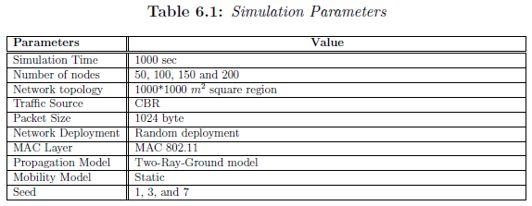
Experimental Results (cont.)
Simulation parameters
Sensor nodes are spread randomly over a at square area of dimensions 1000 * 1000 m2. All experiments are performed against different network sizes (W) ranging from 50 to 200 sensor nodes.

Slide 24
Experimental Results (cont.)
Simulation Setup
  First Setup Experiment (effective sub-packet size)
  Second Setup Experiment (effective coding rate)

Slide 25
Experimental Results (cont.)
Important parameters:
  Packet size: This parameter represents the size of the packets transmitted over the network.
  Code rate: This parameter represents the ratio of the total number of packets generated by the erasure coding technique to the sufficient number of packets to reconstruct the original message (𝑛/𝑚).

Slide 26
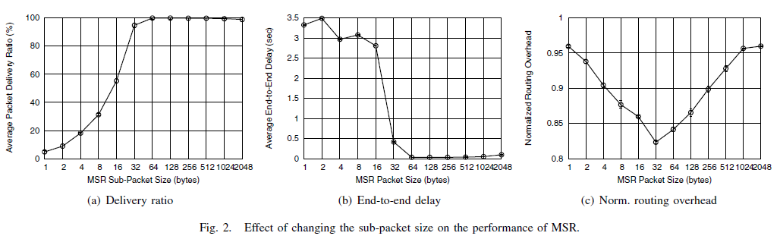
Experimental Results (cont.)
First Setup Experiment (effective sub-packet size)

Slide 27
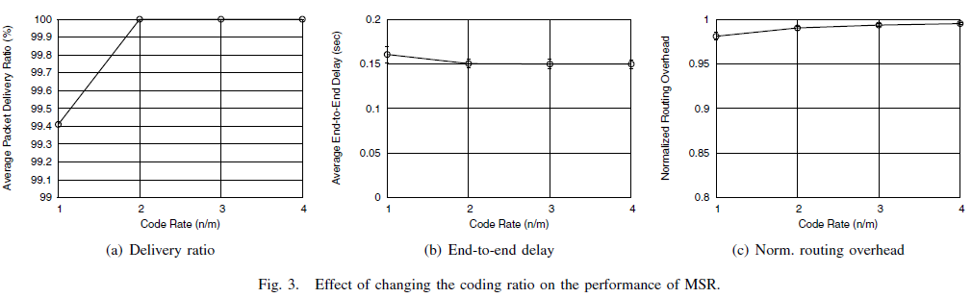
Experimental Results (cont.)
Second Setup Experiment (effective coding rate)

Slide 28
Experimental Results (cont.)
MSR vs. AOMDV
  Data Packet Delivery Ratio
    The results show that MSR outperforms AOMDV especially for small network sizes.

Slide 29
Experimental Results (cont.)
MSR vs. AOMDV
  End-to-End Delay
    End-to-end delay is increased in MSR compared to AOMDV as MSR needs extra time to encode, send, decode and reconstruct the original message.

Slide 30
Experimental Results (cont.)
MSR vs. AOMDV
  Routing Overhead
    The results show that MSR has a slightly higher overhead compared to AOMDV.

Slide 31
Experimental Results (cont.)
Resistance against Attacks
  Against blackhole attack
    MSR can achieve significant gain, more than 40%, as compared to AOMDV in the exist of blackhole attack.

Slide 32
Experimental Results (cont.)
Resistance against Attacks
  Against grayhole (selective forward) attack
    the selective forwarding attack is less severe than the blackhole attack as expected. As noticed the packet's delivery ratio improves while the dropping probability decreases in both protocols

Slide 33



Analytical Analysis
Analytical Measures:
  → The successful delivery probability of a transmitted message.
  → The successful delivery probability of a transmitted message if a malicious node can forward or drop a packet with probability.
  → The maximum number of attackers that MSR is resistant to (= N – m) .

Slide 34
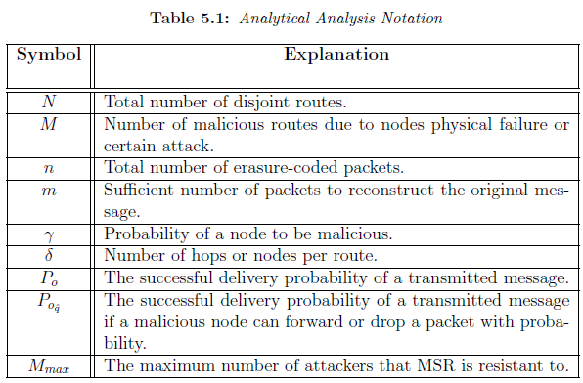
Analytical Analysis (cont.)
Analytical Parameters

Slide 35

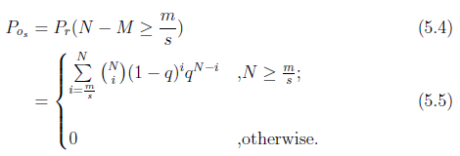
Analytical Analysis (cont.)
We can model the transmission of a packet on a route as a Bernoulli trials with successful probability (1 - ) and unsuccessful probability .
The successful delivery probability of sending block of packets per route .

Slide 36

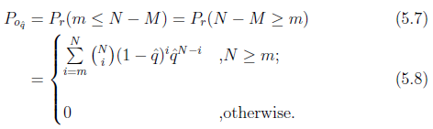
Analytical Analysis (cont.)
The probability is that a malicious route has at least a malicious node and will not forward a packet with probability , then can be calculated as in Equation (5.6).
Therefore can be calculated by replacing each unsuccessful probability with .

Slide 37
MSR Complexity
MSR route discovery algorithm is O(bd) where,
  b : number of a node’s neighbors
  d : the max number of hops
Erasure coding can be performed in a linear time as shown in [10, 11 and 12] then it adds O(n).
  n : the number of spitted shares.
The security checks of PACK are performed simultaneously with the running of discovery with a constant magnitude, so the order still
O(K.bd) where, K : is constant.
The total complexity of MSR is O(K.bd) + O(n) .

Slide 38
Conclusion
Passive Acknowledgment
Erasure Coding
On-Demand Multipath Routing

Slide 39

Thank You
Questions

Slide 40
References
[1] T.Kavitha and D.Sridharan, “Security vulnerabilities in wireless sensor networks: A survey”, Journal of Information Assurance and Security, 2010.
[2] Mariam Moustafa, Moustafa Youssef and Nazih Elderini, "MSR: A Multipath Secure Reliable Routing Protocol for WSNs", The 9th ACS/IEEE International Conference on Computer Systems and Applications, AICCSA 2011, Sharm El-Skeikh, Egypt, December 2011.
[3] Mariam Moustafa, Moustafa Youssef. Nazih Elderini and Magdy Abd-Elazim Ahmed "Analysis of MSR Routing Protocol for WSNs", The 12th IEEE International Conference on Wireless Information Technology and Systems ICWITS 2012, Hawaii, USA, November 2012.

Slide 41
Related Work
Recent advances in wireless sensor networks have led to many new protocols specially designed for but few of them consider security.
H-SPREAD[2], MDR[3], SMR[4] and AOMDV[1].
We focus on AOMDV (Ad hoc On-demand Multipath Distance Vector), it guarantees loop freedom and link-disjoint paths.
Back draws of AOMDV:
  Doesn’t use alternative paths simultaneously.
  Use retransmission concept for reliability.
  No Security support.

Slide 42
Future Work
Approve the simulation results analytically.
MSR against difficult attacks and environmental conditions.
  Sybil and mobile/energy-aware.
MSR performance optimization.
  Use efficient routing metrics.
MSR packet allocation optimization.
  Weighted-k-out-of-n algorithm.

Slide 43
MSR Simulation Assumptions
The sensor network is static.
The sensor nodes are homogeneous.
The communication channels are bidirectional.
The deployment is random.

Slide 44
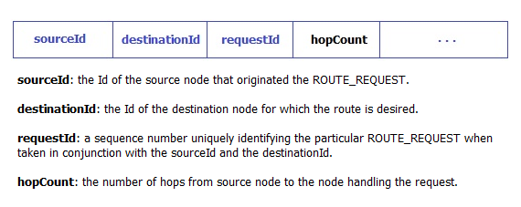
MSR: On-Demand Multipath Routing (cont.)
ROUTE_REQUEST packet format

Slide 45
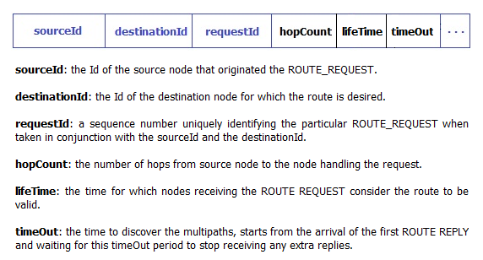
MSR: On-Demand Multipath Routing (cont.)
ROUTE_REPLY packet format

Slide 46
MSR: On-Demand Multipath Routing (cont.)
ROUTE_REQ UEST
A
E
Routing Discovery Algorithm
S
D
B
C
Lifetime
A
E
Fresh Path
S
D
B
C
Timeout
A
E
ROUTE_REPLY
S
D
B
C

Slide 47
MSR: On-Demand Multipath Routing
The on-demand multipath route discovery process as follow:
  When a node needs a route to a destination, it broadcast a ROUTE-REQUEST.
  Any node with a current route to that destination, can unicast a ROUTE-REPLY back to the source node.
  Route information is maintained by each node in its routing table.
  Information obtained through ROUTE-REQUEST and ROUTE-REPLY packets is kept with other routing information in the route table.

Slide 48
Splitting Method using Erasure Coding
Erasure coding provides an efficient option for achieving reliability against the noisy channel and efficient data replication without end-to-end retransmission [16].

Slide 49
Splitting Method using Erasure Coding (cont.)
In erasure coding, selecting an optimal value of the encoding code rate r, where r = n/m is a critical issue. In general the larger it is, the more reliability we can achieve but with the more overhead as well!

Slide 50
Security Check via Enhanced Passive Acknowledgment
A consistent dropping of a packet from a neighbor can be used as a sign of a blackhole attack [23].
A partial dropping of a packet from a neighbor can be used as a sign of a selective forward attack [23].
Packet headers can be checked to detect any malicious changes in the headers. This can be used to detect spoofing.
The packet content itself can be analyzed to detect any unauthorized changes to the packet.

Slide 51
Agenda
Introduction.
Motivation.
Contribution.
Background.
Related Work.
MSR: A Multipath Secure Reliable Routing Protocol for WSNs.
Scheme analysis.
Experimental Results.
Conclusions.
Future Work.
Objectives Review.
References.

Slide 52
Background
Security requirements.
Attacker models.
Erasure coding.
Passive acknowledgment.

Slide 53
Background - Security Requirements
Authentication.
Availability.
Confidentiality.
Integrity.
Freshness.

Slide 54
Background – Attacker Models
Mote-class versus laptop-class.
Passive versus active.
Outsider versus insider.

Slide 55
Background – Erasure Coding
Erasure coding is a forward error correction (FEC) code for the binary erasure channel, which transforms a message of m blocks into a longer message with n blocks (codeword) such that the original message can be reconstructed from a subset of the n symbols. The fraction r=m/n is called the code rate.

Slide 56
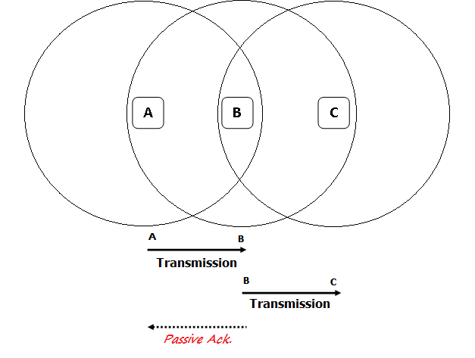
Background – Passive Acknowlegdement
Passive Acknowledgment (PACK) refers to the sender passively listen after finishing the message transmission to confirm that the message has been received by the destination (indirect overhearing).

Slide 57
Assumption
The network is static.
The sensor nodes are homogeneous.
The communication channels are bidirectional.
The deployment is random
Each sensor node has a unique Id.
An attacker is assumed to be a mote-class, insider, and active.

Slide 58
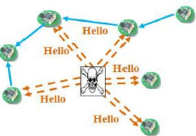
Security Analysis
Security Attacks Definitions in WSNs:
  Hello flood attack: a laptop-class adversary broadcasting routing information with large transmission power could convince every node in the network that the adversary is its neighbor.

Slide 59
Security Analysis (cont.)
Security Attacks Definitions in WSNs:
  Blackhole attack: when a malicious node drops all the packets through it.

Slide 60
Security Analysis (cont.)
Security Attacks Definitions in WSNs:
Selective forward attack: when a malicious node can however drop or forward certain messages (it selectively forward the packets).

Slide 61
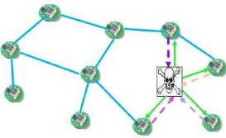
Security Analysis (cont.)
Security Attacks Definitions in WSNs:
Acknowledgment spoofing attack: when a malicious node spoofs an acknowledgment convincing the sender that a weak link may be strong or a dead node is alive.

Slide 62
Security Analysis (cont.)
Security Attacks Definitions in WSNs:
Replay, alter and spoofing attacks: Adversaries are retransmitted the valid data repeatedly to inject the network routing traffic. They may be able to attract or repel network traffic, extend or shorten source routes, generate false error messages, partition the network, and increase end-to-end latency.

Slide 63
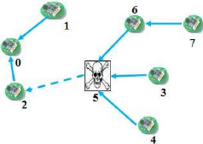
Security Analysis (cont.)
Security Attacks Definitions in WSNs:
Sinkhole attack: An adversary tries to attract almost all the traffic toward the compromised node. (The path presented through the malicious node appears to be the best available route for the nodes to communicate)

Slide 64
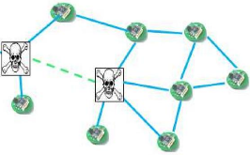
Security Analysis (cont.)
Security Attacks Definitions in WSNs:
Wormhole attack: An adversary tunnels messages received in one part of the network over a low latency link, to another part of the network where the messages are then replayed. (Wormholes are dangerous because they can do damage without even knowing the network.)

Slide 65
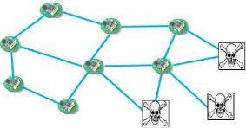
Security Analysis (cont.)
Security Attacks Definitions in WSNs:
Sybil attack: a single adversary node presents multiple identities to all other nodes in the WSN, which may affect data aggregation, voting or disjoint path routing.

