Slide 1
Hello APTs in the Middle East
By Mohamad Amin Hasbini
Senior Security Researcher
Kaspersky Lab

Slide 2
Agenda
Carbanak
Regin
TURLA
EQUATION
APTs

Slide 3
The nature of the threats - 2016
Cyber-weapons - APTs
0.1%
9.9%
Targeted threats to organisations
Traditional cybercrime
90%

Slide 4
REGIN

Slide 5
Targets:
Telecom operators
Government institutions
Multi-national political bodies
Financial institutions
Research institutions
Individuals involved in advanced mathematical/cryptographical research
Main objectives:
Intelligence gathering
Facilitating other types of attacks

Slide 7
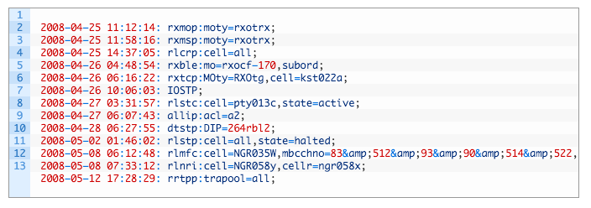
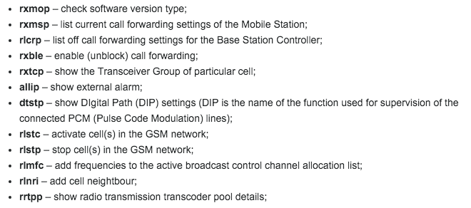

Slide 9
Notes:
Symantec identified 50 victims in Russia and Saudi

Slide 10
REGIN SUMMARY
Breached Telcos
Long active infection
State-sponsored attack

Slide 11
TURLA

Slide 12
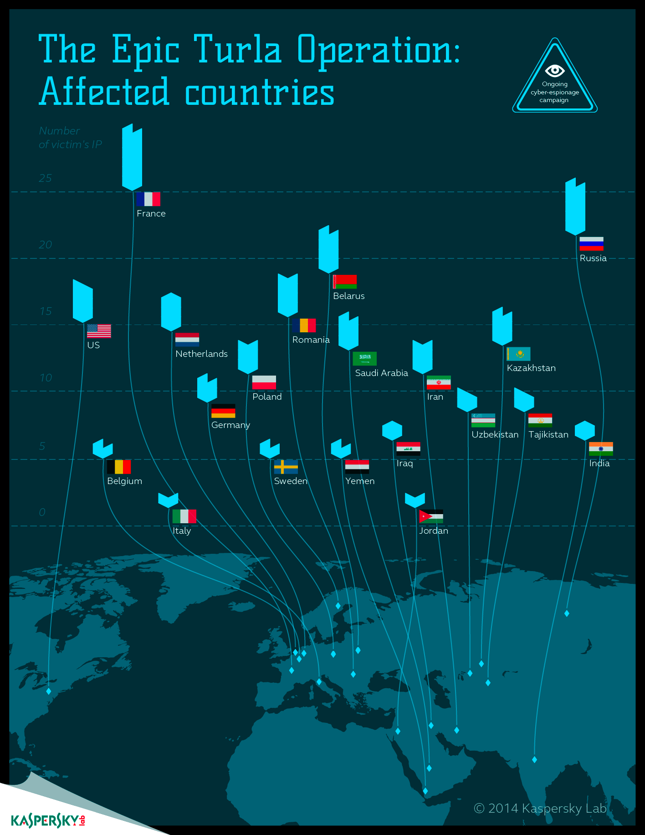
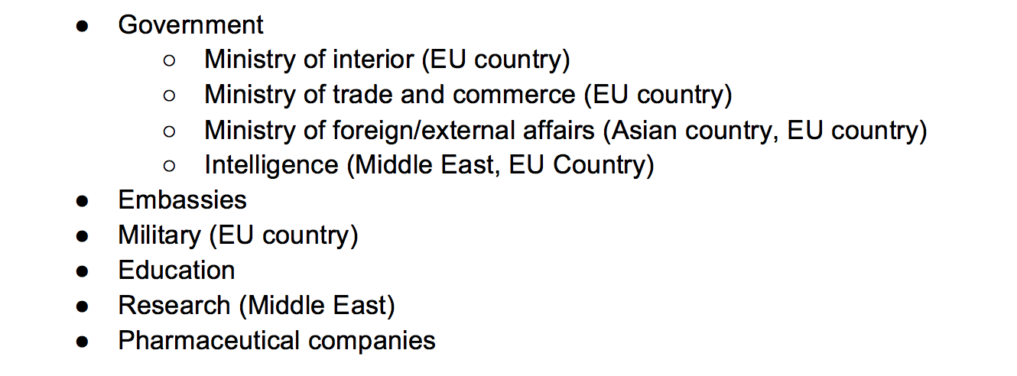

Slide 13
TURLA Satellite

Slide 15
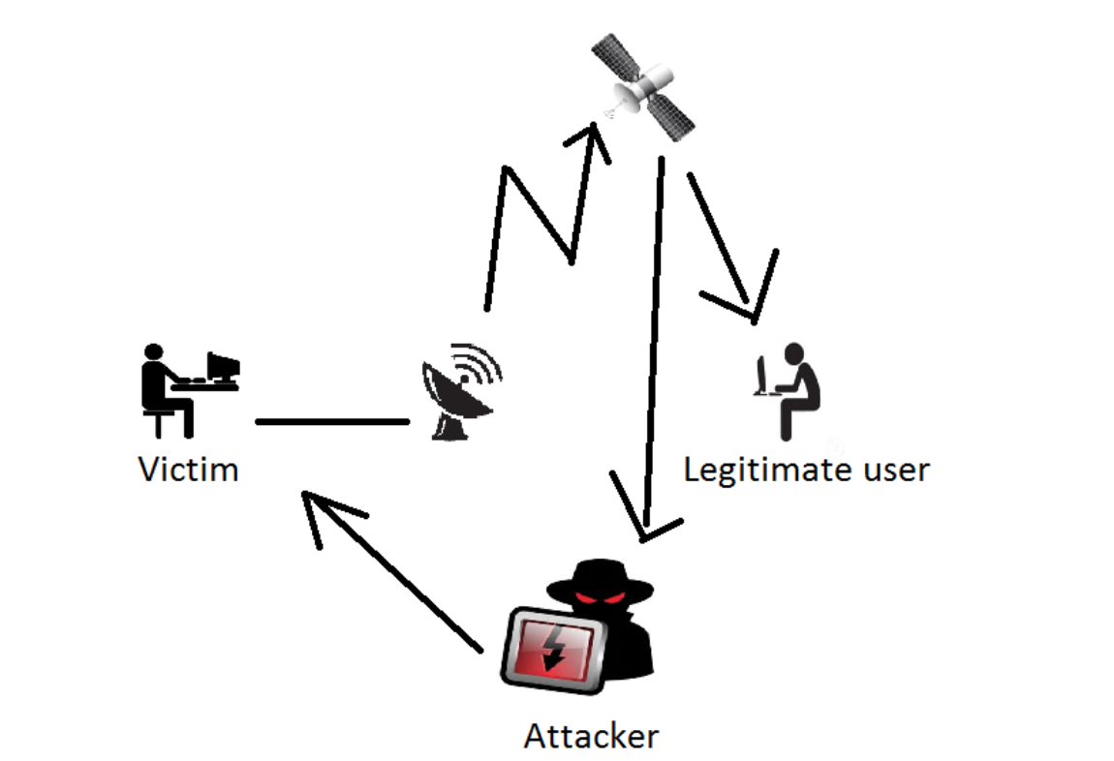
Country | Infrastructure
Lebanon | 2 providers, 4 ip addresses
Iraq | 1 provider, 1 ip address
Nigeria | 2 providers, 4 ip addresses
United Arab Emirates | 1 provider, 4 ip addresses
Denmark | 1 provider, 3 ip addresses
United Kingdom | 1 provider, 1 ip address
Zambia | 1 provider, 1 ip address
Afghanistan | 1 provider, 1 ip address
Somalia | 1 provider, 1 ip address

Slide 17
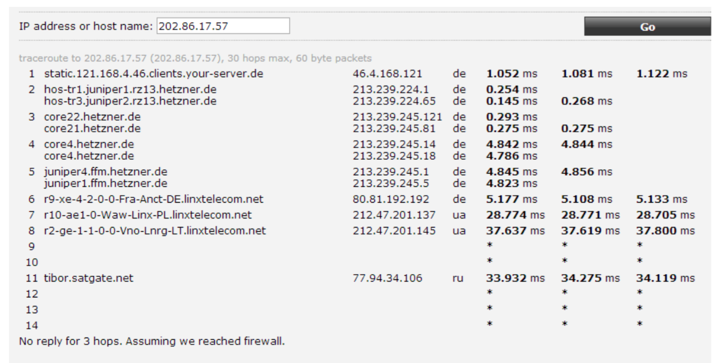
Notes:
Route to one of the CnC ip addresses in Afghanistan through Ukraine and Russia

Slide 18
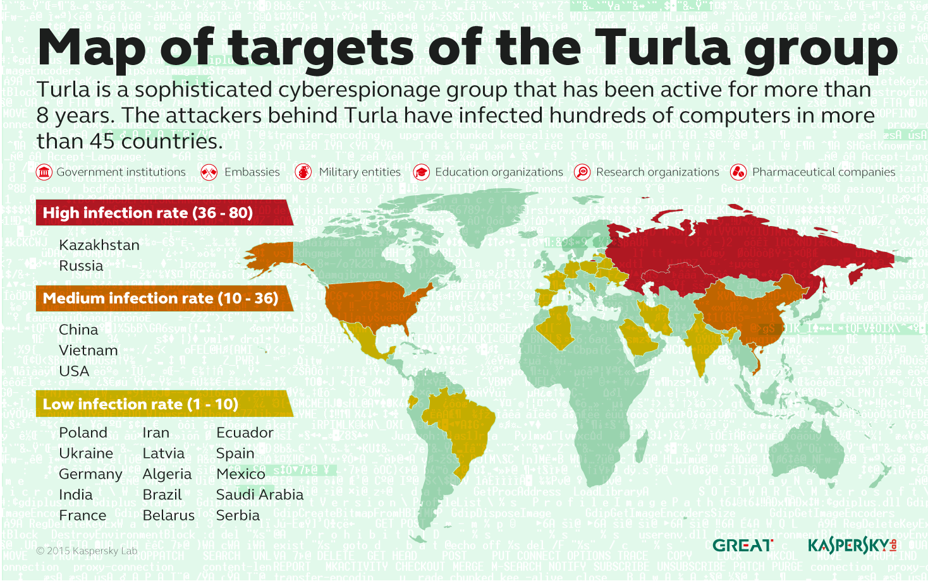

Slide 19
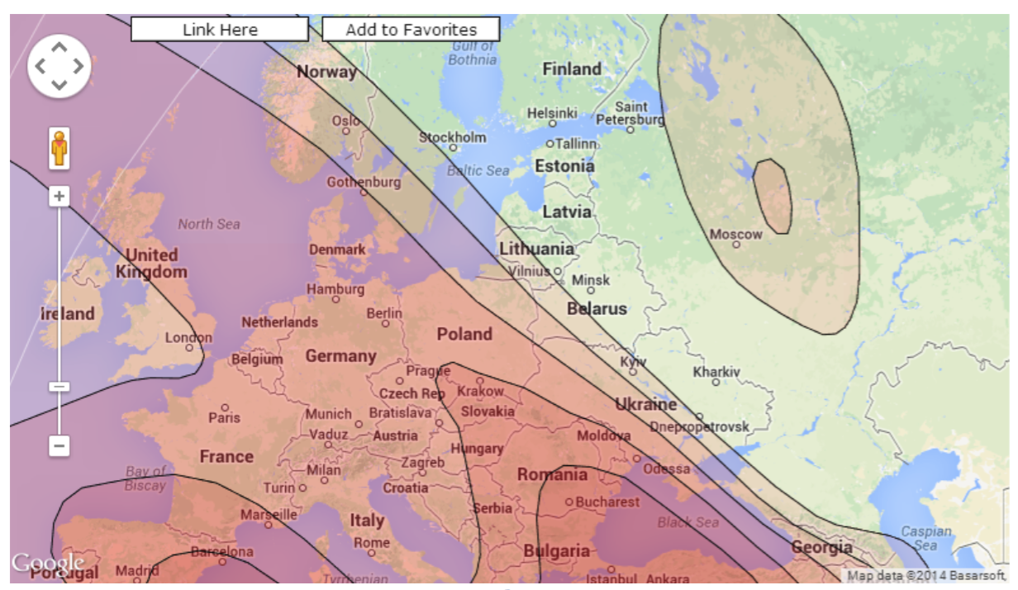

Slide 20
TURLA SUMMARY
BGP Hijacking and Satellites
Anonymous infections
State-sponsored attack

Slide 21
Identifying threats
Localizing threat data
Learning attackers techniques
Attack readiness
Decision making support
Importance of Threat Intelligence

Slide 23
Stay Close…
Mohamad Amin Hasbini
Senior Security Researcher
Global Research and Analysis Team (GReAT)
Amin.Hasbini@Kaspersky.com
Twitter/Linkedin: @mahasbini
Thank you

