Slide 1
SaudiNIC Experience in Deploying DNSSec
AbdulRahman Al-Ghadir
SaudiNIC - CITC
MENOG 16

Slide 2
The Start
SaudiNIC was observing the growth of DNSSec development till it got mature.
SaudiNIC staff conducted a study that consist of:
What is DNSSEC?
In depth study of some pioneer DNSSEC implementations:
Netherland
New Zealand
A road map for DNSSEC deployment by SaudiNIC

Slide 3
Road Map
Start of the project
Creating startup team
DPS draft
SaudiNIC DNSSec procedures
SaudiNIC DNSSec setup
DNSSec workshop
Building test lab
Enabling DNSSec on .Alsaudiah (IDNA)
Enabling DNSSec on .SA
Open DNSSec for public
End of the project

Slide 4
Creating DNSSEC Startup Team
Read … read … read
DNSSEC RFCs
Best practices
Guidelines
Technical implementation
Presentations and reports
Continuous meetings and brainstorming sessions
Test … test … test

Slide 5
DPS Draft
Review several RFC(s) related.
Review some registries’ DPSs:
.ca Canada
.au Australia
.nz New Zealand
.at Austria
.com
.cl chili
… etc

Slide 6
DPS Draft

Slide 7
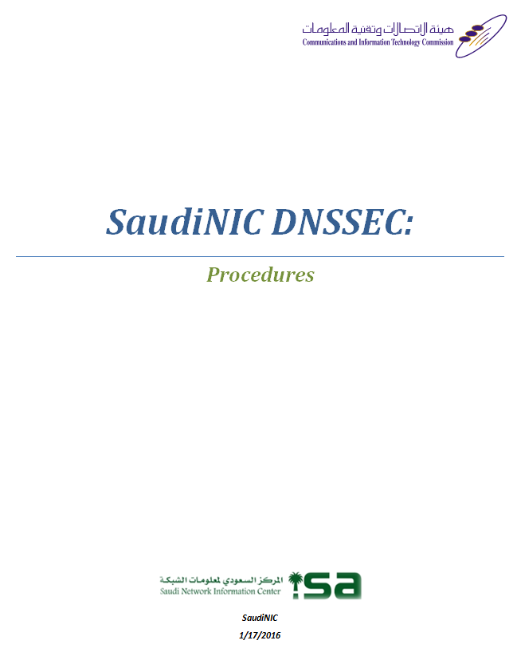
SaudiNIC DNSSec Procedures

Slide 8
SaudiNIC DNSSec Procedures
DNSSEC Keys Generation Ceremony
DNSSEC Keys Installation Procedure
DNSSEC Emergency Keys Installation Procedure
DNSSEC New Safe Arrangement Procedure
DNSSEC Safe Content Transfer Procedure

Slide 9
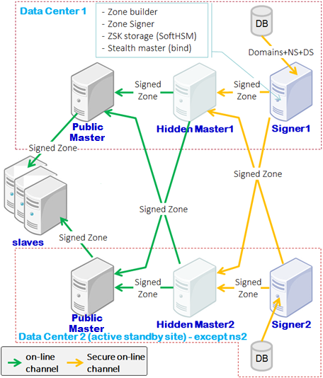
SaudiNIC DNSSec Setup

Slide 10
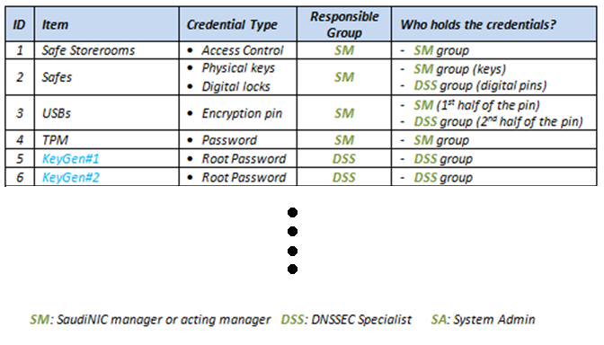
DNSSEC Credential Matrix

Slide 11
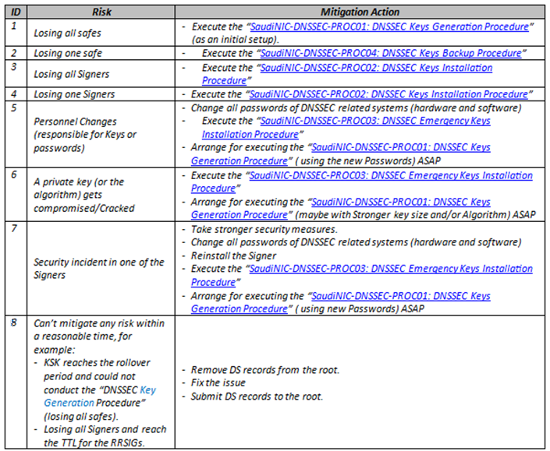
DNSSec Key Management Risks

Slide 12
Keys Setting
The zone is signed using pair of keys:
Key Signing Key (KSK):
RSA/SHA2
Rollover every 1 year
Key size is 2KB
Key rollover algorithm is Double signature
Zone Signing Key (ZSK):
RSA/SHA2
Rollover every 6 months
Key size is 2KB
Key rollover algorithm is Pre-publish

Slide 13
Building a Test Lab
A virtual setup identical to the actual DNSSec setup.
Hands-on on DNSSec to test it out.
Selection of HW/SW for DNSSec systems that meet our need.
Validate key generation, signing, key rollover, … etc.

Slide 14
Challenges
So many documents to read and digest related to DNSSec (RFCs, best practices, … etc).
Rollover techniques (key rollover and algorithm rollover).
So many parameters to tune them (RRSIG inception and expiration, jitter, Max/Min TTL, … etc).
Easy to break!

Slide 15
What is Next?
Enabling DNSSec on .Alsaudiah (IDNA).
Monitor and keep track on what is going on.
Allow a closed access to certain clients.
Monitor and keep track on what is going on.
Enabling DNSSec on .SA.
Monitor, Monitor, Monitor … etc.
Done!

Slide 16
Thank you!

