Slide 1
IPv6 Deployment Case of Sudan/SudREN
شبكة البحث العلمي والتعليم السودانية
Sudanese Research and Education Network
Middle East Network Operators Group (MENOG 15)
1-2 April 2015, Dubai, UAE

Slide 2
Sudanese Experience Toward IPv6

Slide 3
Activities
1st IPv6 Workshop; 24June, 2010
As a side event of AREGNET Meeting.
2nd IPv6 Workshop; 1 August, 2010
Publish the Sudanese IPv6 Migration Plan (2011-2015).
Formation of the SDv6TF.
3rd IPv6 Workshop; 1-4 November, 2010
2nd IPv6 Training.
Internet Governances day.
4th IPv6 Workshop; 27 October, 2011
Evaluation of the IPv6 Deployment in Sudan on 10 Major Information Network Operator

Slide 4
National IPv6 Training Center

Slide 5
Achievements
Number of Session Organized | 17
Total Number of Attends | +400
Exam Taken | 218
CNE6 Level-1 Certified | 182

Slide 6
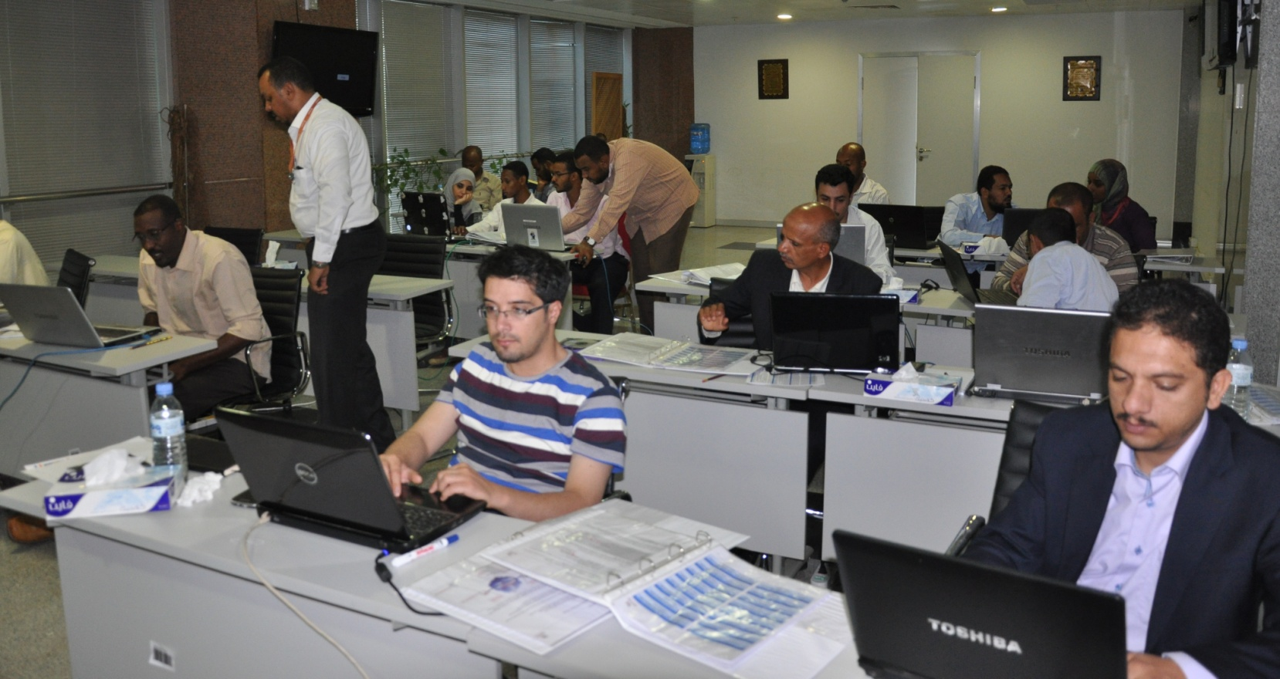
Activities
5th IPv6 Workshop; 26-30 October, 2013
IPv6 Workshop for Yemeni Delegations

Slide 7
IPv6 Deployment
Development of the National IPv6 Migration Plan (2011-2015)
Participate on IPv6 Events (ITU, ICANN, AfriNIC, NAV6)
Formation of the SDv6TF
Five workshops are organized
Collaborate with NAv6 in continuous training program
Operators are IPv6 Enable/Ready.
Host AfriNIC-17

Slide 8
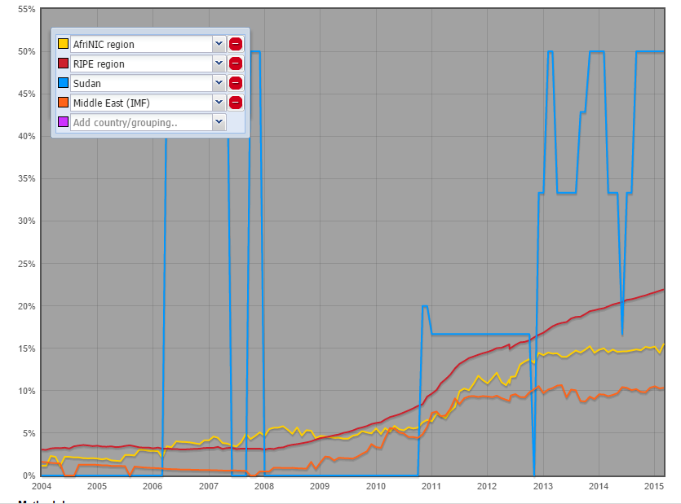
Development in IPv6 Assignment

Slide 9
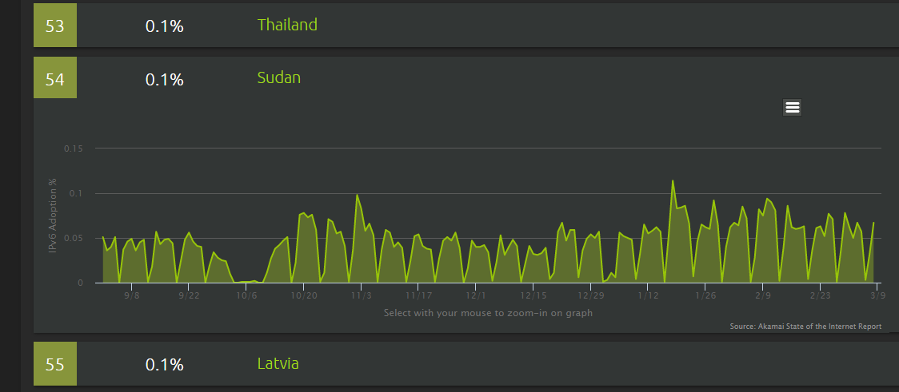
IPv6 Traffic

Slide 10
Join the SDv6TF @facebook.com

Slide 11
SudREN at a Glance
SudREN is licensed ISP dedicated to the Sudanese research and educational intuitions.
3 STM-1 (450 Mb) Total Bandwidth to the upstream providers,
63+ Member Institution are connected via Layer-3 MPLS VPN on Local carries providers (Sudatel, Canar),
SudREN has its own Numbering resources from
41.67.0.0/18
197.251.0.0/17
2c0f:fec8::/32

Slide 12
Internet-Sudatel
Internet-Canar
SIXP
200 Mbps
100 Mbps
BGP
4 Mbps
BGP
BGP
150Mbps
BGP
PoP1
PoP2
BGP
BGP
Fiber
SudREN Network
OSPF
Member 63
OSPF
Member 1
OSPF
OSPF
OSPF
Member 4
Member 2
Member 3

Slide 13
Resource Utilization
SudREN has a utilized of about 90% of the the 1st block and about70% of the 2nd one.
SudREN started to put a strategic plan in accordance with the National Migration Plan toward IPv6.

Slide 14
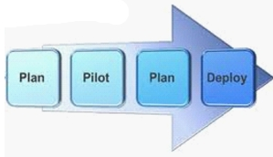
Migration Plan
Network Analysis:
Gather information on network infrastructure, key network equipment, servers, appliances and computers.
Define roadblocks:
Identify the main challenges and key issues that hinder deploying IPv6.
Workarounds:
Develop a plan to migrate to IPv6 with minimum impact on existing critical applications.
Final Plan:
Prepare a set of strategies covering IT equipment acquisition, new critical applications, manpower resource planning and network policies to prepare for fully enabled IPv6 Network

Slide 16
Deploying IPv6
Gateway
Internal Network (DMZ)
Enable IPv6 on SudREN internal Network
Members’ VPN
Enable IPv6 for SudREN members
Enable IPv6 on the Gateways
Steps to deploy IPv6

Slide 17
IPv6 in the Gateways
SudREN has a native IPv6 link to the internet via (Sudatel)
Redundancy Tunnel is also available through
Internet-Sudatel
BGP
BGP
IPv6-Link
DMZ
PoP1
IPv6-Link

Slide 18
IPv6 Addressing
Each members currently is assigned /48 IPv6 Address block, and reserved /40 for future demand.
SudREN started putting a strategy to extend its IPv6 block.
New IPv6 Addressing plan goals
Improving routing aggregation.
Minding future growth with contiguous address space.
Hierarchical allocation “universities & campuses”
Recognizing directly from the IPv6 Address what location/environment a networks belongs to.
Reflect the organization infrastructure..

Slide 19
IPv6 Addressing (Cont.)
New IPv6 Addressing factors and criteria
The classification of members’ institutions.
SudREN Infrastructure (i.e. PTP, DMZ, Loopbacks …etc.)
Universities & Colleges
Research Institutions
Schools (expected)
Educational Hospitals (expected in the future)
The geographical areas in which the member are based.
Central Area (Khartoum), Northern, Western, Southern, & Eastern
Members’ campuses listing.
Number of campuses for each member

Slide 20
IPv6 Addressing example
2C0F:FE | Geographical Area | Member Type | Member Name | Campuses | IP Address /48 | Meaning
2C0F:FE | 0 | 0 | 00 | 00 | 2C0F:FE00:: | University X Campus 1 in Khartoum
2C0F:FE | 0 | 0 | 00 | 01 | 2C0F:FE00:1:: | University X Campus 2 in Khartoum
………………
2C0F:FE | 3 | 4 | 22 | 01 | 2C0F:FE34:2201:: | College X Campus 1 in North of Sudan
………………
2C0F:FE | 6 | 0 | 00 | 03 | 2C0F:FE60:0003:: | University X Campus 3 in West of Sudan

Slide 21
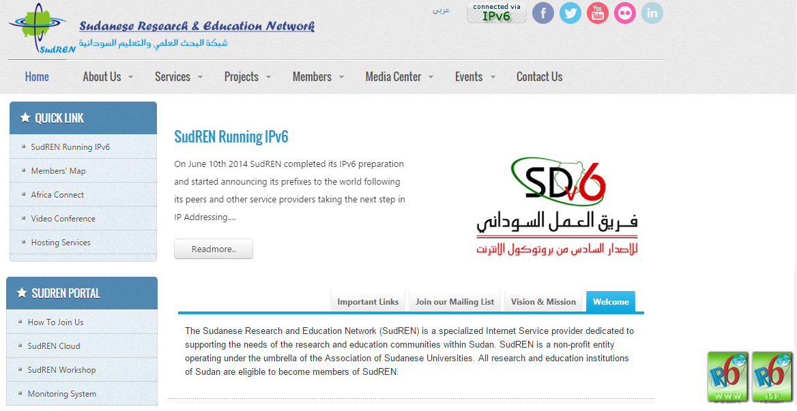
Achievements
http://sudren.edu.sd/

Slide 22
Achievements

Slide 23
Challenges
Coordination with upstream providers.
IPv6 is not supported in most members’ routers.
Use of tunnels.
No Redundancy for IPv6 Connectivity in Our POPs.
IPv6 is not fully supported in both POPs Firewalls.
Temporary IPv6 vs. DHCP.

Slide 24
شبكة البحث العلمي والتعليم السودانية
Sudanese Research and Education Network
Sami Salih
SudREN, CEO
Sami.salih@sudren.edu.sd

