Slide 1
Cyber Security:
Implications of recent breaches
MENOG April 2015

Slide 2
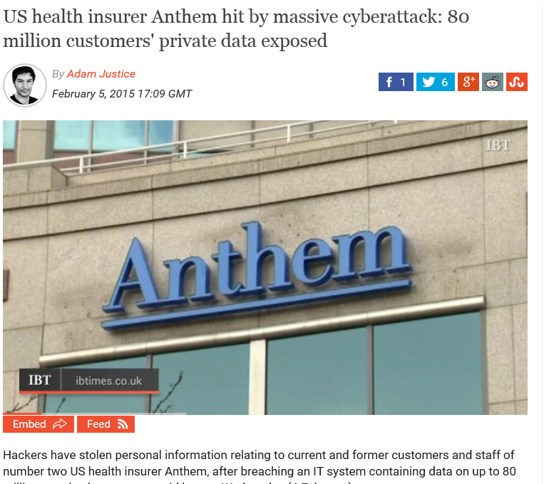
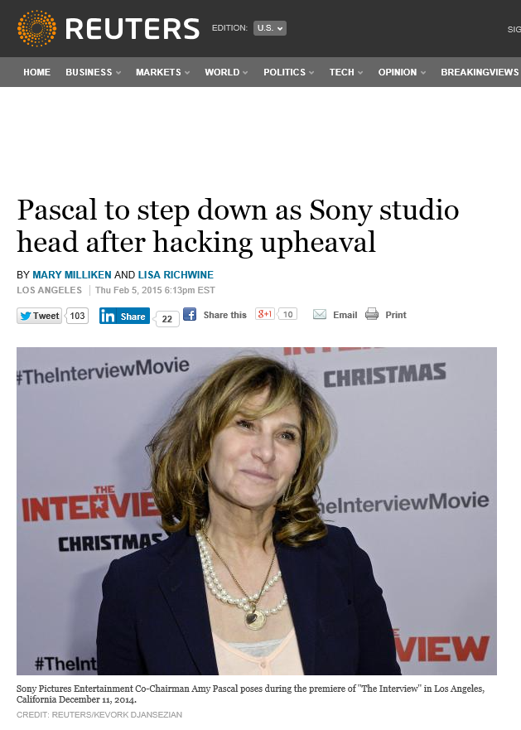
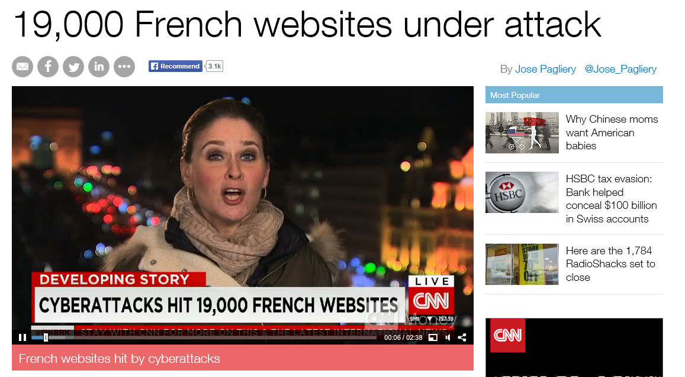
Cyber attacks dominating the news

Slide 3
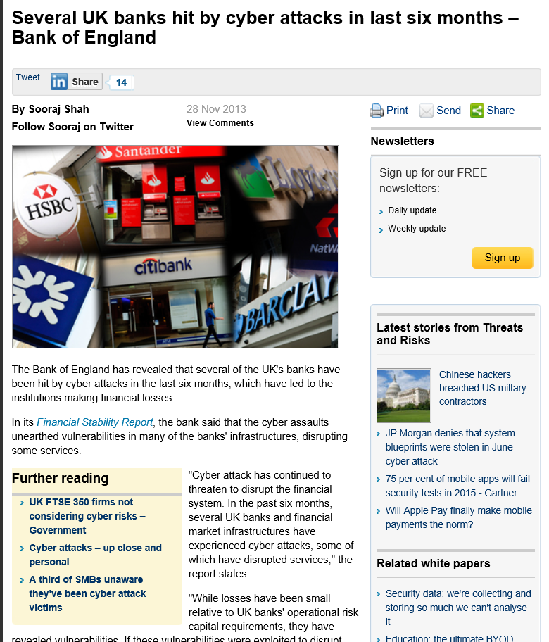
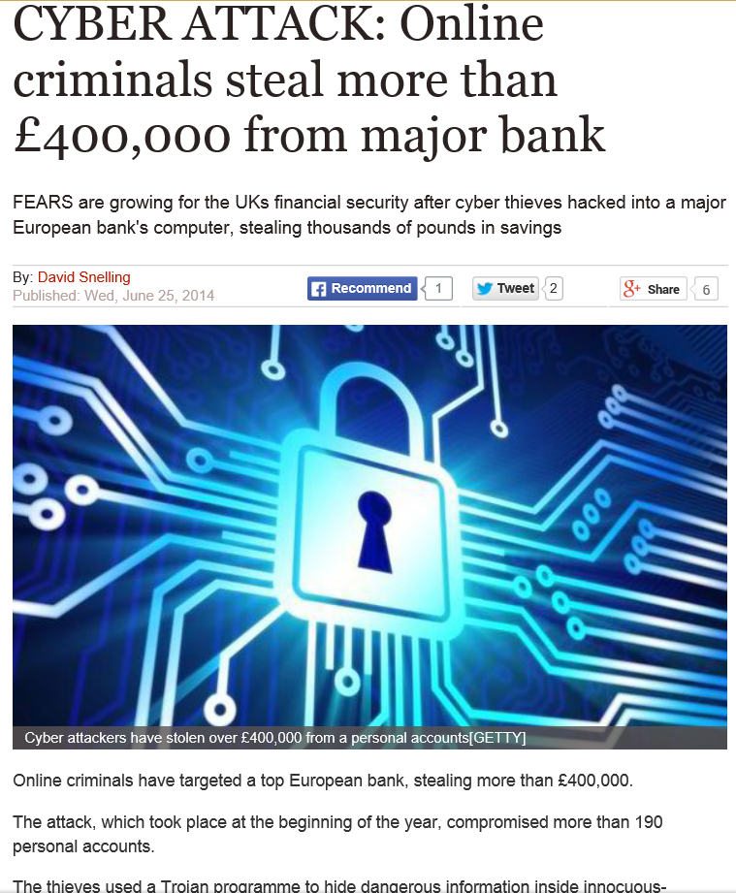
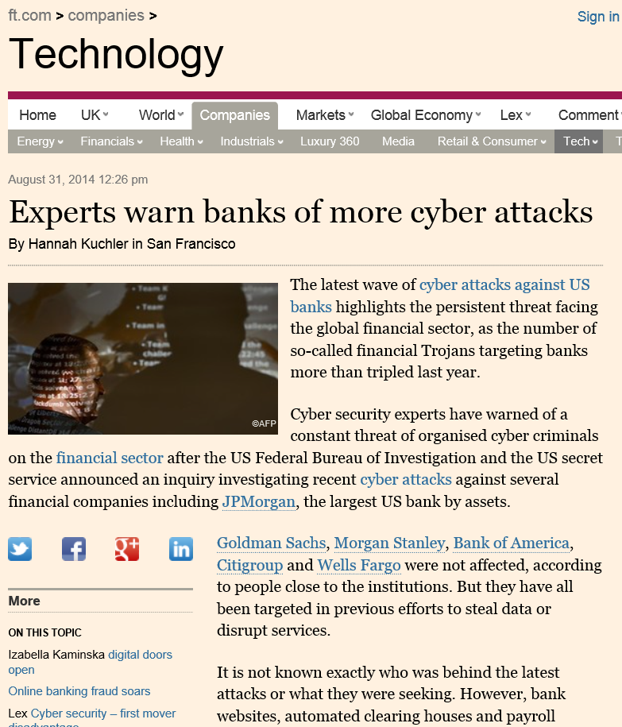
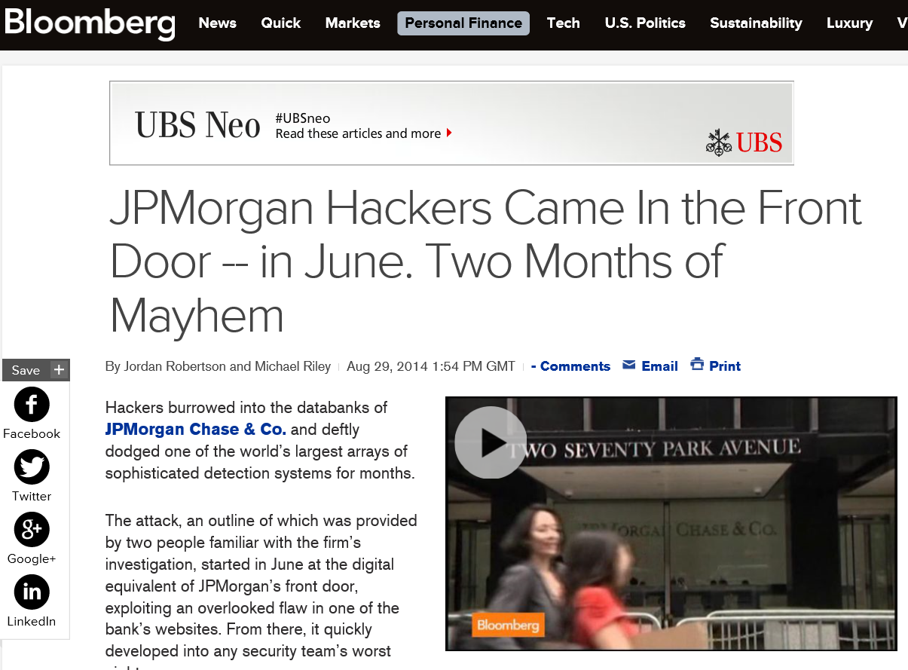
Financial services are a major target

Slide 4
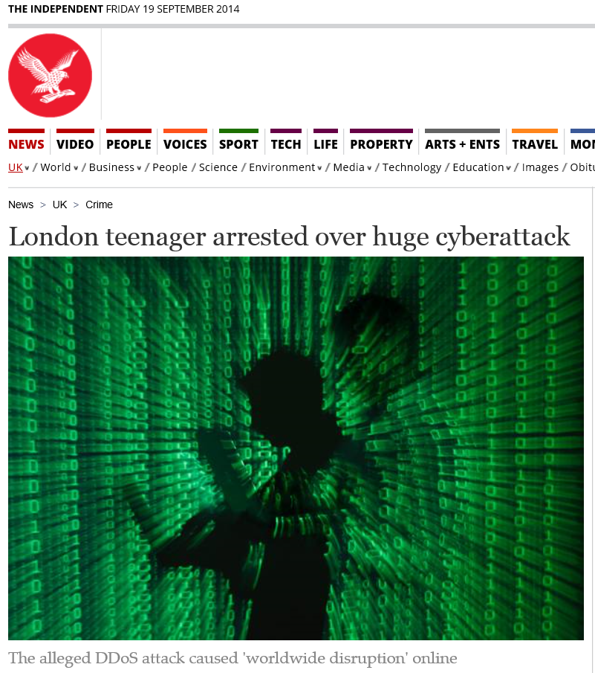
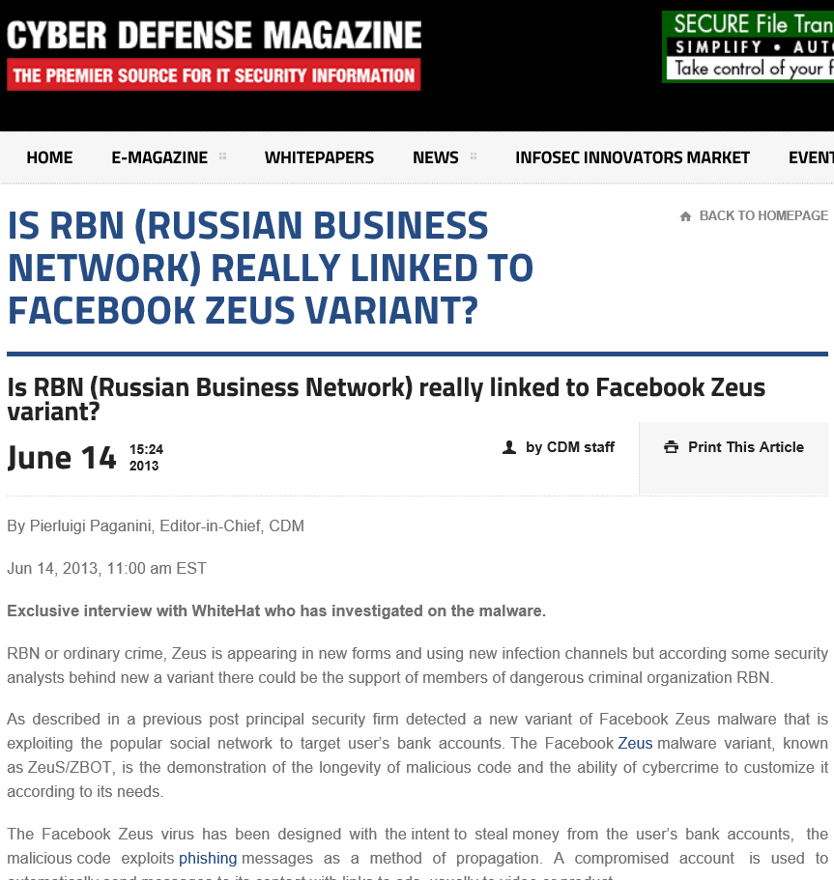
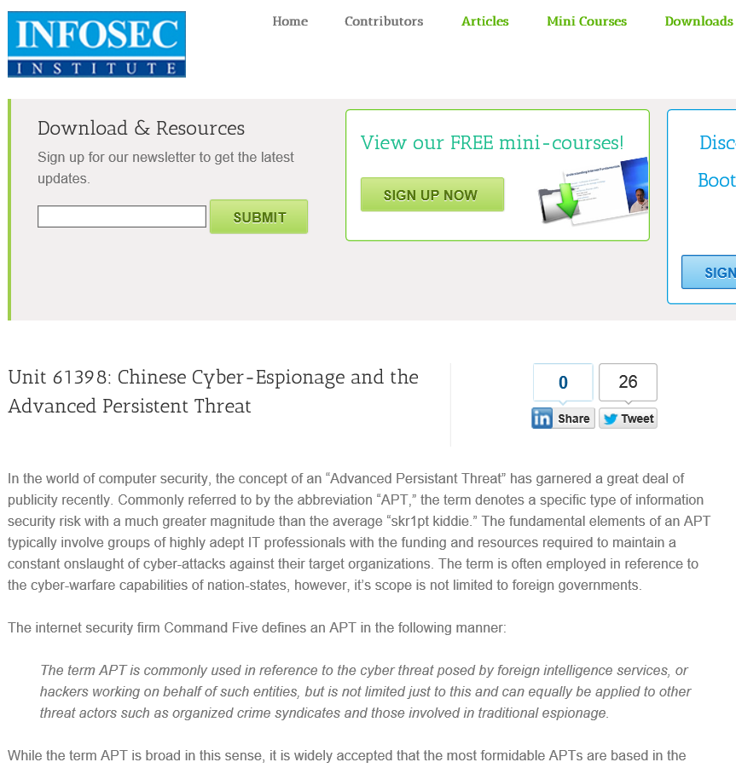
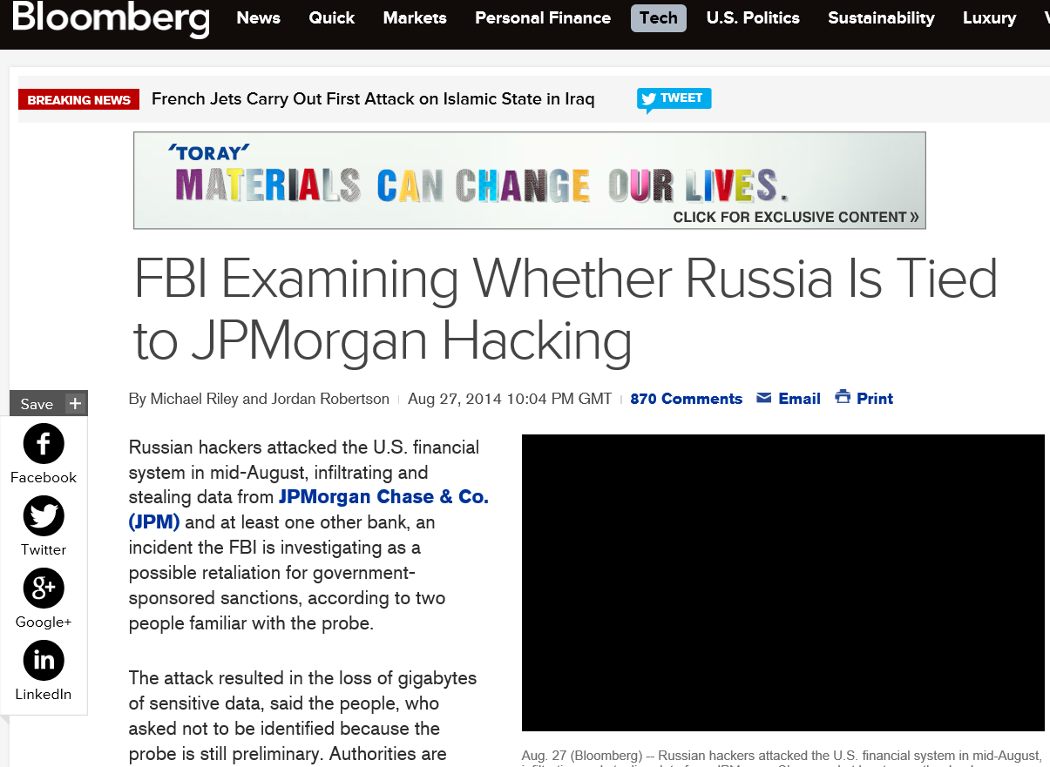
With traditional perpetrators
Petty criminals
Organised crime
Governments

Slide 5
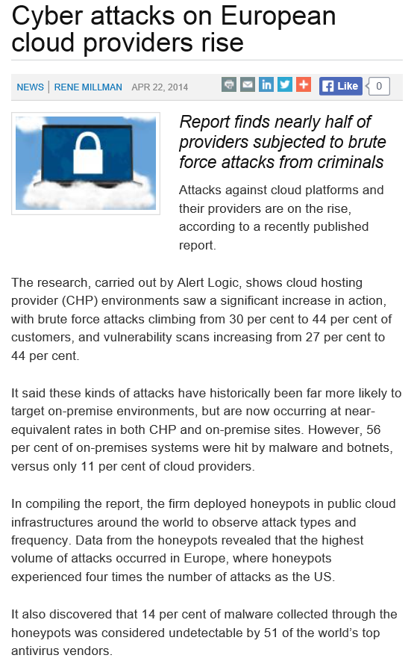
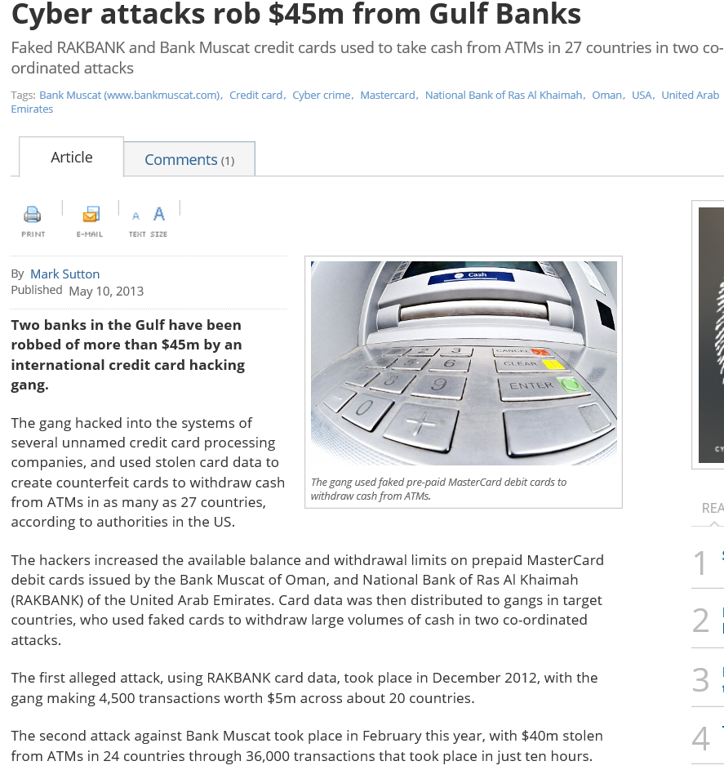
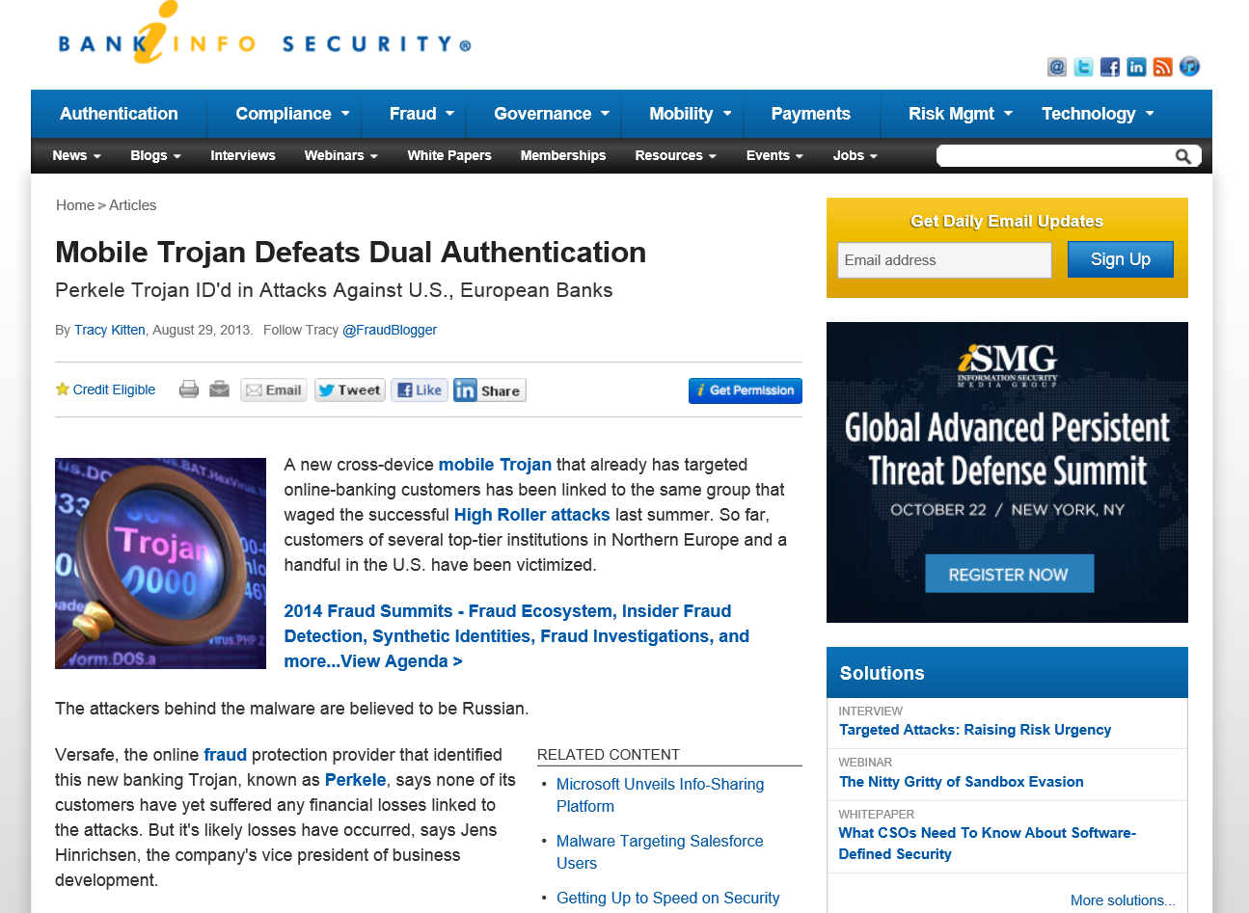
Their targets and MO evolve
Attackers follow data into the cloud
Developing countries and mid tier banks
Mobile platform vulnerabilities

Slide 6
Users don’t help
67% of cyber espionage attacks in 2014 started with a phishing e-mail – 20% fall for it
85% of cyber attacks would be unsuccessful if IT staff had taken basic steps
51% of the worst UK data breaches in 2013 were caused by staff error or misuse
49% of companies do not perform employee security-awareness training even though their annual losses are four times greater than those that do (PwC US)
50% of end-users have taken data from their company
69% of former employees can still access their systems
28% of passwords are breakable in 15 seconds

Slide 7
… pursuing traditional objectives
Making a point
Making money
Supporting geopolitical conflict
Pursuing national intelligence objectives

Slide 8
Making money
Stolen credit card details
Personal data theft
Ransom and extortion
Banking details
Market manipulation
Cyber fraud

Slide 9
Looking ahead - targets
Attacks on banking systems
Point of sale attacks on credit cards
Identity theft: Customer data , Patient and healthcare data
SCADA targets - more obvious and lucrative thanks to IoT
Plus:
economic espionage
cyber skirmishes in support of conflicts
hacktivists interest in newsworthy events

Slide 10
Looking ahead - attacks
Ransomware
Malware in advertising
Mobile malware
Exploits increasingly reserved for targeted attacks alongside spear-phishing, watering-holes and social media
Social engineering and phishing weapon of choice for cyber crime
More ‘old vulnerabilities’
Targeted attacks

Slide 11
What can be done?
Developing cyber profession – training and research
Workforce transformation – IT, operational and leadership
Information sharing
Technologies to counter the insider threat to complement perimeter defence
Threat intelligence

