Slide 1
What’s Happening at the IETF?
Internet Standards and How to Get Involved
Chris Grundemann Internet Society
MENOG 15 – Dubai – 2 April 2015

Slide 2
The Internet Engineering Task Force (IETF)
First, one important point:
No one really speaks FOR the IETF.
I am speaking about the IETF as an individual participant.
https://trac.tools.ietf.org/group/iesg/trac/wiki/SpeakingForIetf

Slide 3
Agenda
What is the IETF?
Why is the IETF important to you?
What is the IETF working on today?
How To Get Involved

Slide 4
What is the IETF?

Slide 5
Mission of the IETF
“Make the Internet work better by producing high quality, relevant technical documents that influence the way people design, use, and manage the Internet.”
5
Notes:
The IETF’s mission is to make the Internet work better by producing relevant technical documents that influence the way people design, use, and manage the Internet.

Slide 6
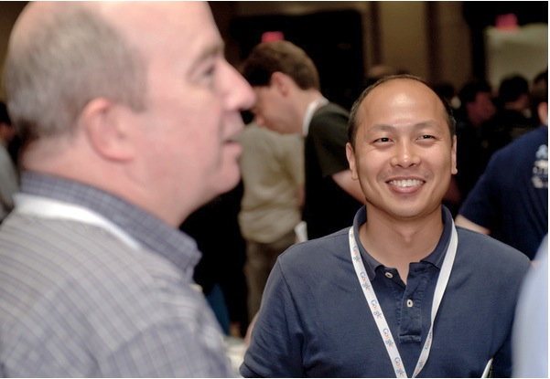
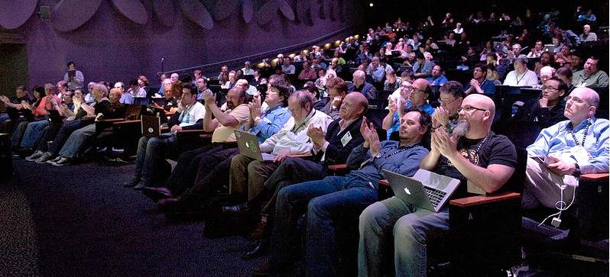
Global IETF Community
2
Photos © Stonehouse Photographic
Notes:
The IETF is an international community of network designers, operators, vendors, and researchers. The IETF is open to any interested individual, and most of its work is conducted over the Internet. The IETF does have three meetings a year, some Working Groups hold interim meetings, and from time-to-time there are workshops on specific topics of interest to the IETF community. But, the overwhelming majority of the IETF’s work is done and all official decisions are taken online so you don’t need to travel to meetings to participate in the IETF.

Slide 7
Ethos of the IETF
Everyone may participate
Keep participation threshold low
Make all work freely available
Judge contributions on technical merits
Determine protocol success by voluntary deployment
“Rough consensus and running code…”
6
Notes:
These are some of the key attributes about how the IETF works. All of the IETF standards processes are open to any individual, and the standards they produce are free to access and use. The standards themselves are focused on technical excellence, and judged by the extent to which they are actually used.

Slide 8
Rough Consensus
Working group discussions
Humming
Last call

Slide 9
Running Code
Gives weight to proposals
A draft with existing code typically > a purely theoretical draft
Hackathon at IETF 92
Working to build implementations of IETF protocols
Code Sprints
Working to improve the IETF tools
Bits-N-Bytes
Demonstrations of implementations of IETF protocols

Slide 10
Permissionless Innovation
These logos are trademarks of individual companies and used for illustrative purposes
Notes:
When developing technology, the IETF usually strives for something we call permissionless innovation. That is, technology that allows others to create new innovations based on it, without limits and without having to come back to us or anybody else when a new application is created. For example none of the most commonly used applications on the Internet today—email, the Web, instant messaging—had been developed when he initial Internet Protocols were developed. No one had to ask permission to create them. That’s the kind of permissionless innovation we strive to continue to enable.

Slide 11
Why is the IETF important to you?

Slide 12
The Internet Standards Body
The IETF is the principal body engaged in the development of new Internet standard specifications.

Slide 13
The IETFs Mission Includes:
Identifying, and proposing solutions to, pressing operational and technical problems in the Internet
Specifying the development or usage of protocols and the near-term architecture to solve such technical problems for the Internet
Making recommendations to the Internet Engineering Steering Group (IESG) regarding the standardization of protocols and protocol usage in the Internet
Facilitating technology transfer from the Internet Research Task Force (IRTF) to the wider Internet community
Providing a forum for the exchange of information within the Internet community between vendors, users, researchers, agency contractors, and network managers

Slide 14
In Other Words…
The IETF is where the future of the Internet is being written – and you’re invited to help!

Slide 15
Why You?
Technical communities inside countries where the Internet is growing (or will grow) the fastest need to be involved in developing the standards that will support that future Internet.

Slide 16
What is the IETF working on today?

Slide 17
Current IETF Work
Enabling the Internet of Things
Strengthening technical foundations for privacy and trust in the Internet
Promoting real-time collaboration through Web browser-based communication
6
Notes:
Some of the most active and exciting developments at the IETF these days are around these topics:
The Internet of things, enabling devices around us to speak IP and become more useful to us, for instance, to save energy.
Improving security and privacy in the Internet—this has been always an issue, but particularly so in the last couple of years. The IETF is committed to doing everything we can from a technical perspective, so that we have the tools for better privacy in the Internet.
Further development of the Web protocols. A new version of the HTTP protocol has just been finalized with significant efficiency improvements. And with protocols like RTCWEB, the IETF is working to make it possible for you to make phone and video calls directly from Web browsers—without plugins or any additional software.

Slide 18
Examples of IETF protocols
Domain Name System (DNS)
Email (IMAP, POP, and SMTP)
World Wide Web transport (HTTP)
Internet Protocol (IPv4 and IPv6)
Instant Messaging (XMPP)
Transmission Control Protocol (TCP)
Open Shortest Path First (OSPF)
Border Gateway Protocol (BGP)
Session Initiation Protocol (SIP)
Multiprotocol Label Switching (MPLS)

Slide 19
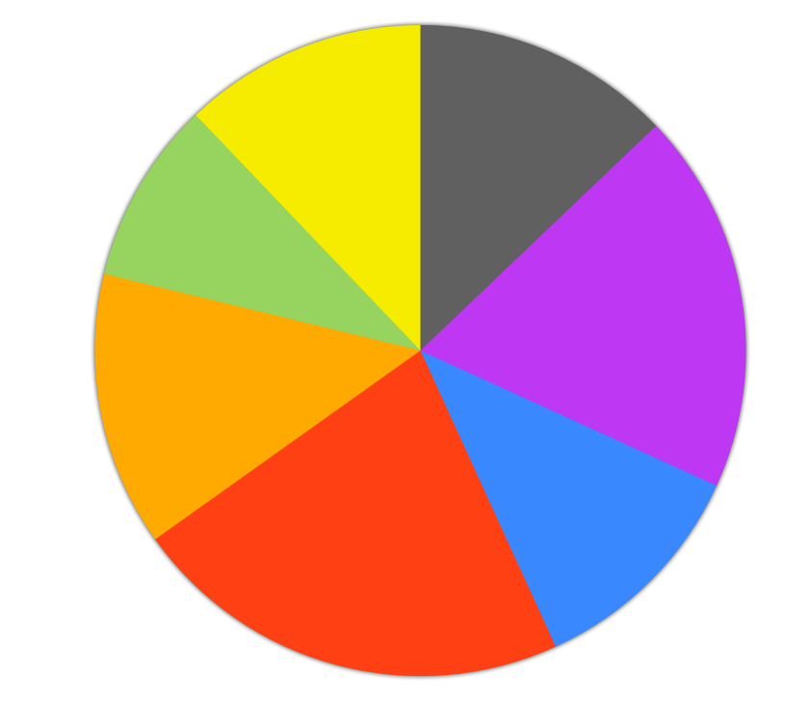
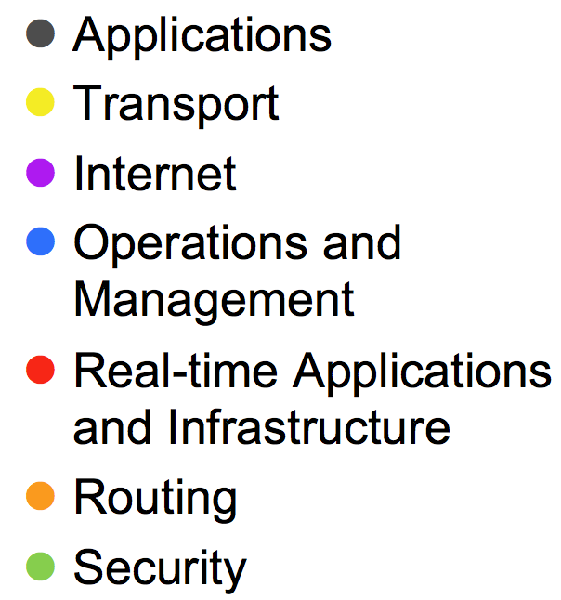
IETF Working Groups
http://datatracker.ietf.org/wg/
behave, tcpm, rmcat
httpbis,scim, websec, iri, eai
tls, jose, oauth, dane
homenet, trill, lisp, dhc, 6lowpan, sunset4, ntp
ccamp, pwe, pim ospf, isis, mpls, pce, idr
clue, codec, dispatch, rtcweb, vipr, xmpp, payload
6renum, dime dnsop

Slide 20
IPv6 Activities
IPv6 now common across most working groups
Some key groups:
v6ops (IPv6 Operations) WG
6man (IPv6 Maintenance) WG
homenet (Home Networking) WG
opsec (Operational Security) WG
sunset4 (Sunsetting IPv4) WG

Slide 21
DNS/DNSSEC Activities
dnsop (DNS Operations) WG
Focus on automation of DNSSEC including communication between zones
dane (DNS-based Authentication of Named Entities) WG
www.internetsociety.org/deploy360/resources/dane/

Slide 22
Routing Activities
sidr (Secure Inter-Domain Routing) WG
Focus on securing the routing infrastructure
idr (Inter-Domain Routing Working Group) WG

Slide 23
TLS Activities
uta (Using TLS in Applications) WG
Aim is to provide guidance to application developers
dane (DNS-based Authentication of Named Entities) WG
tls (Transport Layer Security) WG

Slide 24
How To Get Involved

Slide 25
IETF Mailing Lists
Majority of IETF work is done on Working Group mailing lists
http://datatracker.ietf.org/wg/
Mailing lists are open
Simply subscribe and start participating!
Start small
The most common mistake is to join too many mailing lists initially

Slide 26
IETF Meetings
Three times each year
Move around the world to different locations
Continuation of discussions on email lists

Slide 27
IETF Meetings – Recent/Upcoming Locations
IETF 89 – March 2014 – London, UK
IETF 90 – July 2014 – Toronto, Ontario, Canada
IETF 91 – November 2014 – Honolulu, Hawaii, USA
IETF 92 – March 2015 – Dallas, Texas, USA
IETF 93 – July 2015 – Prague, Czech Republic
IETF 94 – November 2015 – Yokohama, Japan
IETF 95 – April 2016 – Buenos Aires, Argentina
IETF 96 – July 2016 – Berlin, Germany
IETF 97 – November 2016 – Seoul, South Korea

Slide 28
IETF 92 – March 22-27, Dallas
www.ietf.org/meeting/92/
Just last week!
1,216 attendees on site from 57 countries (~13/4 ME)
Policymakers from Egypt and Qatar in attendance
Our posts about IETF 92 at:
http://www.internetsociety.org/deploy360/blog/tag/ietf92/
https://www.internetsociety.org/rough-guide-ietf92

Slide 29
Next Meeting - IETF 93 – July 19-24, Prague
http://www.ietf.org/meeting/93/
Remote participation available:
Audio streams
Web conferencing systems
Jabber chat rooms

Slide 30
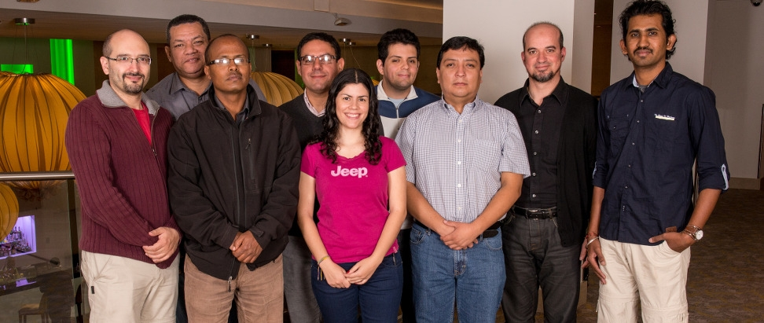
IETF Fellows Program
Fellowships available to enable people to attend IETF meetings
http://bit.ly/ietf-fellows

Slide 31
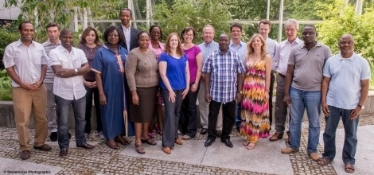
"Regulators to the IETF" Program
Fellowships available for regulators to attend IETF and learn about IETF standards process
http://bit.ly/ietf-fellows

Slide 32
Help The IETF Create Better Standards
To Learn More:
http://www.ietf.org/newcomers.html
http://www.ietf.org/tao.html
Particularly:
IPv6 Operations (V6OPS)
DNS Operations (DNSOP)
You can:
Join the mailing lists
Read the drafts and provide comments
Submit your own Internet-draft

Slide 33
Thank You http://www.internetsociety.org/deploy360/ deploy360@isoc.org

