Slide 1
The Flat Earth Theory: Convergence of Prices Around the World (Middle East Edition)
Alan Mauldin
TeleGeography
MENOG 15 Dubai
April 1, 2015

Slide 2
The Original Flat Earth Theory

Slide 3
The New Flat Earth Theory

Slide 4
The Flat Earth Theory and Global Prices
Prices of transport and IP transit are constantly declining.
Have prices become “flat” (similar) across major world regions and routes?
If so, why may this be happening?
What are the prospects for more “flattening”?

Slide 5
Words Of Caution
TeleGeography has collected pricing data anonymously from operators around the world since 2002.
Prices shown here are median prices for a single unit for a one-year term.
A broad range of prices exists in the market.
Substantial discounts exist for higher volumes and longer terms.
Discounts also exist depending on who you are (what is the broader commercial relationship and type of the customer).

Slide 6
Transport

Slide 7
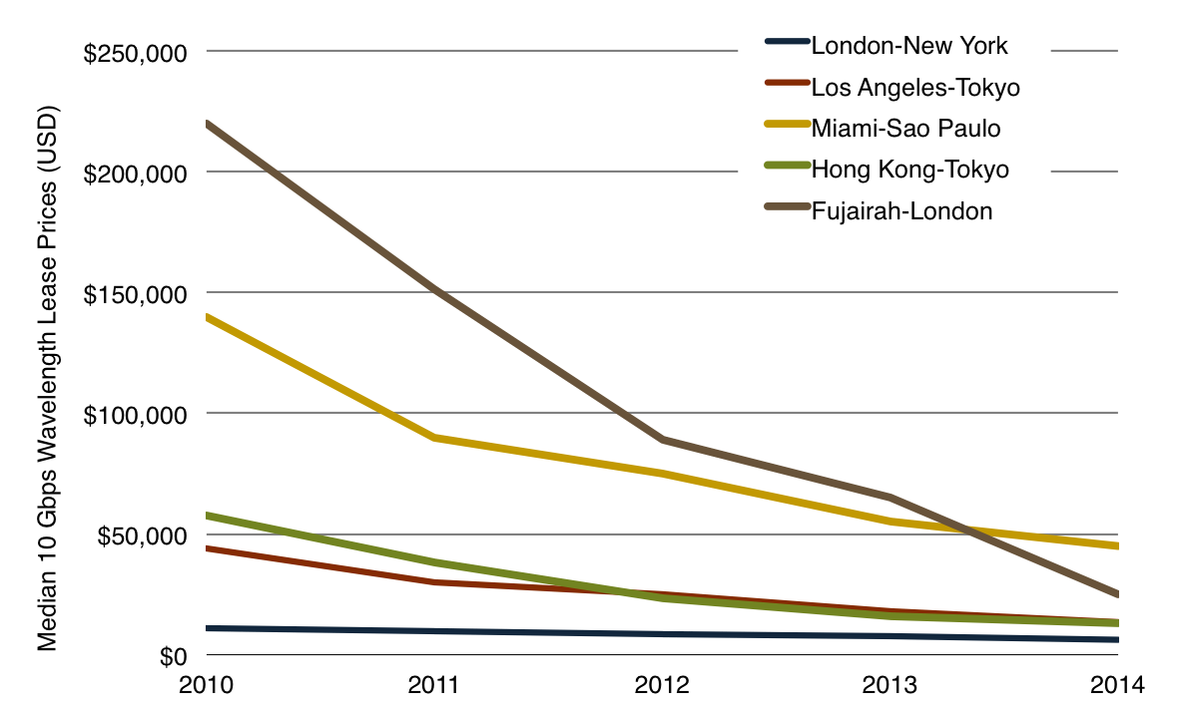
Prices Perpetually Decline
Median Monthly 10 Gbps Wavelength Lease Price, 2010-2014

Slide 8
Factors that Explain (Submarine) Transport Price Variance
Length
Longer cables require more fiber and repeaters, use more power, and have higher maintenance costs.
Competition
More cables on a route should lead to lower prices.
Supply
Higher-capacity cables have lower unit costs for O&M and capacity upgrades, can charge lower prices.

Slide 9
Factors that Explain (Submarine) Transport Price Variance
Network Configuration
Direct subsea paths exist for London-New York and Los Angeles-Tokyo route, so no substantial difference in terminal equipment requirements.
For Fujairah-London, multiple submarine segments and terrestrial are used (e.g. London-Marseilles-Alexandria-Suez-Fujairah) which makes it inherently more expensive.
Not all cables serving a route are the same – e.g. different landings, availability of express fiber pairs.

Slide 10
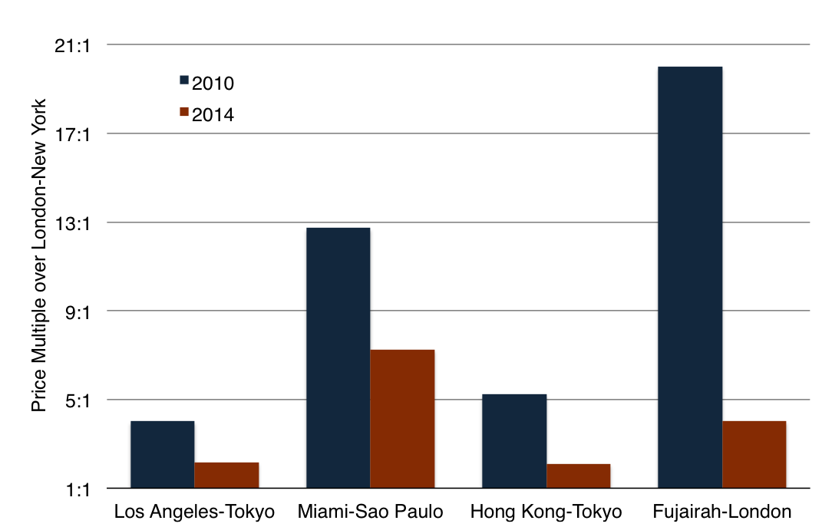
Price Differences Are Narrowing
10 Gbps Wavelength Lease Price Multiples over London-New York

Slide 11
Why Are Prices Converging?
Length? No.
New cables are not significantly shorter than existing systems.
More importantly, pricing on some routes increasingly is based on the incremental upgrade costs (which does not account for distance), instead of construction costs.

Slide 12
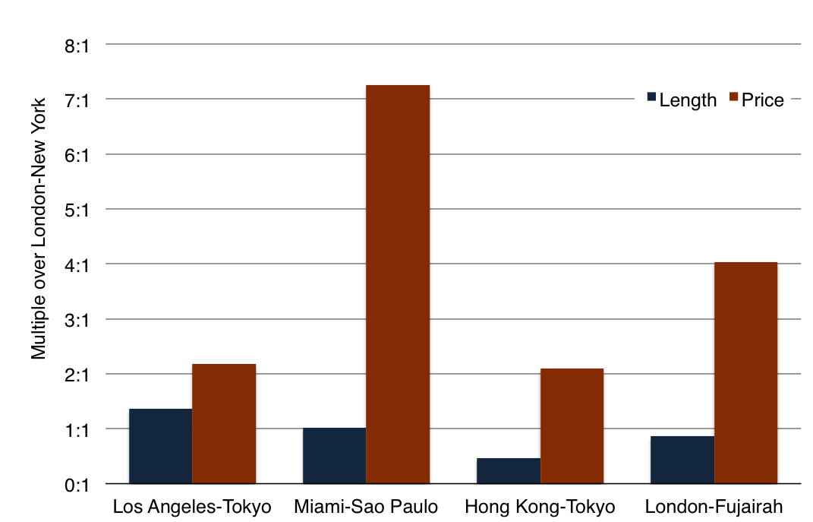
Distance versus Price
Length and Price Multiple over London-New York, 2014

Slide 13
Why Are Prices Converging?
Length? No
Competition? Yes.
Competition increased on some routes, many new cables since 2008.

Slide 14
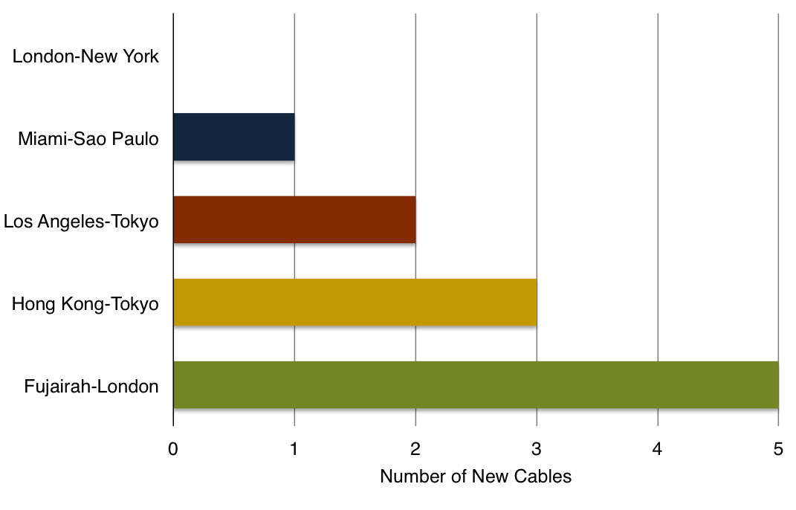
New Cables’ Impact Varies by Route
Number of New Cables by Route, 2008-2014

Slide 15
Why Are Prices Converging?
Length? No
Competition? Yes
Supply? Yes
Similar volumes of lit capacity on cables lead to similar unit costs for upgrades.

Slide 16
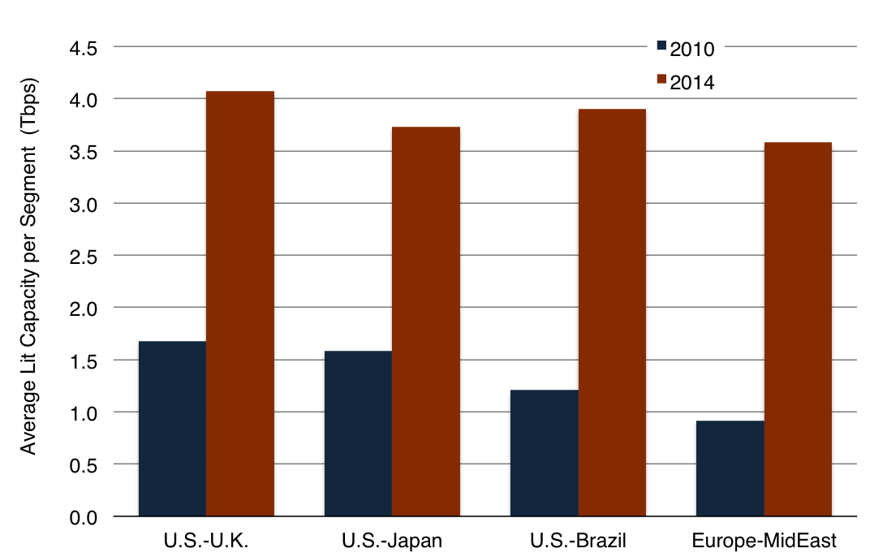
Capacity per Cable Becoming Similar
Average Lit Capacity on 3 Highest-Capacity Cables

Slide 17
Why Are Prices Converging?
Length? No
Competition? Yes
Supply? Yes
Network design changes? Yes
Less equipment required with express routes and OADMs branching units
Better integration of backhaul reduces city-to-city prices.

Slide 18
Prospects for Further Transport Price Convergence
Competition is increasing (SMW-5 and AAE-1 in 2016)
Ability to further improve network design with OADM branching units and more landings directly in colo sites to reduce upgrade costs.
Prices on major routes will continue to converge, but a single global price between any two locations may never occur given disparities in underlying demand and costs.

Slide 19
Ip Transit

Slide 20
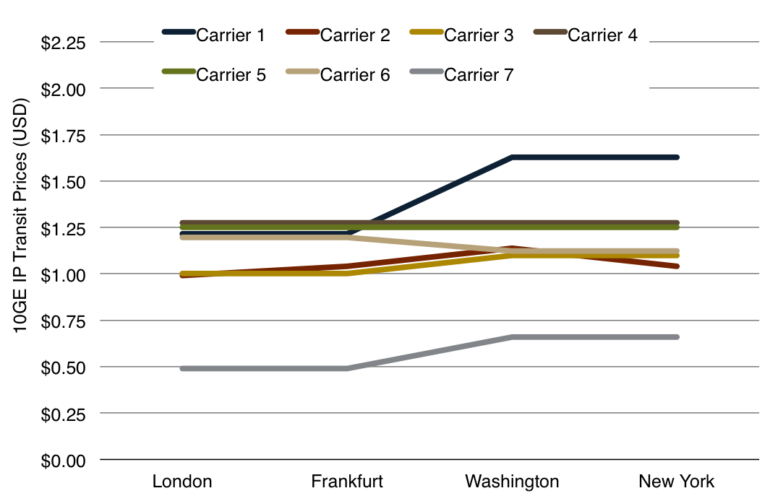
Relative “Flatness” Already Exists in Europe and North America
10 GigE IP Transit Prices for Selected Carriers, Q4 2014

Slide 21
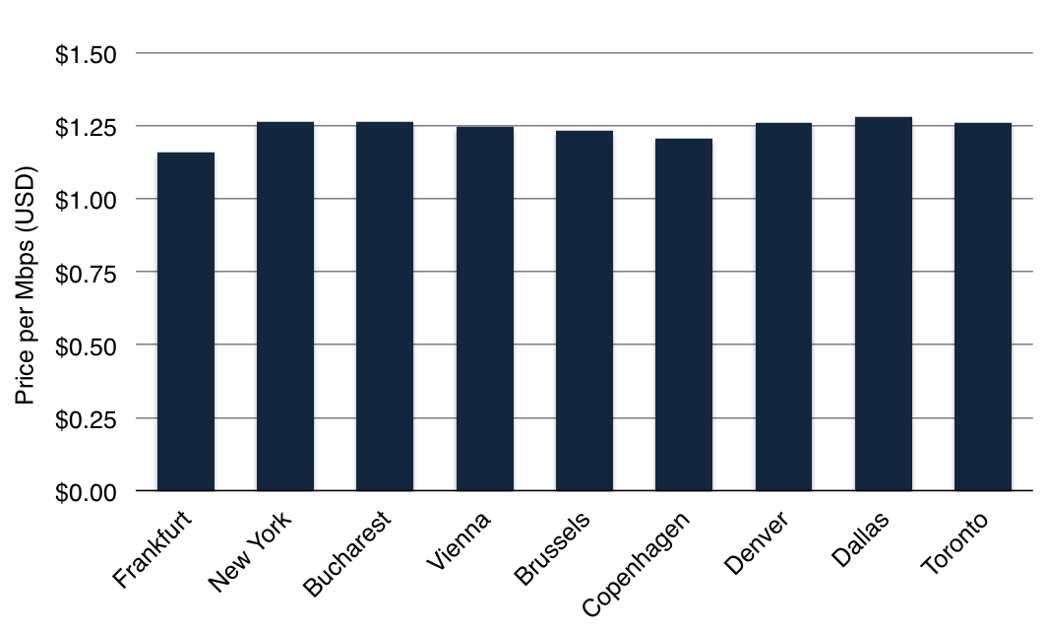
Similar Prices Even Outside of Major Hubs too
Median 10 GigE IP Transit Prices, Q4 2014

Slide 22
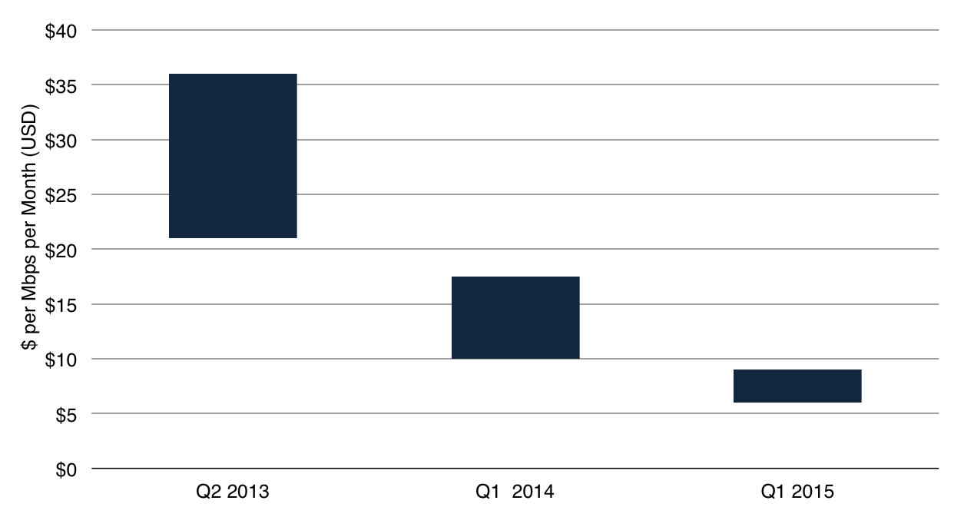
IPT Prices Dropping Rapidly Especially in the Middle East
10 GigE IP Transit Price Range in Dubai

Slide 23
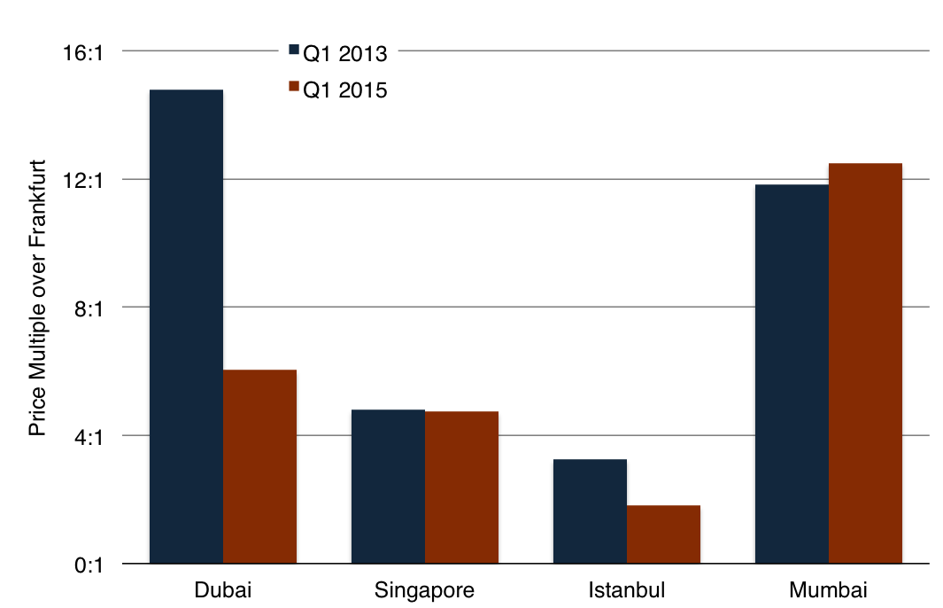
Prices Not Always “Flattening”
10 GigE IP Transit Price Multiples over Frankfurt

Slide 24
What Factors Influence IPT Price Convergence?
Transport prices – outside of major U.S. and European cities, IPT prices often reflect the cost of transport to a hub city.
Higher transport prices -> Higher IPT prices.
Type of competition.
IPT providers offering low-price service do not exist all over the world.
Expensive backhaul/cross-connects

Slide 25
Outlook for the Middle East
Transport prices between the Middle East and Europe are becoming more similar to other major routes, increased erosion expected with new cables.
Difference between Middle East and European IP transit prices have narrowed substantially, but cross-connect and backhaul prices remain relatively expensive.

Slide 26
Outlook for the Middle East
Lower prices for transport and IPT, along with regional interconnection facilities (e.g. Smarthub and Datamena) helping to move more content to the region.
Networks remain primarily focused on connecting to Europe—substantial investments have been and are still being made for subsea and terrestrial routes.

Slide 27
Thank You
Alan Mauldin
amauldin@telegeography.com

