Slide 1
The Role IXPs and Peering Play in the Evolution of the Internet
MENOG14, Dubai, 30-31 March 2014
Stephen Wilcox, President and CTO, IX Reach

Slide 2
A Quick Introduction
Stephen Wilcox – founded IX Reach in 2007, President and CTO
Global leading provider of wholesale carrier solutions such as:
  IX Remote Peering
  Low Latency Global High-Speed Point-to-Point and Multipoint Capacity
  Metro and DWDM in Major Cities
  Enterprise Business IP
  BGP Transit
  Cloud Connectivity Solutions (AWS Direct Connect)
  Colocation
30 major global cities (and growing)
90+ data centres on-net
26 Internet Exchanges partners globally

Slide 3
Internet Exchange Points – The Early Days
Early Internet evolved in the US
In the early to mid 90s everyone bought Transit from Tier 1 ISPs
Most content originated within the US, long international circuits
This led to high costs for local operators
They ultimately gathered together to create local points of interconnections to reduce costs and improve user experience
This resulted in more traffic remaining within national borders
The resulting IXPs were set up by academic and research networks or by telecom operators

Slide 4
Internet Exchange Points – The Situation Today
400+ Internet Exchanges around the world
The majority, and largest, are concentrated in Europe (over 50)
Only a few are classed as international hubs
But all play a part in ASN topology and evolving the Internet
Daily trafﬁc volumes are comparable to those seen by largest global Tier 1 ISPs
The largest are increasing their services and expanding to become multi-site IXPs (or bigger brands)
IXPs are widely considered to help develop markets
IXPs are critical for understanding how content is distributed in today’s Internet and how the different networks are adapting to the changing nature of content distribution
Lower costs of peering eg resellers drive viable peering long distances

Slide 5
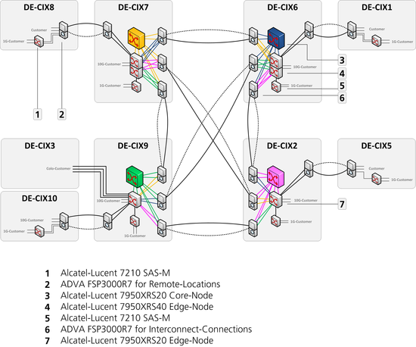
Example Major IXP Infrastructure

Slide 6
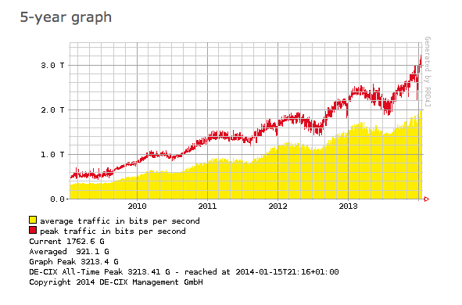
Source: DE-CIX

Slide 7
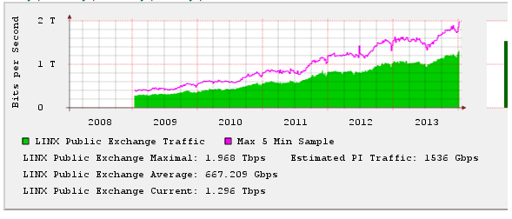
Source: LINX

Slide 8
Source: AMS-IX

Slide 9
Benefits and Key Observations of IXP Activity
Tier-1s are members at IXPs and do public peering
  Typically ‘restrictive’ peering policy
  Most IXP members use an ‘open’ peering policy
Many IXPs make it very easy for its members to establish public peerings with other members
  ‘Handshake agreements’
  Use of IXP’s route server is offered as free value-added service
  Use of multi-lateral peering agreements
Most peering links at an IXP see traffic, they’re not just for backup
  Most of the public peering links see traffic
  Does not include traffic on the private peering links at IXP

Slide 10
Benefits and Key Observations of IXP Activity
Large IXPs are starting to look more and more like networks
  Offering SLAs (DE-CIX in 2008, AMS-IX in 2011)
  Support for IXP resellers (e.g. IX Reach)
  Expanding geographically (both domestically and internationally) - becoming multi-site IXPs and using their ‘brand’ (e.g. France-IX Marseille, UAE-IX powered by DE-CIX, the US market and Open-IX community)
  Extensive monitoring capabilities
  Small IXPs are expanding regionally and offering remote peering to bigger IXPs (e.g. LU-CIX’s Central European Peering Hub
  Some have their own partial networks and offer connectivity - anything to help connect new members
It is becoming increasingly difficult to differentiate between international and local peering, and Networks and Internet Exchanges

Slide 11
Peering Patterns Geographically
Lack of local peering infrastructure normally means higher bandwidth pricing in many emerging markets (history repeating itself)
Traffic is sent internationally that would be more economical to keep local, e.g. as seen in the Middle East and parts of AsiaPac
The US, historically, didn’t have the same commercial drivers being dominated by national Tier1s. IXPs were often commercially operated by these operators e.g. Worldcom and later as a secondary value add service e.g. Equinix and Telehouse
Expanding IXPs helps keep local traffic local, unburdens expensive interregional links and stimulates investment in local networks

Slide 12
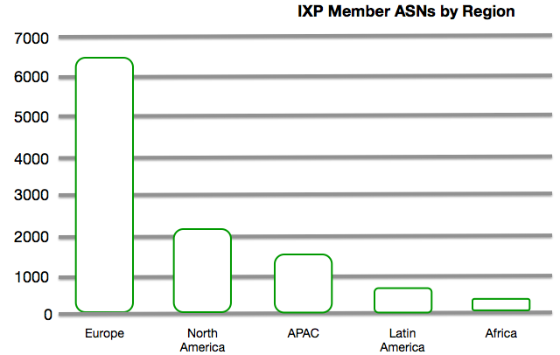
European IXP Model Vs the US IXP Model
Managed non-profit IXPs are now moving to the USA with the support of the Association Open-IX
North American IXP marketplace is dominated by for-profit IXPs
IXPs in North America have less peerings historically
Source: Euro-ix

Slide 13
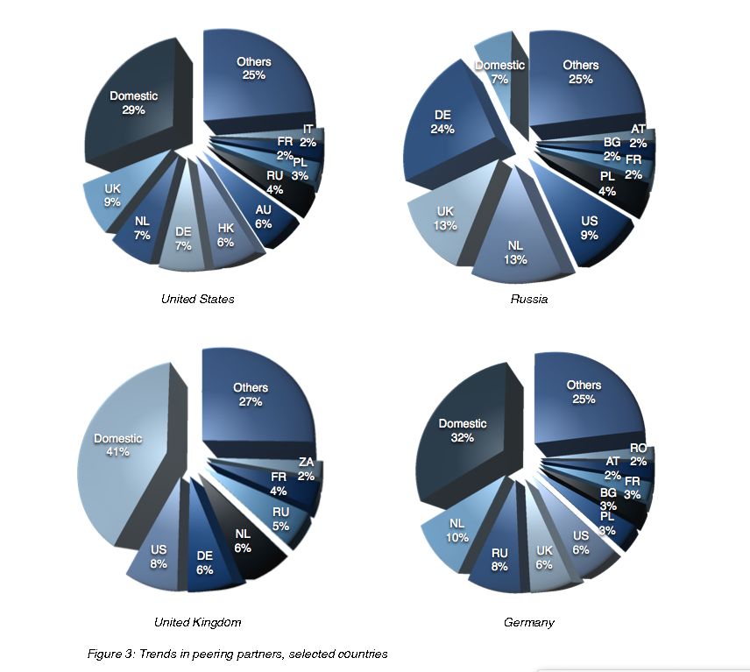
Source: PCH

Slide 14
Peering vs Transit – A Reminder
Peering:
Settlement-free interconnection between two networks
Cost efficient
Traffic optimisation and low latency
Scalability and redundancy
Improved end-user experience – closer to the eyeballs
Community and marketing
Transit:
Connecting smaller ISPs, for a fee, to the larger Internet
Historically more expensive
No control over routes

Slide 15
Influence from Remote Peering
AMS-IX, “75% of new members come from reseller partners”
No local infrastructure at the IXs
Typically bundled pricing and deployment model – One Stop Solution
Lower operational and capex costs
Fast turn up compared to traditional physical deployment (hours vs weeks)
Peering is more accessible to smaller/medium sized networks and developing markets

Slide 16
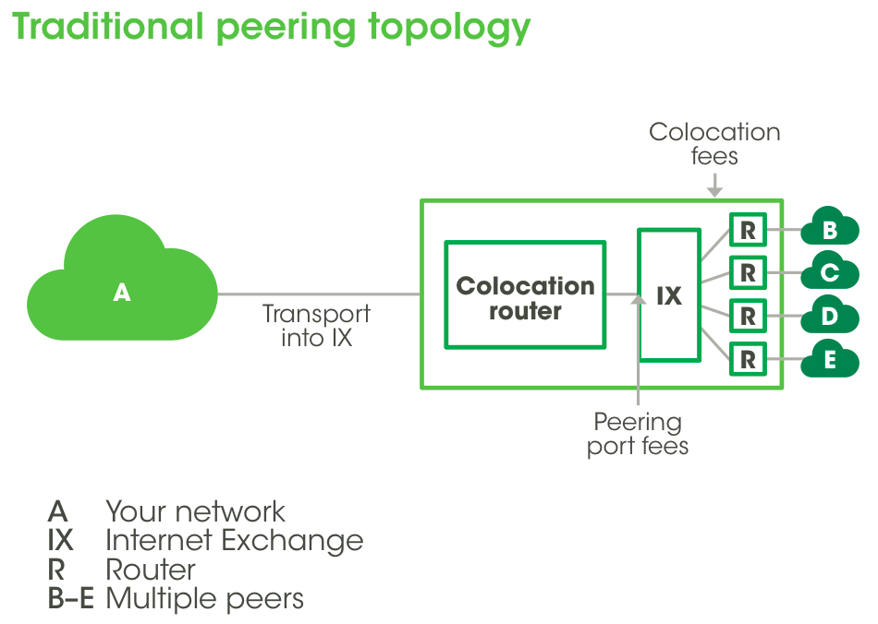

Slide 17
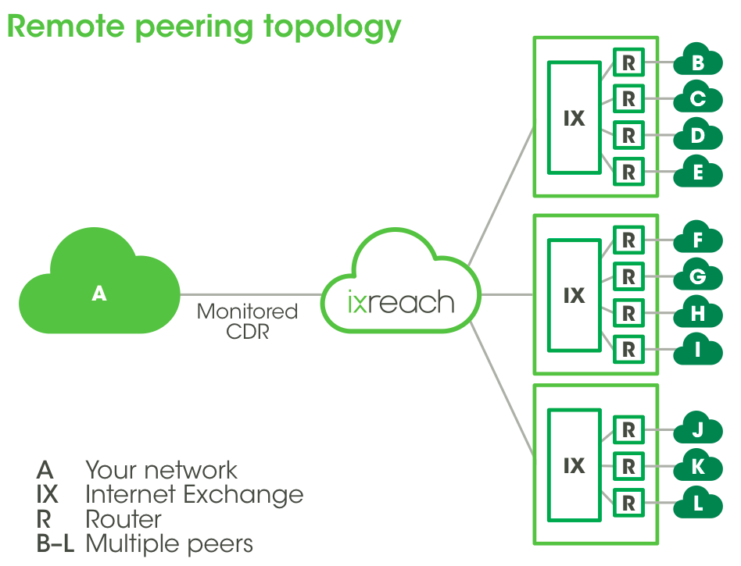

Provider

Slide 18
Typical Peering Relationships
Open peering
Selective peering
Restrictive/Closed peering
Similar sized ISPs peer together
Upstream providers sell Transit to lower Tiers when traffic is not balanced
Forming network of interconnections that creates the Internet

Slide 19
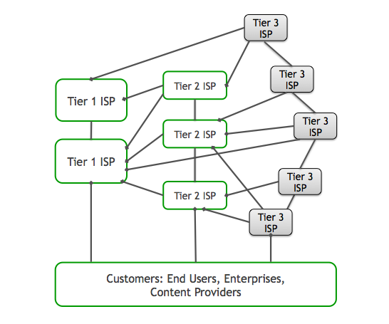
Which looks a bit like this…

Slide 20
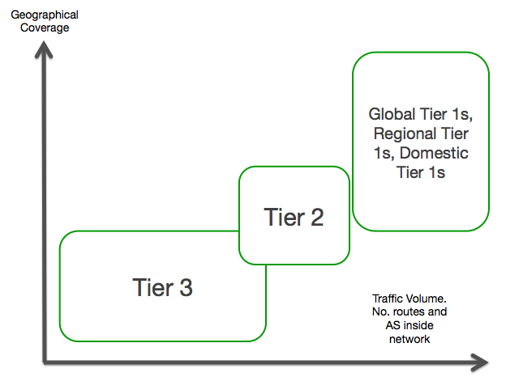
Notes:
There are fewer Tier 1 ISPs and they have the largest number of routes. Many Tier 1s reside in the US and many Tier 2s and Tier 1s in Asia and Europe.

Slide 21
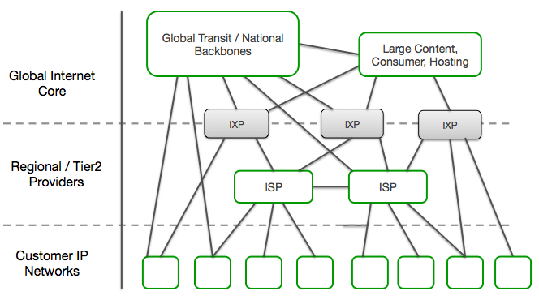
Internet Map 2000s

Slide 22
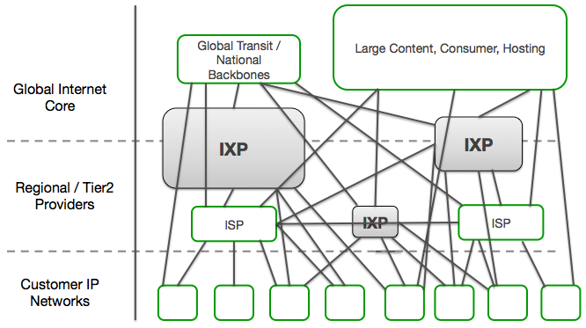
Internet Map Today

Slide 23
Peering on a Handshake
Peering model isn’t perfect
99.5% of peering is on a handshake
Tiers 2 and 3 free peer with Tier 1s (when profitable)
Peering ratios and bandwidth share are scrutinised
De-peering can occur when unbalanced
Tier 1s have more power and can apply pressure
Smaller Tiers are forced to pay or they’re de-peered
Potential disruption to end-users
Potentially huge financial losses to smaller Tiers

Slide 24
Cases of De-Peering
2005, Level 3 Communications de-peered Cogent
  Isolation of millions of IP addresses
December 2002, Cogent and AOL during a ‘test’ peering
2005, Level 3 Communications and XO Communications
October 2008, Cogent and Sprint.
  289 single homed autonomous systems behind Cogent and 214 autonomous systems behind Sprint were unable to connect to each other

Slide 25
Non-US Cases of De-Peering
March 2008, Cogent USA and Telia in Sweden
  Outage that lasted from 13th March, 2008 to 28th March, 2008.
  Mostly impacted US customers of Cogent and North-Central Europe customers served by Telia.
  1.6% of the routes in the global routing table were partitioned
January 2011, Egypt de-peered themselves
  First de-peering of its kind in Internet history
  Attempt to block routing information between international ISPs during the revolution
April 2005, France Telecom and Cogent
  France Telecom tried to get Cogent to pay to reach their customers in their territory
March 2012, Cogent and China Telecom

Slide 26
Avoiding Non-Technical Network Issues
Don’t rely too heavily on one transit provider, capacity plan carefully
Peer directly with your important ASNs:
  Overbuild peering to allow failover and improve connection quality
  Peer publicly and privately
  Prepare to pay for peering for important traffic
Have a backup solution for both technical and non-technical issues of de-peering
Multi-home – a single incident is less likely to affect you
Use agreements with monopoly providers, build in flexibility

Slide 27
IXPs’ Impact in the Future
Richness in peering and opportunities for flexible and sophisticated routing policies
Makes strategic alliances between ISPs and CDNs more attractive for end user content delivery that’s faster and more efficient
Internet traffic flow analysis becomes increasingly more difficult as peerings increase and diversify
Rise in Cloud providers adds an additional layer of complexity
IXPs provide a valuable ‘vantage point’ for traffic analysis on both a local and international level
Increased number of multi-site IXPs may decrease the level of international peering at major IXPs

Slide 28
Trends and Evolution
Smaller networks become more global as transport costs fall and remote peering becomes more common
Move of content from being seen as a customer to being a main player in the Internet core
Increased interconnection between regional networks and major content providers (“donut peering”)
Shift of traffic away from historical Tier1s towards direct peering between networks and content
Increasingly content delivered directly into a network operators network

Slide 29
More information
Any questions?
Contact:
  Email: steve.wilcox@ixreach.com
  Web: www.ixreach.com
  Services: enquiries@ixreach.com

