Slide 1
Submarine and Terrestrial Network Developments in the Middle East
Alan Mauldin
TeleGeography
MENOG 14
March 30, 2014

Slide 2
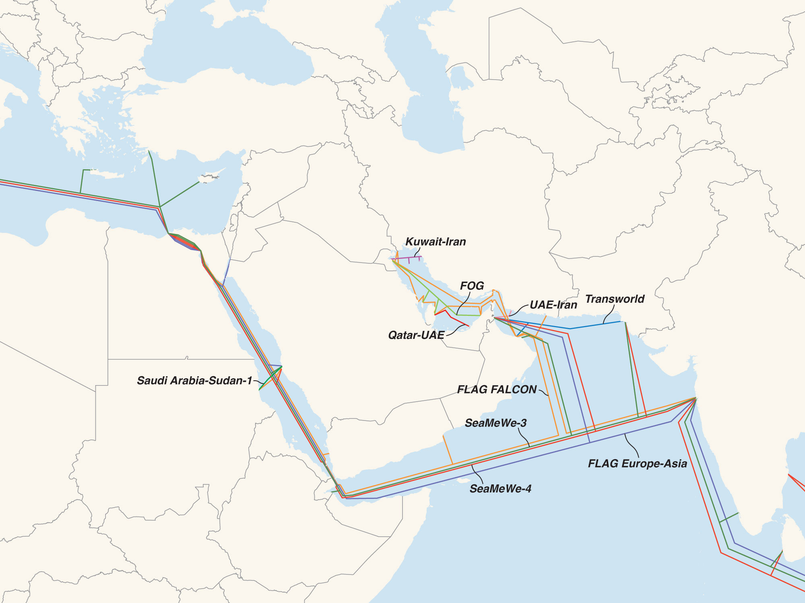

Middle East Submarine Cables 2008
Carlsbad, CA | Washington, DC | Exeter, UK | Singapore | www.telegeography.com | info@telegeography.com

Slide 3
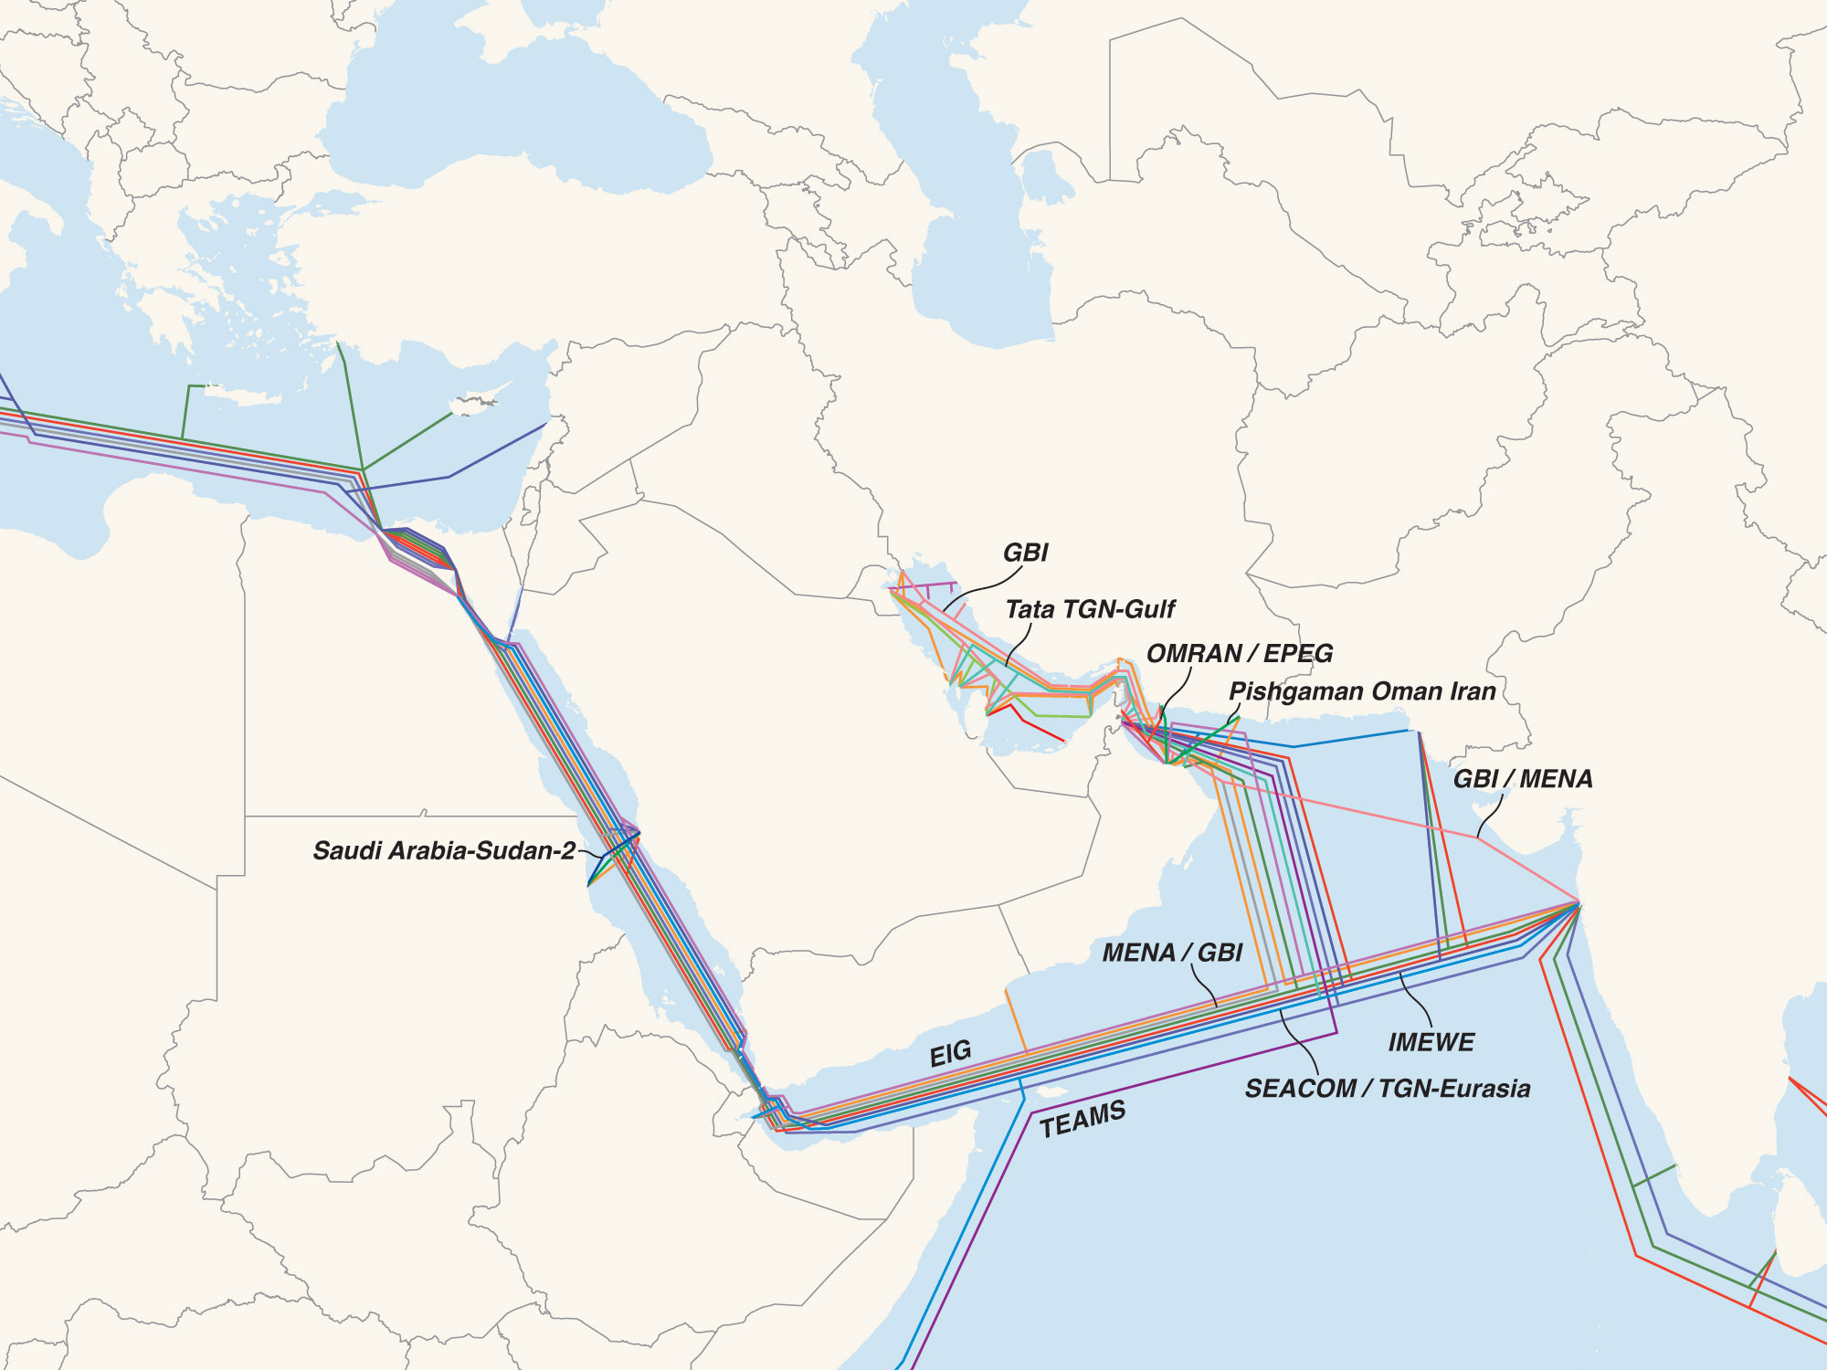
Middle East Submarine Cables 2014
Carlsbad, CA | Washington, DC | Exeter, UK | Singapore | www.telegeography.com | info@telegeography.com

Slide 4
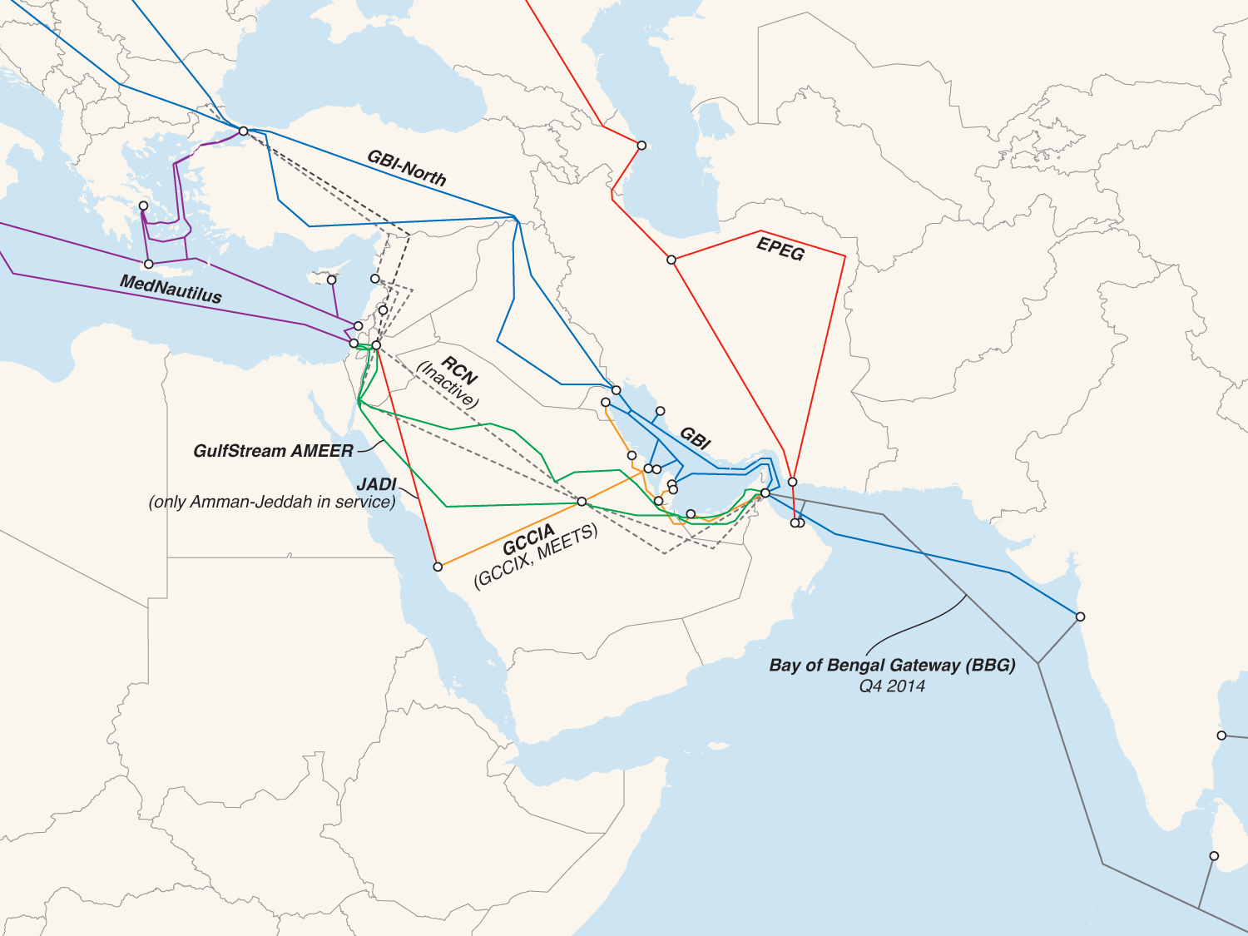

Terrestrial/Hybrid Routes
Carlsbad, CA | Washington, DC | Exeter, UK | Singapore | www.telegeography.com | info@telegeography.com

Slide 5
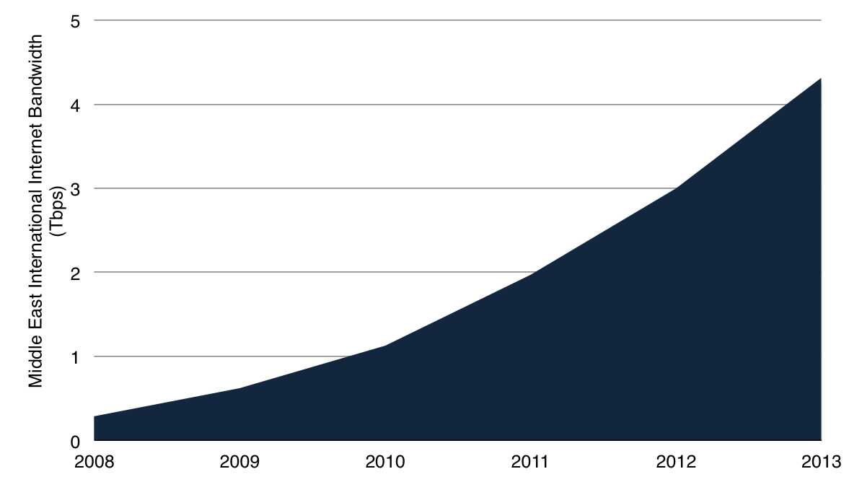
Rapid Growth of Internet Bandwidth
Middle East International Internet Bandwidth, 2008-2013
5 Year CAGR = 72%

Slide 6
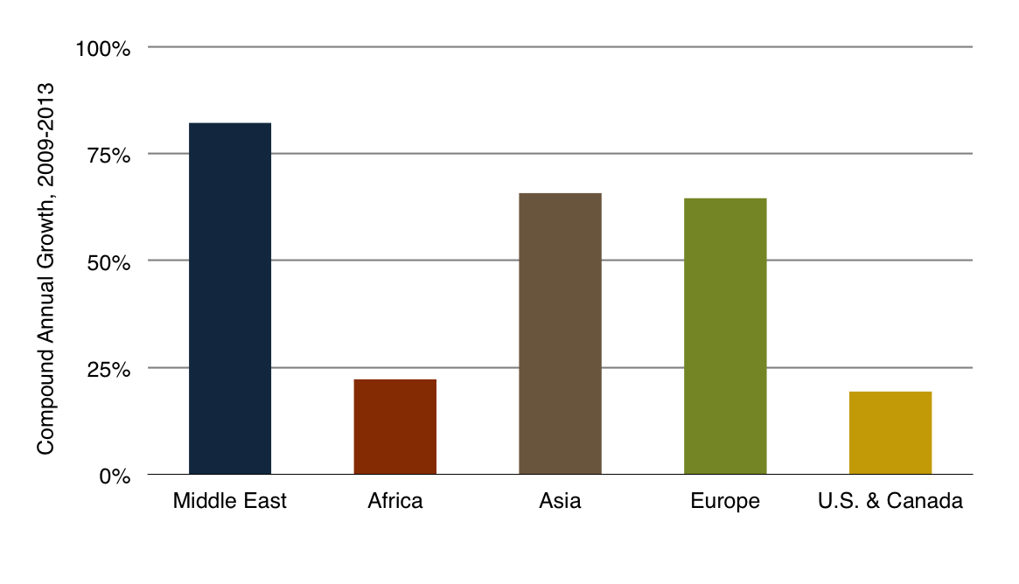
Intra-Middle East Capacity Rising Rapidly…
Growth in International Internet Bandwidth Connected to the
Middle East by Region

Slide 7
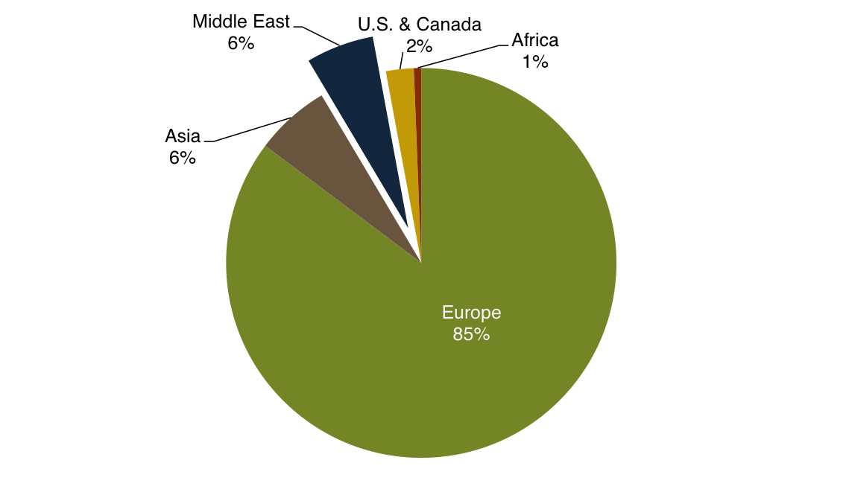
…but Remains a Small Share
Share of International Internet Bandwidth Connected to the
Middle East by Region, 2013

Slide 8
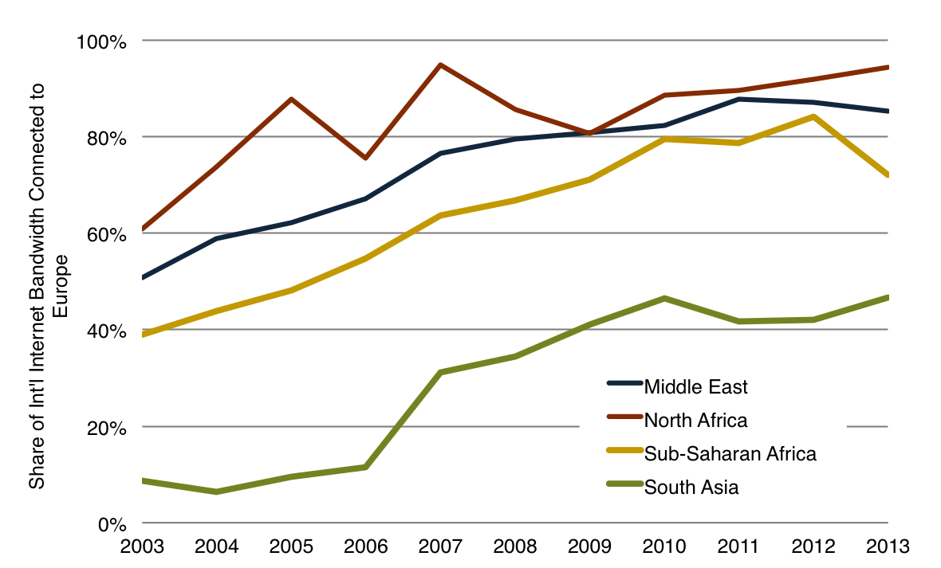
Europe’s Growing Role as a Hub
Regional Internet Capacity Connected with Europe

Slide 9
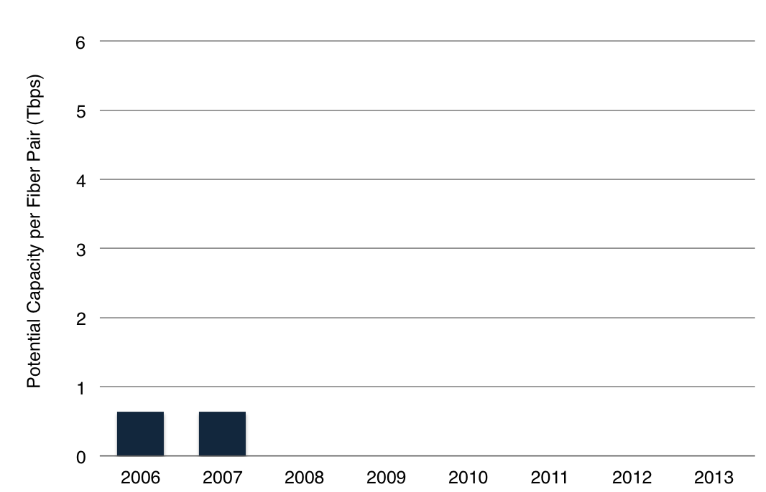
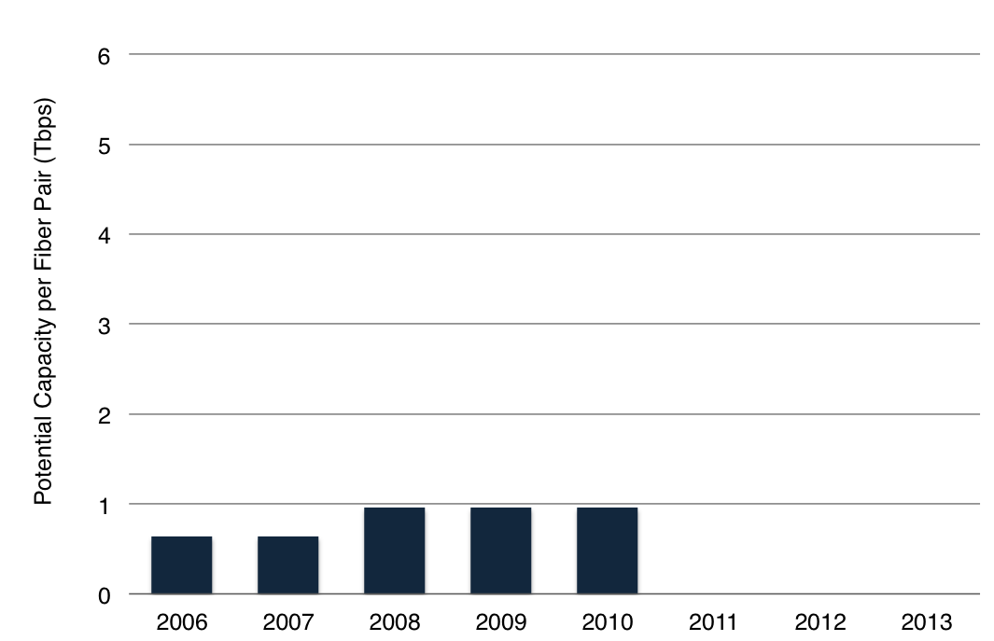
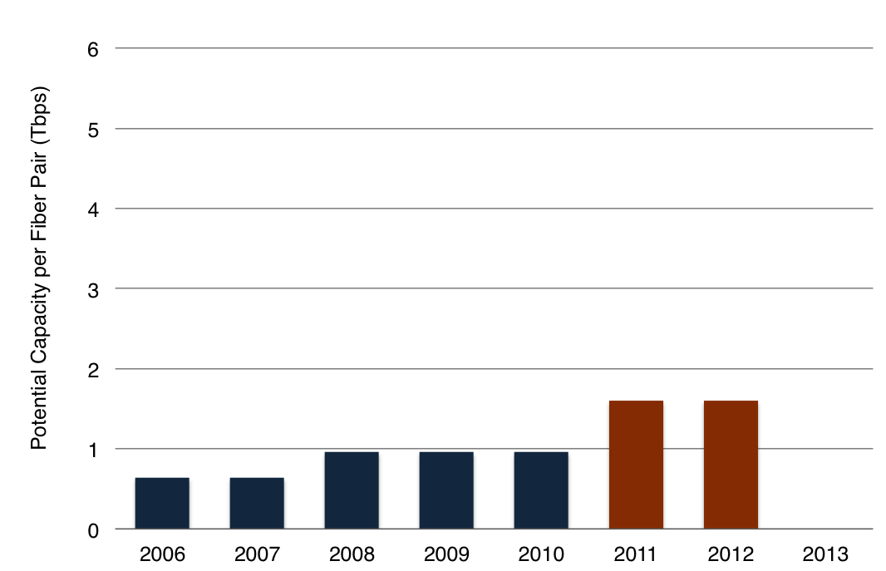
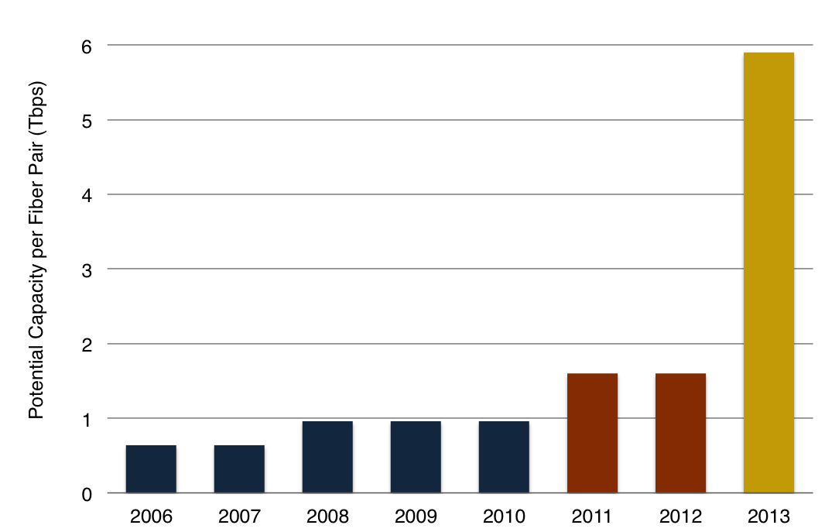
From a 10G to a 100G World
Potential Capacity per Fiber Pair on FALCON (Gulf Ring)
59 x 100 Gbps
40 x 40 Gbps
64 x 10 Gbps
96 x 10 Gbps

Slide 10
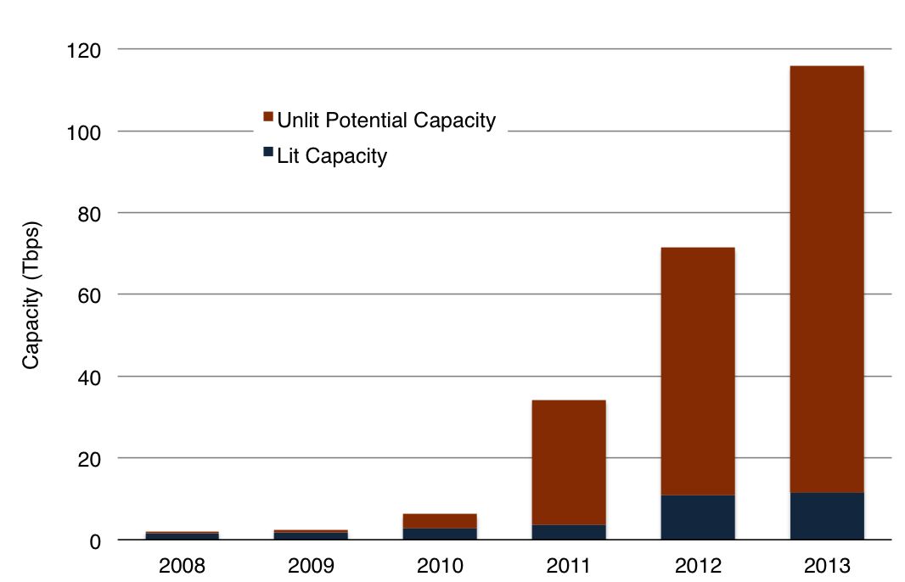
Plenty of Room to Grow
Europe-Asia/Middle East via Egypt Lit Cable Capacity
10% Lit
77% Lit

Slide 11
Cable Damage Still An Issue
Multiple Cable Faults
in 2008…
…and again in 2013.

Slide 12
More Cables on the Way
Submarine Cables
UAE-Oman-India-SE Asia: Bay of Bengal Gateway (BBG) Q4 2014
Europe-Middle East-India-SE Asia: Asia Africa Europe-1 (AAE-1) and SeaMeWe-5 (SMW-5) in 2016
Terrestrial Networks
MEETS extension from Kuwait to Turkey via Iraq
Additional trans-Iran routes
Libya-Sudan linking Med and Red Sea Coasts

Slide 13
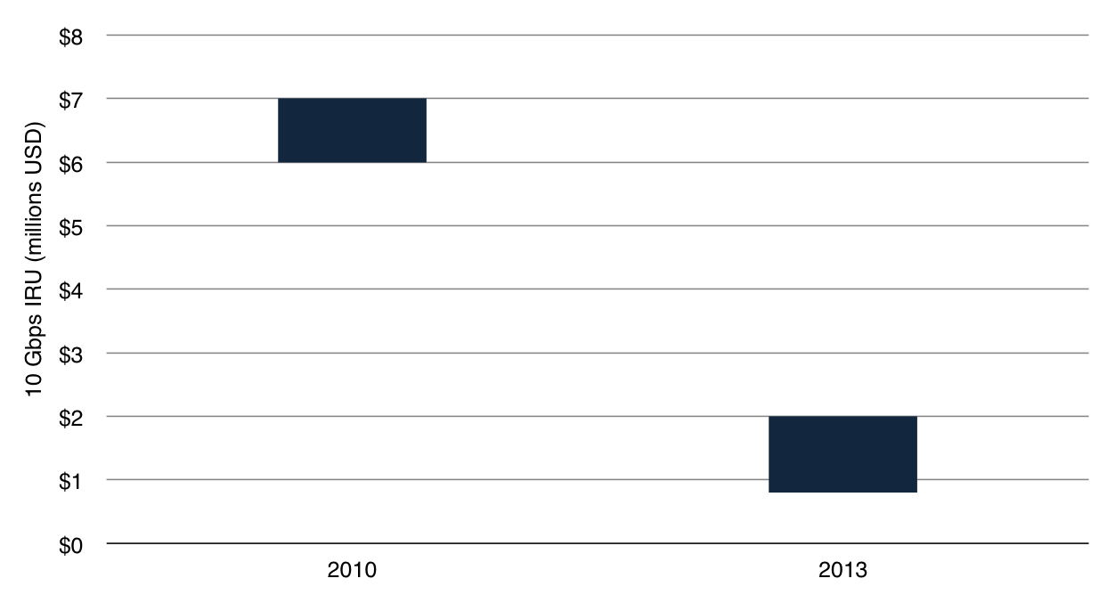
Transport is Getting Cheaper…
Marseilles-Fujairah 10 Gbps Wavelength IRU Price Range, 2010 vs. 2013

Slide 14
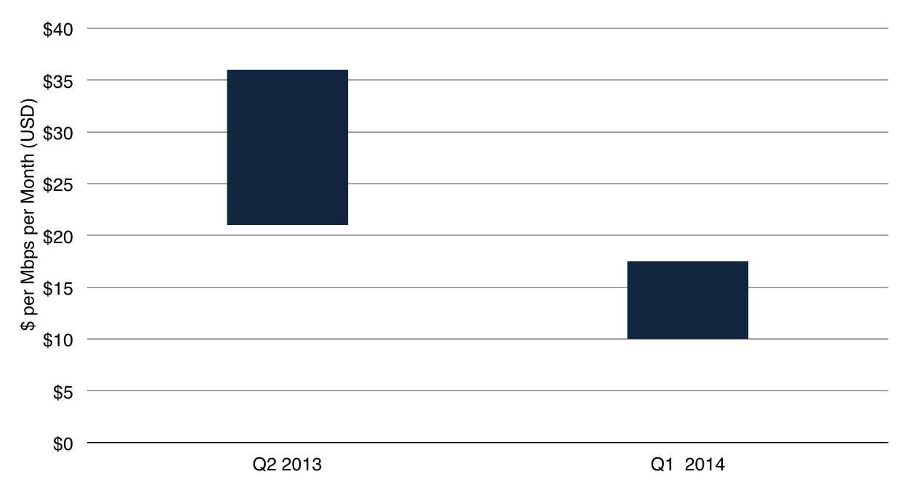
..and so is IP Transit
Dubai IP Transit 10GE Price Range, Q2 2013 vs. Q1 2014

Slide 15
Conclusion
Recent construction has infused the region with considerable lit and potential capacity
Fractured market structure and need to manage for risk continue to fuel new construction
More regional interconnection and local content (UAE-IX, Datamena, Smarthub), but networks still focused on accessing Europe
Prices for transport and IP transit are dropping rapidly; however, cross connect and backhaul fees remain expensive.

Slide 16
Online Submarine Cable Map
Available at: www.submarinecablemap.com

Slide 17
Thank You
Alan Mauldin
TeleGeography
amauldin@telegeography.com

