Slide 1
2012 Infrastructure Security Report
Darren Anstee, Arbor Solutions Architect
8th Annual Edition

Slide 2
Key Findings in the Survey*
Advanced Persistent Threats (APT) a top concern for service providers and enterprises
  This year’s survey found an increased level of concern over ‘botted’ or compromised machines on service provider networks
  Looking ahead, there is even more concern about APT, industrial espionage, data exfiltration and malicious insiders
DDoS: Attack Sizes Plateau in Trend Towards Complex Multi-Vector Attacks
  HTTP and DNS most common application layer targets
  Growth in proportion of respondents seeing attacks targeting HTTPS
  Largest volumetric attacks in 60 – 100 Gbps range
Data Centers Increasingly Becoming Victimized
  94% of datacenters seeing DDoS attacks regularly
  Just over a third see firewalls fail due to DDoS attacks
  As more companies move their services to the “cloud,” shared risk is more of an issue
Ideology Is Primary DDoS Driver
  Top 3 attack motivations are based on politics, gamesmanship, beliefs and revenge
*Survey time period: Oct 2011 – Sept 2012

Slide 3
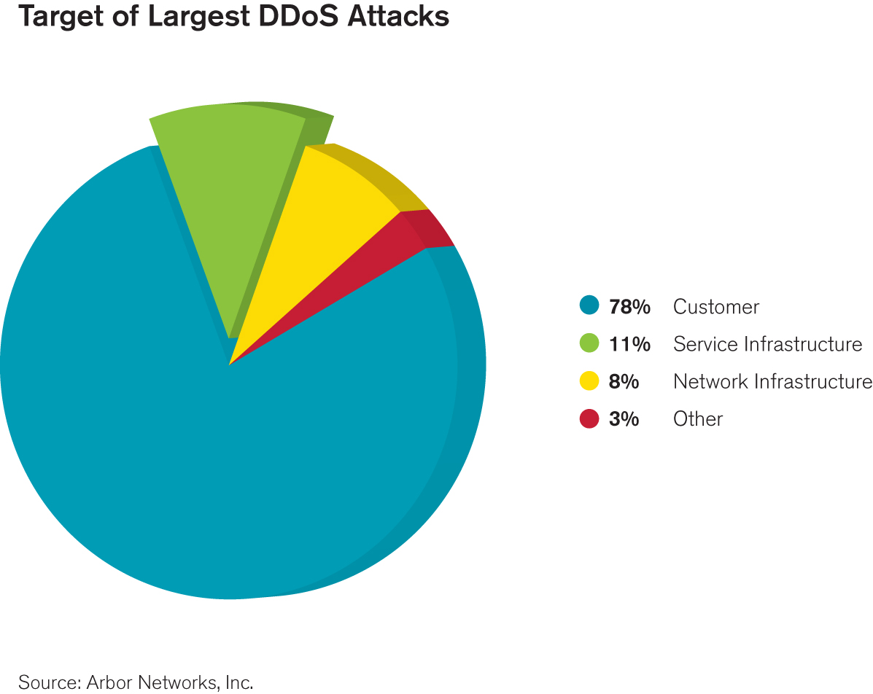
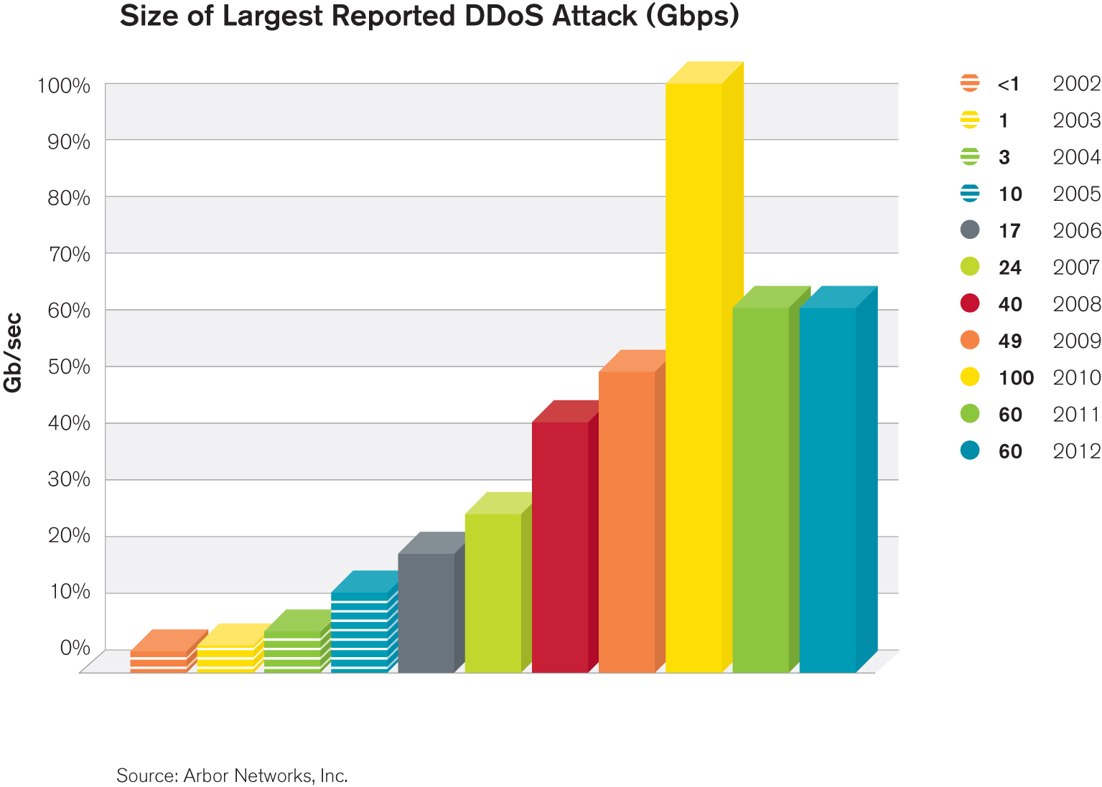
Large DDoS Attacks Still Occurring
Service provider customers are most common targets of the largest reported attacks
Largest reported attack at same level as last year, 60Gbps
  ATLAS continues to report attacks in the 80 – 100Gbps range
  Attacks seem to have plateaued at around 100Gbps top-end for past 3 years

Slide 4
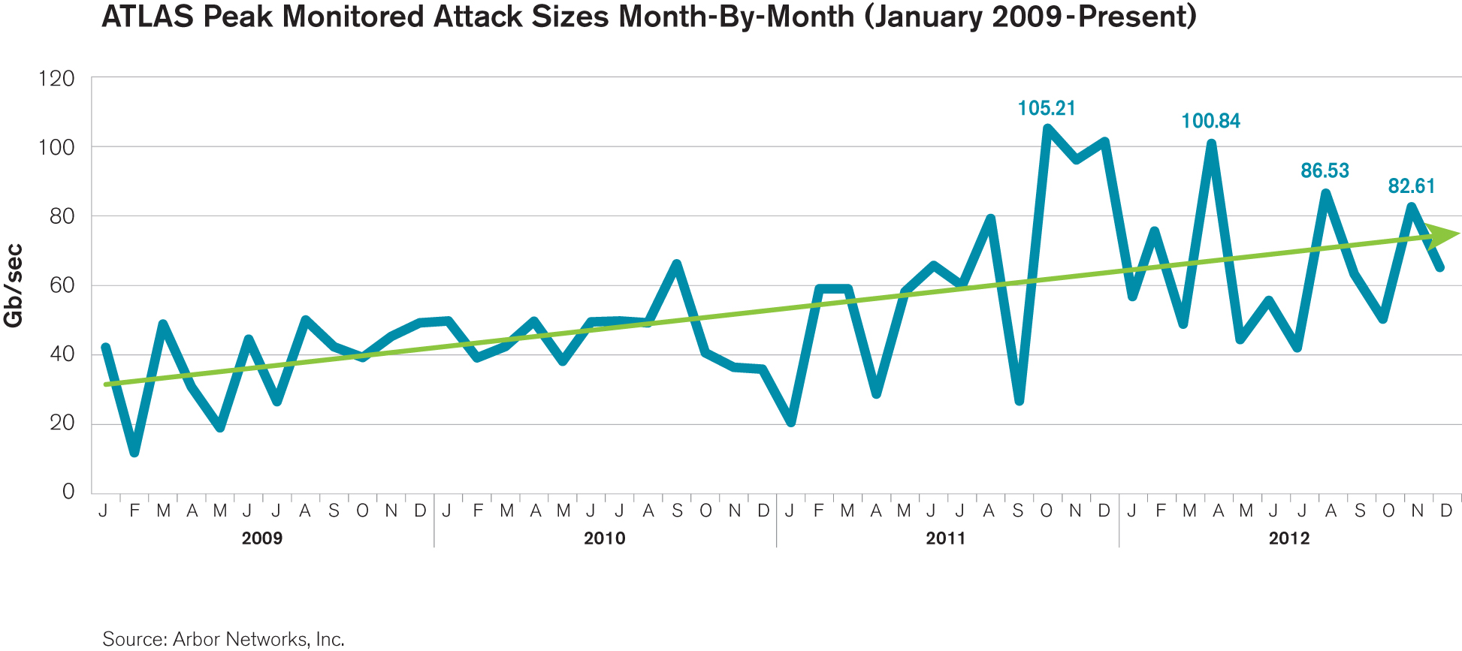
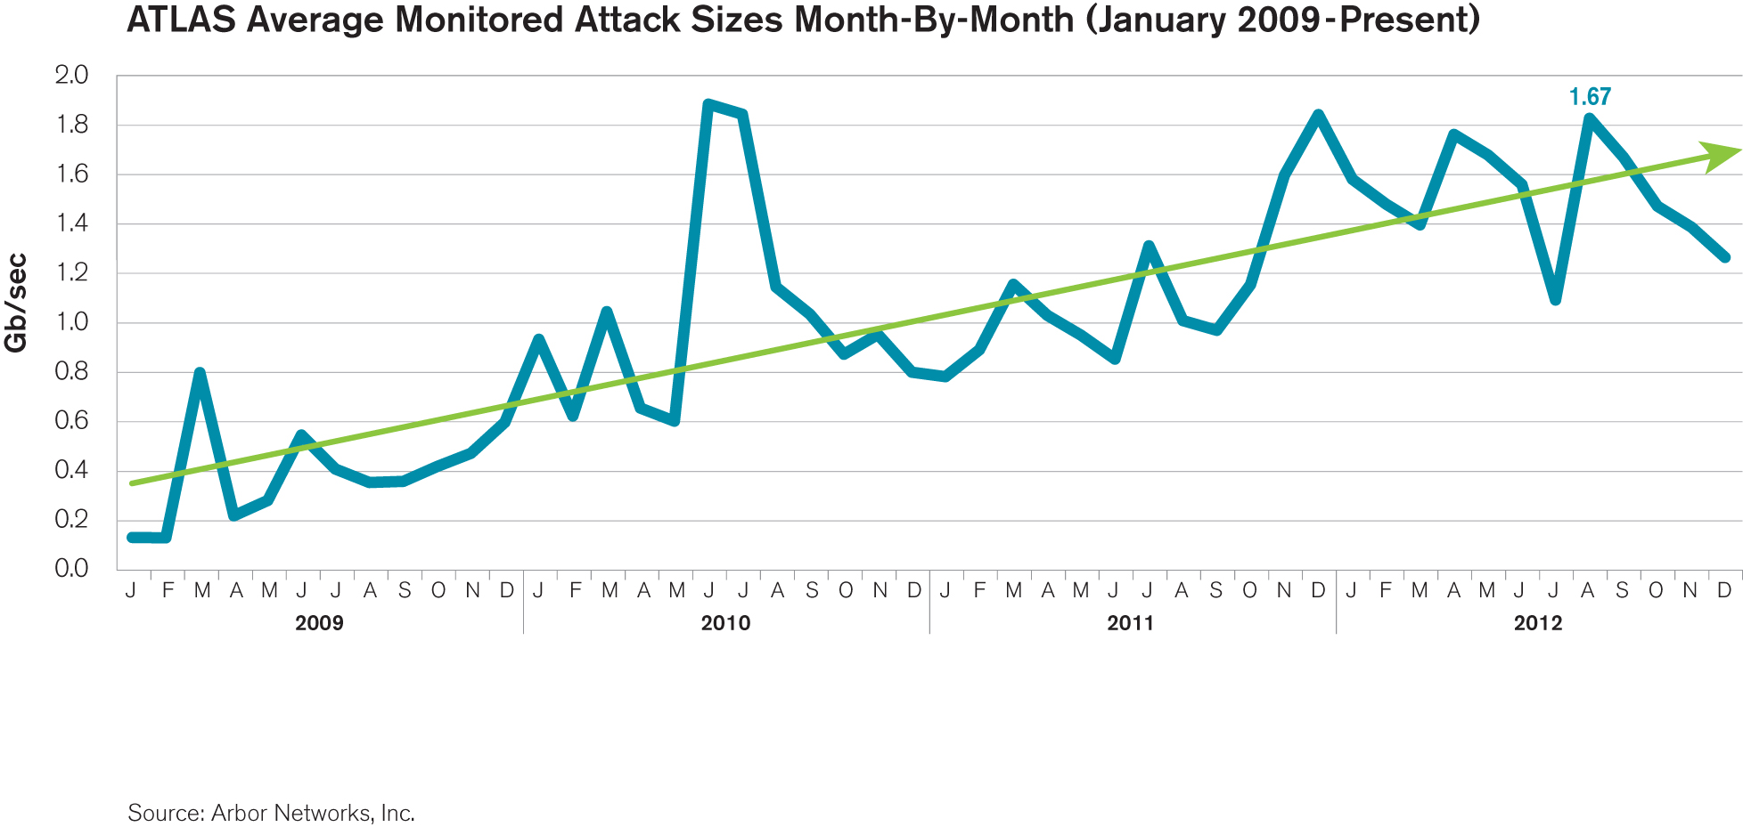
ATLAS Attack Sizes
Peak attacks at 80 - 100Gbps in 2012
Average attacks now consistently over 1Gb/sec

Slide 5
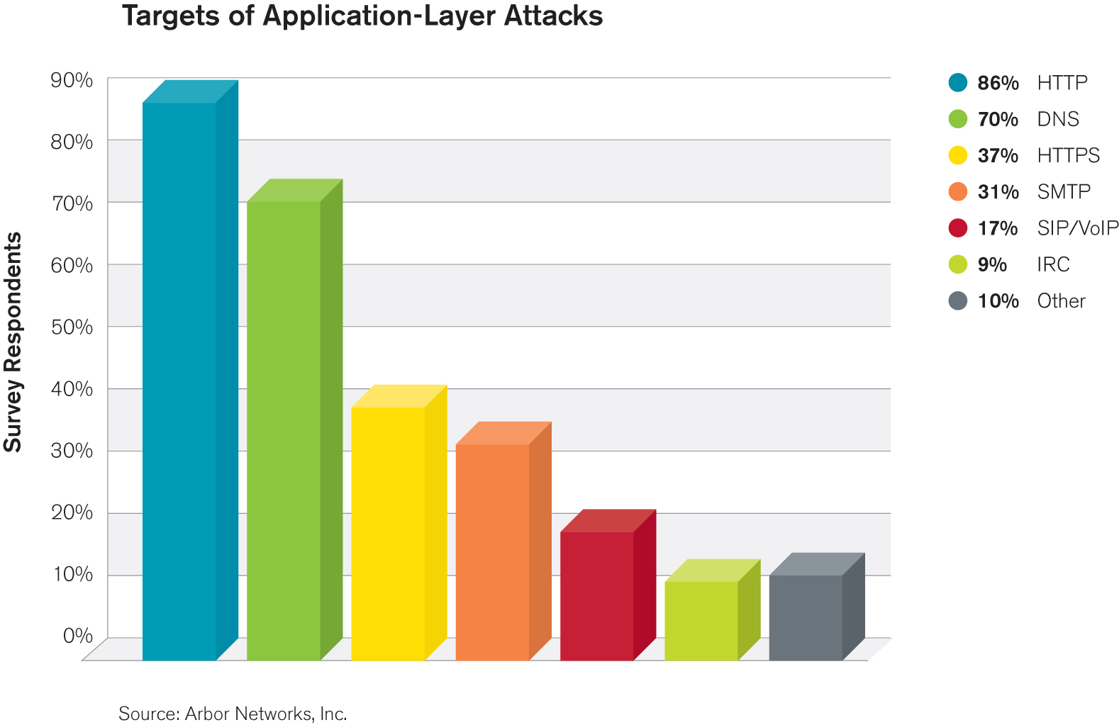
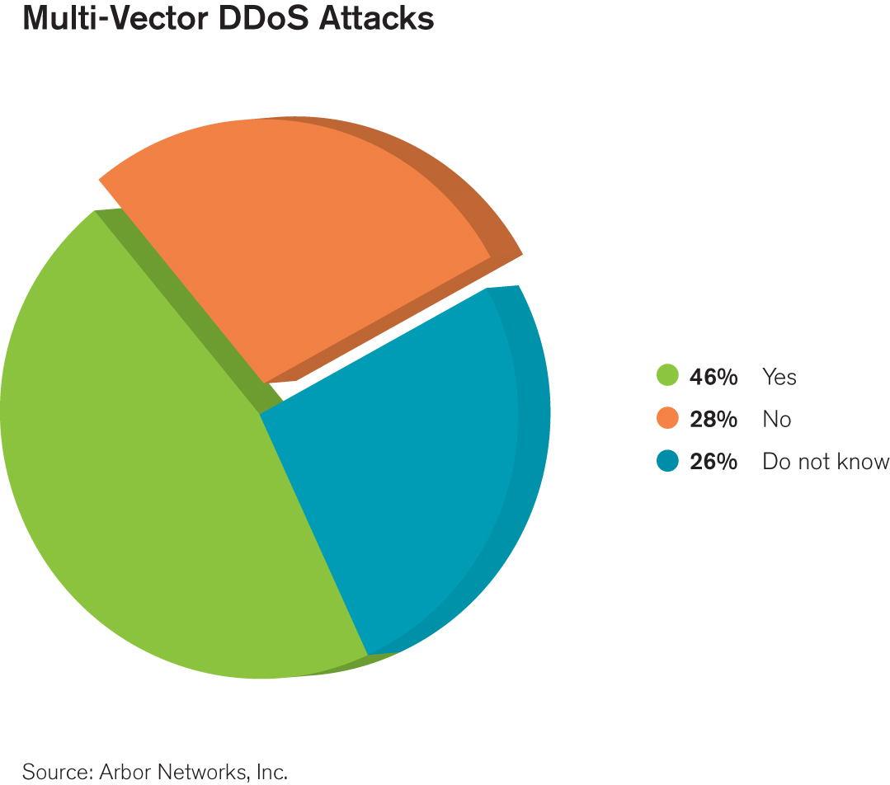
Application Layer / Multi-Vector Attacks Are Rising
HTTP and DNS services most frequently targeted by application layer attacks.
In a 60% increase over last year, nearly half of respondents now seeing multi-vector attacks
  Multi-vector attacks are a concern as they generally require layered defenses for successful mitigation
  Q4 2012 Financial Attacks were a good example

Slide 6
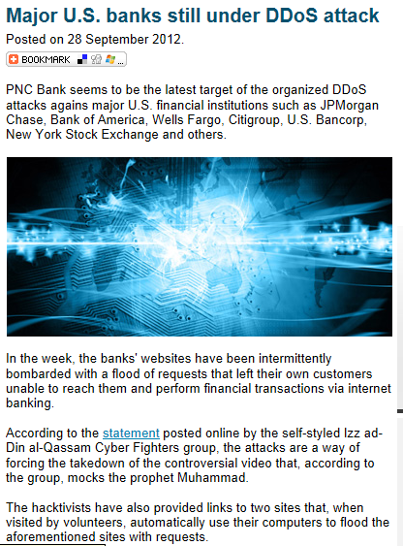
Recent Financial Attacks aka “Operation Ababil:”
Multi-Vector DDoS On A New Level
Compromised PHP, WordPress, & Joomla servers
Multiple concurrent attack vectors
  GET and POST app layer attacks on HTTP and HTTPS
  DNS query app layer attack
  Floods on UDP, TCP Syn floods, ICMP and other IP protocols
Unique characteristics of the attacks
  Very high packet per second rates per individual
  source
  Large bandwidth attack on multiple companies simultaneously
  Very focused
    could be false flag
    could be Cyberwar
    could be hacktivism

Slide 7
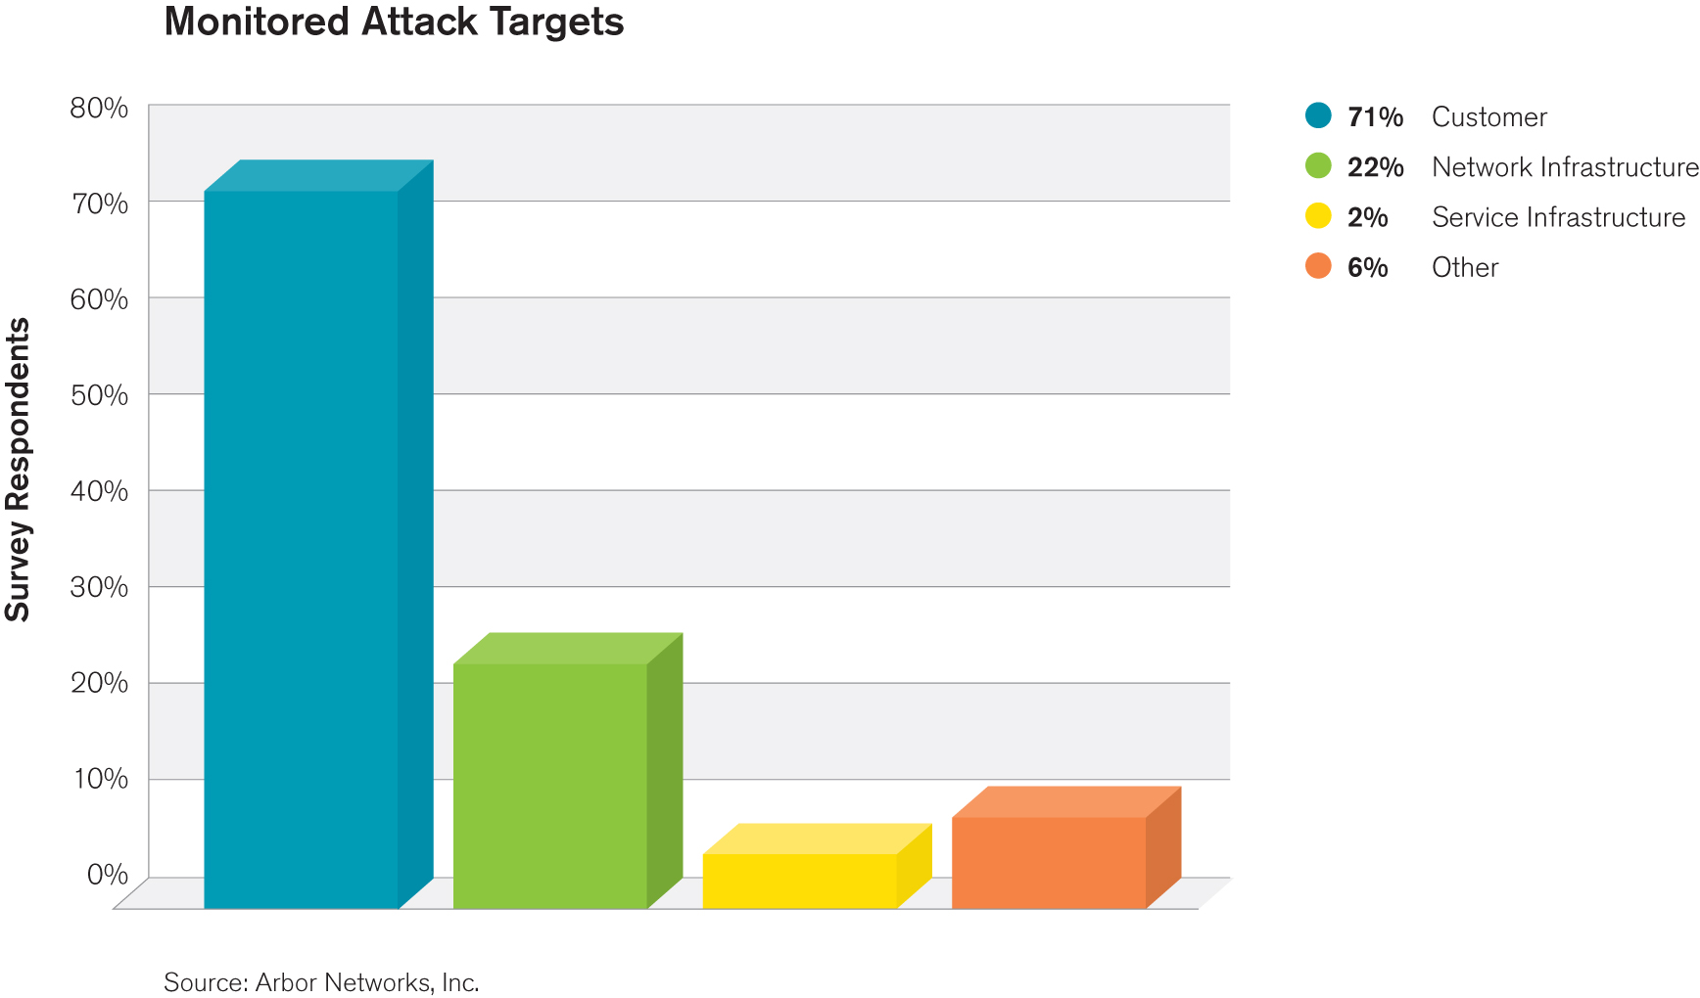
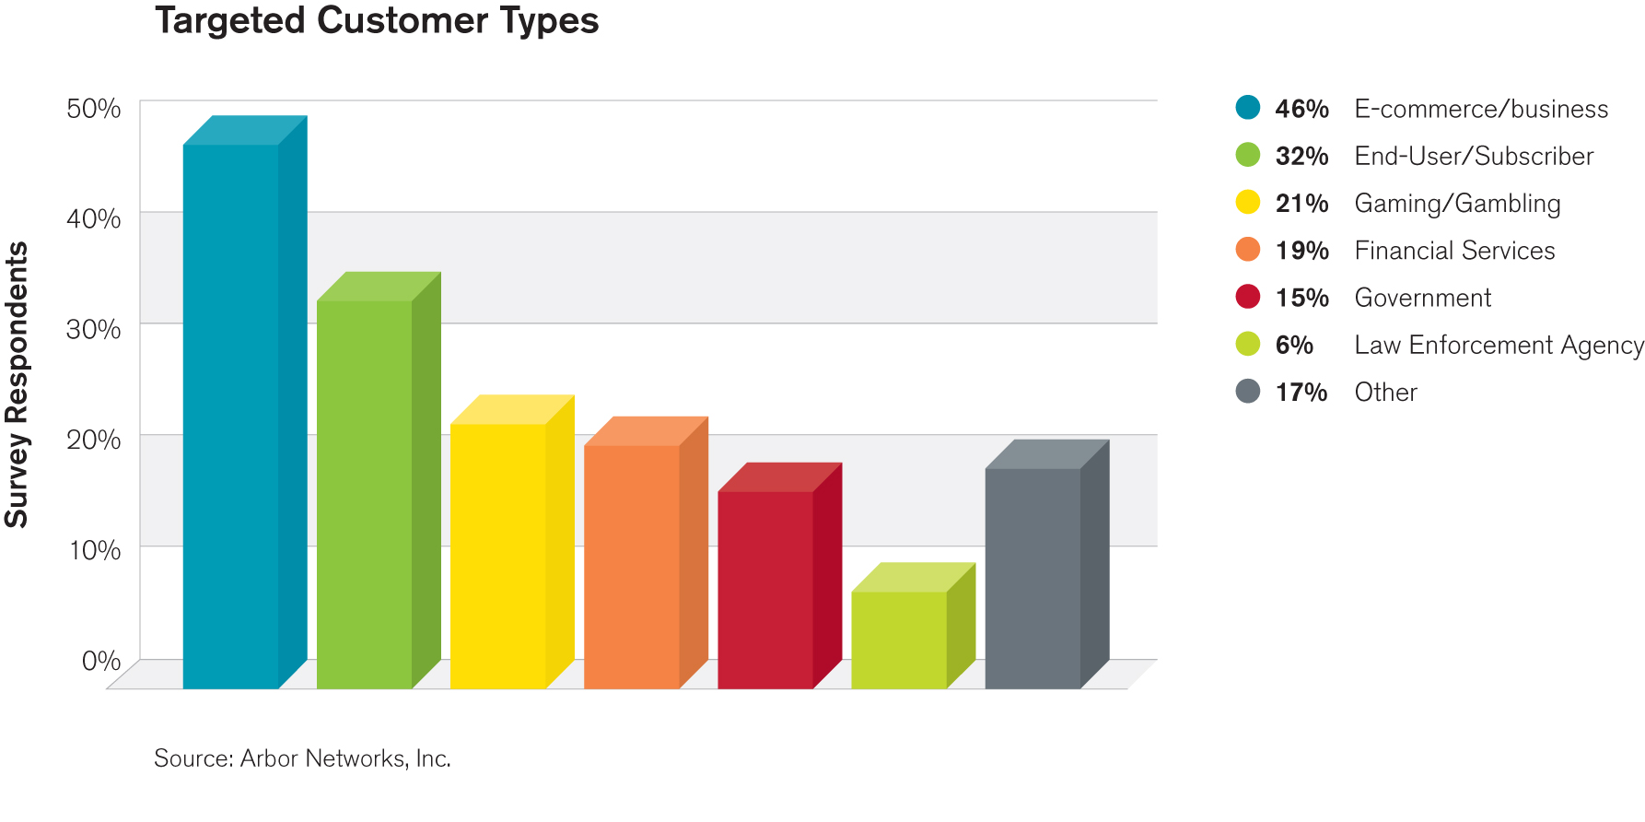
Overall Attack Targets
Respondent customers are by far the most common target of attacks
e-commerce / business customers are the most likely targets, followed by end-users / subscribers.
Financial services and government are a distant fourth and sixth, counter to media coverage and expectation

Slide 8
Key Findings in the Survey*
Advanced Persistent Threats (APT) a top concern for service providers and enterprises
  This year’s survey found an increased level of concern over ‘botted’ or compromised machines on service provider networks
  Looking ahead, there is even more concern about APT, industrial espionage, data exfiltration and malicious insiders
DDoS: Attack Sizes Plateau in Trend Towards Complex Multi-Vector Attacks
  HTTP and DNS most common application layer targets
  Growth in proportion of respondents seeing attacks targeting HTTPS
  Largest volumetric attacks in 60 – 100 Gbps range
Data Centers Increasingly Becoming Victimized
  94% of datacenters seeing DDoS attacks regularly
  Just over a third see firewalls fail due to DDoS attacks
  As more companies move their services to the “cloud,” shared risk is more of an issue
Ideology Is Primary DDoS Driver
  Top 3 attack motivations are based on politics, gamesmanship, beliefs and revenge
*Survey time period: Oct 2011 – Sept 2012

Slide 9
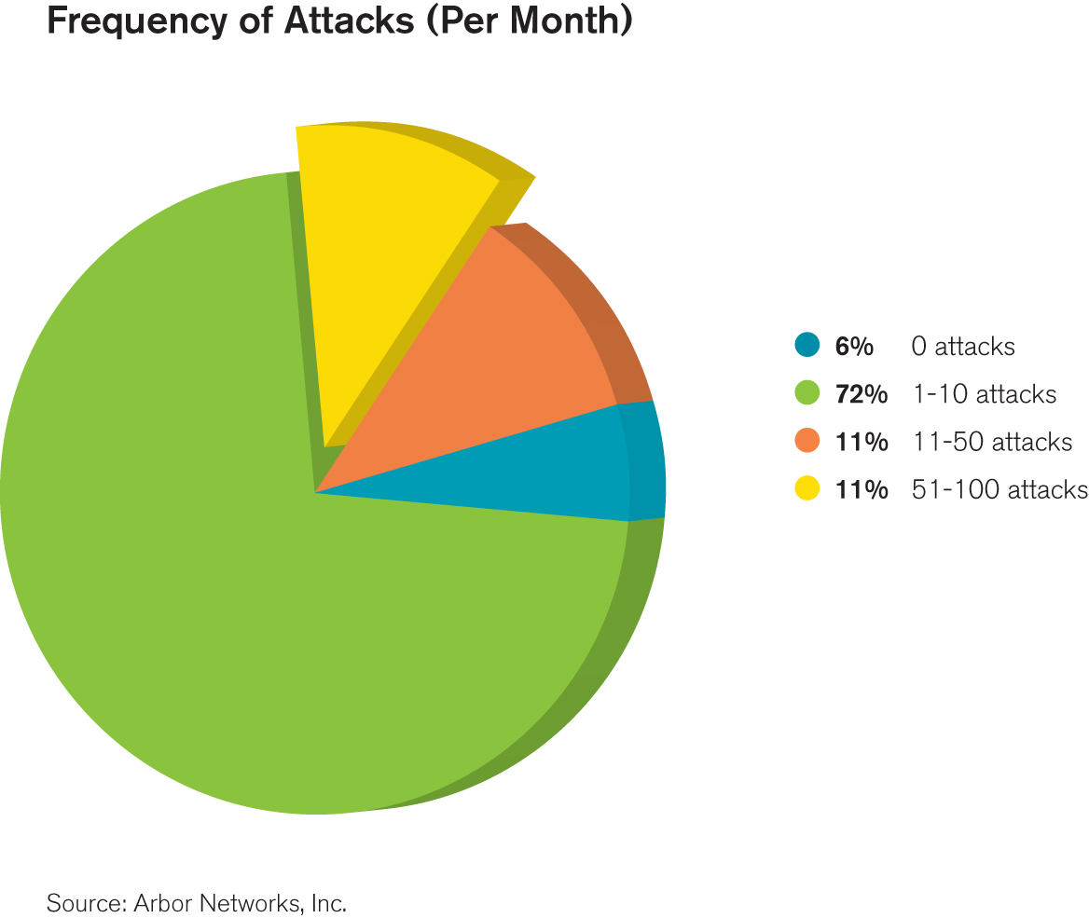
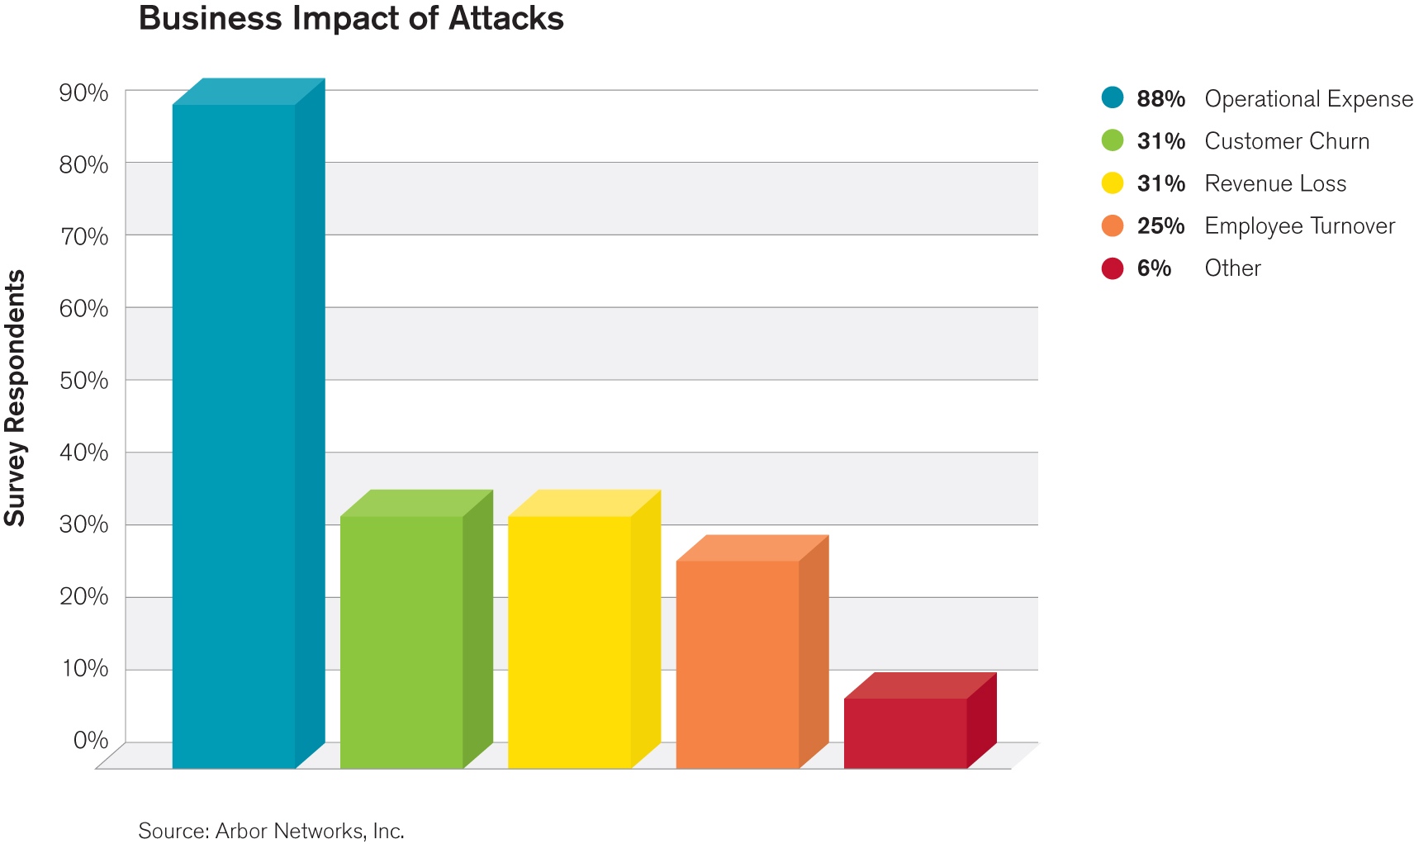
Data Center DDoS Attack and Impact
83.3% of respondents now see between 1 and 50 attacks per month.
Proportion of respondents seeing 0 attacks per month drops from 30% to 5.6%
Big rise in proportion of respondents seeing attacks targeting infrastructure and infrastructure services.
Operational costs are main expense for data center operators in dealing with attacks.
  However nearly a third experience customer churn or revenue loss due to attacks.

Slide 10
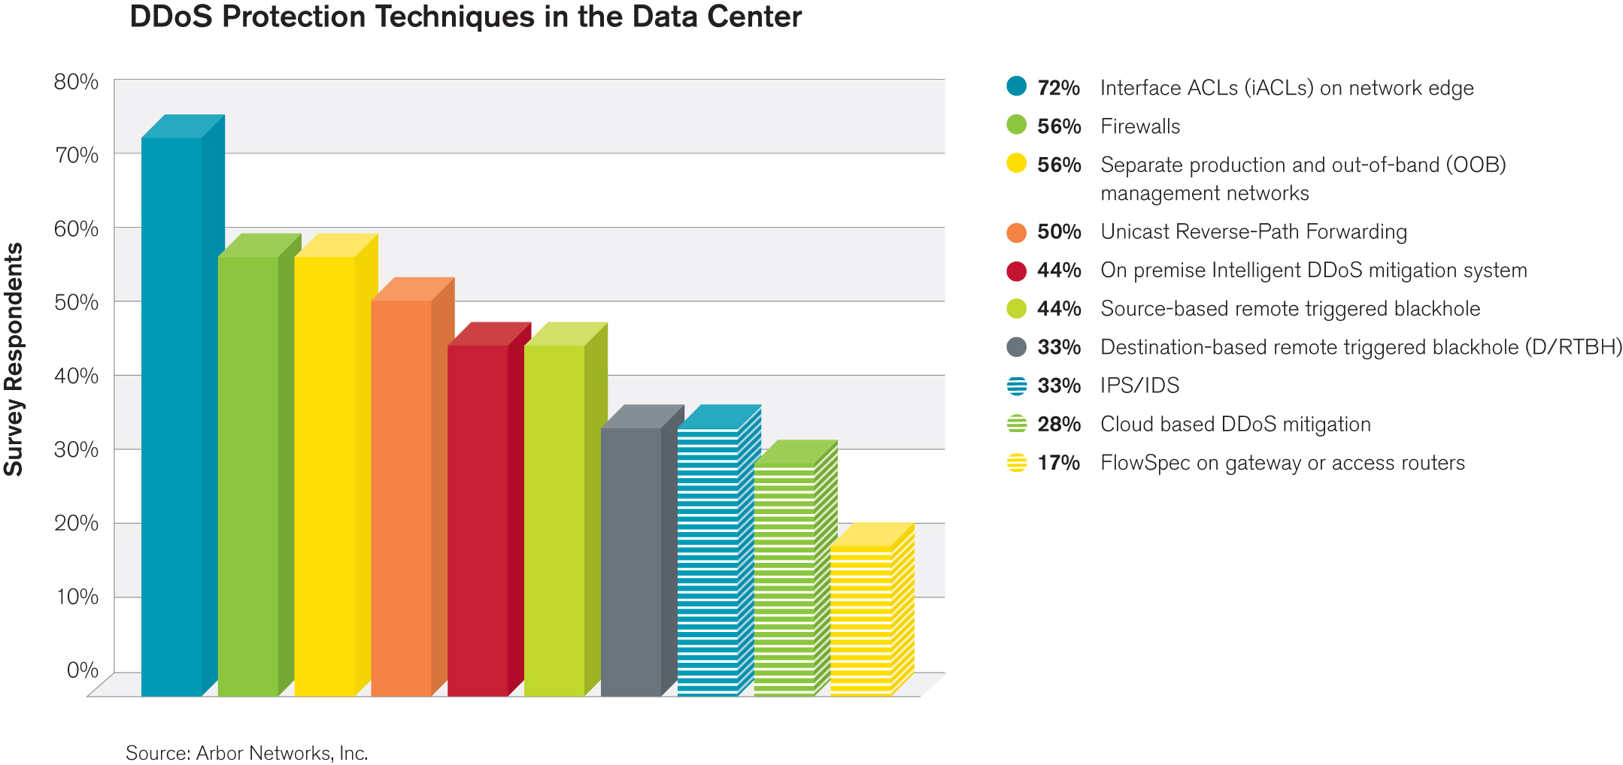
Data Center DDoS Mitigation
10% increase in use of IDMS and 22% decrease in use of D-RTBH
  May indicate increased focus on maintaining service availability.
Big increase in use of firewalls for mitigation
  35% saw firewalls fail due to DDoS attacks during the survey period

Slide 11
Key Findings in the Survey*
Advanced Persistent Threats (APT) a top concern for service providers and enterprises
  This year’s survey found an increased level of concern over ‘botted’ or compromised machines on service provider networks
  Looking ahead, there is even more concern about APT, industrial espionage, data exfiltration and malicious insiders
DDoS: Attack Sizes Plateau in Trend Towards Complex Multi-Vector Attacks
  HTTP and DNS most common application layer targets
  Growth in proportion of respondents seeing attacks targeting HTTPS
  Largest volumetric attacks in 60 – 100 Gbps range
Data Centers Increasingly Becoming Victimized
  94% of datacenters seeing DDoS attacks regularly
  Just over a third see firewalls fail due to DDoS attacks
  As more companies move their services to the “cloud,” shared risk is more of an issue
Ideology Is Primary DDoS Driver
  Top 3 attack motivations are based on politics, gamesmanship, beliefs and revenge
*Survey time period: Oct 2011 – Sept 2012

Slide 12
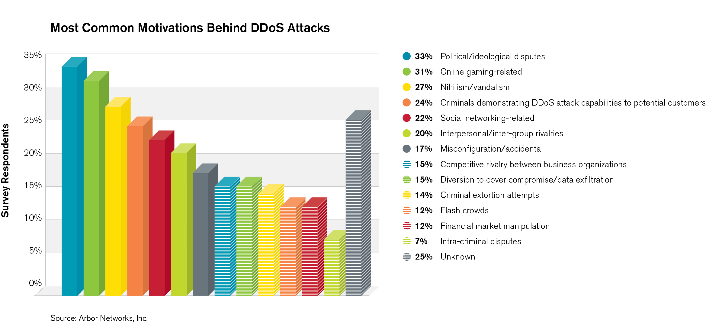
Top DDoS Motivations
Number one motivation is still ideological hacktivism
  Not surprising given media coverage this year
On-line gaming up from third to second
Nearly 15% seeing attacks motivated by extortion, competitive rivalry or as a cover for data exfiltration. DDoS is now a part of more complex cyber attack campaigns.
Broader range of motivations = higher risk of attack

Slide 13
Additional Key Findings
Mobile Providers Continue to be Reactive
  A full 60 percent of respondents do not have visibility into the traffic on their mobile/evolved packet cores.
  The economics of consumer subscriber networks do not incent providers to implement security until a problem occurs.
DNS Infrastructure Remains Vulnerable
  The Internet’s name resolution service continue to be both victimized by DDoS and used as an attack tool
IPv6 Deployments Quickly Becoming Pervasive
  80% of respondents either have IPv6 implemented or will do within the next 12 months
  More focus on availability of IPv6 services
Operational Security Resources still Challenged, Limited Law Enforcement Involvement
  Just under a quarter of respondents have NO dedicated security resources
  A half of respondents NEVER practice their incident handling processes
  More than half of respondents do NOT refer security incidents to law enforcement.

Slide 14
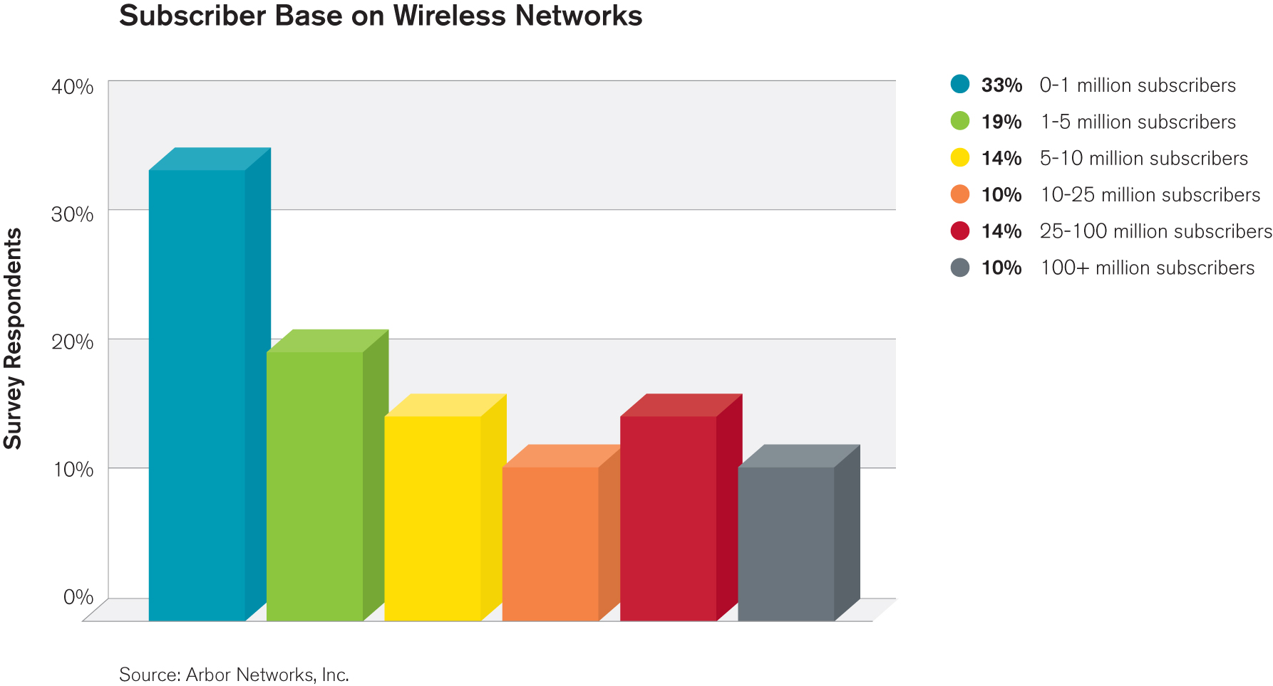
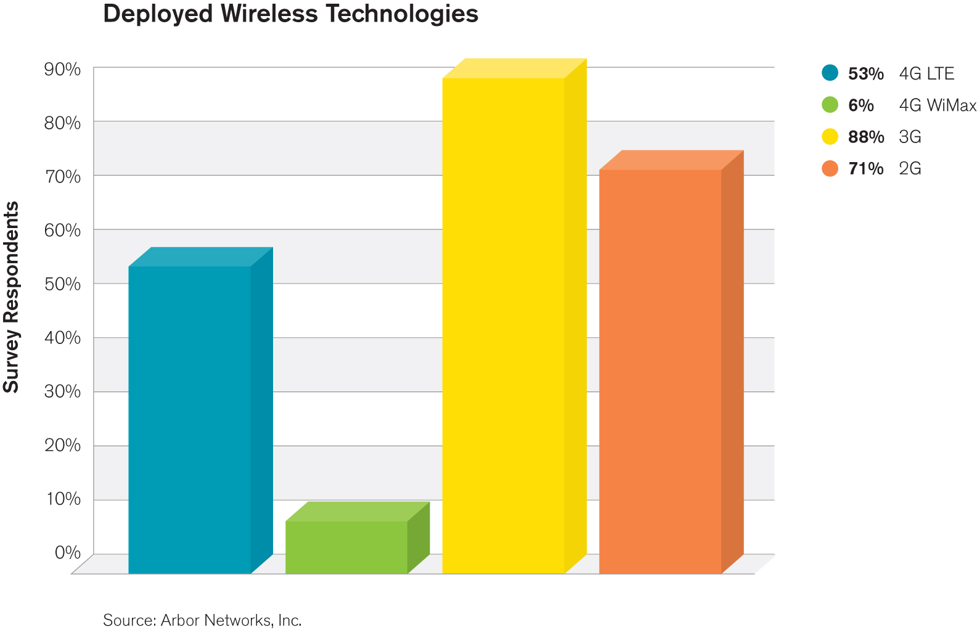
Mobile Respondents and Technologies
57% offer services to more than 1M subscribers
  34% have more than 10M subscribers
3G and 2G still dominate
LTE deployment growing fast, from 28.6% last year to 52.9% this year
  33% offering commercial 4G services now, up from 19% last year
  44.5% plan for 4G services in 2013/14

Slide 15
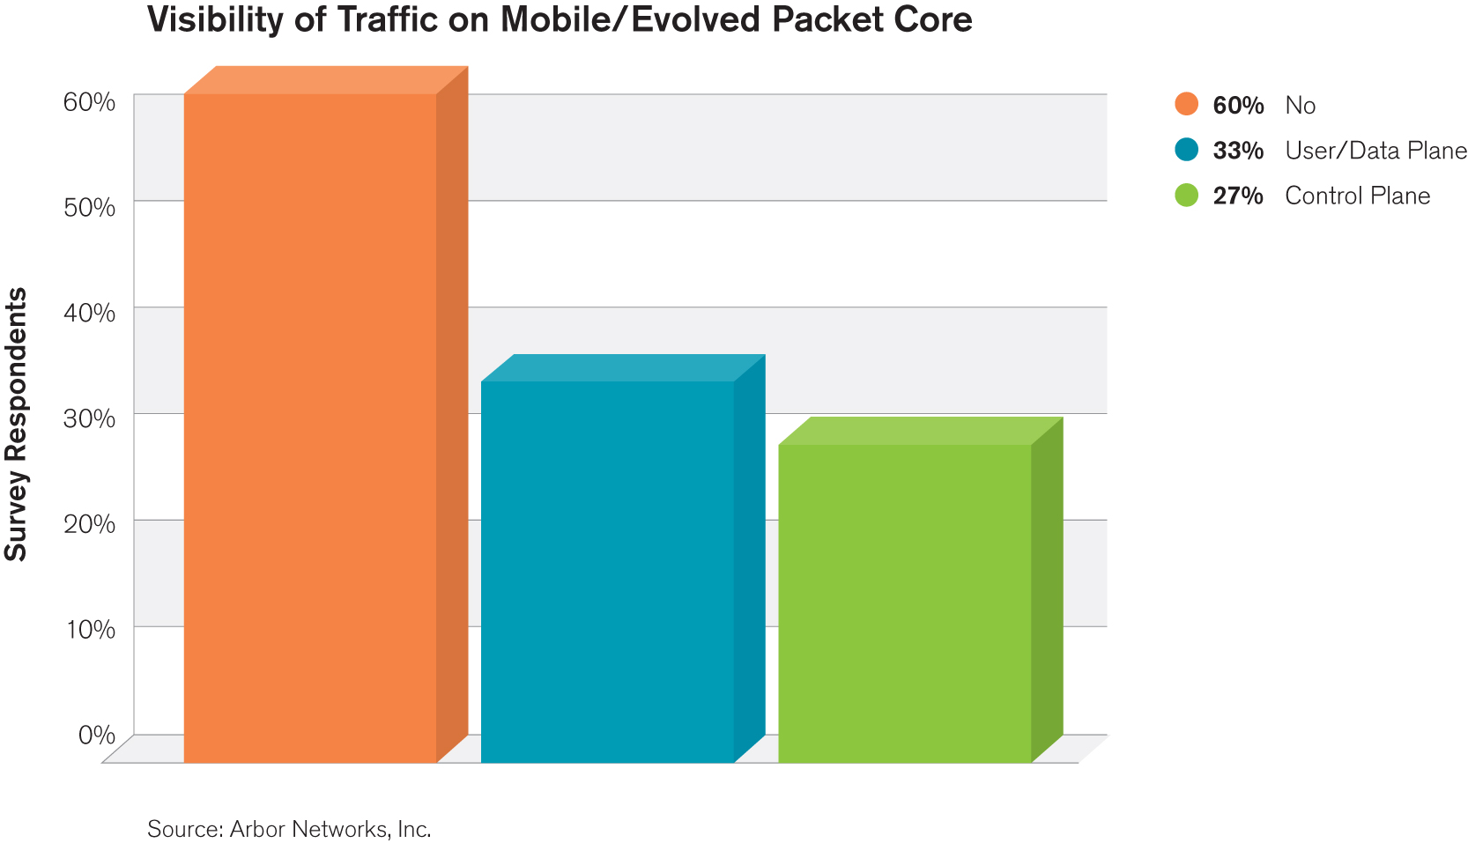
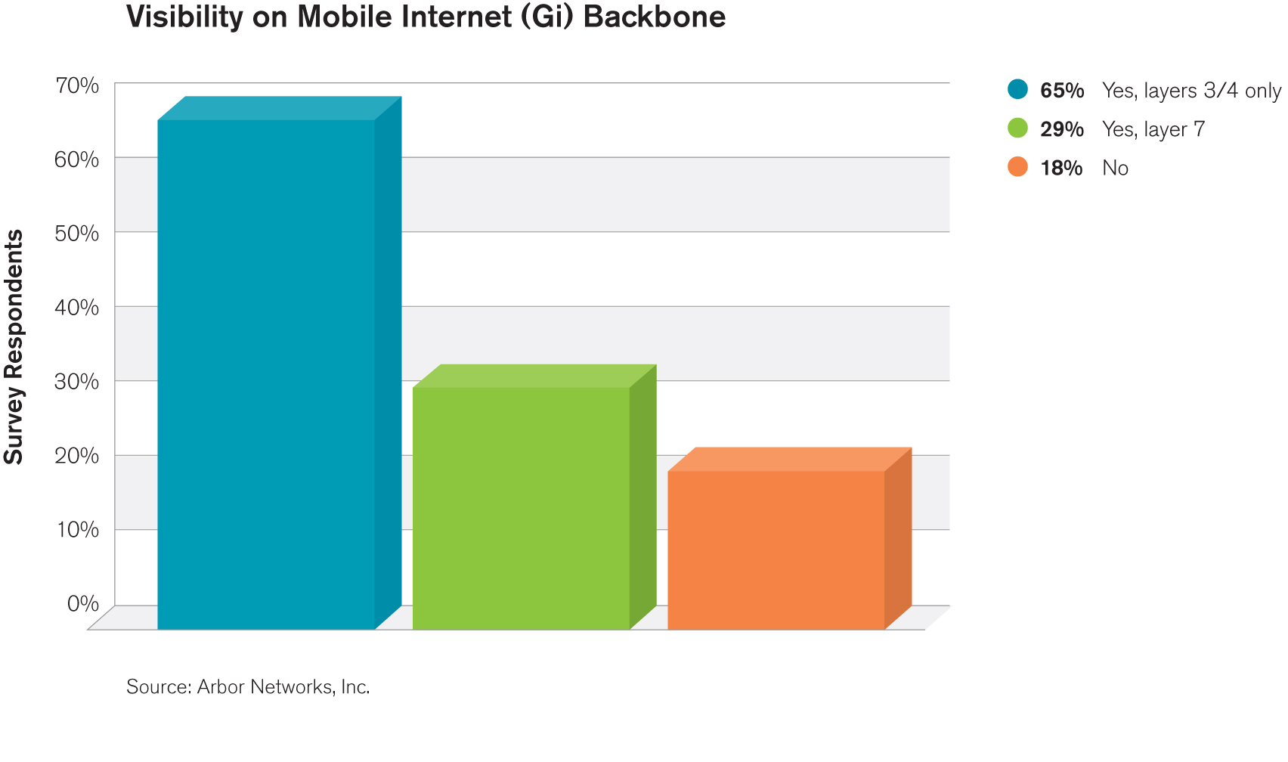
Mobile Traffic Visibility Still an Issue
33% of respondents saw a customer visible outage due to a security incident, up from 12.5%.
But, visibility of what is going on is still a key issue:
  60% do not have visibility of traffic on their MPC / EPC
  18% do not have visibility of traffic at their Gi

Slide 16
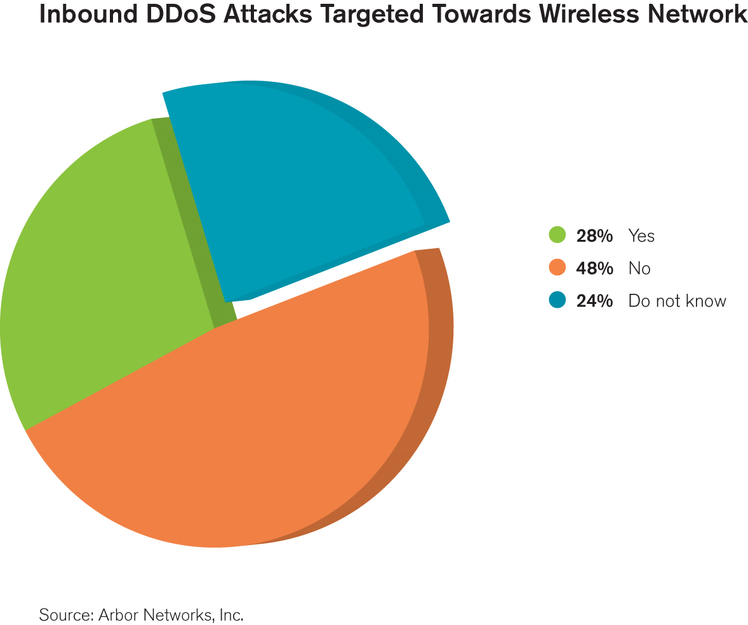
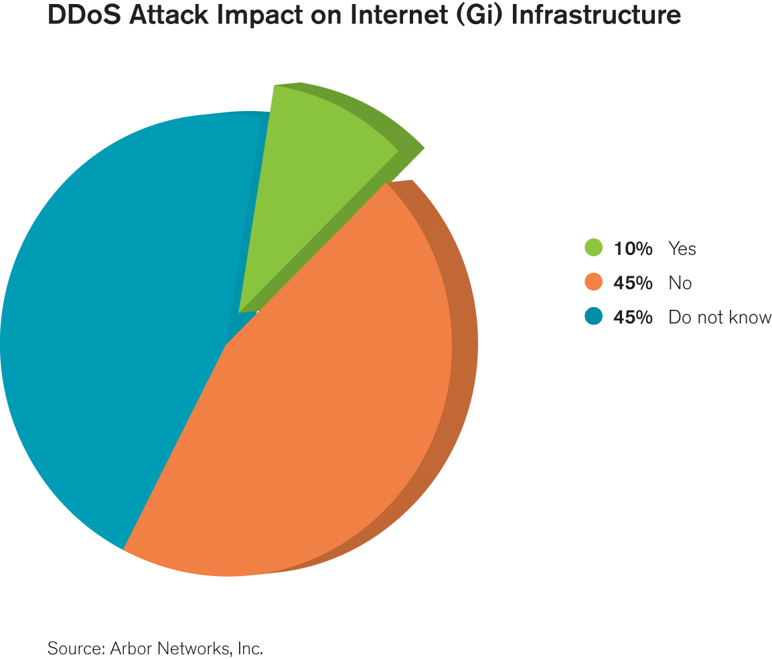
Mobile Threat Detection Limitations
28.6% see attacks targeting mobile users, RAN, back-haul or packet core
  Firewalls and end-users are most commonly affected
Only 10% of respondents see DDoS attacks impacting their Gi side infrastructure
  Only targets were DNS servers and routers / links (congestion)
  Very low given anecdotal conversations
  45% don’t know if they are being attacked
57% of respondents do NOT know how many compromised
subscribers there are on their networks.

Slide 17
Additional Key Findings
Mobile Providers Continue to be Reactive
  A full 60 percent of respondents do not have visibility into the traffic on their mobile/evolved packet cores.
  The economics of consumer subscriber networks do not incent providers to implement security until a problem occurs.
DNS Infrastructure Remains Vulnerable
  The Internet’s name resolution service continue to be both victimized by DDoS and used as an attack tool
IPv6 Deployments Quickly Becoming Pervasive
  80% of respondents either have IPv6 implemented or will do within the next 12 months
  More focus on availability of IPv6 services
Operational Security Resources still Challenged, Limited Law Enforcement Involvement
  Just under a quarter of respondents have NO dedicated security resources
  A half of respondents NEVER practice their incident handling processes
  More than half of respondents do NOT refer security incidents to law enforcement.

Slide 18
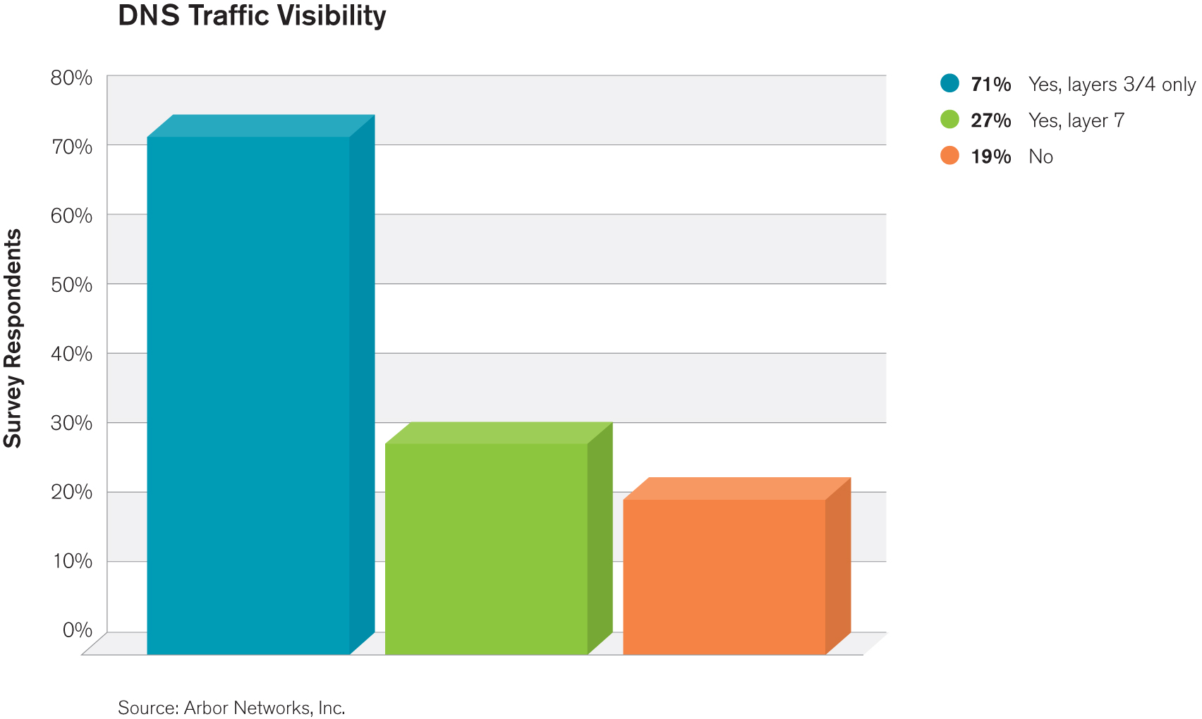
DNS Visibility
81% of respondents operate DNS infrastructure.
19% have NO security team responsible for it
  An improvement from 23% last year
  Still not good given the criticality of this service
Nearly three quarters have good visibility at layers 3/4 , but only just over a quarter have layer 7 visibility
  Needed to detect some types of attacks etc.

Slide 19
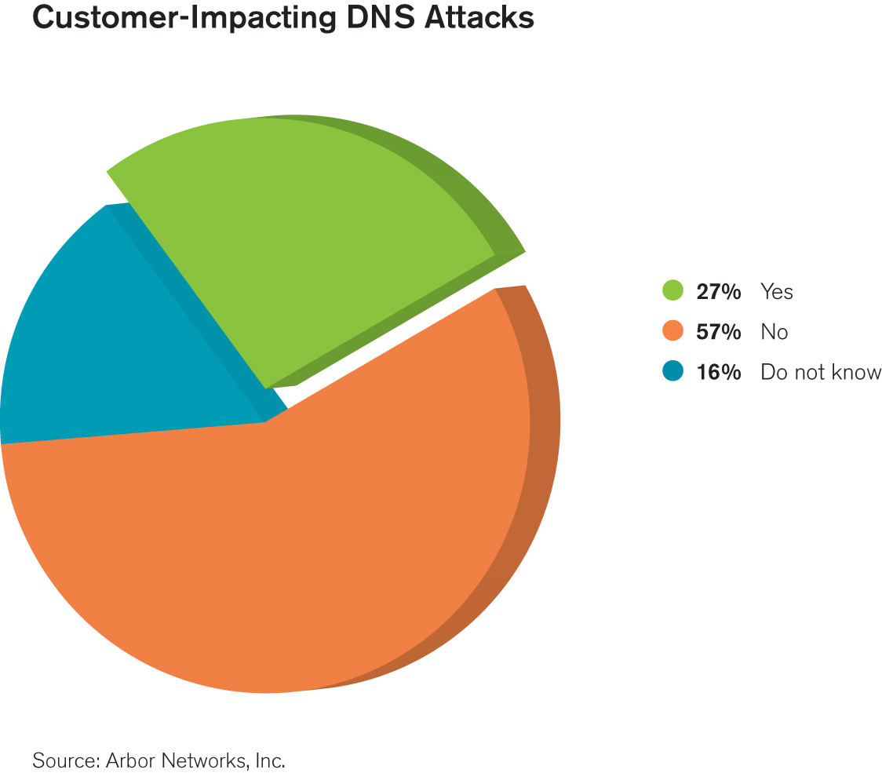
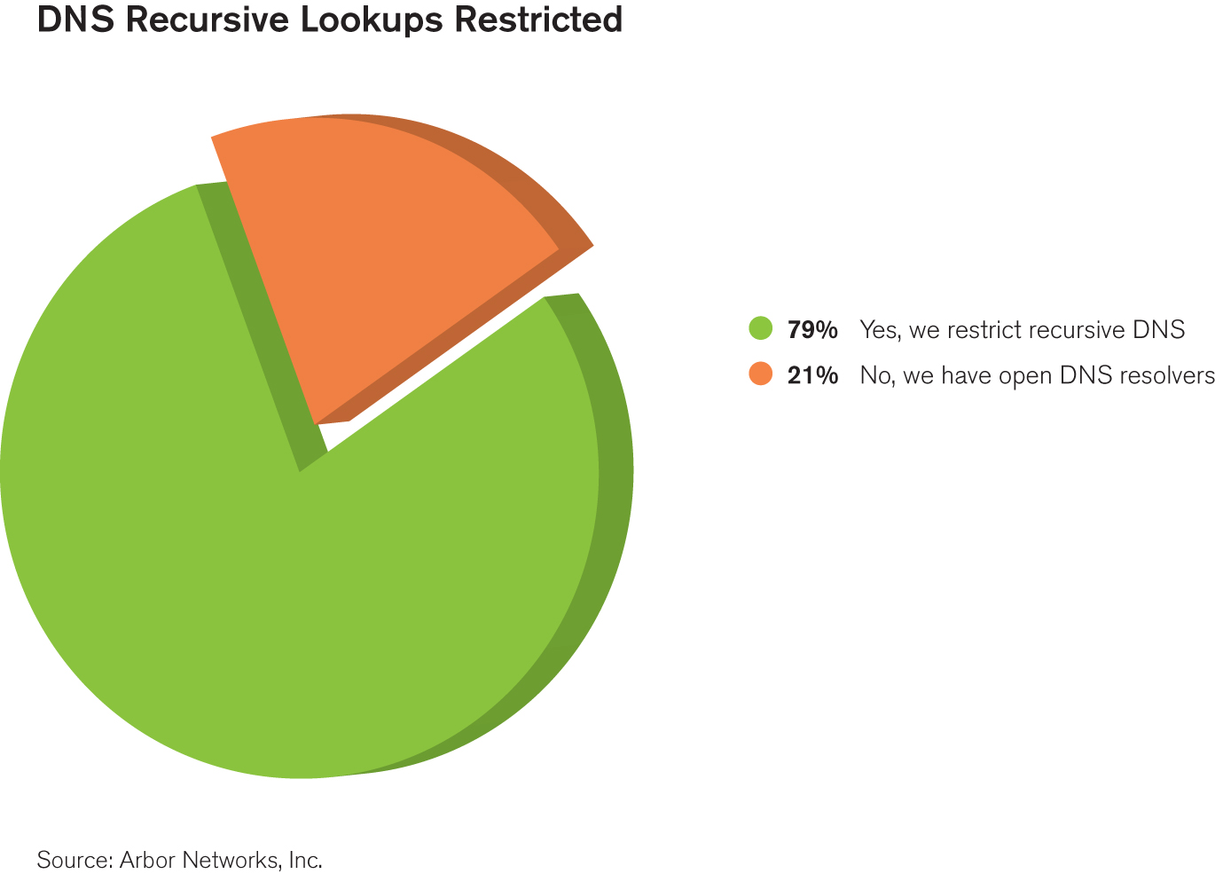
DNS Security
Just over a quarter have seen customer impacting DDoS attacks against DNS infrastructure
  40.8% have seen attacks against authoritative servers
  24% have seen attacks against recursors
21% of respondents do NOT restrict recursive look-ups
  Same result as last year
  Contributes toward reflective amplification attacks
The majority of respondents have NOT seen issues with DNSSEC

Slide 20
Additional Key Findings
Mobile Providers Continue to be Reactive
  A full 60 percent of respondents do not have visibility into the traffic on their mobile/evolved packet cores.
  The economics of consumer subscriber networks do not incent providers to implement security until a problem occurs.
DNS Infrastructure Remains Vulnerable
  The Internet’s name resolution service continue to be both victimized by DDoS and used as an attack tool
IPv6 Deployments Quickly Becoming Pervasive
  80% of respondents either have IPv6 implemented or will do within the next 12 months
  More focus on availability of IPv6 services
Operational Security Resources still Challenged, Limited Law Enforcement Involvement
  Just under a quarter of respondents have NO dedicated security resources
  A half of respondents NEVER practice their incident handling processes
  More than half of respondents do NOT refer security incidents to law enforcement.

Slide 21
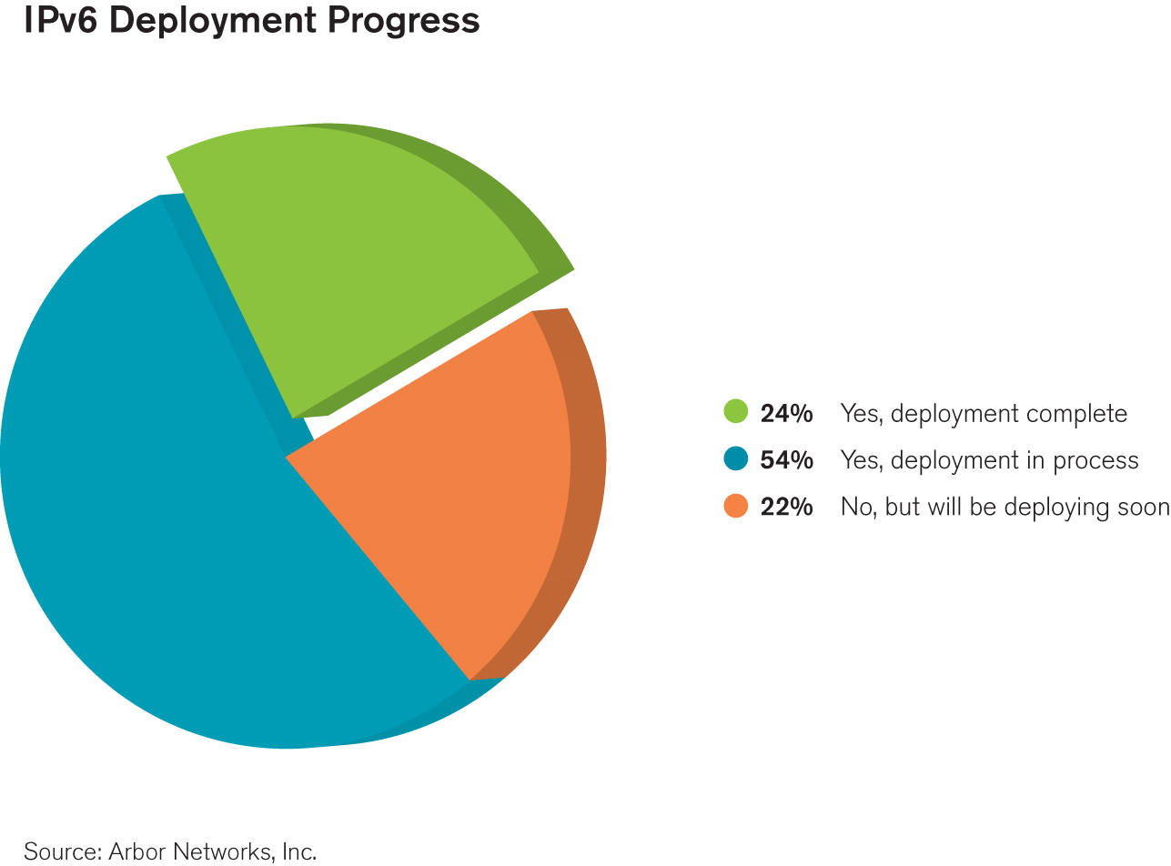
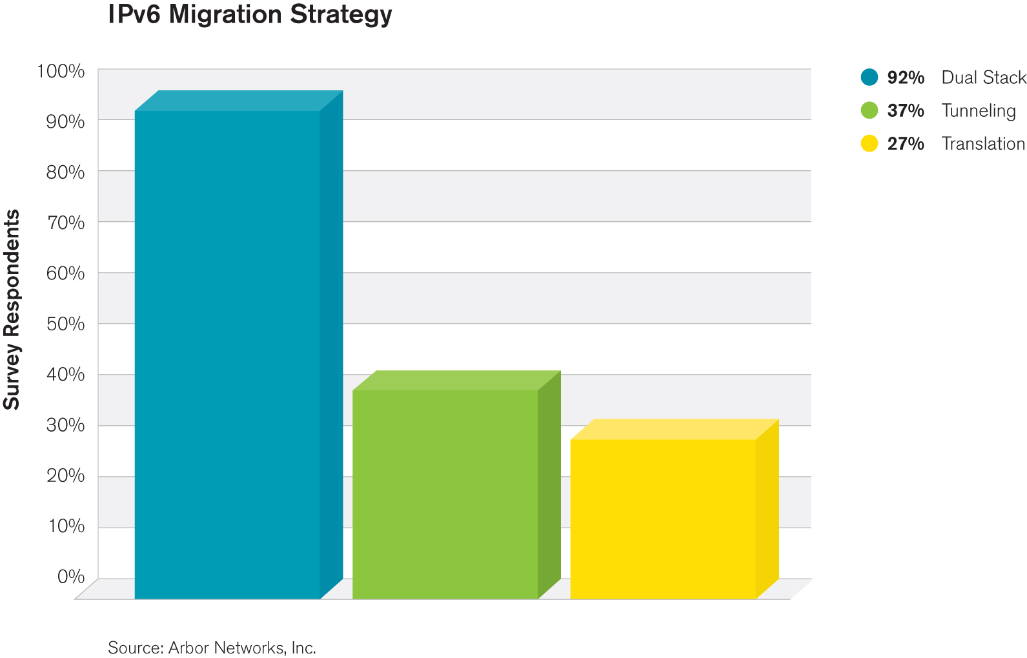
IPv6 Roll-Out Moves Forward
80% of respondents either have IPv6 implemented or will do within the next 12 months
  24.1% have already completed their roll-out
IPv4 address space exhaustion is NOT seen as a concern by the majority of respondents
Dual-stack seems to be the most widely implemented migration strategy

Slide 22
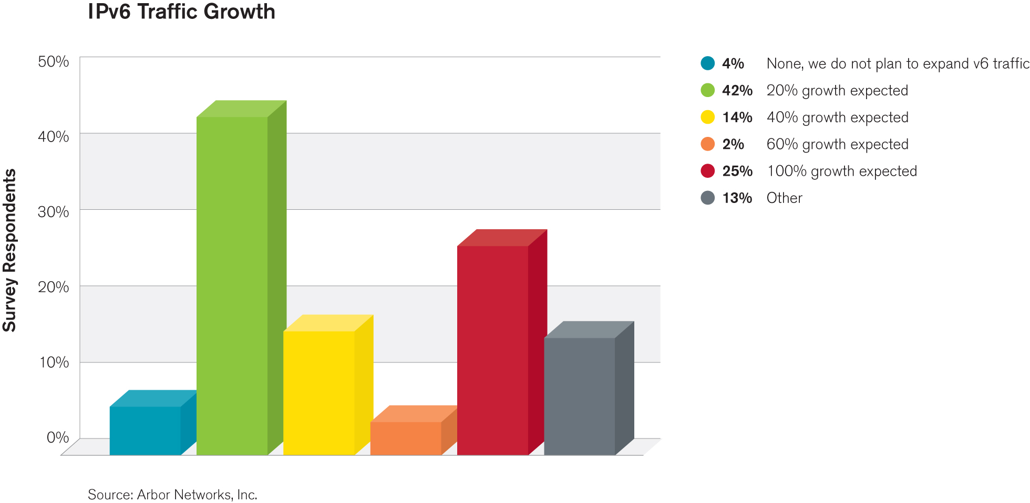
IPv6 Growth
Nearly half of respondents only anticipate 20% growth in IPv6 traffic volume over next twelve months
One quarter expect more than 100%
ATLAS data shows that IPv6 is growing at more than 100% per year, but is still only a small fraction of IPv4 traffic

Slide 23
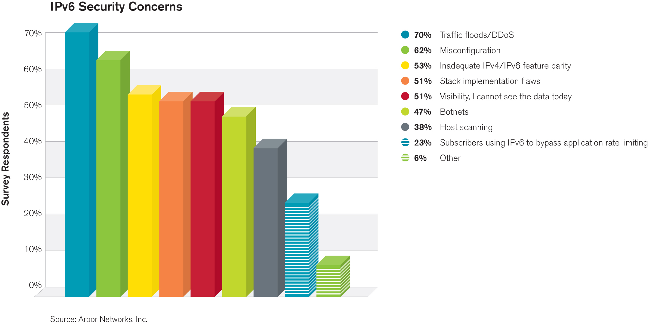
IPv6 Threats and Concerns
Traffic floods and DDoS have moved up to the top spot here.
  May indicate more focus on the availability of IPv6 services from respondents
  Big drop in percentage of respondents who would NOT mitigate an attack against an IPv6 service backs this up, change from 20% to 3.9%
Inadequate feature parity, last year’s top concern, has moved down to third
  This may indicate that equipment vendors have finally delivered the IPv6 feature parity they have been promising
Visibility has dropped considerably as a concern
  Maybe due to the improved level of flow support (63% -> 74.5%) for IPv6
Misconfiguration remains an issue

Slide 24
Additional Key Findings
Mobile Providers Continue to be Reactive
  A full 60 percent of respondents do not have visibility into the traffic on their mobile/evolved packet cores.
  The economics of consumer subscriber networks do not incent providers to implement security until a problem occurs.
DNS Infrastructure Remains Vulnerable
  The Internet’s name resolution service continue to be both victimized by DDoS and used as an attack tool
IPv6 Deployments Quickly Becoming Pervasive
  80% of respondents either have IPv6 implemented or will do within the next 12 months
  More focus on availability of IPv6 services
Operational Security Resources still Challenged, Limited Law Enforcement Involvement
  Just under a quarter of respondents have NO dedicated security resources
  A half of respondents NEVER practice their incident handling processes
  More than half of respondents do NOT refer security incidents to law enforcement.

Slide 25
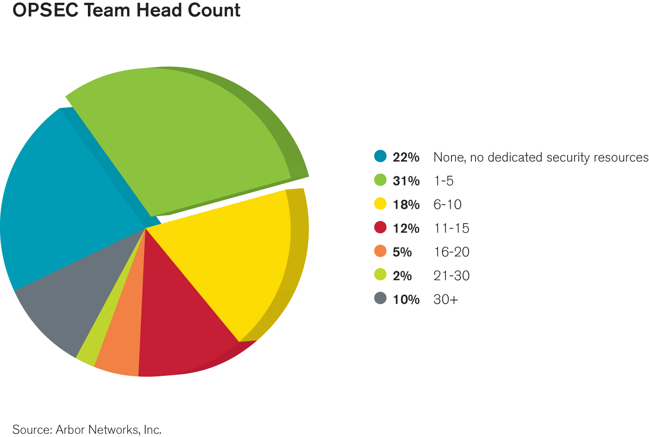
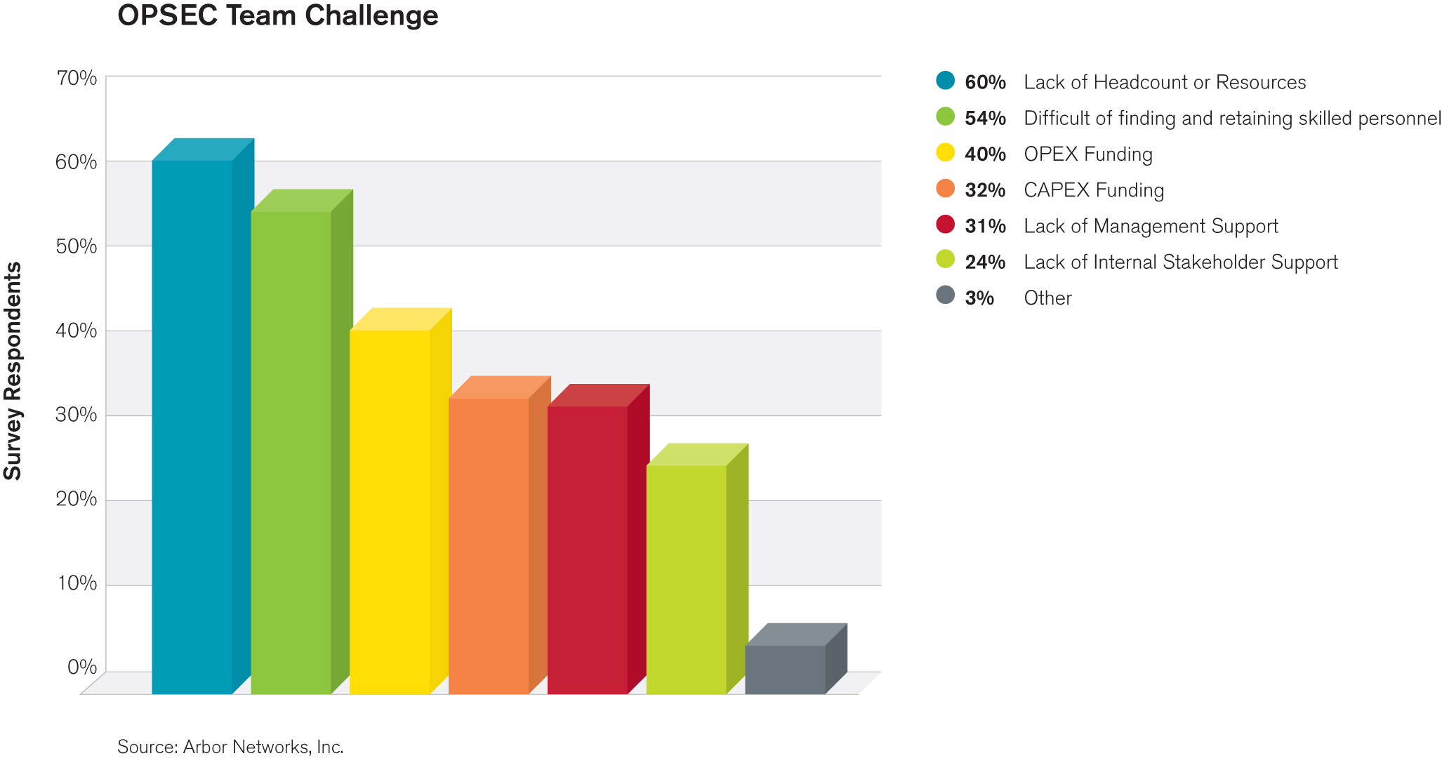
Operational Security Team Headcount
Just under a quarter of respondents have NO dedicated security resources
  An increase from last year. Maybe due to increased outsourcing.
‘Lack of headcount and resources’ top issue when building and maintaining a security team
  Increase in the proportion of respondents citing Opex and Capex funding as issues this year.

Slide 26
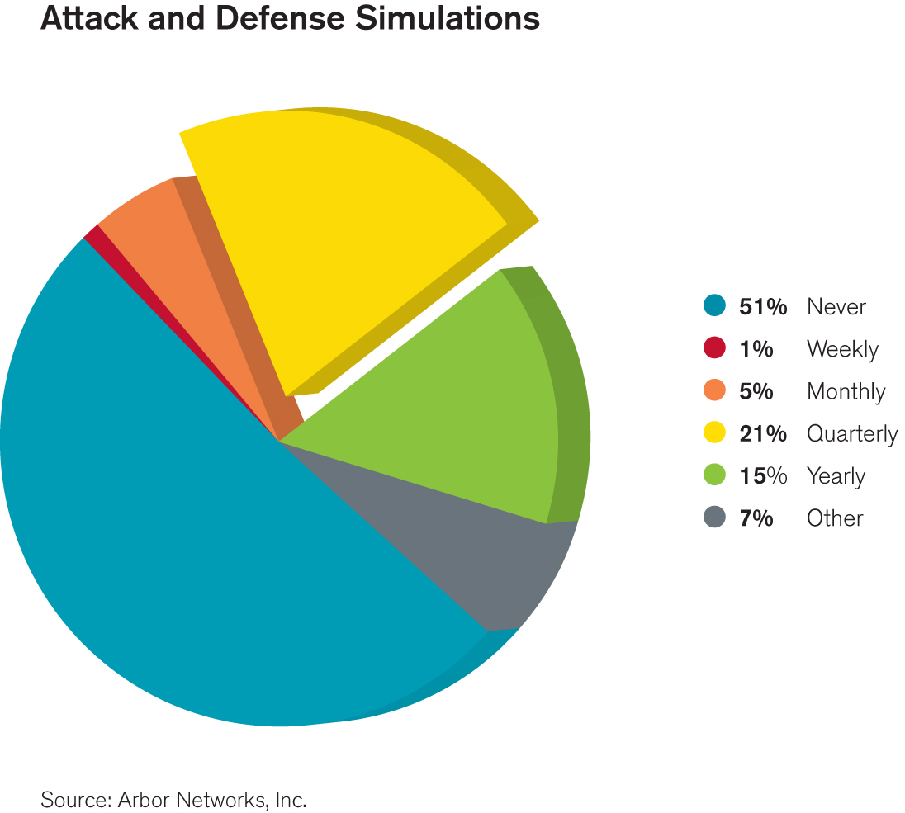
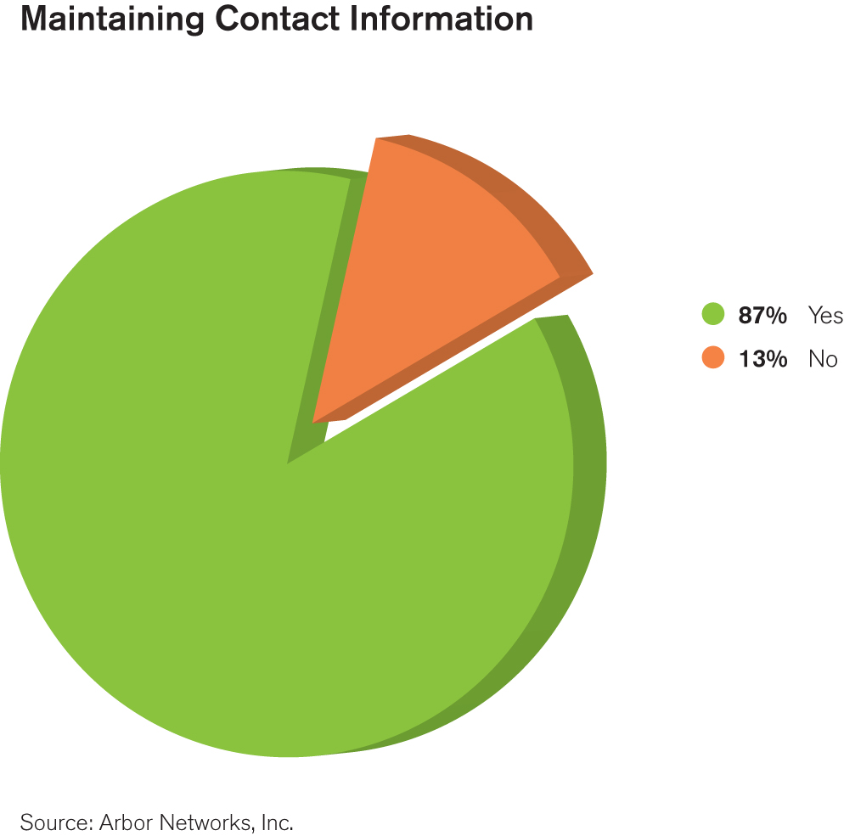
Attack / Defense Readiness
A half of respondents NEVER practice their incident handling processes
  Not good, but better than the 58% last year
86.7% now maintain contact information for their peers, transit providers etc.
  A 17% improvement on last year
  Security incidents can be prolonged if the right people are not involved

Slide 27
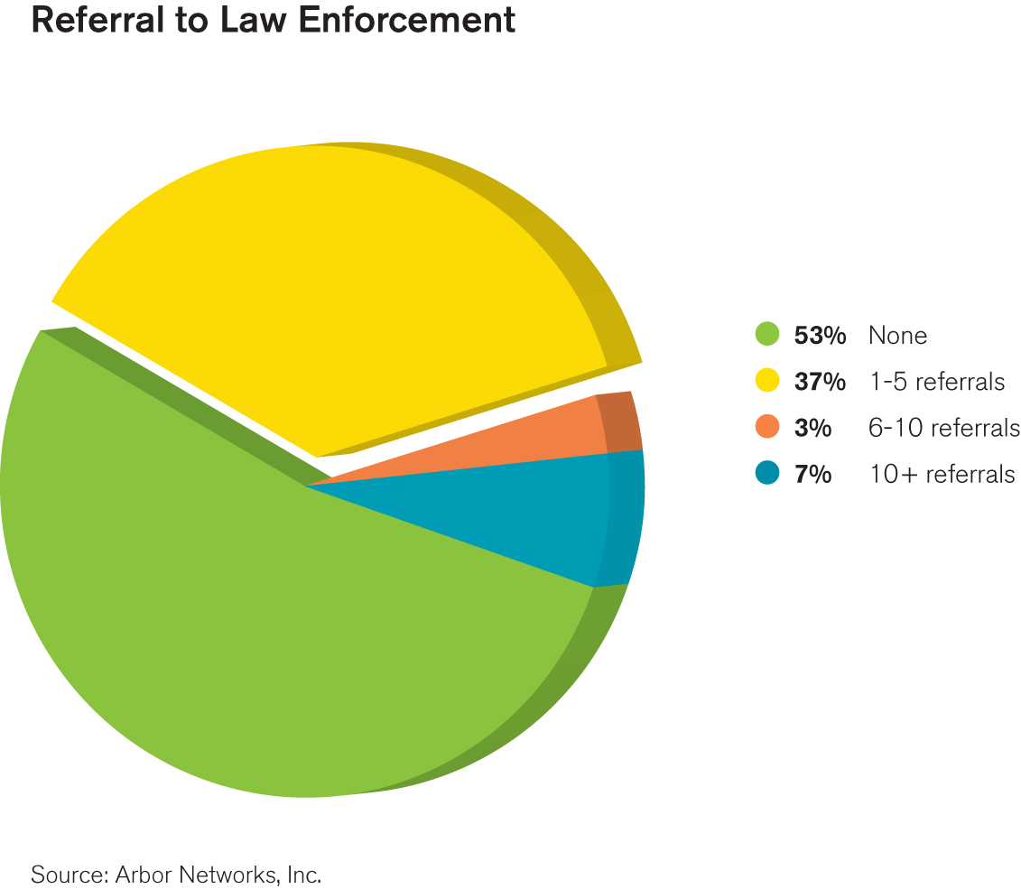
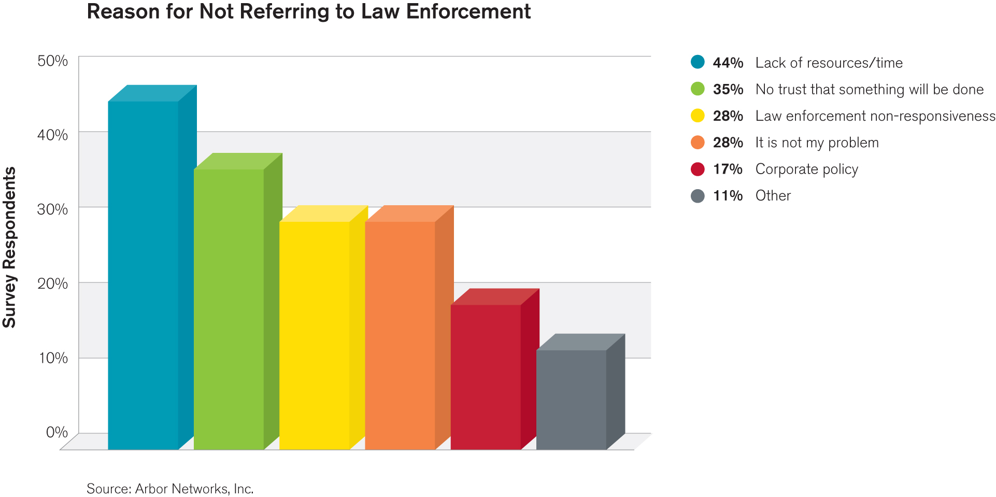
Law Enforcement Referral
More than half of respondents do NOT refer security incidents to law enforcement
Biggest barriers are ‘lack or resources’ and ‘low confidence that anything will get done’
84% believe government CERT / CSIRT have a positive role to play and welcome their involvement
66% believe governments are NOT doing enough to protect critical infrastructure

Slide 28
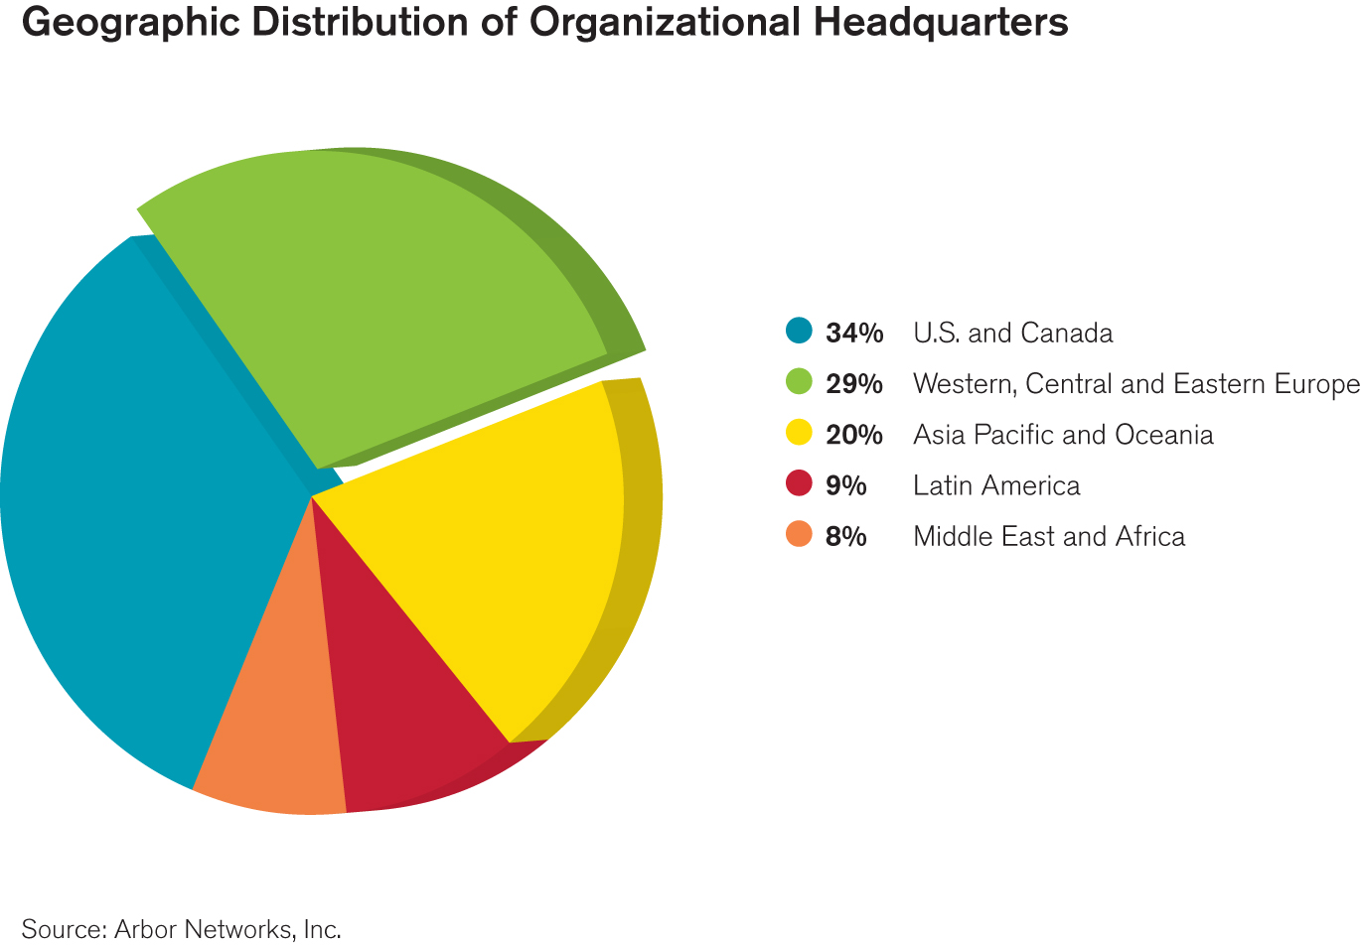
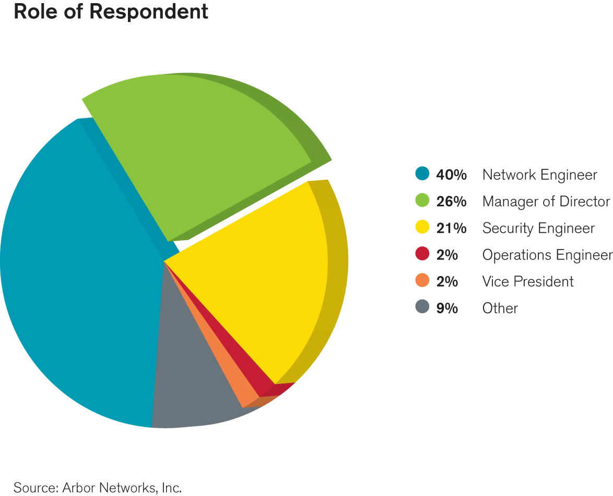
2012 Infrastructure Survey Demographics
Geographic distribution
29.1% Europe
34.2% US and Canada
9.4% Latin America
19.7% APAC
7.7% Middle East / Africa
63% of respondents network, security, operations engineers, analysts or architects
28.1% of respondents management or executives

Slide 29
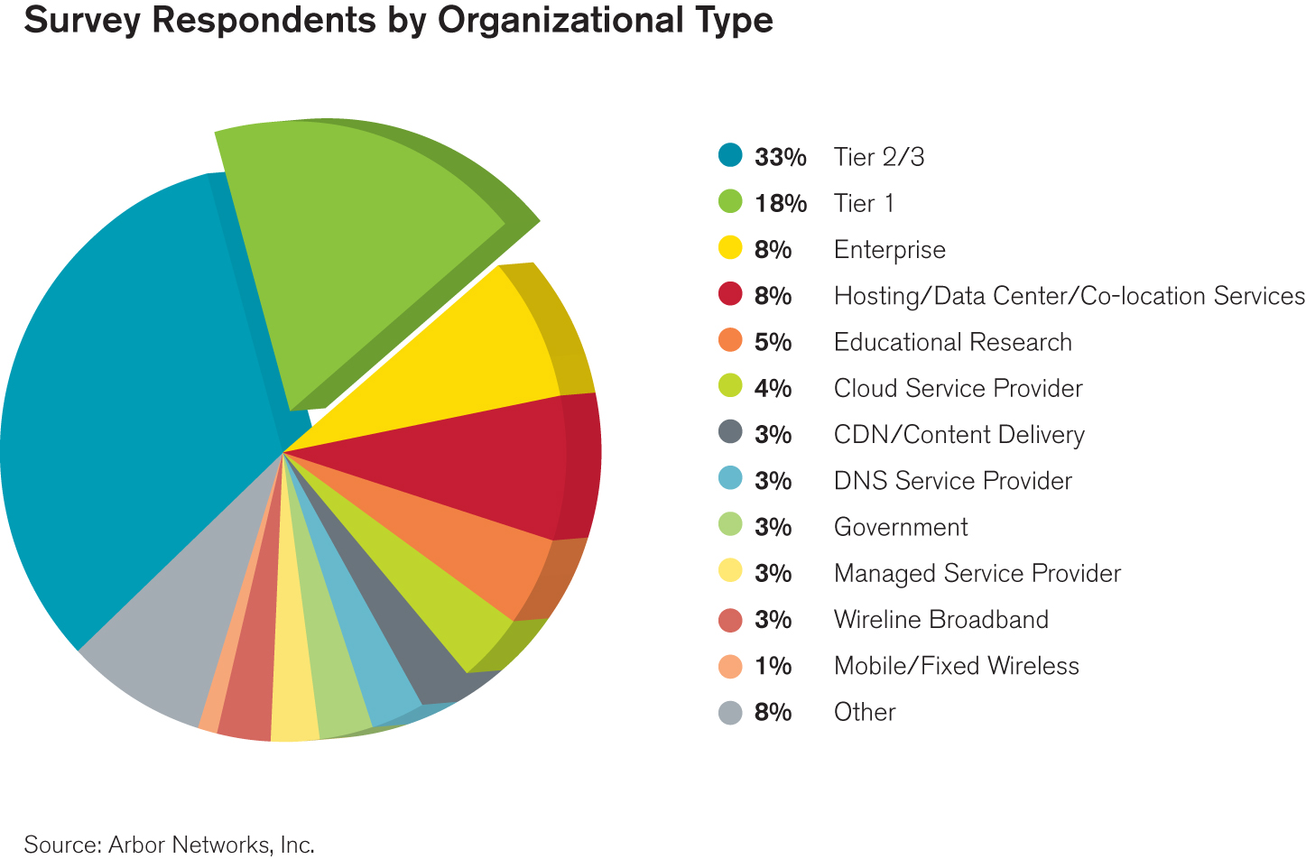
2012 Infrastructure Survey Demographics
Survey conducted in September 2011 & October 2012
130 total respondents across different market segments
75% Internet Service Providers

Slide 30
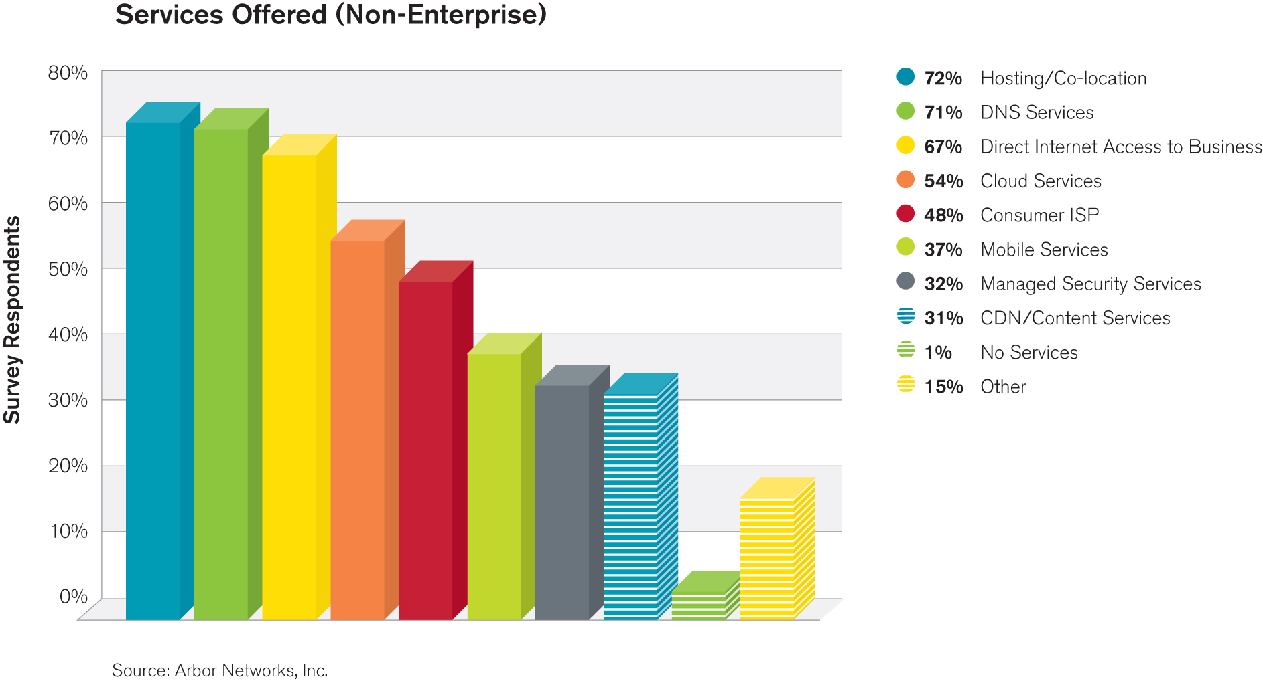
2012 Infrastructure Survey Demographics
Multiple services offered by most respondents
Business Internet, Co-Location and DNS services most common
62.3% of respondents offer managed security services

Slide 31
Thank You

