Slide 1
The Internet usage gap
MENOG 12
Dubai, March 2013
Lars-Erik Ödman
Strategy & Development
larserik.odman@datamena.com

Slide 2
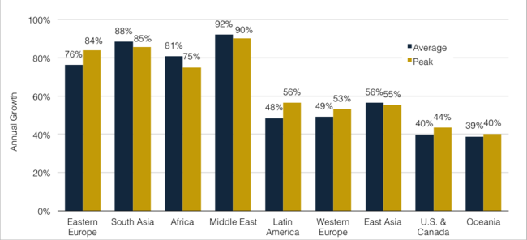
Middle East Internet traffic growth is rocking
Source: Telegeography 2012

Slide 3
… but the region is well behind in terms of usage
2015
Average usage 2010 and 2015
Gb per user per month
2010
105% annual Internet growth required to catch up
102
38
38
15
9
11
2
US
World
Middle East
Source: Informa 2011

Slide 4
Key questions for the Middle East to close the gap
3
Can the region create an Internet “ecosystem” of content and services?
2
Will it be possible to establish a competitive market for IP in the region?
1
Are there enough resilient cable routes to global hubs?
Latency
Cost
Reliability
A “Maslow hierarchy” for Internet supply

Slide 5
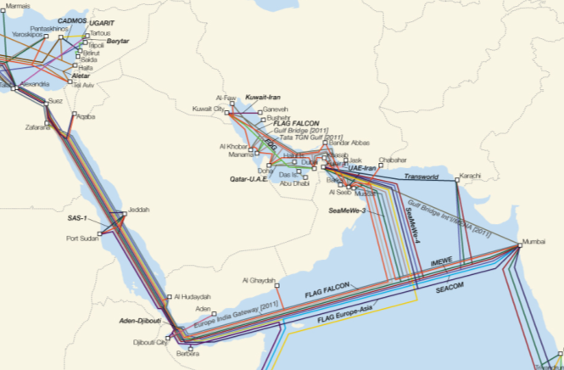
Are there enough resilient cable routes to global hubs?
There is no shortage of cables reaching the region…
1
Over 10 existing international cables reaching Europe and/or Asia
At least 7 new cables under construction or that have been announced

Slide 6

Will it be possible to establish a competitive marketplace?
The region can establish competitive markets
2
Big Mac index
$ per burger
Source: The Economist Intelligence Unit, 2012

Slide 7
Will it be possible to establish a competitive marketplace?
Can this be translated to IP?
2
Median GigE IP Transit price, Q3/Q4 2012
$/Mbps per month (US$)
Note: Prices represent median monthly price per Mbps for a fully committed GigE port in Q3/4 2012
Source: Telegoegraphy 2013

Slide 8












Can the region create an “ecosystem” of content and services?
There is an opportunity to improve the experience by enabling content to host locally in the region
3
Regional IP cloud
ISP 1
10-40 ms
Regional IXPs
Global IP cloud
ISP 2
60-150 ms
Global IXPs

Slide 9
5 supply side elements that we believe are critical to close the usage gap
Average usage 2010 and 2015
Gb per user per month
Competitive market place for IP and Capacity
Multiple fibre highways between countries within the region
Carrier neutral data centres
Regional Internet Exchanges
“Ecosystem” of global and local service providers
38
2015 World
105% annual Internet growth
11
2
2015 Middle East
2010 Middle East
Source: Informa 2011

Slide 10
Thanks!
Lars-Erik Ödman
Strategy & Development
larserik.odman@datamena.com

Slide 11

Can ISPs provide a world class Internet experience to end-users?
There is an opportunity to improve the experience by enabling content to host locally in the region…
3a
Regional IP cloud
10-40 ms
3% of intl. traffic
Global IP cloud
60-150 ms
97% of intl. traffic

Slide 12
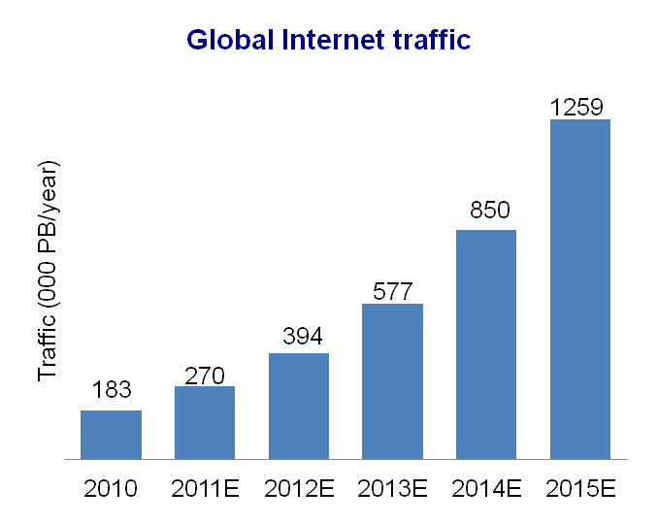
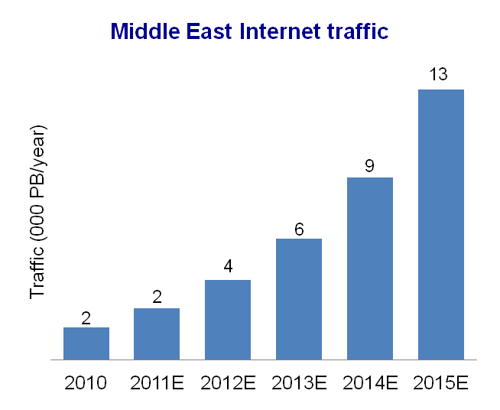
Internet traffic keeps growing rapidly, but Middle East growth will only slightly outperform global growth
CAGR 47%
CAGR 53%
Source: Informa Telecoms & Media, 2011

Slide 13
Successful Internet Exchanges are a key element to improve the Internet structure of the region
Peering in Europe
Peering regionally
Impact of regional peering
Resilience
(QoS)
Over 20 major cable cuts since 2008
Reach UAE-IX through submarine and terrestrial cables
Reduced risk of outages
Diversity to peering in Europe and Asia
Cost
$50-80 per mbps ⁽¹⁾
$5-20 per mbps
Up to 70% cost saving
Latency
(QoE)
Up to 80% reduction in latency
Dramatically improved customer experience –> demand -> revenue
150-300ms
10-40ms
(1) Cost vary significantly between different ISPs

