Slide 1
MENOG12 – MPF1
Peering personals!

Slide 2
CDNetworks
Woohyun Jang
ASN: 36408
Traffic Profile: Content (cache based)
Traffic Volume: 200-300Gbps
Peering Policy: Open
Peering Location(s): Major IXP including UAE-IX
PeeringDB Entry: as36408.peeringdb.com
Contact: peering@cdnetworks.com

Slide 3
Hurricane Electric
Contact: Martin Levy
ASN: AS6939
Traffic Profile: Both Content & Eyeball
Traffic Volume: Terabits
Peering Policy: Open
Peering Locations: 59 locations
PeeringDB Entry: http://as6939.peeringdb.com/
Contact: peering@he.net
Equinix Hong Kong, Equinix Singapore, Equinix Tokyo, HKIX, JPIX, JPNAP Tokyo, iAIX
AMS-IX, B-CIX, DE-CIX Frankfurt, ECIX Berlin, ECIX Duesseldorf, ECIX Hamburg, Equinix Paris, Equinix Zurich, France-IX, KleyReX, LINX Juniper LAN, LONAP, LU-CIX, MIX-IT, NIX CZ, NL-IX, NetNod Stockholm, PIX - Poznan, PLIX, SOL-IX / SOLIX, STHIX, SwissIX, Thinx, VIX
BigApe, CoreSite - Any2 Denver / RMIX Denver, CoreSite - Any2 Los Angeles, CoreSite - Any2 Silicon Valley, Equinix Ashburn, Equinix Chicago, Equinix Dallas, Equinix Los Angeles, Equinix New York, Equinix Palo Alto, Equinix San Jose, Equinix Seattle, Equinix Toronto, KCIX Kansas City, LAIIX, MICE, MadIX, NASA-AIX, NOTA, NWAX, NYIIX, PIX Vancouver, QiX 3, SIX, Telx Atlanta, Telx New York, Telx Phoenix, TorIX

Slide 4
Jim Cowie
ASN: 34135 (64597 for BGP Collection)
Traffic Profile: Zero!
Traffic Volume: None
Peering Policy: Open
Peering Location(s): ISTIX, DECIX, LINX, AMSIX
PeeringDB Entry: as64597.peeringdb.com
Contact: Danny Pare
peering@renesys.com

Slide 5
Init7
Fredy Künzler
ASN: 13030
Traffic Profile: more Content than Eyeballs
Traffic Volume: ~500 Gbps
Peering Policy: Open
Peering Location(s): many, mainly Europe new: Marseille / France
PeeringDB Entry: as13030.peeringdb.com
Contact: Fredy Künzler peering@init7.net

Slide 6
Easynet Ltd
Easynet Ltd
ASN: 4589
Traffic Profile: Eyeball
Traffic Volume: 550Gbps
Peering Policy: Selective
Peering Location(s): Too many to mention
PeeringDB Entry: as4589.peeringdb.com
Contact: Nigel Titley
peering@easynet.net

Slide 7
2Connect
ASN: 35313 (Middle East) & 51406 (Europe)
Traffic Profile: Fairly Balanced?
Peering Policy: Open (“all geographies” rule)
Peering Location(s):
Europe – LINX / LONAP / Private in Telehouse
ME Region – GCCIX (Kuwait, Qatar, UAE/Silaa, Bahrain), AMT Bahrain, Smarthub Fujairah
PeeringDB Entry: as51406.peeringdb.com
Contact: Andy Davidson
peering@2connectintl.com

Slide 8
MojoHost
Raman Sud
ASN: 27589
Traffic Profile: Content/Eyeball/Balanced? Content
Traffic Volume: 40-50 Gbps
Peering Policy: Open, Selective or Closed? Open
Peering Location(s): MIAMI NOTA
PeeringDB Entry: as27589.peeringdb.com
Contact: Raman Sud
peering@mojohost.com

Slide 9
NAWRAS
Wisnu Utomo
ASN: 50010
Traffic Profile:
Traffic Volume: 7 Gbps
Peering Policy:
Peering Location(s):
PeeringDB Entry: n/a
Contact: wisnu.utomo@nawras.om

Slide 10
Amazon
Matthew Moyle-Croft
ASN: 16509 (Worldwide) / 38895 (Singapore)
Traffic Profile: Content/Balanced
Traffic Volume: V. large
Peering Policy: Yes, please (read peeringdb for details)
Peering Location(s): Many Globally
PeeringDB Entry: as16509.peeringdb.com
Contact:
peering@amazon.com

Slide 11
Google Inc.
Paul Mandl
• ASN: 15169
• Traffic Profile: Content
• Traffic Volume: Tbps
• Peering Policy: Open
• Peering LocaHon(s): Muscat,Fujairah,++
• PeeringDB Entry:as15169.peeringdb.com
• Contact: pma@google.com
http://peering.google.com/

Slide 12
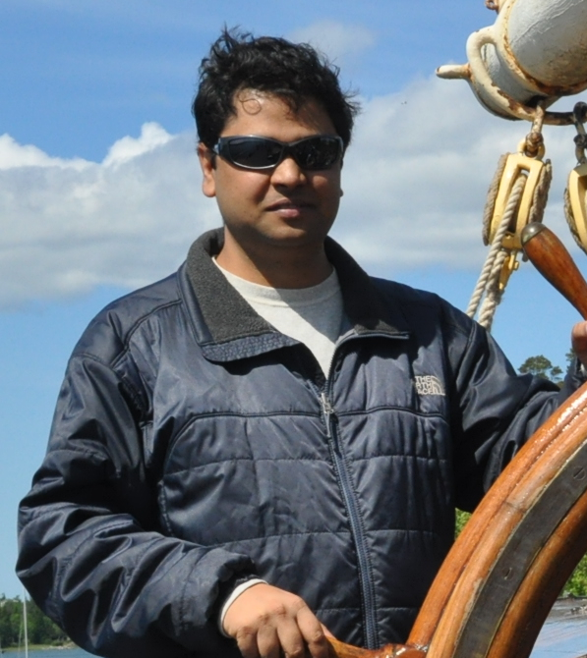
Limelight Networks
Gaurab Raj Upadhaya
ASN: 22822
Traffic Profile: Content
Traffic Volume: Huge
Peering Policy: Selective
Peering Location(s):
PeeringDB Entry: as22822.peeringdb.com
Contact: Gaurab Raj Upadhaya
gaurab@llnw.com, peering@llnw.com

Slide 13
LinkedIn
LinkedIn
ASN: US:20049/EU:197612
Traffic Profile: Content
Traffic Volume: Not Disclosed
Peering Policy: Open
Peering Location(s): All Major IXP’s
PeeringDB Entry: as20049.peeringdb.com
Contact: Zaid Ali Kahn
peering@linkedin.com

Slide 14
Kevin Epperson
ASN: 8075
Traffic Profile: Balanced
Traffic Volume: Tbps
Peering Policy: Open
Peering Location(s): 30+
PeeringDB Entry: as8075.peeringdb.com
Contact: peering@microsoft.com

Slide 15
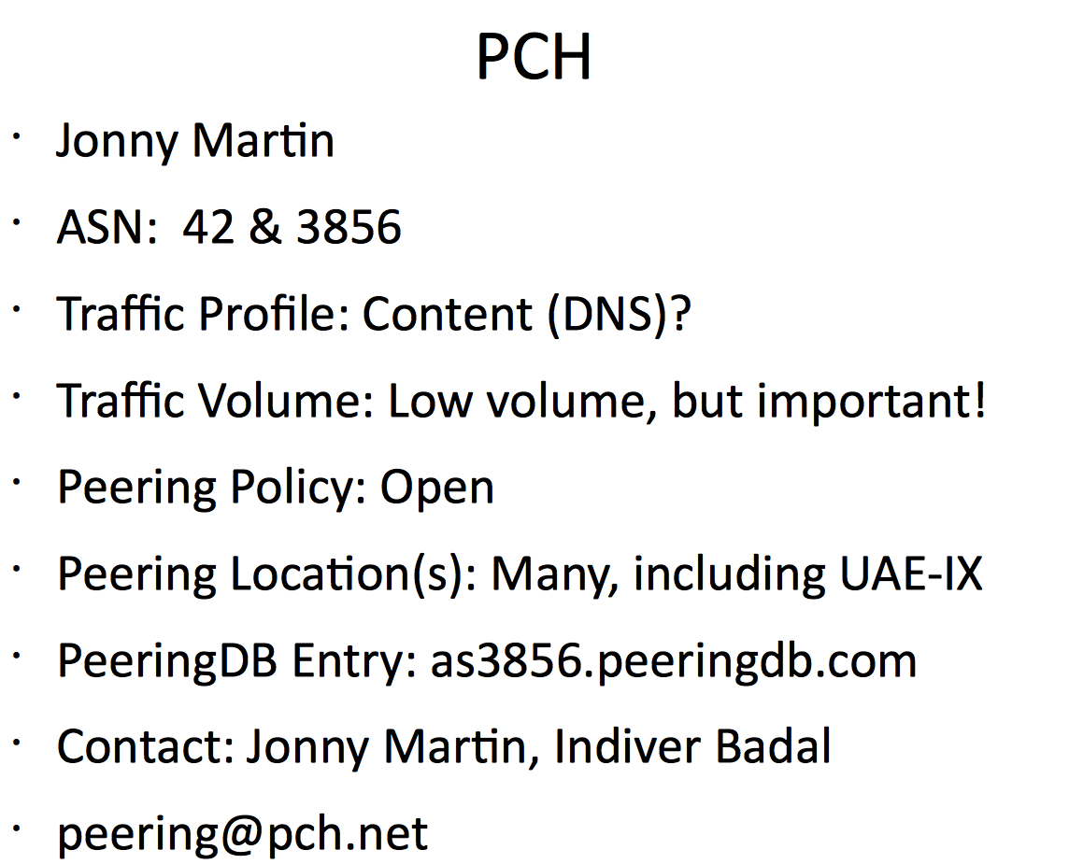
Kevin Epperson
ASN: 8075
Traffic Profile: Balanced
Traffic Volume: Tbps
Peering Policy: Open
Peering Location(s): 30+
PeeringDB Entry: as8075.peeringdb.com
Contact: peering@microsoft.com

