Slide 1
BGP Traffic Engineering
__________________________________
Andy Davidson andy@2connectintl.com
2Connect UK, LONAP, IXLeeds MENOG12, March ‘13, Dubai
APRICOT2013, 25 Feb ‘13, Singapore
. BCIX Tech Roundtable, 19th Nov ‘12, Berlin

Slide 2
Why do Traffic Engineering?
Manage your capacity demands
Ensure service quality
Recover from Failures
Manage service/circuit costs
Handle traffic growth
James Cridland http://www.flickr.com/photos/jamescridland/

Slide 3
Complexity
Life starts out very simply, “send traffic to peers if possible, then transit providers”
But what about when your network grows?
What about when your traffic grows?
What if you add more cities/POPs/exchanges?
Caisey Hussain Bisson -http://www.flickr.com/people/maisonbisson/

Slide 4
Real examples
Circuits with cost difference > $100/Mbit
Regional networks - poor local peering
Circuit failure causing congestion
Changing customer demand/behaviour
Increased quality expectation

Slide 5
Internal network TE
Simple compared with Interdomain TE
You administrate both sides
You know the price of all paths
The IGP knows the capacity of all paths
IGP protocols let you map price, capacity to shape routing using cost.

Slide 6
Inter-domain TE
You do NOT control both sides
Path vector protocols hide metric, capacity, cost
Simplicity of BGP protocol imposes limitations
Volume of traffic matters, not # of routes
However, large volume of traffic is usually with a small number of other ASNs

Slide 7
BGP Best Path Selection Algorithm
Affects traffic in outbound direction
Local Preference
AS PATH length
Lowest Origin Type
Lowest MED
Prefer eBGP paths
Lowest IGP Metric
Oldest route

Slide 8
Outbound vs Inbound
Outbound heavy networks
Somewhat easier life
Inbound heavy networks
You must trick the Best Path Selection methods of networks sending you traffic.
Their config change will move your traffic.
Elliot http://www.flickr.com/photos/pointnshoot/677657225/

Slide 9
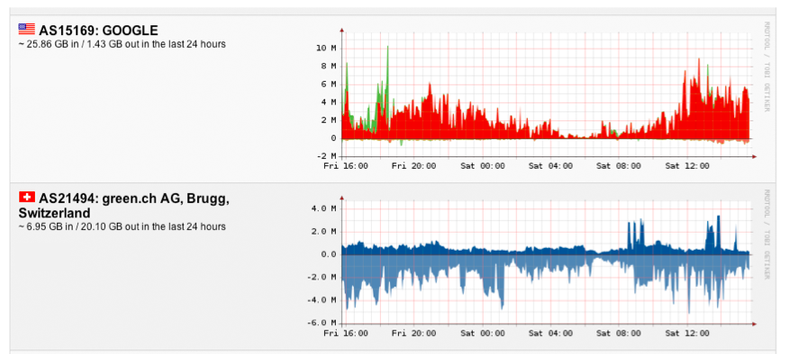
You need data
Manuel Kasper - https://neon1.net/as-stats/as-stats-presentation-swinog16.pdf

Slide 10
Other ways to get data
Log file analysis
Useful before you have a network, for working out the benefit of building a network/peering.
Best for ‘single service’ networks, webshops…
Wild Guess
Your instinct is better than you think, confirm with top talkers, etc.
But you should use Netflow. ☺

Slide 11
Data tells you
Your traffic direction
Mainly inbound
Mainly outbound
Balanced
Your top traffic originators or destinations

Slide 12
Mainly outbound, single POP
Localpref
A hammer – blunt tool, inflexible.. But it is a tool.
“Generally” prefer to send traffic to customers, then peers, then transits.
Manage top ‘n’ networks, so that there is a preferred path, and a failure path, with capacity on both circuits.

Slide 13
Transit
Many peers
Many peers
EX1
EX2
4Gbit
4Gbit
PP1
4Gbit
4Gbit
AS1
5Gbit
RT1
RT2
2Gbit
6Gbit
PP3
PP2
AS12345
AS2
AS3
AS2 is your largest flow - via PP2 - maybe needs a second private peer backup on RT2?
AS1 via PP1, configure a backup over EX1 or EX2 for deterministic routing?
Can you move larger peers behind EX1 and EX2 onto private peering?
If there is an exchange failure, where will the traffic go? How big a flow should you care about?
If you lose RT2, how will traffic to PP3 and traffic volume via EX2 be delivered?
If you lose RT1, how will traffic volume via PP3 and EX1 be delivered?

Slide 14
Localpref – blunt hammer
10.0.0.0/8 Localpref 100 via 100 123
10.0.0.0/8 Localpref 500 via 300 200 200 200 200 123
Which link will you prefer ?
AS123 here is trying to shape inbound traffic via AS100. Why ?
Higher capacity link ?
More reliable ?
What should you do ?
Answer: It depends on the volume of traffic, cost of capacity, value of traffic

Slide 15
Configuration Example
ip as-path access-list 30 permit _7018_
ip as-path access-list 30 permit _2828_
ip as-path access-list 30 permit _4323_
ip as-path access-list 30 permit _3561_
ip as-path access-list 30 permit _1668_
ip as-path access-list 40 permit _3330_
route-map PEER_EX1 permit 10
match as-path 30
set local-preference 300
route-map PEER_EX1 permit 15
match as-path 40
set local-preference 200
route-map PEER_EX1 permit 20
set local-preference 150
route-map PEER_EX2 permit 10
match as-path 40
set local-preference 300
route-map PEER_EX2 permit 15
match as-path 30
set local-preference 200
route-map PEER_EX2 permit 20
set local-preference 150
Larger flows are in ASNs
Listed in as-path 30 and 40
Deterministic exits configured

Slide 16
Mainly outbound – Many POPs
Use hot potato routing to best effect
Nearest exit routing
Understand who your top traffic sinks are and peer at all POPs
Ignore MEDs from others – unless you want to carry the traffic on your backbone

Slide 17
Transit
BCIX
DECIX
7Gbit
4Gbit
AS1
6Gbit
4Gbit
5Gbit
Berlin
Frankfurt
2Gbit
6Gbit
AS1
AS2
Amsterdam
If you lose a POP
does the traffic
go away or move?
AS12345
Internal capacity
likely more $ than
local handoff
AS1
2Gbit
AS2
8Gbit
If you understand your top flows, you will cope with traffic growth and failures

Slide 18
Deterministic routing
Local Preference
AS PATH length
Lowest Origin Type
Lowest MED
Prefer eBGP paths
Lowest IGP Metric
Oldest route
Top flows should leave your network via deterministic means, and not left to BGP Best Path selection (or to chance).
If you are relying on oldest route to make the decision, you risk traffic taking unpredictable routes.
However, oldest routes do break the ‘flapping sessions’ problem. You need to monitor and manage your top flows constantly.

Slide 19
Inbound traffic engineering
Much harder
Trick others’ Best Path calculations
You do not administrate origin party router
But remember…
Largest flows come from a small number of networks
Content networks want to deliver traffic to you as well as possible!

Slide 20
Selective Announcements
Shortest prefix
Local Preference
AS PATH length
Lowest Origin Type
Lowest MED
Prefer eBGP paths
Lowest IGP Metric
Oldest route
Prefix length considered before BGP.
10.0.0.0/16 vs 10.0.0.0/17 & 10.128.0.0/17

Slide 21
Problem of Selective Announcements
Often filtered
Considered rude – might lead to depeering
Never announce ‘globally’

Slide 22
…But can be used to great effect
To the same peer or transit provider, announce aggregate and regional pfx
Transit
10.0.0.0/8
10.0.0.0/9
10.0.0.0/8
10.128.0.0/9
Add NO_EXPORT community
Berlin
Frankfurt
Use with permission

Slide 23
AS_PATH prepending
Signal preferred path by growing AS_PATH on less preferred paths
Marginal effect which degrades quickly
Signal backup link to a single AS, but load-balancing capacity is much harder
May not be heard at ‘distant’ ASNs
Another ‘blunt’ tool, but can move some traffic.

Slide 24
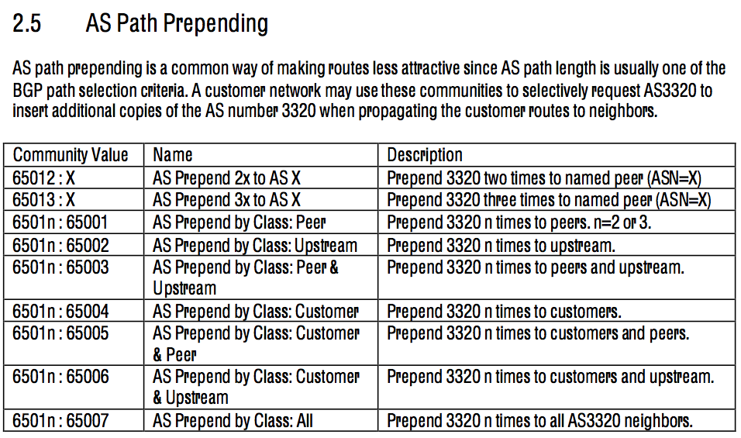

Slide 25
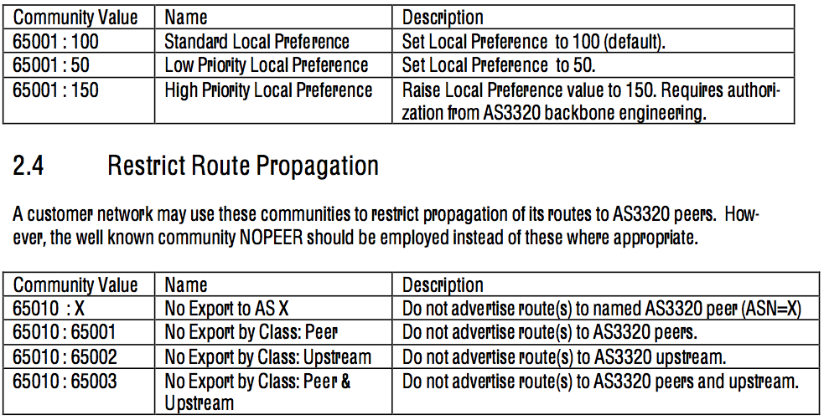

Slide 26
MEDs
Lowest MED wins.
Opposite of Nearest Exit routing, “carry traffic to me”
Only works to the same peer in multiple regions
Copy IGP metric to MED
Normally subject to negotiation
Sometimes honoured, often when network traffic is latency or loss sensitive.

Slide 27
MEDs are often filtered
Many networks set MED to 0 when they learn prefixes, so that hot potato routing will override MED.
route-map peers-in permit 10
set local-preference 200
set metric 0

Slide 28
Origin changing
IGP
EGP
Incomplete
Highest priority
route-map PEERS permit 10
set origin igp
route-route-map TRANSIT permit 10
set origin incomplete
Often peers set to ‘igp’ or ‘egp’ statically on
routers to nullify effects of Origin changing.

Slide 29
Inbound – what does work well?
Overprovisioning
Peer with top networks widely (buy options!)
Build relationships
Constantly monitor and manage
If you care about your traffic, let it go. ☺
Playing games with peering hurts your customers’ traffic
Affecting distant ASNs is very hard – a region may only see a single next-hop ASN.

Slide 30
Constantly manage
Peering on the Internet changes every day.
Capacity on the Internet grows every day.
Small networks become large.
Large networks become larger (consolidation)
A “bad” path might become good overnight

Slide 31
Questions?
______________________________
Andy Davidson
andy@2connectintl.com
+44 114 3190605

