Slide 1
African Internet Ecosystem, Lessons Learned Along the Way
Hisham Ibrahim
IPv6 Program Manager, AFRINIC
MENOG-12, Dubai
6 March 2013

Slide 2
Content
Internet Number Resources (namely IPv6)
Internet Exchange Points (IXPs)
Root Name Servers
Top Level Domains & Content
Page 2

Slide 3
The Multiplier Effect
Page 3

Slide 4
Internet Number Resources (namely IPv6)
Page 4

Slide 5
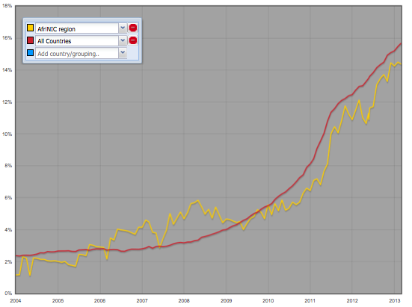
African Networks seen globally over IPv6
All countries: 15.69% (6864 out of 43748 ASes) AFRINIC Region: 14.38% (90 out of 626 ASes)
Page 5

Slide 6
Internet Exchange Points (IXPs)
Page 6

Slide 7
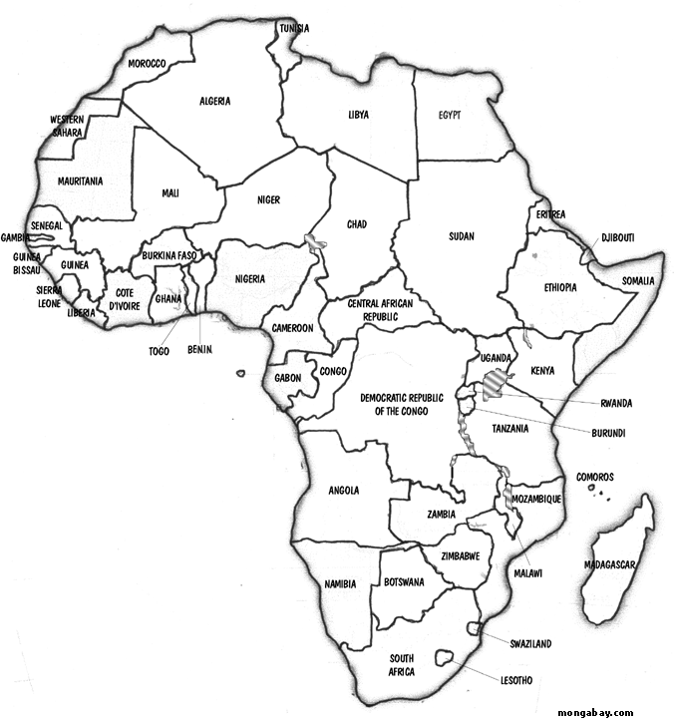
Internet exchange Points (IXPs)
SOUTH SUDAN
At least one IXP known to exchange traffic
At least one IXP soon to exchange traffic
Mauritius
Page 7
Notes:
he operational ones that i know are known to me are as follows i.e can
provide stats etc.;
1) Capetown IXP (CINX)
2) Cairo IXP (CAIX)
3) Johanesburg IXP (JINX)
4) Kenya Internet Exchange Point (KIXP)
5) Dar-es-Salaam IXP (TIX)
6) Arusha Internet Exchange Point (AIX)
7) Malawi Internet Exchange Point (MIX)
8) Mozambique Internet Exchange Point (MOZIX)
9) Nigeria Internet Exchange Point (IXPN)
10) Lusaka Internet Exchange Point (LIXP)
11) Angola Internet Exchange point (AIXP)
12) Uganda Internet Exchange Point (UIXP)
13) Swaziland Internet Exchange Point (SZIXP)
14) Rwanda Internet Exchange Point (RINEX)
15) Ghana Internet Exchange Point (GIX and AIX - two IXPs now joined)
16) Grahams Town IXP (GINX)
17) Lesotho Internet Exchange Point (LIXP)
18) Sudan Internet Exchange Point (SIXP)
The ones that are known to exist but are not known to be exchanging
traffic or no stats can be given from them are as follows;
1) Kinshasa Internet Exchange Point (KINIX) - To be Re-Launched in Nov 16 2012
2) Zimbabwe Internet Exchange Point (ZINX) - Not really working as a proper IXP no traffic data
3) Mombasa Internet Exchange Point (KIXP-MSA) - To be launched as East Africa IX in partnership with AMSIX and SEACOM
4) Sierra Leone Internet Exchange Point (SLIX) - no traffic yet
5) Botswana Internet Exchange Point (BINX) - Operated inside incumbents no traffic data
6) Cote D' Ivore (CI-IXP) was not on this list until AfPIF-2 - new process to revamp it
7) Abuja IXP (IXPN - Abuja) - Launched in August/July no traffic data yet 8) Mauritius Internet Exchange Point (MIXP) - Will confirm am 50/50

Slide 8
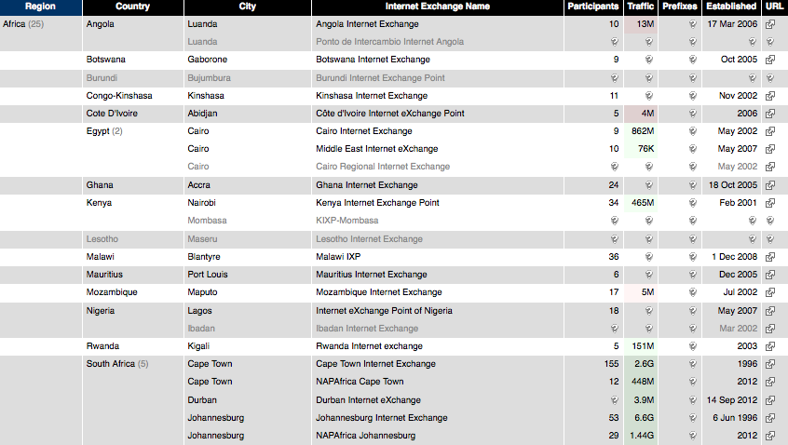
Return address

Slide 9
The Nigerian IXP
Latency Impact: The presence of the IXP has reduced latencies experienced from between 200 – 400 to sub 10ms.
Cost Savings: The wholesale savings of exchanging 300Mbit/s = $1,080,000 per year
Local Content and Hosting:
West African Examination council Website is locally hosted and accessed.
Interswitch e-transactions and e-payment system with over 10,000 ATMs and 11,000 POS terminals has started migrating some of services hosted abroad back into Nigeria
Page 9
Notes:
Using an average cost of $300 per Mbit/s for International connectivity,

Slide 10
The Kenyan IXP
Latency Impact: KIXP members experience between 10ms – 2ms latencies between their networks compared to between 200ms – 600ms without the IXP.
Cost savings: KIXP exchanges 1Gbit/s Wholesale saving are at $1,440,000 per year.
Increased revenues: Mobile operators in Kenya charge by the MB for Internet access. Through the KIXP revenues increased of about $6,000,000 per year.
Local Content and Hosting: The Kenya Revenue Authority Online services saves the private sector $4.5m
Return address
Page 10
Notes:
using a conservative value of $120/Mbit for Transit. There are over 107 Autonomous System Numbers (ASN’s) visible at KIXP with over 50% of them being external to Kenya therefore increasingly acting as a regional hub for traffic from neighboring countries.

Slide 11
The South African IXPs
Latency Impact: With 3 national IXPs that host 5 different Root Name Servers members experience between 10ms – 20ms latencies between their networks compared to between 160ms – 550ms without the IXP.
Cost savings: The 3 IXPs exchanges and aggregate traffic of over 9 Gbit/s Wholesale saving are at $25,000,000 per year.
Local Content and Hosting:
South Africa remains the most developed data market with most of the capacity located there and over 800,000 domains under .ZA
Return address
Page 11
Notes:
using a

Slide 12
Root Name Servers
Page 12

Slide 13
Root Name Servers
There are only 15 Root Name Servers in Africa out of 350 Servers globally.
SOUTH SUDAN
E (NASA Ames Research Center)
F (Internet Systems Consortium)
I (Netnod)
J (VeriSign)
L (ICANN)
Page 13

Slide 14
Local Content
Page 14

Slide 15
Top Level Domains & Content
There are only 5 ICANN Accredited registrars in Africa out almost 1,000 ICANN Accredited registrars globally.
SOUTH SUDAN
Kheweul, Senegal
AfriRegister, Burundi
Ghana Dot Com Ltd., Ghana
Internet Solutions, South Africa
Genious Communications, Morocco.
Page 15

Slide 16
Local Content
UNESCO has defined local content as an expression and communication of a community’s locally generated, owned and adapted knowledge and experience that is relevant to the community’s situation.
These communities are defined by their location, culture, language or area of interest.
The idea of relevant content in the speaker’s own language is called local content.
There may be cases where relevant information exists but not in a language that is accessible. In other cases, illiteracy poses a significant problem for transmitting knowledge.
Page 16

Slide 17
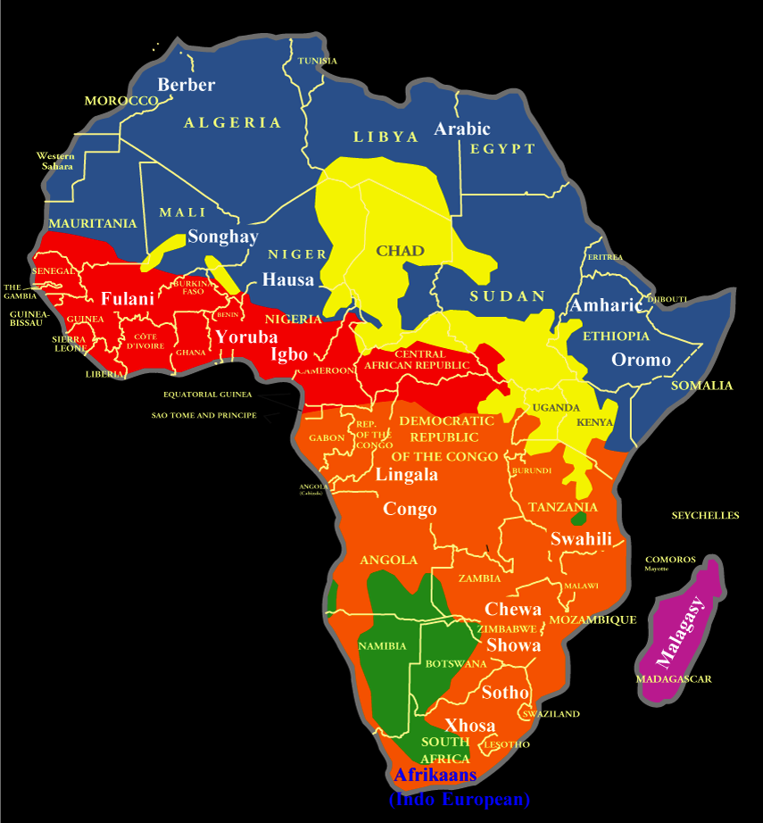
Language Diversity
Africa is a continent with a very high linguistic diversity, there are an estimated 1500-2000 African languages.
Afro-Asiatic
(approximately 200 languages) covering nearly Northern Africa.
Nilo-Saharian
(approximately 140 languages) with some eleven millions speakers in Central and Eastern Africa.
Niger-Saharian (Niger-Congo) (approximately 1000 languages )
covering the two thirds of Africa with 200 millions speakers.
Khoisan
(approximately thirty languages) in Western part of Southern Africa.
Page 17

Slide 18
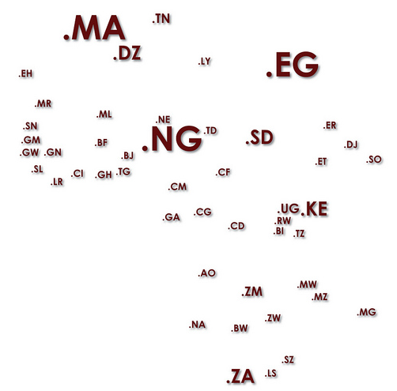
ccTLDs & IDNs
There is a correlation between local domain names and local content.
South Africa has over 800,000 domains under .ZA
Kenya has over 20,000 domains under .KE
Egypt, Sudan and Tunisia have their Arabic IDNs. مصر؛ .السودان؛ .تونس. and expect to see more traffic on those domains as a result of literacy in Arabic.
Return address
Page 18

Slide 19
African Interconnection
Page 19

Slide 20
African Interconnection IPv6 only BGP Map
A hand full of countries interconnect together over IPv6
* Africa IPv6 BGP Map, curtsy of Hurricane Electric, September 2012. * Thicker lines indicate more BGP sessions * Not all links will show within these graphs, due to the limited number of collectors in Africa
Page 20

Slide 21
AF* Organizations
Page 21

Slide 22
AF* Organizations
To list a few:
* AFRINIC - managing Internet Number Resources www.afrinic.net
* AFTLD - focal point for all the African TLDs Managers www.aftld.org
* AFNOG - the African Network Operator group www.afnog.org/
* AFREN - The African Reacurch and Education Network coordnation body. * The African IGFs : African IGF as well as South, Nourth, East, West and Arab IGFs * AF6TF : African IPv6 Task force www.af6tf.net/
* AFPIF : AFrican Peering and Interconnection Furom www.internetsociety.org/events/afpif

Slide 23
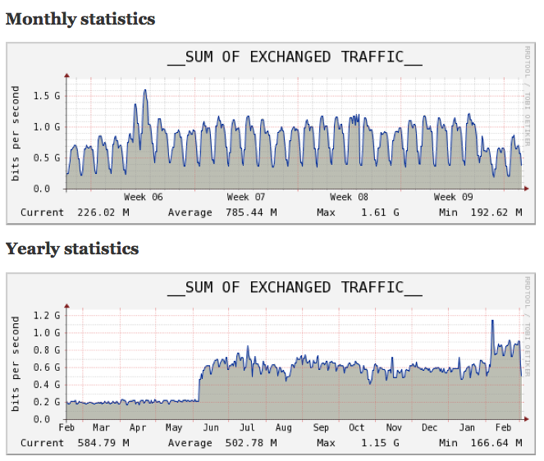
Why are meet Peering meeting important?
Return address
Page 23

Slide 24
Thank you hisham@afrinic.net

Slide 25
References
http://ispa.org.za/inx/
http://www.internetsociety.org/ixpimpact
https://prefix.pch.net/applications/ixpdir/summary/
http://bgp.he.net/report/world To see a detailed BGP map of your country
http://v6asns.ripe.net/v/6?s=_RIR_AfriNIC
Page 25

