Slide 1
IPv6 For Managers
Non-technical track
Hisham Ibrahim
IPv6 Program Manager, AFRINIC
IPv6 for Managers, Dubai
5 March 2013

Slide 2

Content
Module # 1
What are Internet Resources?
Module # 2
IPv4 Address Exhaustion
Module # 3
Proposed Technical Solutions
Module # 4
IPv4 Address Exhaustion Implications
Module # 5
Planning for IPv6
Page 2

Slide 3
IPv6 For Managers
A non-technical track
Module # 1
What are Internet Number Resources?
Page 3

Slide 4
Content
What is the Internet?
What is an IP address?
What are Internet Resources?
  What IPv4?
  What is IPv6?
  What is an ASN?
Page 4

Slide 5
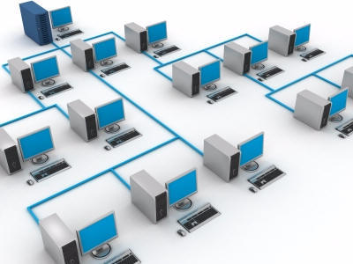
What is the Internet?
Devices and Terminals interconnect forming a
NETWORK
Page 5

Slide 6

What is the Internet?
These NETWORKS may support different
devices and technologies
Page 6

Slide 7

The Internet
The reality is “THERE IS NO ONE BIG INTERNET”
Page 7

Slide 8

The Internet
It is a network of networks that consists of millions of private, public, academic, business, and government networks, of local to global scope.
Page 8

Slide 9

What is the Internet?
These NETWORKS interconnect forming the
INTERNET
Page 9

Slide 10
What is the Internet?
The Internet has one very simple job:
To move information from one place
to another.
In this respect, the Internet works a bit like the postal service. Letters are simply passed from one place to another, no matter who they are from or what messages they contain.
Page 10

Slide 11

What is an IP address?
Sender’s Name
Street Address
City, Country
Return address
Recipient Full Name
Street Address
City, Country
Destination address
These addresses must be unique to ensure delivery
Page 11

Slide 12
What is an IP address?
In the Internet world these Addresses are the Protocol addresses or IP addresses for short.
192.168.0.1
These IP addresses are part of INTERNET Number RESOURCES along with Autonomous System numbers (ASN)
Page 12

Slide 13
What is an IP address?
To send data back and forth, both the SOURCE and the DESTINATION IP addresses must be known
192.168.0.1
192.168.0.113
Page 13

Slide 14
What is an IP address?
IP addresses must be UNIQUE to ensure delivery
192.168.0.1
192.168.0.113
??
192.168.0.113
Page 14

Slide 15
What is an IP address?
To send data back and forth the both the SOURCE and DESTINATION IP addresses must be known
www.afrinic.net
192.168.0.1
196.216.2.1
Where is
www.afrinice.net ??
1
3
2
196.216.2.1
Page 15

Slide 16
What are
Internet Resources?
Internet Number Resources are the numbers used to identify devices and networks on the Internet.
These resources include
IPv4, Internet Protocol version 4
IPv6, Internet Protocol version 6
ASN, Autonomous System Numbers
Page 16

Slide 17
What is IPv4?
IPv4 is the most original and widely deployed Internet protocol today.
IPv4 is designed to identify a total of 4.2 billion possible unique equipment. Not all of them can be used (Network and Broadcast identifiers must be deducted).
Example: 196.216.0.1
Page 17

Slide 18
What is IPv6?
IPv6 is the network layer Protocol design to replace IPv4 and address some of its weakness.
IPv6 is designed to identify a total of 340 trillion trillion trillion, possible equipment, not all of them can be used.
IPv6 and IPv4 are different protocol in design hence are not directly compatible
Example: 2001:0:0:A52::3D16/64
Page 18

Slide 19
What is an ASN?
An ASN is a collection of connected Internet Protocol nodes under the control of one or more network operator that share a clearly defined routing policy to the Internet.
AS####
AS****
Network(s) A
Network(s) B
Page 19

Slide 20
Number Resources in Summary
IPv4
Internet Protocol version 4 is the dominant protocol of the internet today. These addresses have to be unique to ensure global reachability.
IPv6
IPv6 is the new version of the Internet address protocol that has been developed to supplement (and eventually replace) IPv4.
ASN
An Autonomous System is a connected group of IP networks that follow to a single unique routing policy. An ASN is a globally unique number used to identify an Autonomous System.
Page 20

Slide 21
IPv6 For Managers
A non-technical track
Module # 2
IPv4 Address Exhaustion
Page 21

Slide 22
Content
Usage of Internet Resources
Internet Resource Management System
What do we mean by IPv4 exhaustion
Page 22

Slide 23
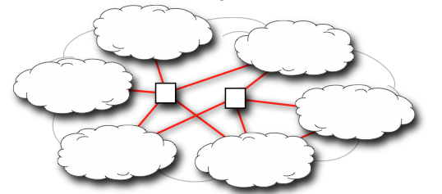
The Internet
ASN
v6
ASN
v4
ASN
v4
v6
ASN
v4
v6
ASN
v4
ASN
v4
v6
Internet Resources are the numbers used to identify devices and networks on the Internet.
Page 23

Slide 24
Internet Resource Management System
Addresses Allocation
IANA
Internet Assigned Numbers Authority
AfriNIC
LIR
APNIC
Manages Central Pool
0/0, 0::/0, ASN
Regional Internet Registries (/8, /12)
Final users (/24, /23, …)
RIPE NCC
LACNIC
ARIN
End Users
Page 24

Slide 25
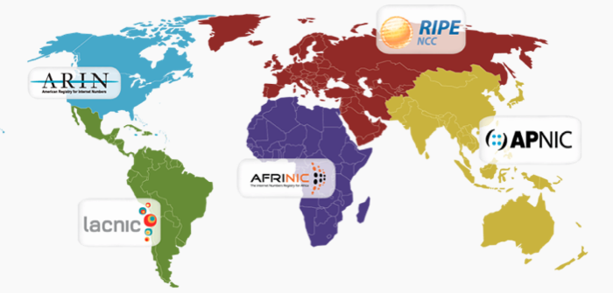
Internet Resource Management System
Page 25

Slide 26
Internet Resource Management System
Policy development
Global Policy
Regional policy
Regional Communities
AfriNIC
Policy makers
APNIC
ASO
ICANN IANA
ARIN
LACNIC
RIPE NCC
Facilitators
Page 26

Slide 27
Internet Resource Management System
OPEN
Need
NO Accreditation
  Inclusive
  Accessible
Evaluate
Discuss
‘BOTTOM UP’
TRANSPARENT
Implement
Consensus
Internet Community Proposes, Discusses, & Approves
Policy
Documented, Published & Accessible
PDP, Policies, & Procedures

Slide 28
Internet Resource Management System
Page 28

Slide 29
Internet Resource Management System
IANA IPv4 /8s remaining
February 3, 2011 = 0!
RIPE NCC IPv4 /8s remaining
September 14, 2012 < 1
APINIC IPv4 /8s remaining
April 15, 2011 < 1
Page 29

Slide 30
IPv6 For Managers
A non-technical track
Module # 3
Proposed technical Solutions
Page 30

Slide 31
Content
Network Address Translation (NAT)
  Why NAT is Bad?
IPv6
  Translation
  Dual stacks
Page 31

Slide 32
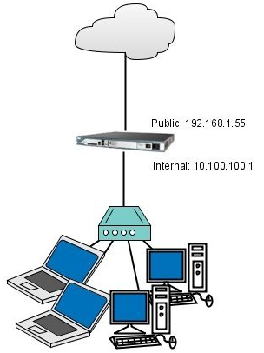
Proposed Technical Solutions
Network Address Translation (NAT):
NAT is a technology that allows several machines share the same public IP address
Not a Sustainable Solution to Address Depletion
Page 32

Slide 33
Proposed Technical Solutions
“NAT has several negative characteristics that make it inappropriate as a long term solution, and may make it inappropriate even as a short term solution.”
K. Egevang and P. Francis
Authors of NAT (RFC 1631)
Page 33

Slide 34
Proposed Technical Solutions
There are several acronyms and names to NAT such as:
Carrier Grad NAT (CGN)
Large Scale NAT (LSN)
NAT 444
Page 34

Slide 35
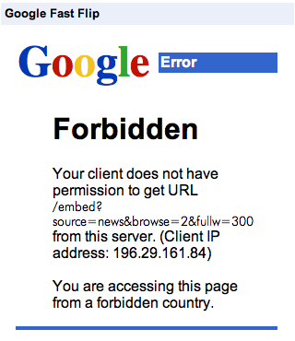
Proposed Technical Solutions
Why NAT is Bad?
Page 35

Slide 36
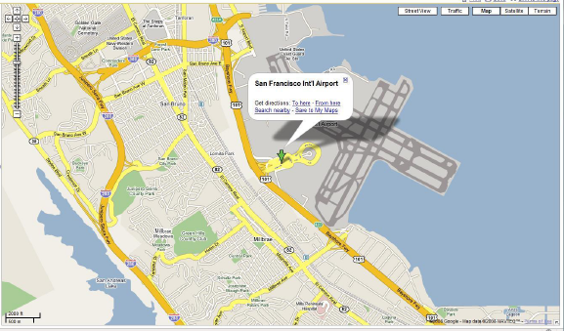
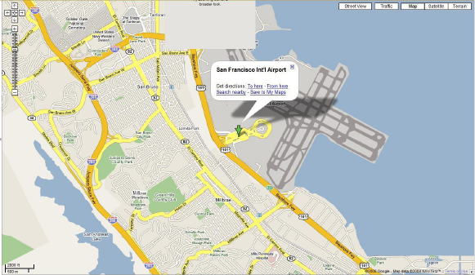
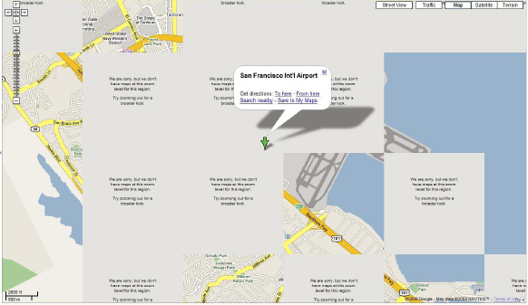
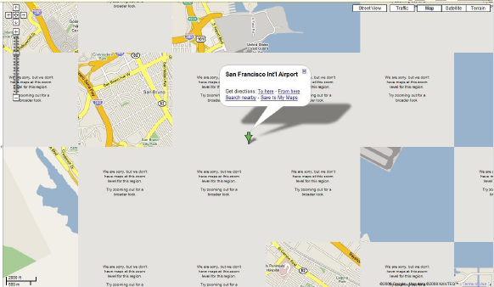
Proposed Technical Solutions
Why NAT is Bad?
Page 36

Slide 37
Proposed Technical Solutions
IPv6
IPv6 has a total of 340 undecillion, possible unique addresses, not all of them can be used
3.4×10³⁸ IPv6 addresses
340 trillion trillion trillion IPv6 addresses
1.84x10¹⁹/64 or 5.76x10¹⁷/59 or 2.81x10¹⁴/48
Proportion wise if IPv4 is big as a golf ball IPv6 is big as the sun
Page 37

Slide 38
Proposed Technical Solutions
IPv4
IPv6
IPv6 and IPv4 are not Incompatible
Page 38

Slide 39
Proposed Technical Solutions
IPv4
IPv4
IPv6
IPv6
Translator
Translation will:
1) Add extra cost and equipment to the network
2) Break the communication
Page 39

Slide 40
Proposed Technical Solutions
IPv6
IPv4
IPv4
& IPv6
IPv6
IPv4 or IPv6
IPv4
IPv4
& IPv6
Dual Stacking
Page 40

Slide 41
IPv6 For Managers
A non-technical track
Module # 4
IPv4 Address Exhaustion Implications
Page 41

Slide 42
Content
IPv4 Address Exhaustion Implications
  Globally
  Regionally
  Nationally
Page 42

Slide 43
What are the implications of IPv4 exhaustion?
Globally
Microsoft paid Nortel Networks 7.5 Million USD for 666,624 LEGACY IPv4 addresses
That’s $11.25 per IPv4 address
Page 43

Slide 44
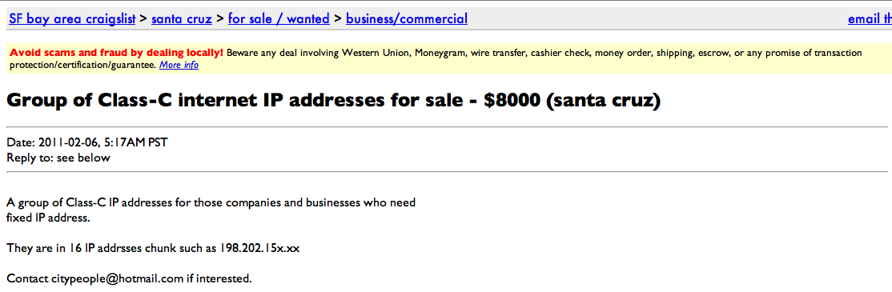
What are the implications of IPv4 exhaustion?
Globally
Page 44

Slide 45
What are the implications of IPv4 exhaustion?
Nationally:
Governments and Regulators
Topics that can not be discussed without mentioning IPv6
1) Interconnection, infrastructure & rural areas
2) Cyber security
3) E – Anything
4) Analog to digital
5) Convergence & mobile Internet networks
6) Content and ccTLDs growth
7) Research and Innovation
8) Internet governance and critical Internet resources
Page 45

Slide 46
What are the implications of IPv4 exhaustion?
Nationally:
Cyber Security & LEAs
Law enforcement agencies have warned about other problems relating to IPv4 address exhaustion, including greater use of carrier-grade Network Address Translation, or CGN, which would entail that Internet providers will have to keep accurate records of every port number assigned to each user.
Page 46

Slide 47
What are the implications of IPv4 exhaustion?
Nationally:
Cyber Security & LEAs
Accurate IPv6 record-keeping does more than help law enforcement.
It's useful for combating abuse.
It's useful for anti-spam measures.
It's useful for figuring out what's going on with distributed denial of service attacks.
It's useful for civil litigants.
Page 47

Slide 48
What are the implications of IPv4 exhaustion?
Nationally:
Private Sector
Telecoms, Service Providers, organizations doing business on the Internet, need to be able to:
Scale their networks; more clients
Support a large mobile workforce
Support large multiple sites
Ensure your content and information will be reached by more viewers
Page 48

Slide 49
What are the implications of IPv4 exhaustion?
Nationally:
Mobile Internet
Smart Phones and Network Aware Devices
Africa has made a revolutionary leap from paper mail to instant messaging.
Network aware devices such as video game consoles, TVs and smart home equipment.
Virtualization and cloud computing.
For each physical machine there can be many virtual hosts, each requiring a unique IP address
Page 49

Slide 50

What are the implications of IPv4 exhaustion?
Nationally:
Mobile Internet
•IP address amount in LTE is about 20-40 times of that in 2G/3G
•LTE is always-on, which means whenever the terminal turns on no matter whether a service will be used or not, IP addresses should be assigned to the terminal.
•Multiple APNs is needed for LTE. Multiple IP addressed should be assigned to one LTE device
Page 50

Slide 51
What are the implications of IPv4 exhaustion?
Nationally:
National Research & Education Networks (NRENs)
Specialized Internet service provider dedicated to supporting the needs of the research and education communities within a country.
With thousands of online students and researchers, NRENs are the ideal places to start implementing and testing new Internet protocols (IPv6) and architectures (Cloud Computing).
Page 51

Slide 52
What are the implications of IPv4 exhaustion?
Nationally:
National Research & Education Networks (NRENs)
The Internet of Things (Innovation):
This includes things such as central heating, cars, lighting, power distribution, temperature and other environmental sensors, clothes and even fast moving consumer goods packaging.
Page 52

Slide 53
IPv6 For Managers
A non-technical track
Module # 5
Planning for IPv6
Page 53

Slide 54
Content
What do I need to consider for IPv6 ?
Planning steps
Page 54

Slide 55

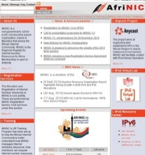

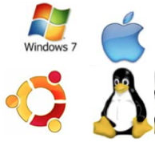
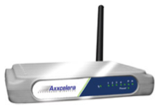

What do I need to
consider for IPv6 ?
Over IPv6
Almost the same at 80%
(Skype & FaceTime still not v6 ready)
Apps
OS
Almost the same 90%
(Microsoft supports XP till 2014)
Internet devices
(CPEs)
Almost 20%
(Dlink and Cisco will enable IPv6 by default)
Internet Service
Providers (ISPs)
ISP
Almost 10%
(AT&T, KDDI, Free, Comcast and others)
Over 75%
(Top 30 sites that generate more than 75%
of traffic are enabling v6)
Content
Page 55

Slide 56


What do I need to
consider for IPv6 ?
Over IPv6
80%
Apps
OS
90%
Internet devices
(CPEs)
20%
Internet Service
Providers (ISPs)
ISP
10%
75%
Content
Page 56

Slide 57
What do I need to
consider for IPv6 ?
Internet devices
(CPEs)
20%
Internet Service
Providers (ISPs)
ISP
10%
Page 57

Slide 58
Planning steps
Education and training
2. Begin internal communications
3. Survey (hard / soft) ware equipment in production
4. Review of the appropriate technical options
5. Selection of the technical approach and corresponding
security policy
6. Development of the project proposal
Page 58

Slide 59
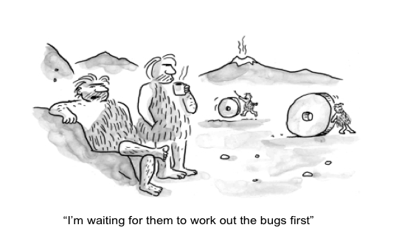
Do NOT wait for others
Page 59

Slide 60
Thank you
Merci
شكرا
Page 60

