Slide 1

The IETF Needs You!
IETF Standards Participation
Invitation to the Middle East www.ietf.org
Moustafa Kattan, Cisco, mkattan@cisco.com
Osama I. Al-Dosary, Solyton, dosary@solyton.com
March, 2013

Slide 2
Internet Engineering Task Force
Develops and promotes IP related standards.
Doesn’t standardize transmission hardware. Organizations like the IEEE and the ITU do.
  Example standards are numerous and range from routing protocols such as bgp, rip, nat,, ipsec, snmp, etc. to general application level protocols like http, pop, smtp, telnet, dns, etc.
  The IETF however does liaison work with both and other bodies when needed.

Slide 3



IETF – ITU-T Liaison Work
Charter: Evolution of the
Internet (IP) Architecture
(MPLS, MPLS-TP, Control Plane)
Active Participants:
Service Providers
Vendors
---WSON
Charter: Global Telecom
Architecture and
Standards
Member Organizations:
Global Service Providers
Telecom equipment vendors
Governments
---ASON
WSON Optical Impairment Aware Work Group:
  http://tools.ietf.org/html/rfc6566
  Based on ITU-T impairment parameters G.680
Notes:
Internet Engineering Task Force (IETF):
All participants are considered individual volunteers
Participation can be limited to signing up on a mailing list
Only fee is for attending meetings – typically $425 per meeting for logistics
Optical Internetworking Forum (OIF):
The mission of the OIF is to foster the development and deployment of interoperable data switching and routing products and services that use optical networking technologies.
International Telecommunications Union – Telecommunications (ITU-T):
An arm of the United Nations
Governments are highest order member (Member States);
CIENA is a Scientific Industrial Organization (Sector Member)
Membership fees can go up to $1.5M/year.

Slide 4
IETF Standardization Model
“a loosely organized group of people” … define protocol specifications, usage and implementations.
Decisions based on “rough consensus”: raising hands in the room & explicit questions on the mailing lists
Anyone can show up and pose questions or comments.
There are only individual contributions (not companies).

Slide 5
IETF Organization
Areas & WGs (Working Groups)
Its organized into many Areas lead by an Area Director.
There are 8 Areas & each Area is subdivided into multiple Working Groups (WG).
There are over 100WGs. Each WG has a charter and disbands once work is complete.
The WGs are divided into several Subject Matter Areas

Slide 6
IETF Organization
WG
IETF
bfd
ccamp
Application
Real-Time
Security
Transport
mpls
pce
ospf
l2vpn
l3vpn
…
General
Internet
Routing
karp
Area

Slide 7
E.g.: Routing Area Active Working Groups
ccamp Common Control and Measurement Plane
pce Path Computation Element
mpls Multiprotocol Label Switching
bfd Bidirectional Forwarding Detection
isis IS-IS for IP Internets
karp Keying and Authentication for Routing
l2vpn Layer 2 Virtual Private Networks
l3vpn Layer 3 Virtual Private Networks
manet Mobile Ad-hoc Networks
nvo3 Network Virtualization Overlays
ospf Open Shortest Path First IGP
pim Protocol Independent Multicast

Slide 8
CCAMP WG and related WGs
CCAMP (Common Control and Measurement Plane)
  The main WG where the GMPLS and control plane activities take place.
  CCAMP has been re-chartered to include control plane for Ethernet networks.
PCE (Path Computational Element)
  Since it’s an architectural option that fit with optical networks. Lots of GMPLS extensions are moving to PCE as well
MPLS
  Since GMPLS is a generalization, MPLS-TE extensions also take place in CCAMP.

Slide 9
IETF Standards Document Flow
Individual Submission
draft-<name>-<something>-00.txt
01.txt
etc.
Working Group Document
draft-ietf-ccamp-<something>-00.txt
01.txt
etc.
RFC
rfcXXXX.txt

Slide 10
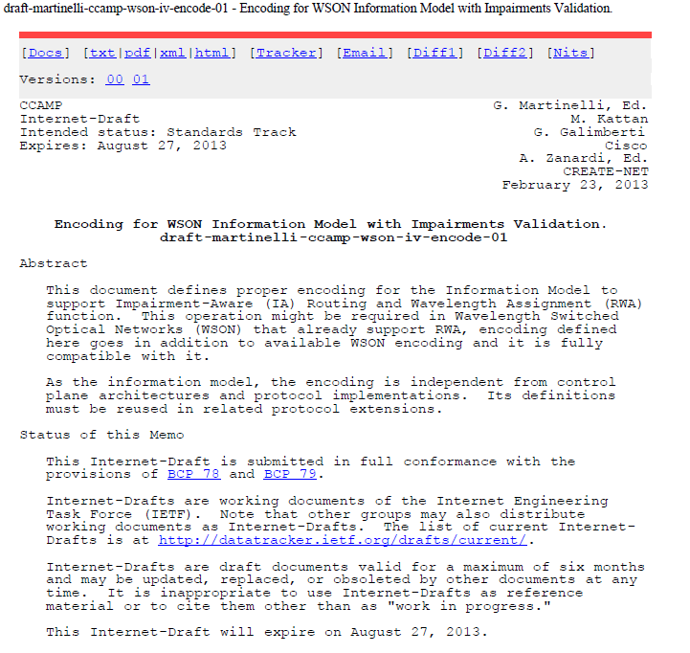
WG DocumentExample:

Slide 11
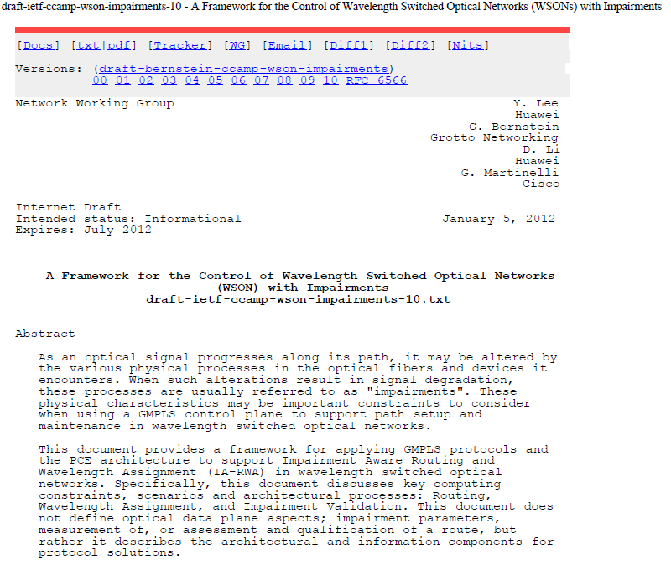
RFC Example: WSON with Impairment

Slide 12
Additional List of CCAMP Drafts
WSON (Wavelength Switched Optical Network) with Optical Impairments
  http://tools.ietf.org/html/draft-martinelli-ccamp-wson-iv-info-01
  http://tools.ietf.org/html/draft-martinelli-ccamp-wson-iv-encode-01
  http://tools.ietf.org/pdf/draft-kattan-wson-property-01.pdf
WSON MIBS
  http://tools.ietf.org/id/draft-gmggm-ccamp-gencons-snmp-mib-00.txt
  http://tools.ietf.org/id/draft-gmggm-ccamp-wson-snmp-mib-00.txt
FlexGrids
  http://tools.ietf.org/html/draft-ogrcetal-ccamp-flexi-grid-fwk-02

Slide 13
Why Participate?
Help better represent our region in the global community.
Contribute to continuous development of the Internet.
Help influence the future of the Internet based on regional needs.
Be part of the innovation and thought leadership, and part of history.

Slide 14
Call to Action:Join an IETF WG now!
Next Meeting: IETF-87 Berlin, July 2013
http://www.ietf.org/meeting/upcoming.html
The IETF is completely open to newcomers.
There is no formal membership.
Meeting attendance is optional ($650 entrance)
Every WG has a dedicated mailing list, and that's where proposals are made and discussed, and where consensus is established.
To START: Decide on one or two (not more!) WGs whose topics are interesting to you, and join their mailing lists.
Notes:
Participation
The IETF is completely open to newcomers. There is no formal membership, no membership fee. By participating, you do automatically accept the IETF's rules, including the rules about intellectual property (patents). If you work for a company the IETF will always view you as an individual, and never as a company representative.
How to Start
It's possible to participate in the IETF without ever attending a meeting. The IETF carries out most of its detailed technical work online, with the primary method being email. Every WG has a dedicated mailing list, and that's where proposals are made and discussed, where issues are raised, and where consensus is established.
Working Group Mailing List
A good technique for newcomers is to decide on one or two (not more!) WGs whose topics are interesting or relevant, and join their mailing lists. Beware: if the WG is in an active phase of discussion, you may well receive tens of message a day from each list.

Slide 15
Questions?

