Slide 1
Optical Techtorial
Moustafa Kattan, Cisco, mkattan@cisco.com
March, 2013

Slide 2

Agenda
Introduction
Fiber Type and DWDM Transmission
10G to 100G
ROADM and Control Plane
Notes:
2

Slide 3
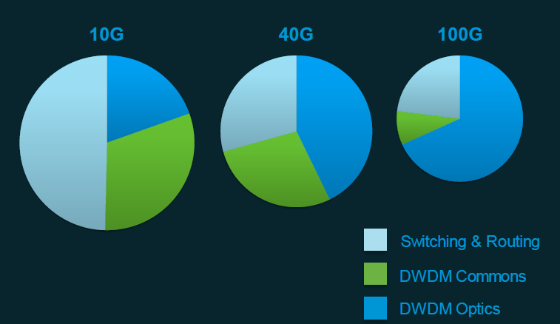
Change in CAPEX Spending
A big % of the cost in NG network will be in optical interfaces
Cost/bit Reduction
100G TCO 10-30% lower
than 40G, let alone 10G.
100G S&R CapEx shrinking
DWDM > 60% of CapEx;
Increasing IP+DWDM
savings opportunity

Slide 4
POS / Ethernet / OTN Migration
Standard
FE
GE
10GE
40/100GE
Demand and Innovation continue
Ethernet
SONET / SDH
Standard
OC3/12
OC192
OC48
OC12
OC192
PoS
OC3
OC48
OC768
OTN
SDH Payload
Eth Payload
Demand and Innovation continue
Standard
OTU1/2
OTU3
OTU4
1985
1990
1995
2000
2005
2010
2015
POS and SDH R&D / Innovation caps 1995 / 2004
Ethernet has undergone continual innovation since standardization
OTN transitions in 2004/5 from SDH hierarchy to Ethernet payloads
SPs are making transition from SDH / POS to Ethernet

Slide 5














Transport Evolution Layers
Emulated
L1
L3
svcs
E-Line
Private Line
E-LAN
E-Tree
Digital
OTN
SONET
/SDH
MPLS/MPLS TP
E-Line
Agile DWDM Layer with OTN G.709
Any Transport over DWDM
Notes:
Transcript:
So in terms of a metro environment, we are not going to see 100G DWDMs deployed in the metro environment anytime soon. We will probably see DWDMs deployed. We will probably see agile DWDMs deployed. We really anticipate packets being important in the metro environment. They're important for doing efficient Ethernet services. They're important for building optimized video environments. They're important for the evolution of the mobile environment from point-to-point connections to LTE. So we see a big role for packet switching technologies and, as I said, Cisco's approach's MPLS-type technologies. We see SONET SDH there. There's SONET SDH there, out there already. In many cases, why do I need to put -- if I have a SONET SDH system out there, why do I need to put it on top of OTN? Because in fact, these guys will be interfacing directly to the DWDM layer today. And we may see, in some situations, in some marketplaces, the requirement for digital OTN cross-connects going down onto the DWDM layer. And that will be, I think, primarily about the support of E-Line services into the metro environment. And as I said, Bill's team is building M2/M6. It does the combination -- well, the combination of these three. We have the sort of existing carrier Ethernet solutions today which are more about providing rich Ethernet video type services down into the metro environments. So we are actually covering both of these bases

Slide 6
Agenda
Introduction
Fiber Type and DWDM Transmission
10G to 100G
ROADM and Control Plane
Notes:
6

Slide 7
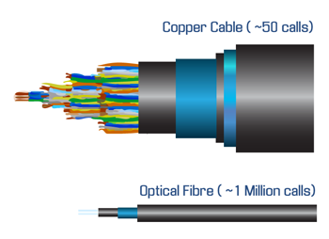

What is Optical Fibre?
Used in Communications to provide massive bandwidth! ✓
Optical fibres are strands of glass or plastic which guide visible or invisible light
Notes:
Transcript:
In the communications world we can use these to provide absolutely massive amounts of bandwidth.

Slide 8
Anatomy of a Single Mode Fiber
Core & Cladding are made of Glass/Silica (SiO2) with doping.
Buffer/Coating serves to strengthen and protect the fiber

Slide 9
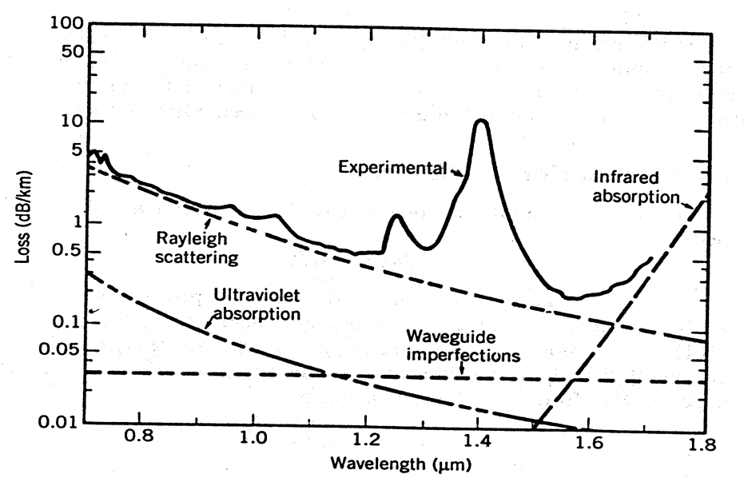
Fiber Attenuation (Loss) Characteristic Curve
850nm Region
Loss:3dB
1310 nm Region
Loss:1.4dB
1550 nm Region
Loss:0.2dB
Notes:
The spectral attenuation curve shows the wavelength-dependence of many of the loss factors. This diagram shows the span of wavelengths used in telecom fiber, from 600nm to 1600nm. The normal operating “bands” of wavelengths, centered around 850nm, 1300nm, and 1550nm, are highlighted. They are areas of the lowest loss (or low-cost sources in the case of the 850nm band).
The effects of Rayleigh Scattering are decreased with longer wavelengths. UV absorption also decreases with wavelength. However, IR absorption picks up at the longer wavelengths and effectively limits the higher wavelength operations.
The “OH” peaks are cause by absorption of light due to the OH ions created in the manufacturing process . They are also called “water peaks” because the OH ion is a component of water -- H2O.

Slide 10
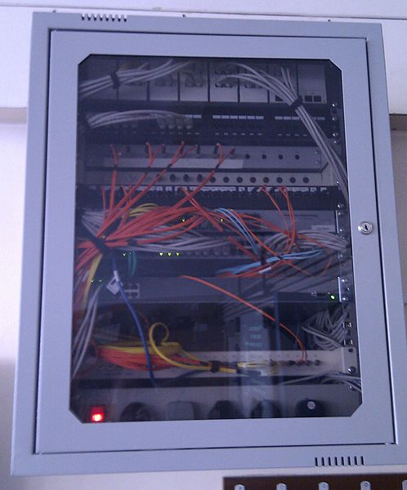
Multi Mode Fiber
Multimode fiber
  Core diameter varies
    50 mm for step index
    62.5 mm for
    graded index
Applications :
  Data Centre
  Within the building
  Typically < 500m
n2
Cladding
n1
Core

Slide 11
Single Mode Fiber
Single-mode fiber
  Core diameter is
  about 9 mm
G.652 is the main fiber used today (70%).
Applications :
  Campus
  Metro/Regional
  Long Haul Terrestrial
  Submarine
n2
Cladding
n1
Core

Slide 12
Different Solutions for Different Fiber Types
SMF (G.652) | CD = 17 ps Good 100G + DWDM OK for 10G DWDM requires DCMs
DSF (G.653) | Not Good for DWDM
NZDSF (G.655) | CD = 4.5 ps Good for 10G DWDM. Some penalties with > 100G
Extended Band (G.652.C) (Suppressed Attenuation in the Traditional Water Peak Region) | Good for DWDM Good for CWDM (> Eight wavelengths)
The Primary Difference Is in the Chromatic Dispersion Characteristics
Notes:
Lights bigger

Slide 13
Optical Spectrum
UV
IR
125 GHz/nm
λ
Visible
Light
  Ultraviolet (UV)
  Visible
  Infrared (IR)
Communication wavelengths
  850 nm Multimode
  1310 nm Singlemode
  1550 nm DWDM & CWDM
Specialty wavelengths
  980, 1480, 1625 nm (e.g. Pump Lasers)
850 nm
980 nm
1,310 nm
1,480 nm
1,550 nm
1,625 nm
c =ƒ λ
Wavelength: λ (nanometres)
Frequency: ƒ (Terahertz)
Notes:
Transcript:
So we talk a lot in transport about wavelengths. If you think of the optical spectrums, so again on the prism approach where you can break white light down into all of its components, those are only the components that the human eye can see. There are a lot more, and what we use are actually the transmission wavelengths from 850 nm up past 1,625 nm. So again it's an invisible part of the spectrum, but it is something that we use fundamentally for optical transport. You may have heard of regions, sometimes they're called windows so the first window is actually 850 nm, typically that's multimode. The second window is 1,310, typically single-mode but some interfaces do work on multimode as well, and 1,550, which is where DWDM and CWDM work. And just for people who did physics again, it's the speed of light in a vacuum is related to the frequency and the wavelength, so there you go.
Author’s Original Notes:
850 nm – multimode
1310 nm – singlemode
1550 nm DWDM & CWDM (Cisco CWDM uses the following eight (8) wavelengths; 1470 nm, 1490nm, 1510 nm, 1530 nm, 1550 nm, 1570 nm, 1590 nm, 1610 nm)

Slide 14
Wavelength and Frequency
Wavelength (Lambda λ) of light: in optical communications normally measured in nanometers, 10^{–9}m (nm)
Frequency (ν) in Hertz (Hz): normally expressed in TeraHertz (THz), 10¹² Hz
Converting between wavelength and frequency:
Wavelength x frequency = speed of light ⇒ λ x ν = C
C = 3x10⁸ m/s
For example: 1550 nanometers (nm) = 193.41 terahertz (THz)
Notes:
The ITU have standardized wavelength grids for DWDM transmission systems. These grids are based on the frequency spacing of 100 gigahertz and 50 gigahertz. Therefore, it is useful to be able to convert from optical wavelength and optical frequency.
Optical wavelength is normally measured in nanometers; while optical frequency is measured in terahertz. To convert between wavelength and frequency, we can use this equation:
Optical wavelength times optical frequency equals the speed of light. The speed of light is 3 times 10 to the eight meters per second. As an example, 1550 nanometers is equivalent to 193.41 terahertz.

Slide 15
ITU Wavelength Grid
The International Telecommunications Union (ITU) has divided the telecom wavelengths into a grid; the grid is divided into bands;
the C and L bands are typically used for DWDM
ITU Bands :
O E S C L U
λ(nm)
1260
1360
1460
1530
1565
1625
1675
λ0
λ1
λn
λ
1530.33 nm
1553.86 nm
0.80 nm
193.0 THz
ν
195.9 THz
CWDM vs. DWDM Spacing
CWDM systems have channels at wavelengths spaced 20 (nm) apart, compared with 0.4 nm spacing for DWDM
Notes:
Standards organizations such as the ITU have standardized wavelengths for use in wave division multiplexing systems.
Another term often used interchangeably with wavelength is channel. A channel represents a bit stream carried over a wavelength.
The distance between channels is an important factor in signal degradation and loss. The smaller the distance between wavelengths the more precise the light source (laser) must be. These precise types of lasers are more expensive but they allow for more channels to be multiplexed across a single fiber.
Gridded optics is another term for the ITU-T G.692 grid spacing specification. Channel spacing is measured in GHz.
Frequency bands:
C-Band (conventional) – 1530nm to 1565nm
L-Band – 1565nm to 1625nm
S-Band – 1460nm to 1530nm

Slide 16
What is DWDM?
Dense Wave Division Multiplexing
Optical (light) signals of different wavelengths travel on the same fiber.
Each wavelength represents an independent optical channel.
Optical channel = wavelength = lambda (λ)
Core
Cladding
Coating
Channel 1
Channel 2
Channel 3
Fiber optic cable
Notes:
DWDM Definition
A fundamental property of light states that individual light waves of different wavelengths may co-exist independently within a medium. Lasers are capable of creating pulses of light with a very precise wavelength. Each individual wavelength of light can represent a different channel of information. By combining light pulses of different wavelengths, many channels can be transmitted across a single fiber simultaneously.
Fiber optic systems use light signals within the infrared band (1 mm to 400 nm wavelength) of the electromagnetic spectrum. Frequencies of light in the optical range of the electromagnetic spectrum are usually identified by their wavelength, although frequency (distance between lambdas) provides a more specific identification.

Slide 17
Transmission Impairments
Attenuation
  Loss of signal strength
  Limits transmission distance
Chromatic Dispersion (CD)
  Distortion of pulses
  Limits transmission distance
  Proportional to bit rate
Optical Signal to Noise Ratio (OSNR)
  Effect of noise in transmission
  Caused by amplifier
  Limits number of amplifier

Slide 18
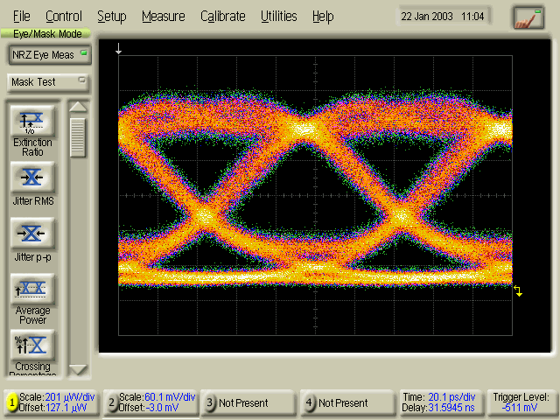
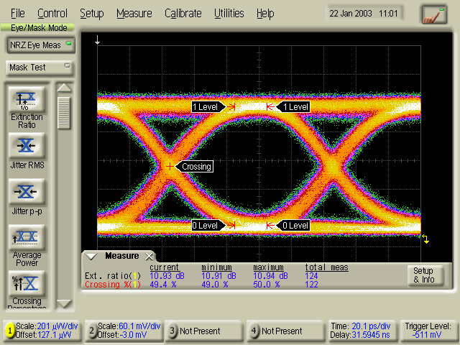
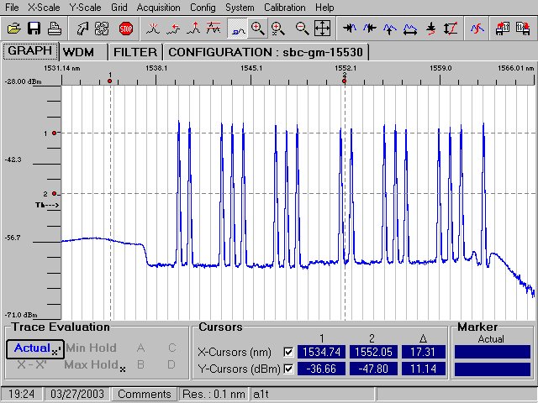
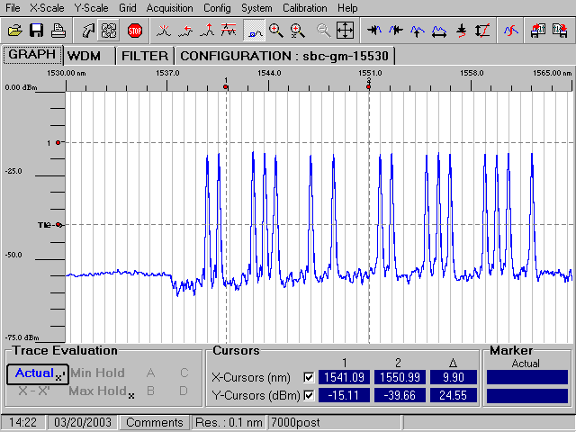
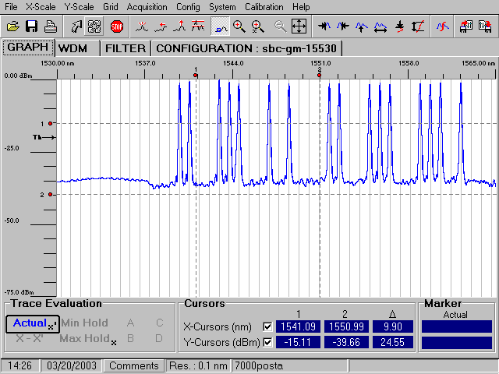
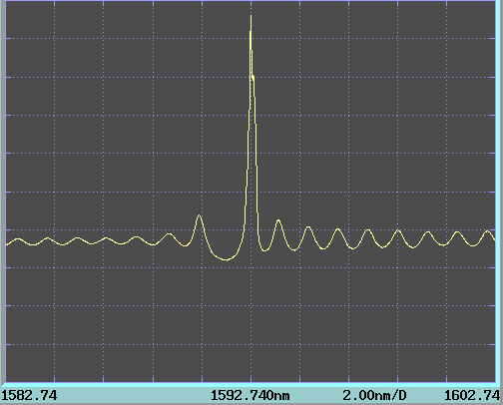
DWDM Components
Optical Transmitter
  Transponders (10G,40G, 100G)
  DWDM XFPs, SFP+, CFP
Optical transmission hardware
  OADM, R-OADM
  DCU, Amplifiers
Optical receiver
  Transponders
  DWDM XFPs, SFP+, CFP
DWDM Optics
Mux-Demux
Amplifier
DCU

Slide 19
Basic WDM Component Terminology
Multiplexer/Demultiplexer
  Combines/Separates all wavelengths on the fiber
  ‘Terminates’ the fiber link – all circuits end here
  Typically exists in 8 channel increments
  Mux/Demux are often combined into one physical part
Optical Add/Drop Multiplexer (OADM)
  Drops a fixed number of channels while others
  pass through
  Typically used in ring configurations
Optical Amplifier (EDFA)
  Boosts DWDM signals for extended distance
Dispersion Compensation Unit (DCU)
  DCUs provide compensation for the accumulated chromatic dispersion

Slide 20
What is a ROADM?
ROADM
ROADM is an optical Network Element able to Add/Drop or Pass through any wavelength
  A ROADM is typically composed by 2 line interfaces and 2 Add/Drop interfaces
Typical ROADM implementations have Add/Drop interfaces dedicated to a direction
  As a side-effect, if it is required to reconfigure the connection to drop the channel from a different side the new channel is sent to a different physical port: this would require to manually change the cabling of any connected client equipment
Line
West
ROADM
West
ROADM
East
Line
East
Add/Drop
West
Add/Drop
East
Directional ROADM
Line
West
ROADM
West
ROADM
East
Line
East
Add/Drop
West
Add/Drop
East
Notes:
A ROADM is an optical Network Element able to Add, Drop or Pass through any wavelength. A ROADM is typically composed of 2 fiber line interfaces, one connected to the west direction and one to the east direction. Additionally there are 2 Add/Drop interfaces, one associated to the west direction and one to the east. So the ROADM is direction dependant.
As stated a typical ROADM implementation has Add/Drop interfaces that are dedicated to a direction. For example, in the case of a ROADM dropping a wavelength on the west side. If you instead wanted to drop that same channel from the east side, you would need to physically re-cable that port and any client equipment connected to it.

Slide 21
Degree-8 ROADM Node Block Diagram
MUX
WSS
B
MUX
P
MUX
B
WSS
DMX
WSS
B
P
P
8 Degree
Patch Panel
DMX
A
DMX
H
B
MUX
MUX
B
WSS
G
C
WSS
B
P
P
DMX
F
D
DMX
MUX
E
MUX
B
WSS
WSS
B
P
MUX
P
DMX
B
WSS
DMX
P
DMX
Each line represents a fiber connections
16 individual fibers need to make 8°

Slide 22
ROADM: Omni-directional & Colourless
A Omni-Directional ROADM, can be reconfigured to drop ANY wavelength from ANY Line Side:
  For instance we can start dropping the green wavelength from the West Side
  and reconfigure the ROADM to drop the green wavelength from the East Side on the same port
  No re-cabling is required
A colourless ROADM can be reconfigured to drop ANY wavelength on ANY port:
  For instance we can start dropping the dark green wavelength
  and reconfigure the ROADM to drop the light green one on the same port
  No re-cabling is required
Omni-Directional ROADM
ROADM
West
ROADM
East
NxN Switch Fabric
NxN Switch Fabric
NxN Switch Fabric
Colourless ROADM
ROADM
West
ROADM
East
Notes:
An Omni-Directional, or directionless ROADM overcomes this. It can be reconfigured to drop ANY wavelength from ANY Line Side. For example, we can start dropping the green wavelength from the West Side, and then reconfigure the ROADM to drop the green wavelength from the East Side on the same port. No re-cabling is required.
A colorless ROADM can be reconfigured to drop ANY wavelength on ANY port. For instance, we can start dropping the dark green wavelength and reconfigure the ROADM to drop the light green one on the same port. Again, no re-cabling is required.

Slide 23
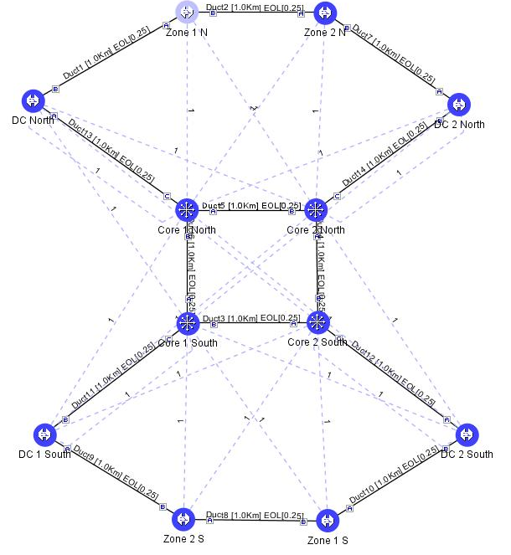
ROADM Based Network Example

Slide 24
Agenda
Introduction
Fiber Type and DWDM Transmission
10G to 100G
ROADM and Control Plane
Notes:
24

Slide 25
Transport Layer Evolution
Coherent Transmission to have deep impact on the Architecture and Design of DWDM Networks
High Tolerance to CD / PMD: MAL-less EDFA
Coherent Receiver: No need to filter down to individual channel
Increasing Number of Degrees / Flexibility of ROADM Nodes
Growing Number of Degrees to 16 (or more…)
Extending Transport Capacity
Support 96Chs 50GHz in C-band
Scale per-wavelength Bit Rate
Scale & Optimize Contentionless architecture
Introduce FlexSpectrum
High Power Co- and Counter-Propagating Raman units to support up to 70dB Spans

Slide 26
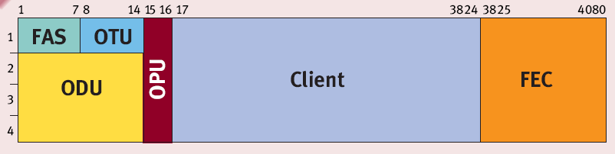
G.709 Digital Wrapper
G.709 is the “evolution” of SDH/SONET
as transport
layer digital wrapper
G.709 is mainly designed to add
FEC and OAM&P
to any payload
OAM bytes (row 1–16) are an enhanced version of SDH/SONET overhead
Notes:
37:13

Slide 27
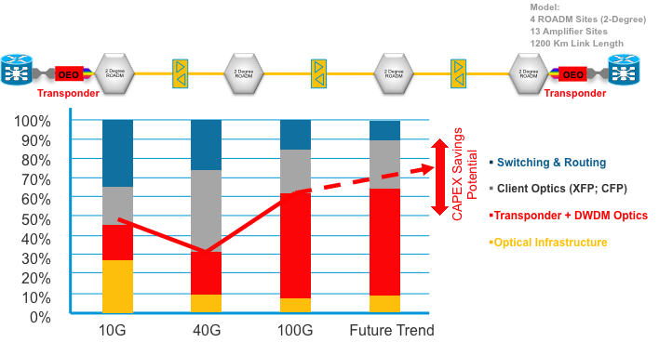
IPoDWDM
Savings:
CAP EX ~25%
Power ~40%
Real Estate ~ 45%
DWDM
Legacy Traffic
Packet Optical Integration eliminates need of Client Optics,
Eliminate Layers, Reduce Power, Space, CAP EX, Planning, etc…
Notes:
Router forwarding engines have constantly reduced in $/capacity
The faster the Optics get 10G→40G→100G→… the larger their proportion of the overall Capex of the link
→ Advantage of IPoDWDM architecture will become even more dominant as link speed increases
40G cost structure
Large cost can be attributed to first to market, multiple mod schemes no MSA etc…
100G cost structure
SR Optical interconnects account for 30+% of the cost

Slide 28
Pre-FEC Proactive Protection
Reactive Protection
Proactive Protection (< 15 msec)
with IP-over-DWDM
Router
Router
working
route
protect
route
working
route
fail
over
protect
route
Router Bit Errors
Hitless
Switch
Router Bit Errors
LOF
FEC
Transponder
FEC Limit
FEC Limit
Pre-FEC Bit Errors
Pre-FEC Bit Errors
FEC
Protection Trigger
Time
Time
ROADM
ROADM

Slide 29
Agenda
Introduction
Fiber Type and DWDM Transmission
10G to 100G
ROADM and Control Plane
Notes:
29

Slide 30
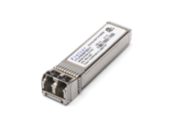
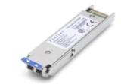
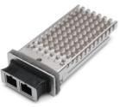
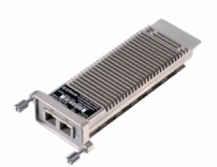
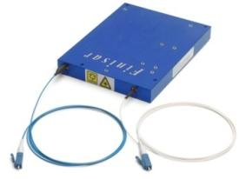
10GE has migrated from low port count to high port count applications…
Front Panel Density Gb/s
Electrical I/O Lane Count x Rate Gb/s
480
48x SFP+
1x10
240
24x SFP+
160
16x XFP
16x X2
80
8x X2
4x3
40
4x XENPAK
1x 300pin
16x0.6
10
2002
2003
2004
2005
2006
2007
Chart & Images courtesy of Finisar
Notes:
Over a nearly ten year period we have seen a migration from the 300pin form factor to the densest solution available today for 10G, SFP+. As you can see in this chart on the left axis, the front panel density has increased nearly 50 fold over this period which was enabled by the size reduction of the 10GE module form factor. A key parameter which enabled this increase in density is shown on the right y-axis – the electrical lane rate & bus width. 300pin uses the 16 bit wide XSBI (10GE Sixteen Bit Interface) based upon the OIF SFI4.1 interface where each lane runs at a nominal 644 Mbps. Mainstream adoption of 10GE began with XENPAK in late 2002 which used the 4bit wide XAUI interface. Many in the industry adopted X2 based modules for greater economy of scale as it allowed reuse of many IP blocks and PHY IC commonality with XENPAK. Other systems skipped X2 and focused on the serial XFP based on the 1bit wide XFI interface. Finally in the 2006 timeframe, the SFP+ which removed the retiming functionality from the module became available. This reduction in bus width drove the form factor width reduction.

Slide 31
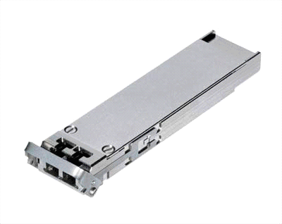

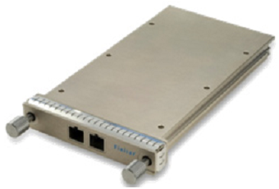
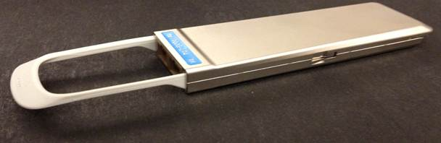
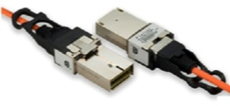
Client interconnection: the evolution game
10G
All interfaces
less power
Higher port density
XFP
SFP+
100G
All interfaces
3 times less power
2 times better density
SR-10
CFP
CPACK

Slide 32
Current 100G DWDM Examples
Modulation: Dual Polarized Quadrature Phase-Shift Keying (DP-QPSK)
SW-configurable FEC algorithm to optimize Bandwidth vs. Reach:
    7% based on Standard G.975 ReedSolomon FEC
    20% based on Standard G.975.1 I.7 UFEC (1xE(-2) Pre-FEC BER)
    7% based on 3rd Generation HG-FEC (4.6xE(-3) Pre-FEC BER)
Baud rate: 28 to 32 Gbaud
96channels Full C-band 50GHz tunable DWDM Trunk
CD Robustness up to 70,000ps/nm, PMD Robustness up to 30ps (100ps of DGD)
Receiver Dynamic Range (Noise Limited): +0dBm to -18dBm

Slide 33
DP-QPSK 100G Module
Block diagram
Integrated Receiver
Coherent Signal Processor
Static Equaliser
Dynamic Equaliser
Carrier/Clk Recovery
Decoder Data Interf
2pol. Hybrid
90°
iTLA
90°
RX
TX
iTLA
Rx and Tx
μC
DP-QPSK Modulator
Mux/Precoder
DP-QPSK
X
Precoder
Data Interfacer
Y
Precoder
Driver amplifiers
Two independent QPSK signals modulated on two orthogonal polarization on the fiber (encoding of 2 + 2 bits/symbol = 4 bits/Htz).

Slide 34
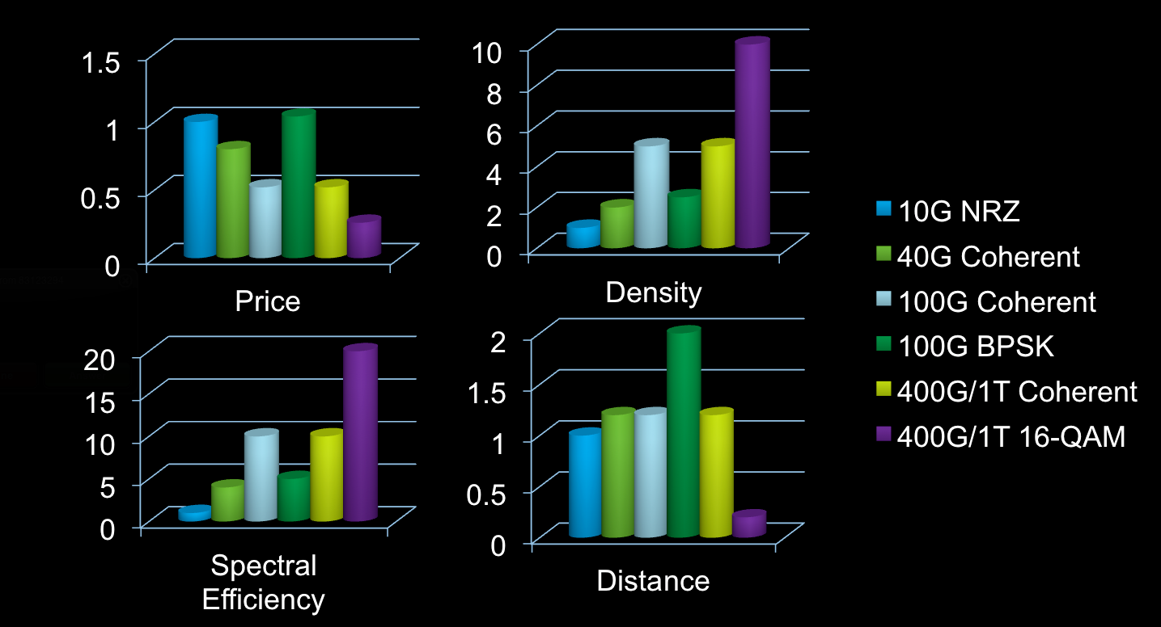
Modulation Flexibility for Trade off Between Reach and Capacity

Slide 35
What is a Flex Spectrum ROADM?
Standard ROADM Nodes support wavelengths on the 50GHz ITU-T Grid
  Bit Rates or Modulation Formats not fitting on the ITU-T grid cannot pass through the ROADM
A Flex Spectrum ROADM removes ANY restrictions from the Channels Spacing and Modulation Format point of view
  Possibility to mix very efficiently wavelengths with different Bit Rates on the same system
  Allows scalability to higher per-channel Bit Rates
  Allows maximum flexibility in controlling non-linear effects due to wavelengths interactions (XPM, FWM)
  Allows support of Alien Multiplex Sections through the DWDM System
100 Gbps
100 Gbps
400 Gbps
1 Tbps
Metro
1 Tbps
Long Haul
100 Gbps
1 - Odd | 1- Even | 2 - Odd | 2 - Even | 3 - Odd | 3 - Even | 4 - Odd | 4 - Even | 5 - Odd | 5 - Even | 6 - Odd | 6 - Even | 7 - Odd

Slide 36
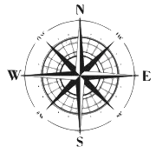
Agile DWDM Layer with Zero Touch Architecture
WSON Restoration – Ability to reroute a dangling resource to another path after protection switch.
Tunable Laser – Transmit laser can be provisioned to any frequency in the C-Band.
Key Values
Complete Control in Software
No Manual Movement of Fibers
Control Plane Can Automate Provisioning, Restoration, Network Migration, Maintenance
Foundation for IP+Optical !
X
Flex Spectrum – Ability to provision the amount of spectrum allocated to each Wavelength allowing for 400G and 1T bandwidths.
Colorless – ROADM add ports provisioned in software and rejects any other wavelengths.
ROADM
Tunable Receiver – Coherent Detection accepts provisioned wavelength and rejects all others.
Contention-less – In the same Add/Drop device you can add and drop the same frequency to multiple ports.
TX
RX
TX
RX
Omni-Directional – Wavelength can be routed from any Add/Drop port to any direction in software.

Slide 37
What is a Control Plane?
An optical control plane is a set of algorithm, protocols and messages enabling a network to automatically do the following tasks:
  Network topology discovery including network changes
  Network resource discovery
  Traffic provisioning
  Traffic restoration
  Network optimization

Slide 38




What Should an Optical Control Plane Do?
N4
N6
N8
N2
L5
L12
L15
L3
L8
L16
L17 & L18 (l)
L1
N1
L7
L9
R2
L2
Router
R1
L4
R3
L10
N7
Fixed OADM
N3
L6
L11
Multidegree ROADM
N5
L13
L14
Multidegree ROADM
(omnidirectional)
WLC
Topology Discovery
Traffic Provisioning
Traffic Restoration
Network Restoration
Pre-computed vs. On-the-fly
In cooperation with client layer(s)
Pre-computed vs. On-the-fly
Network Optimization
Use of Regenerators, Multi-Degree nodes
Computationally hard
Connectivity Matrix
Nodes
Links
Resource Discovery
Network Element
Link Properties
Optical Transmission Parameters
Increasing Complexity

Slide 39

Network Architecture
Control
Control
IPoDWDM/
MPLS-TP
Packet Optical
DC/SAN
DSLAM /
Wireless
backhaul
SONET
SDH
Control
GMPLS UNI
Control
UNI-N
UNI-N
UNI-N
UNI-N
UNI-N
UNI-N
UNI-N
WSON
Control
WSON
UNI-N
E-NNI
Control
Any Transport over DWDM

Slide 40
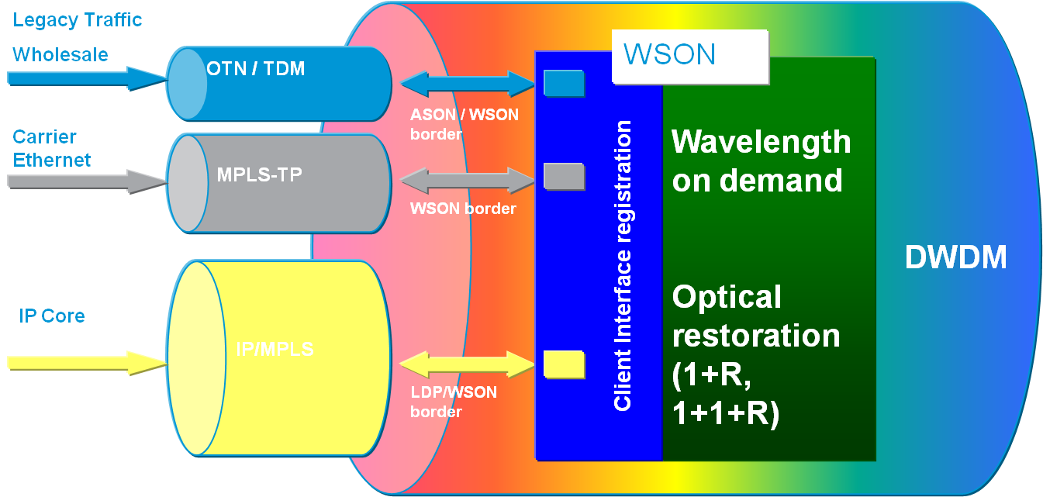
Multi Layer Control Plane Interaction
WSON = Wavelength switched optical network
ASON = Automatically Switched optical network

Slide 41
What’s WSON
WSON = Wavelength Switched Optical Network
It is GMPLS control plane which is “DWDM aware”, i.e.:
  LSP are wavelength and,
  the control plane is aware of optical impairments
WSON enables Lambda setup on the fly – Zero pre planning
WSON enables Lambda re-routing, i.e. changing the optical path or the source/destination
WSON enables optical re-validation against a failure reparation or against re-routing

Slide 42



WSON in the Standards Bodies
Charter: Evolution of the
Internet (IP) Architecture
(MPLS, MPLS-TP)
Active Participants:
Service Providers
Vendors
--WSON,
Charter: Global Telecom Architecture and
Standards
Member Organizations:
Global Service Providers
PTTs, ILECs, IXCs
Telecom equipment vendors
Governments
---ASON, impairment parameters G.680
WSON Optical Impairment Unaware
  https://datatracker.ietf.org/doc/draft-ietf-ccamp-rwa-wson-framework/
WSON Optical Impairment Aware Work Group Document
  http://datatracker.ietf.org/doc/draft-ietf-ccamp-wson-impairments/
Notes:
Internet Engineering Task Force (IETF):
All participants are considered individual volunteers
Participation can be limited to signing up on a mailing list
Only fee is for attending meetings – typically $425 per meeting for logistics
Optical Internetworking Forum (OIF):
The mission of the OIF is to foster the development and deployment of interoperable data switching and routing products and services that use optical networking technologies.
International Telecommunications Union – Telecommunications (ITU-T):
An arm of the United Nations
Governments are highest order member (Member States);
CIENA is a Scientific Industrial Organization (Sector Member)
Membership fees can go up to $1.5M/year.

Slide 43
WSON AREA
WSON MIBS
http://tools.ietf.org/id/draft-gmggm-ccamp-gencons-snmp-mib-00.txt
http://tools.ietf.org/id/draft-gmggm-ccamp-wson-snmp-mib-00.txt
FlexGrids
http://tools.ietf.org/html/draft-ogrcetal-ccamp-flexi-grid-fwk-02
WSON with Optical Impairments
http://tools.ietf.org/html/draft-martinelli-ccamp-wson-iv-info-02
http://tools.ietf.org/html/draft-martinelli-ccamp-wson-iv-encode-02

Slide 44
WSON READING LIST
RFC6163: WSON Framework RWA (no impairments)
RFC6566: WSON FWK with Impairments
WSON RWA:
  http://tools.ietf.org/html/draft-ietf-ccamp-rwa-info-16
  http://tools.ietf.org/html/draft-ietf-ccamp-general-constraint-encode-10
  http://tools.ietf.org/html/draft-ietf-ccamp-rwa-wson-encode-19

Slide 45
What does WSON do for you ?
Client interface registration
  Alien wavelength (open network)
  Transponder (closed network)
  ITU-T interfaces
Wavelength on demand
  Bandwidth addition between existing S & D Nes (CLI)
Optical restoration-NOT protection
  Automatic Network failure reaction
  Multiple SLA options (Bronze 0+1, Super Bronze 0+1+R, Platinum 1+1, Super Platinum 1+1+R)

Slide 46
ITU-T G.680 Optical Parameters
Many optical parameters can exhibit significant variation over frequencies of interest to the network these may include:
    Channel insertion loss deviation (dB, Max)
    Channel chromatic dispersion (ps/nm, Max, Min)
    Channel uniformity (dB, Max)
    Insertion loss (dB, Max, Min)
    Channel extinction (dB, Min)
    Channel signal-spontaneous noise figure (dB, Max)
    Channel gain (dB, Max, Min)
    Others TDB in conjunction with ITU-T Q6/15
Non linear impairments are TBD

Slide 47
WSON Impairment Aware
Linear impairments
  Power Loss
  Chromatic Dispersion (CD)
  Phase Modulation Distortion (PMD)
  Optical Signal to Noise Ratio (OSNR)
Non linear Optical impairments:
  Self-Phase Modulation (SPM)
  Cross-Phase Modulation (XPM)
  Four-Wave Mixing (FWM)
WSON input
Topology
  Lambda assignment
  Route choices (C-SPF)
Interface Characteristics
  Bit rate
  FEC
  Modulation format
Regenerators capability

Slide 48
Control Plane – The Right Model
Multi – Layer Control Plane
Peer Model – Optical NEs and Routing NEs are one from the control plane perspective, same IGP. Routing has full visibility into the optical domain and vice versa.
Overlay Model – Having different Control Planes per Layer and signaling between them to make requests
The Right Model shall leverage the best of both!

Slide 49

Control Plane-Information Sharing
Server (DWDM) to Client (Router)
  SRLGs – along the circuit
  Latency – through the server network
  Path – through the server network
  Circuit ID – unique circuit identifier
  Topology / Feasibility Matrix – maybe required for advanced features
Client to Server
  Path matching or disjoint to a Circuit ID
  Latency bound or specified Latency
  SRLGs to be included or excluded
ML Control Plane (CP) is a generic multi-layer routing and optimization architecture addresses these challenges
Client: IP layer
Server: DWDM layer

Slide 50
Protection
Protection is provided via L0 Team
  1+1, Fiber protection, etc…
  Does not efficiently utilize available BW
  Increases Cost per Bit
Protection is provided via L3 team
  Decrease Interface Utilization
  Does not efficiently Utilize BW
  Increase Cost per Bit
Protection is provided via L3 team with IPoDWDM
  Decrease interface utilization
  Reduce Client interfaces
  Better but still increase Cost per Bit

Slide 51
Multi Layer Restoration & Optimization
Premium: 45G
3x 100G
6 X 100Gig interfaces
300Gig capacity
140Gig traffic
47% Normal Utilization
70% Failure Utilization
BB1
BB2
BE: 95G
Premium: 45G
2x 100G
BB1
BB2
4 X 100Gig interfaces
200Gig capacity
140Gig traffic
70% interface Utilization
BE: 95G
26% less IPoDWDM interfaces

Slide 52

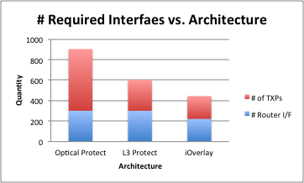
Cost Benefit – Sample User Network
Looking at a 12 node network with associated traffic demands
Compare :
  (1) Optical Protect (2) Traditional L3 Protect (3) iOverlay Restoration

Slide 53
IP + Optical Restoration Example
Yunbo’
Kuwait
Riyadh
A
B
D
C
Abu Dhabi
Bahrain
Jeddah
B
A
Dubai
Najran
C
D
OI Aware DWDM Control Plane
Switch when you can & regenerate when you must (Lambda Switching)
Minimize TDM XC/OEO
Minimize Latency and cost
Oman

Slide 54
Questions?

