Slide 1
Introducing DE-CIX Academy

Slide 2
Marco Brandstätter Regional Director Middle East & South Asia DE-CIX Management GmbH

Slide 3
DE-CIX Academy – Learn from the experts
Webinars
White Papers for download
Knowledge Cards

Slide 4
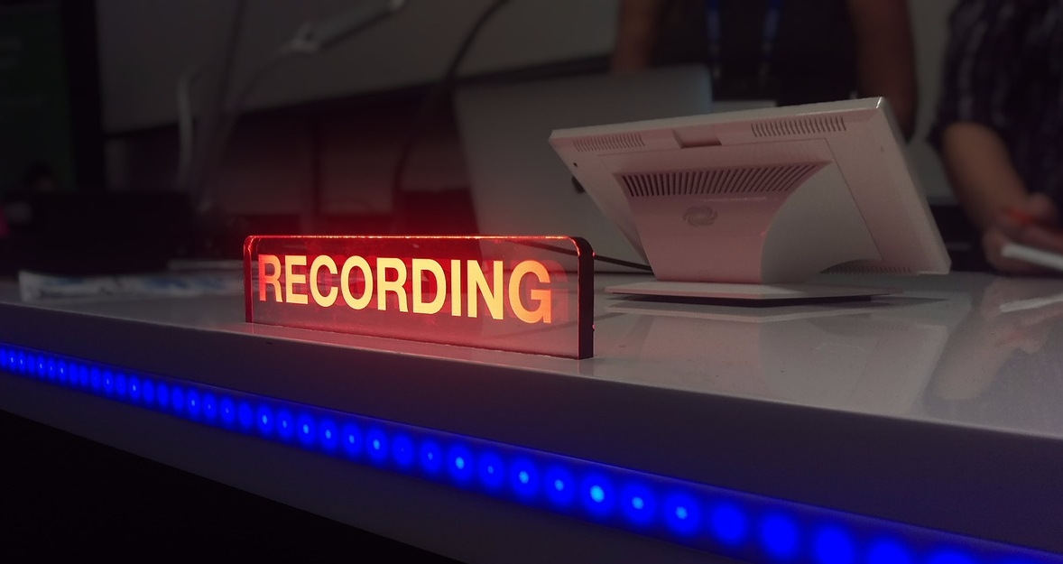
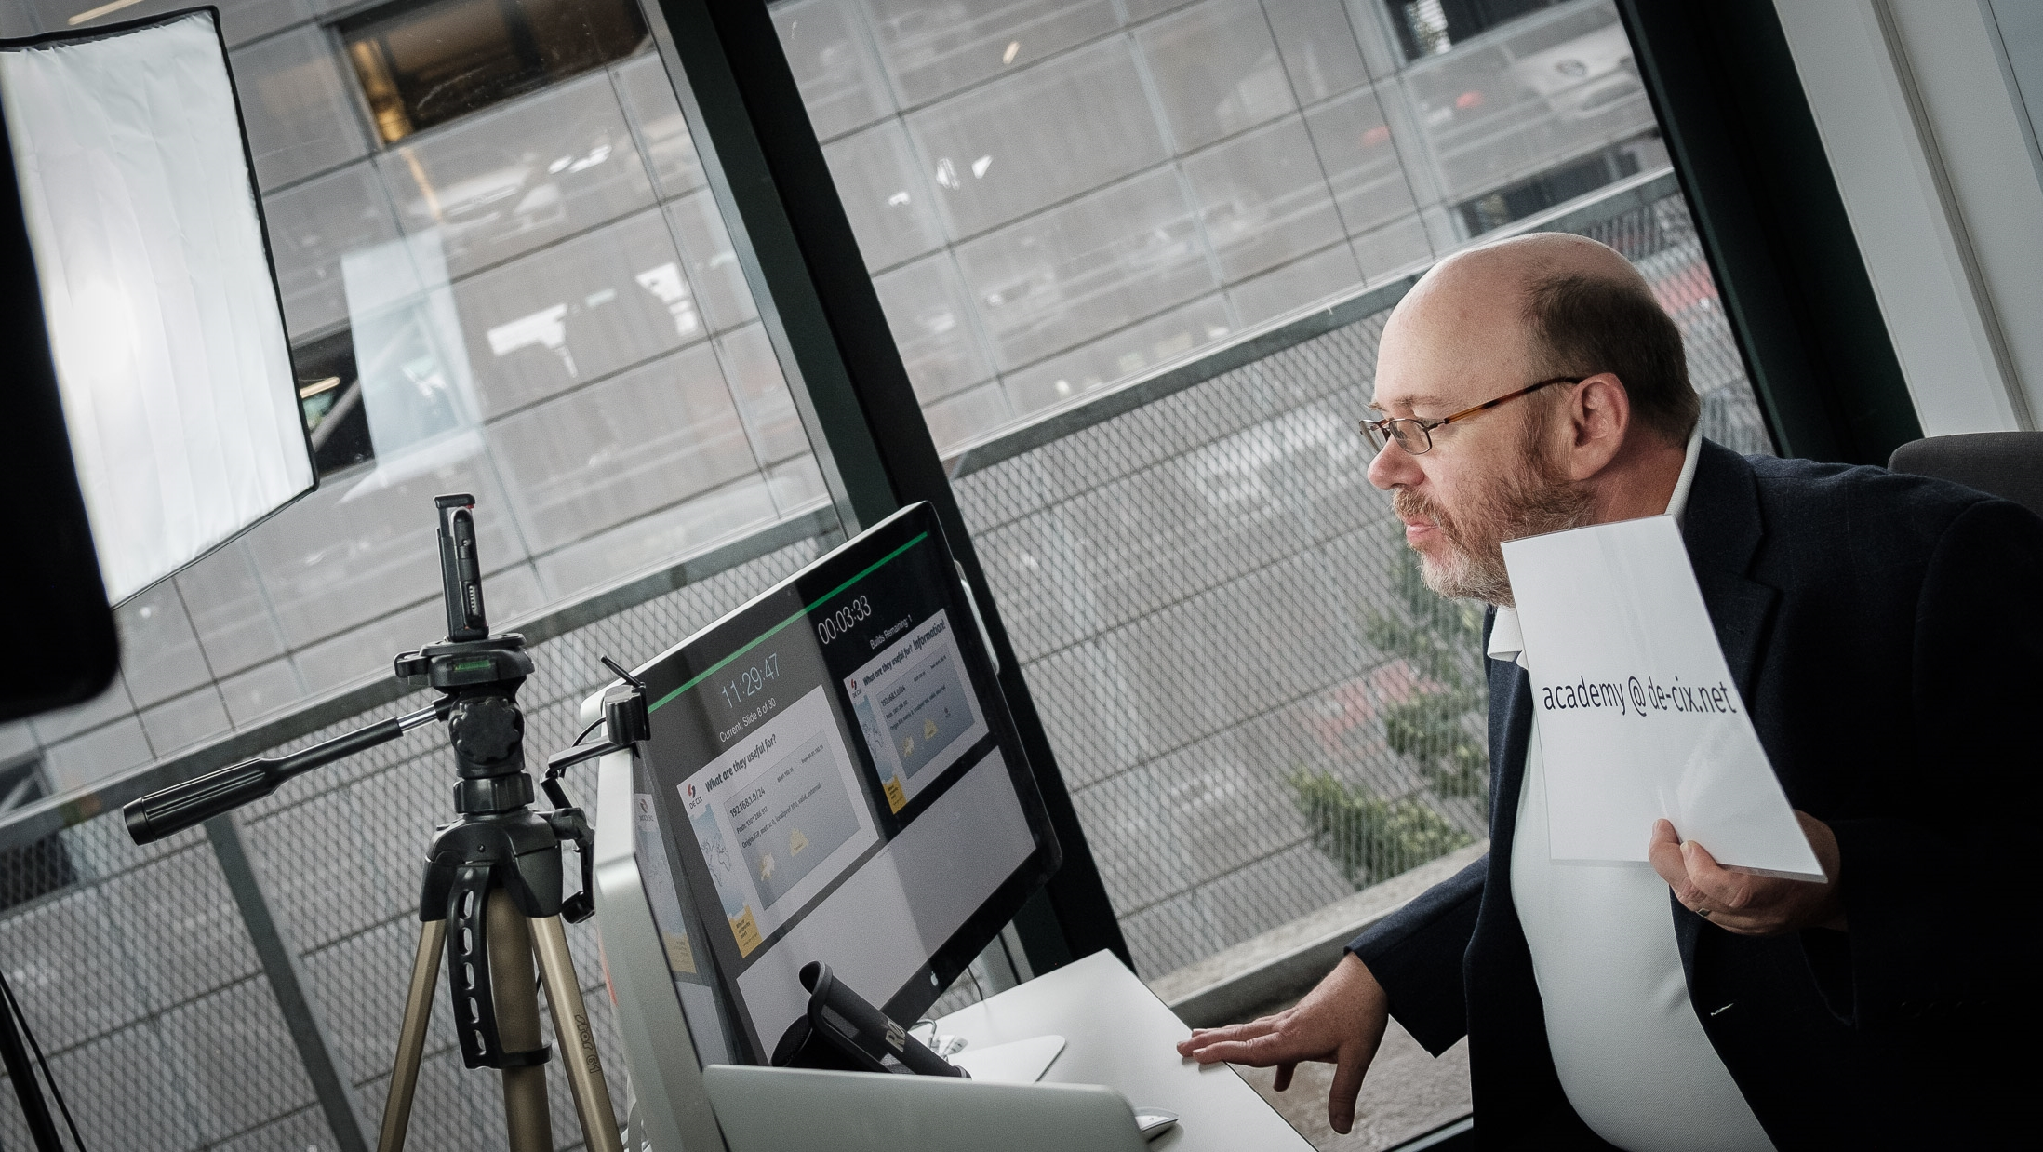
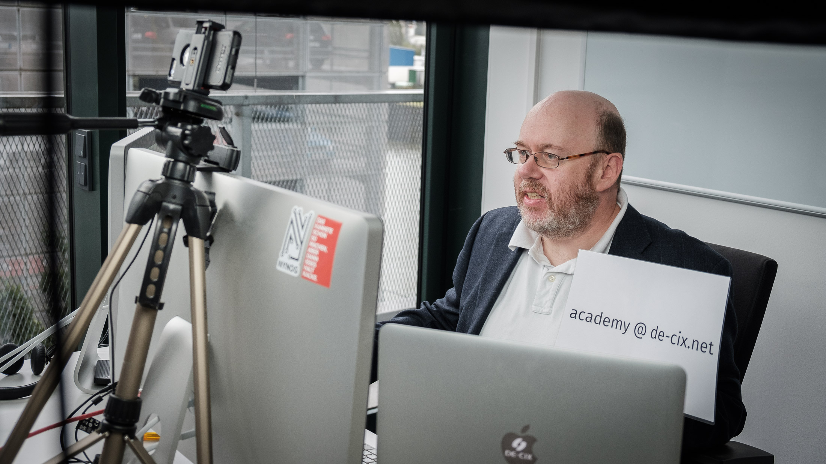
DE-CIX Academy – Webinars
Focusing on network related topics
Currently: 8 Webinars about BGP available
Language: English
View live or watch a recording
Each webinar features a presentation, network simulations
Downloadable material
https://www.de-cix.net/en/about-de-cix/academy/videos-and-webinars

Slide 5
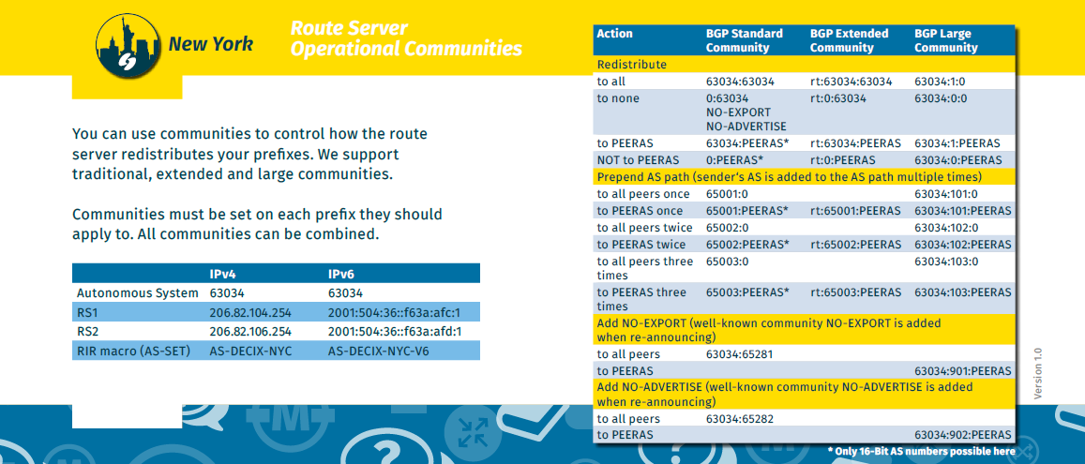
DE-CIX Academy – Knowledge Cards
One card – one topic
BGP Routing Algorithm
DE-CIX Route Server Information
Download PDFs or get printed versions

Slide 6
DE-CIX Academy – White Papers
DE-CIX offers papers on the following topics for download:
White papers on peering and Blackholing
Technical guides on how to connect to different cloud service providers like AWS or Microsoft
Market spotlights on the interconnection needs of different industries
Market studies on the position of metro markets in the global telecommunications landscape

Slide 7
Want to know more?
www.de-cix.net/academy

Slide 8
Thank you! www.de-cix.net

