Slide 1
Peering for the Middle East
How to build a successful Internet exchange in the Middle East
March 2016
MENOG 16, Istanbul
Marco Brandstaetter
Business Development
marco.brandstaetter@uae-ix.net

Slide 2
Some thoughts before we start

Slide 3
Middle East – Great potential for a regional hub
Large region of over 350 million people
Common language: Arabic
GDP growth rate at 4.1% in 2010 and 5.1% in 2011
Internet traffic growth 2007 – 2011: 98 % per year
Increase of submarine and terrestrial connectivity between the Middle East, Europe, Asia and Africa
Geographically well positioned as a transit hub between Europe, Africa and Asia

Slide 4
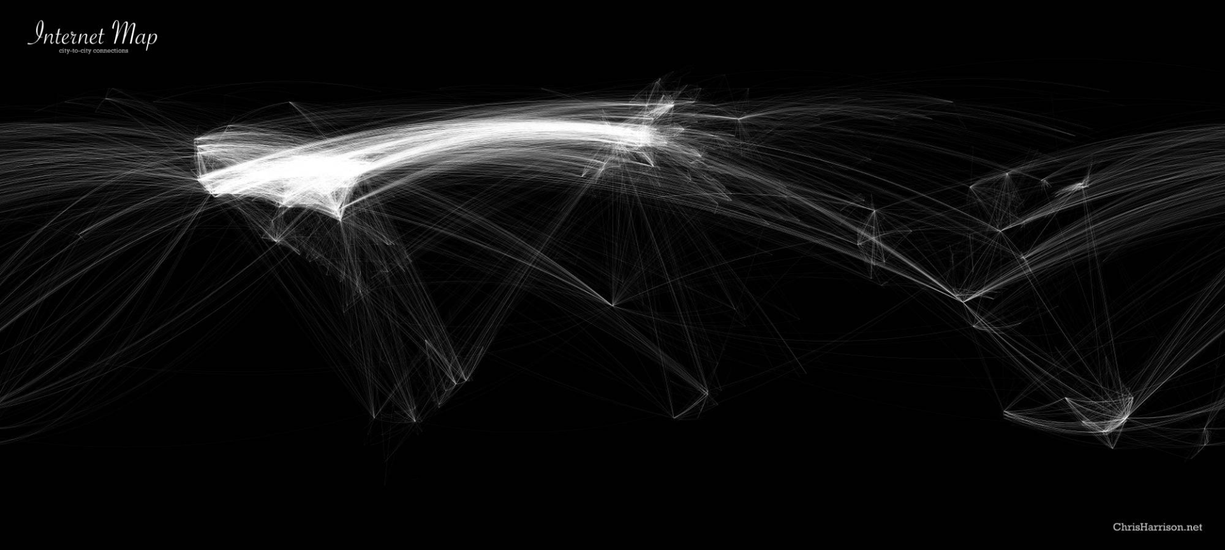
No major IP gravity hub between Europe & Asia

Slide 5
UAE-IX – challenges ….. and workarounds…

Slide 6
Awareness
“We do open peering – we decide case by case”
“Great idea – why don’t you do that in our country”
“We are peered anyway at our borders”
“How can I earn money with peering…”
“Great idea – but we will never peer with other operators from the region”

Slide 7
Backhaul
“MOC is charging a high amount for each and every Mbit/s that leaves the country”
“It’s cheaper to reach Europe than Dubai”
“You are sitting in a very nice empty expensive restaurant”
“We can do a barter deal with them… But they have to ask us”

Slide 8
Regulation
“We are allowed to peer in Europe but not in GCC”
“I would love to peer – but how to handle filtering…”
“This data center is not reachable for wholesales – backhaul price is regulated – so it’s ten times higher”
“We want to establish an IXP… as a platform for IP transit wholesales”
“Only DSPs are allowed to buy international capacity”

Slide 9
Prohibitive market situation
“We have 30 ASNs in our country – but only two will be allowed to do peering”
“We cannot sell capacity to that data center”
“We cannot connect directly – we have to go thru a neighbor country”
“The backhaul price is ok but SDH/Ethernet conversion price kills the business case”

Slide 10
Convenience
“We had a look at the Middle East… and we simply don’t understand it”
“We are afraid to step into a trap”
“All the content is in Europe anyway”
“Who can deliver backhaul from xx to you”
“We already stepped into a trap… We don’t want to do the same mistake again”

Slide 11
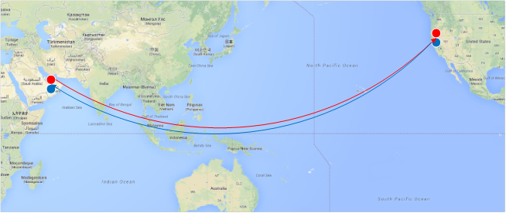

Slide 12
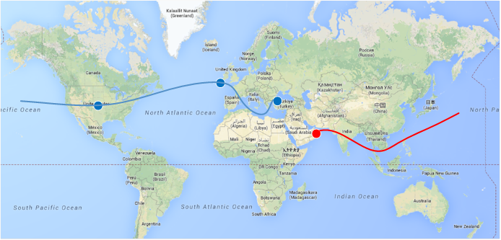

Slide 13
UAE-IX vs. DE-CIX New York … The difference of an open market

Slide 14
UAE-IX vs. DE-CIX New York
UAE-IX | DE-CIX New York
Start 10/2012 | Start 2014
47 members | 120 members
60 Gbit traffic | 80 Gbit traffic
2 data centers | 11 data centers
Restrictions for local ASNs | No restrictions for local ASNs
Restrictions for regional ASNs | No restrictions for regional ASNs
Not reachable by all possible seacables | No restriction in reachability

Slide 15
UAE-IX – Key success factors …. and what’s next in Middle East

Slide 16
Key success factors
Support and build a community
Help your peers with non peering related tasks (even how to apply for a RIPE ASN and IP addresses)
Support your existing peers to get more peerings and traffic
Initiate collaborations
Help to make peering a valid business case

Slide 17
What’s next
DE-CIX Istanbul
Launch on 1st October 2015
First location Mednautilus Istanbul and second at ZENIUM
15+ connected sides in Istanbul, Ankara, Bursa, Izmir
Hub for Turkey, Irak, Iran, Caspian and Balkans
8 Peers so far connected – more to come soon

Slide 18
JOIN US NOW www.uae-ix.net sales@uae-ix.net Phone: +43 676 5185027

