Slide 1
Lessons Learned and best practices – Engineering a global dual stack and DDoS Mitigation infrastructure
Raju Raghavan . S
TATA COMMUNICATIONS
MENOG – 13
22 Sep 2013

Slide 2
Agenda
Key Global Trends
The Context
The network journey / key learnings
Summary

Slide 3
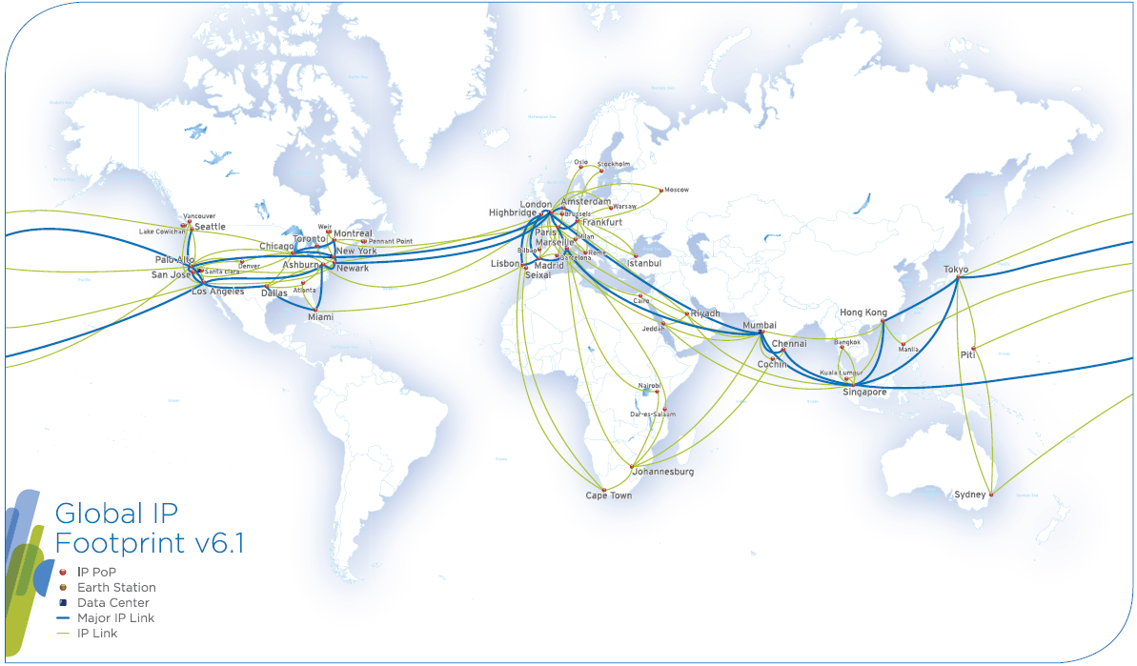
Tata Communications - Context
Over 219 PoPs in 31 countries
6th largest global IP Service Provider
13 Terabits of round the globe owned cable system.
Key benefit
Global IP Service Provider - 6,100G of backbone capacity
Notes:
Network to deliver traffic spanning the world, nonstop.
Owner of submarine cable capacity : easy upgrade when capacity required
Major Backbone ownership :
TGN-Atlantic
TGN-Pacific
TGN-IA (intra Asia)
APCN-2 (Asia)
TIC (Singapore-India)
India NLD network
SMW4, TGN-EA, IMEWE : to Europe
WACS, Sat3, Safe, Seacom : Africa
Europe : TCL owned capacity : Marseille, Paris, Madrid, Lisbon, London, Amsterdam, Frankfurt
London-Paris-Amsterdam-Frankfurt: 12x10G ring

Slide 4
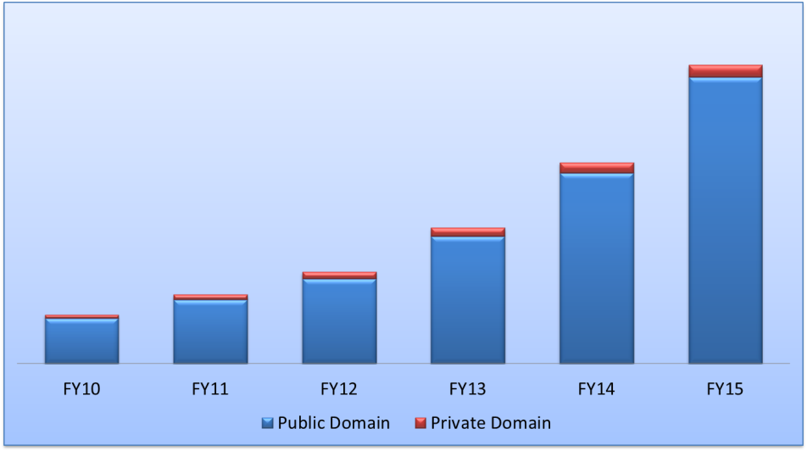
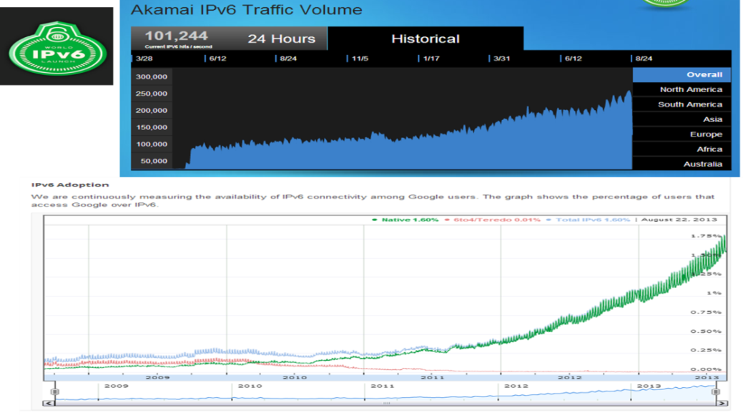
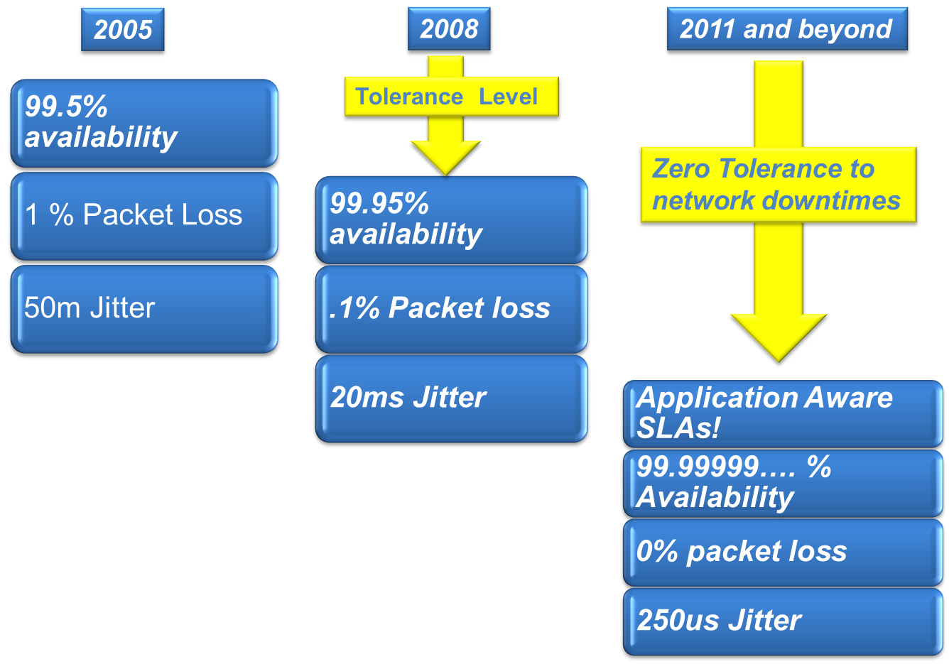
Challenging Global Trends drive innovation in network planning
Exponential traffic growth leads to shorter planning cycles
250K hits per second
Zero Tolerance

Slide 5
Impact of the global trends on SP infrastructure
Netflow / sFlow / jFlow / IPFIX
Data Plane
Capacity – 100G, 40G, 10G, 1G, STM16, STM4.,
Planning for
Traffic
Growth
Backbone / Peer / customer link Utilization
encrypted flow, L2 PW Flow, giant flow
Load Balancing – LAG, ECMP, entropy label.
Vicious
Cycle
Control Plane’s effect on Data plane
Data Plane’s effect on Control plane
CPU
FIB
MFIB
Fast SPF calculations
Planning for
Zero
Tolerance
BFD
BGP ADD Path
LFIB
L2FIB
QoS TCAM
xSTP
BGP Best External
Adjacency
LFA
BFD NP Scale
FRR
EOAM
G.8032
Control Plane

Slide 6
Network Analytics and focused instrumentation unravel interesting perspectives
Control Plane
Data Plane
Public Cloud / Domain
Private Cloud / Domain
VPNs, Fast Convergence, BFD/LFA
100G / 40G / LAGs
Hot potato Routing, Peering management,
Multiple QoS requirements
Application Optimization and SLAs, zero tolerance
Multi Gigabit DDoS Attacks, IPv6

Slide 7
Food for thought
High Traffic vs. high Control plane intensive geographies
Does economics play a role?
How does it affect planning cycles?
Converged Network Model
De-Converged Network Model
Tata Communications deploys both converged and de-converged architecture in different parts of the network

Slide 8
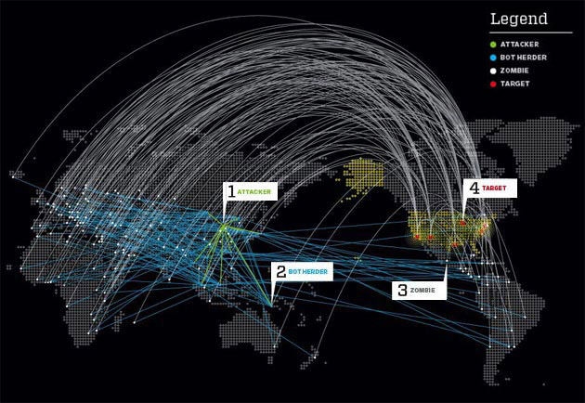
Globally ~2500 large DDoS attacks happen every day (about 2.5 Mn attacks every year)
BOSS
BOT Chief
Infected Computer

Slide 9
DDoS attacks can be mitigated using behavioral analysis, black list filtering ,protocol validation techniques etc., in a DDoS Scrubbing Farm
How can we defend DDoS attacks?
Zombies
Zombies
Zombies
DDOS Scrubbing farm
Target / Victim
Clean Traffic
Zombies
Zombies
Zombies

Slide 10
+ In premise DDoS mitigation infrastructure are not an alternative for obvious reasons . + Firewall, IDS, IPS , Antivirus are a different ballgame
Cloud based distributed mitigation vs. in premise mitigation
Zombies
Zombies
Regional Scrubbing Farm
Zombies
Target
Clean Traffic
Zombies
Zombies
Zombies
So Tata Communications has deployed a global distributed scrubbing farm that scrubs attack traffic regionally

Slide 11
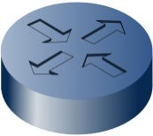
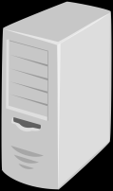
Anycast on-ramping
How can you seamlessly add / remove scrubbing farms as the attack evolves quickly?
Anycast GRE
GRE Tunnel
Target
Zombies
GRE Tunnel
Advertise /32 of the target

Slide 12
Case Study | Large Service provider
Large Service Provider in Asia .
Typical traffic towards one particular destination – 35- 40 Mbps
20Gbps Attack from Europe and American zombies

Slide 13
Case Study | Large Service provider
Bandwidth Attack – Avg Packet size = 1KB

Slide 14
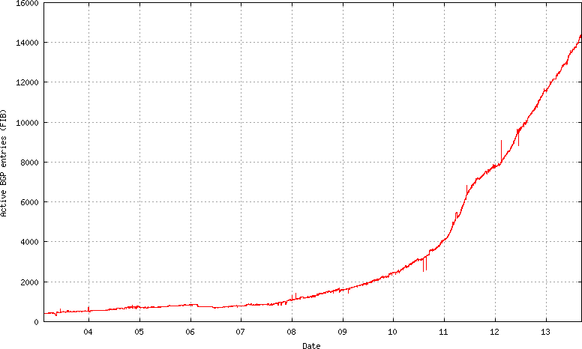
Tata Communications IPv6 Context
14

Slide 15
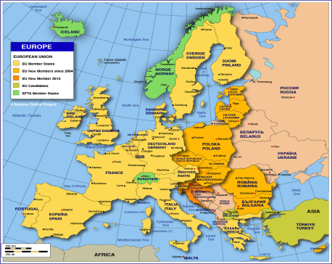
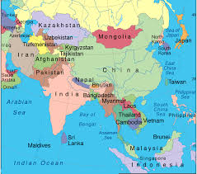
Learnings from the IPv6 deployment journey
Have you tried deploying 6 PE with a hierarchical design?
Swapping 6PE service labels have no standard mechanisms across leading vendors .
Every vendor has a different way of generating the 6PE service labels
Tata Communications deploys a global native dual stack backbone with native IPv6 IGP and BGP
Global backbone

Slide 16
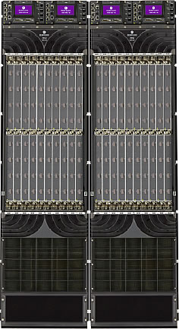
Global Dual Stack IGP deployment
Integrated Topology view
Multi Topology view
V4 and v6 Topology
V6 Topology
V4 Topology
Tata Communication's deploys Multi-topology ISIS
This gives us the flexibility of steering IPv6 and IPv4 traffic on different topologies as vendors evolved their IPv6 support / maturity

Slide 17
Summary
Innovation in network engineering is being driven by challenging global network trends of exponential traffic growth vis a vis zero tolerance expectations
Network analytics of control and data plane uncovers interesting perspectives related to technical behavior of various market segments . These insights can be innovatively applied in network engineering/design.
Tackling todays multi gigabit DDoS attacks is best done using a global distributed / intelligent DDoS scrubbing infrastructure. In premise DDoS mitigation infrastructure are not an alternative.

Slide 18
Summary
Since we started our IPv6 Network journey 10 years back , we had several learnings that prompted us to deploy a unique global dual stack and multi-topology infrastructure
Build your network infrastructure not based on “generic best practices” but based on in-depth contextual analytics / focused instrumentation and technical / business merit !

Slide 19
Thank you and Happy Innovating for your network!

